Slide 1


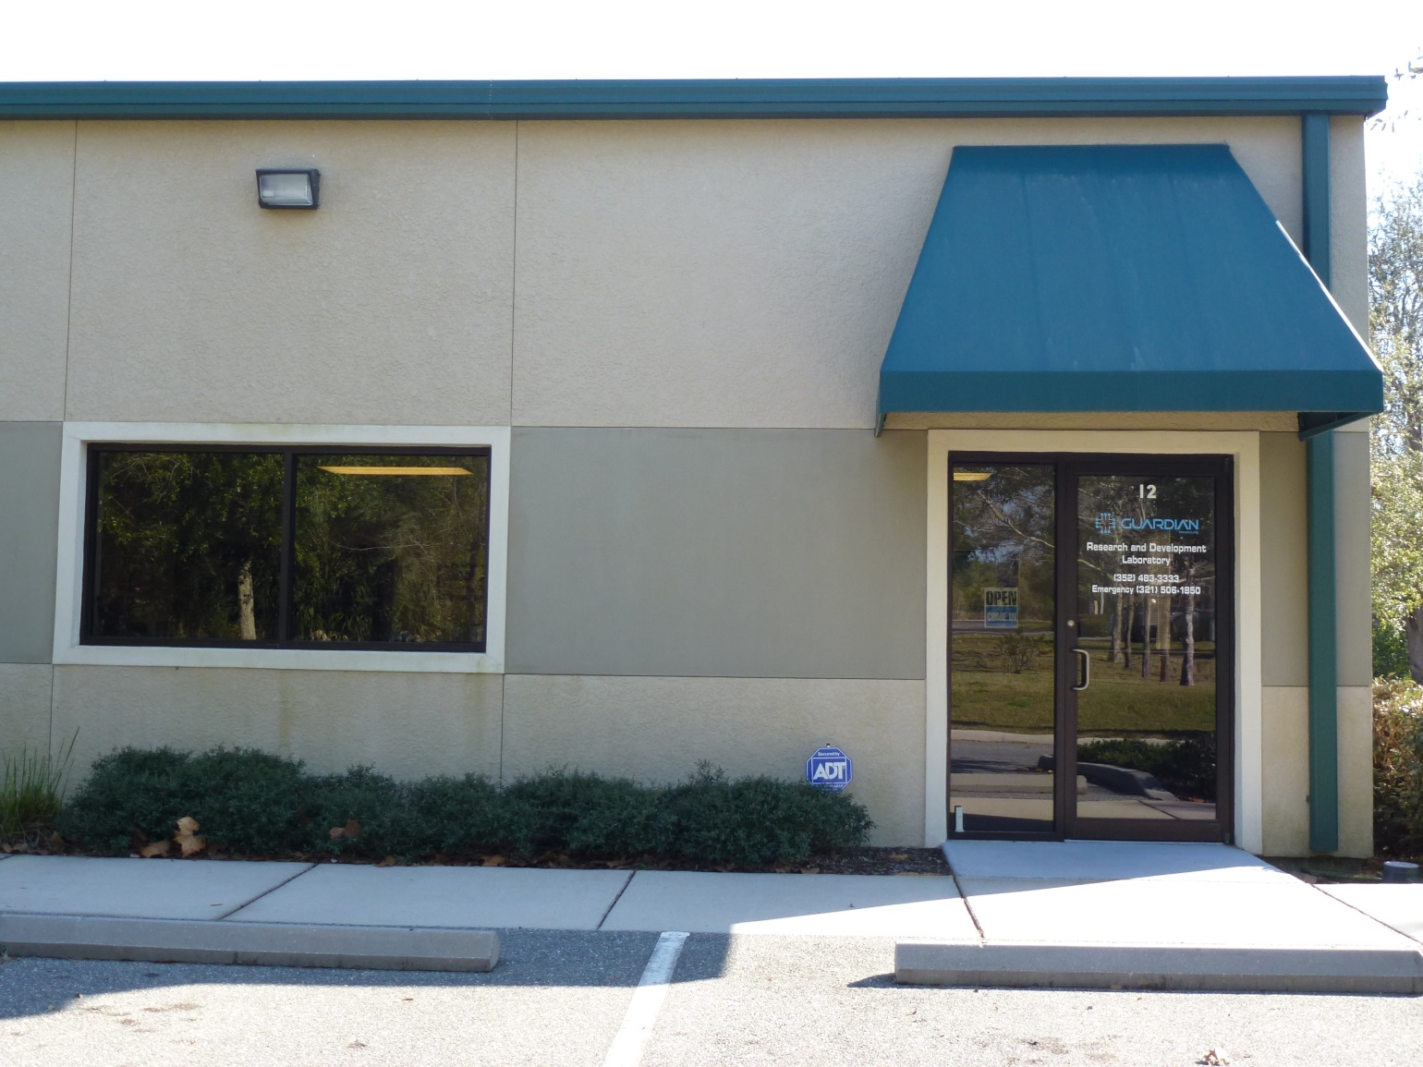
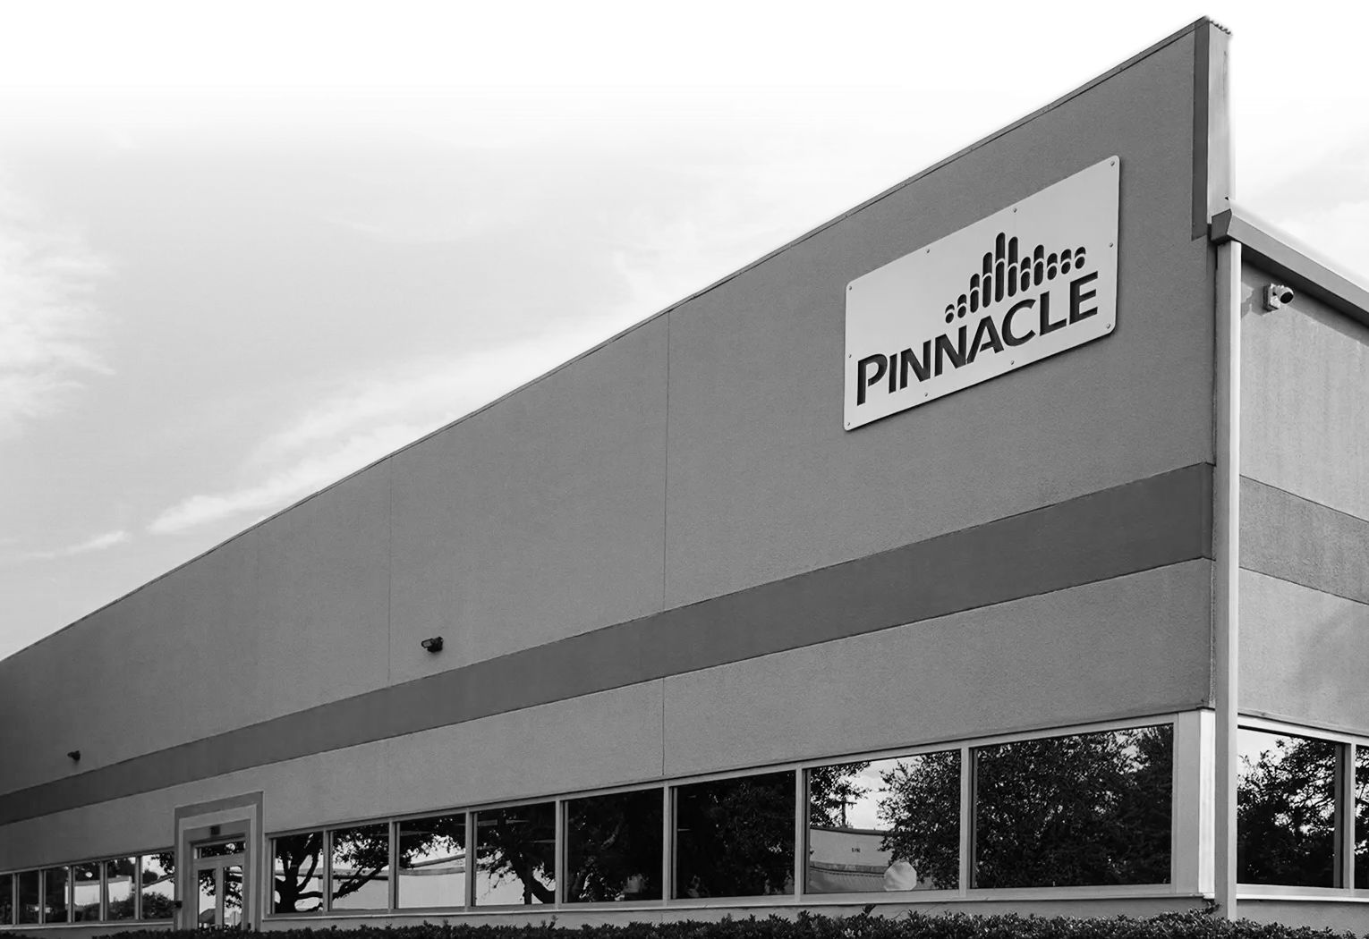


Pinnacle R&D Lab
EUSTIS, FLORIDA
1,600 sq. ft. Facility with 2 Main Lab Areas & Front Office
PINNACLE OZONE SOLUTIONS
Ozone Research & Development Lab and Ozone Pilots
Thoram Charanda
CHIEF SCIENCE OFFICER
Analytical Chemistry and Ozone Demand / Decay Tests
Ozone Research & Development and Application Testing

Slide 2

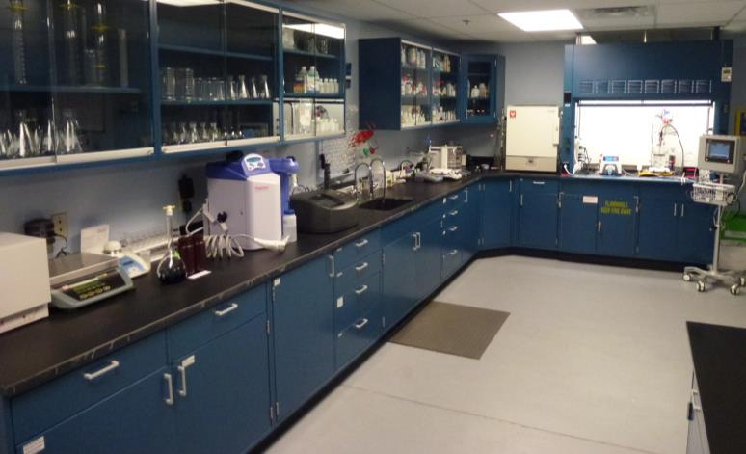
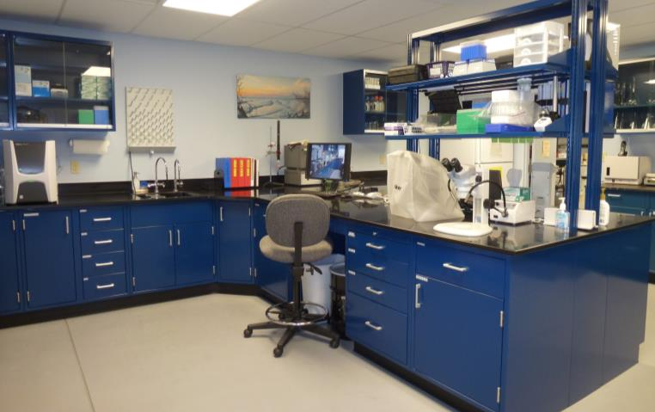
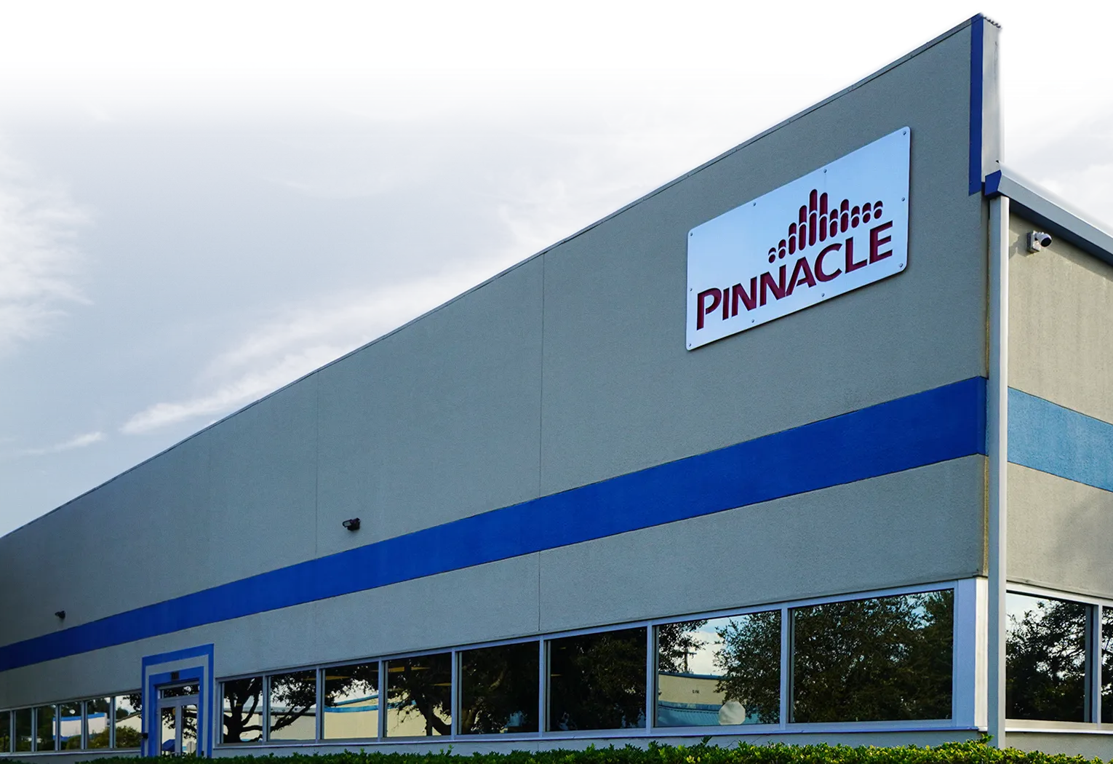
Pinnacle R&D Lab
PINNACLE OZONE SOLUTIONS
EUSTIS, FLORIDA
1,600 sq. ft. Facility with 2 Main Lab Areas & Front Office
Ozone Research & Development Lab and Ozone Pilots
Analytical Chemistry and Ozone Demand / Decay Tests
Ozone Research & Development and Application Testing
Thoram Charanda
CHIEF SCIENCE OFFICER

Slide 3
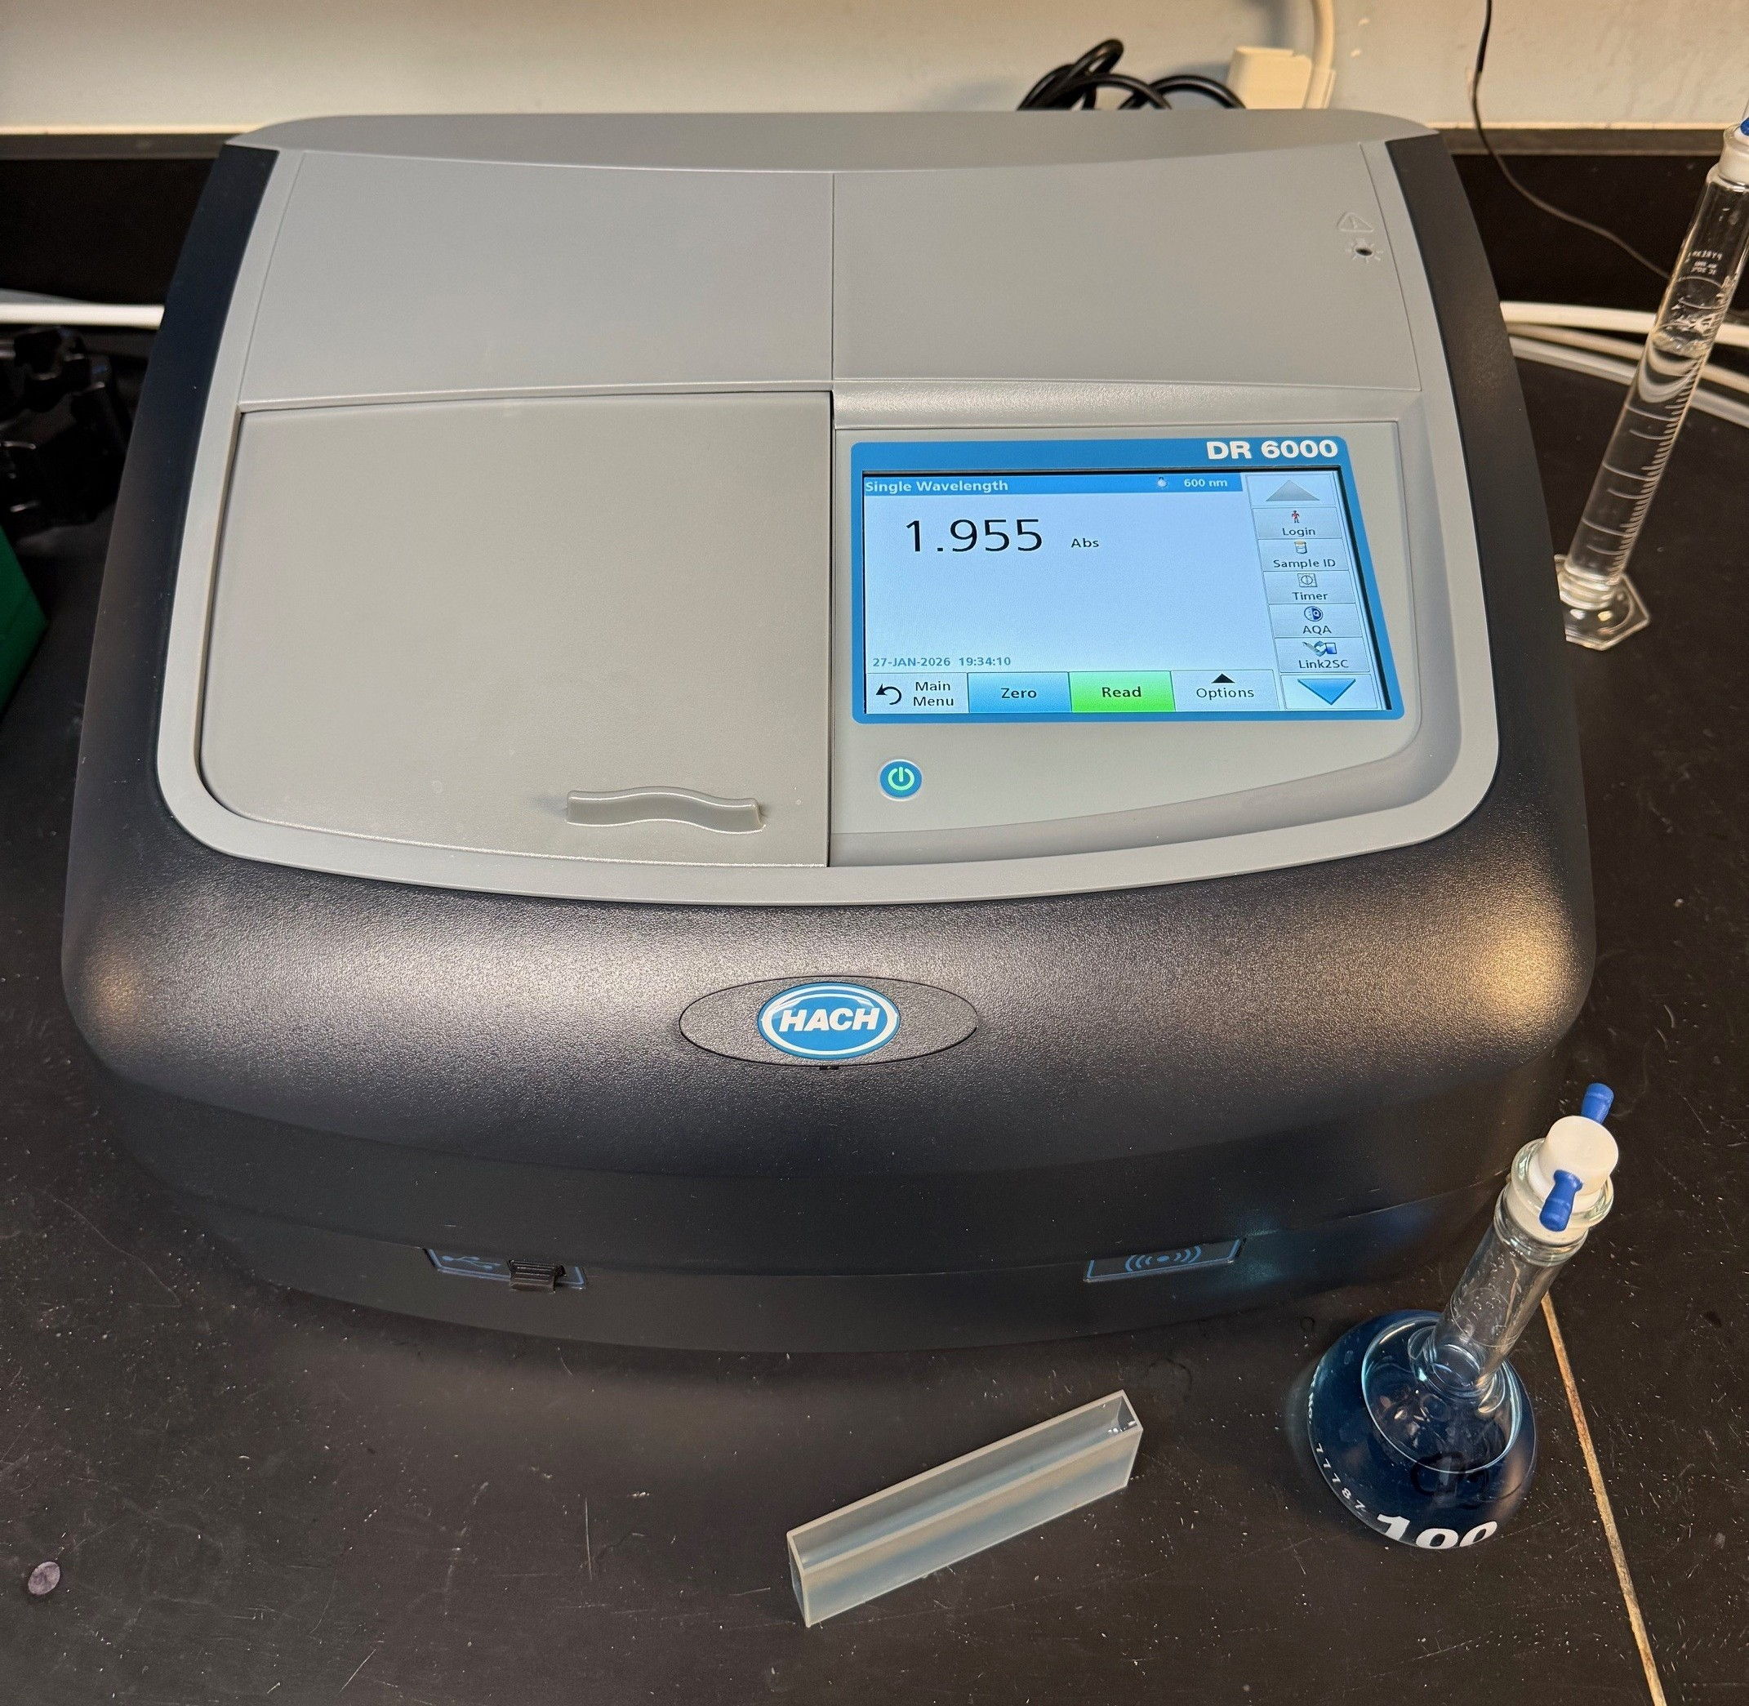

MAIN ANALYTICAL EQUIPMENT
HACH DR-6000 UV/VIS Spectrophotometer
>200 Analytical Methods
Main Analytical Chemistry Lab

Slide 4
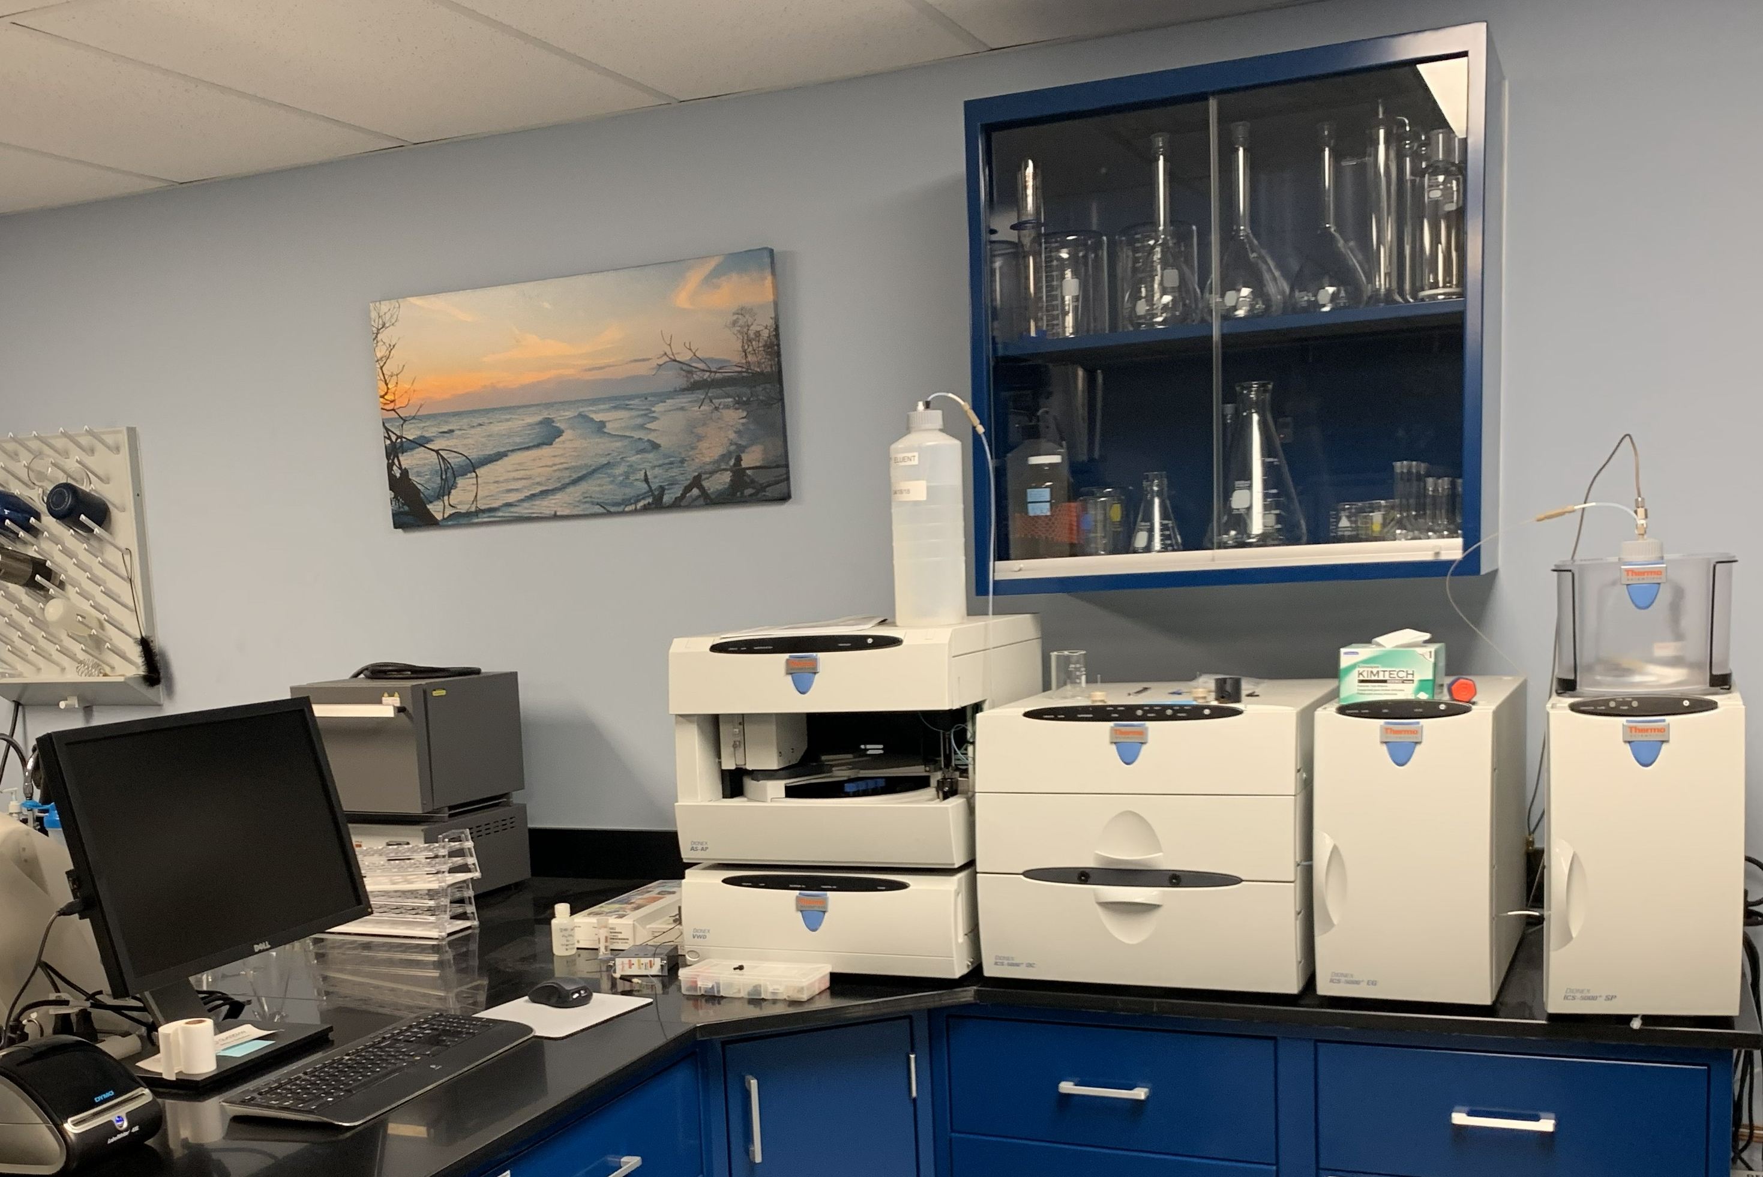
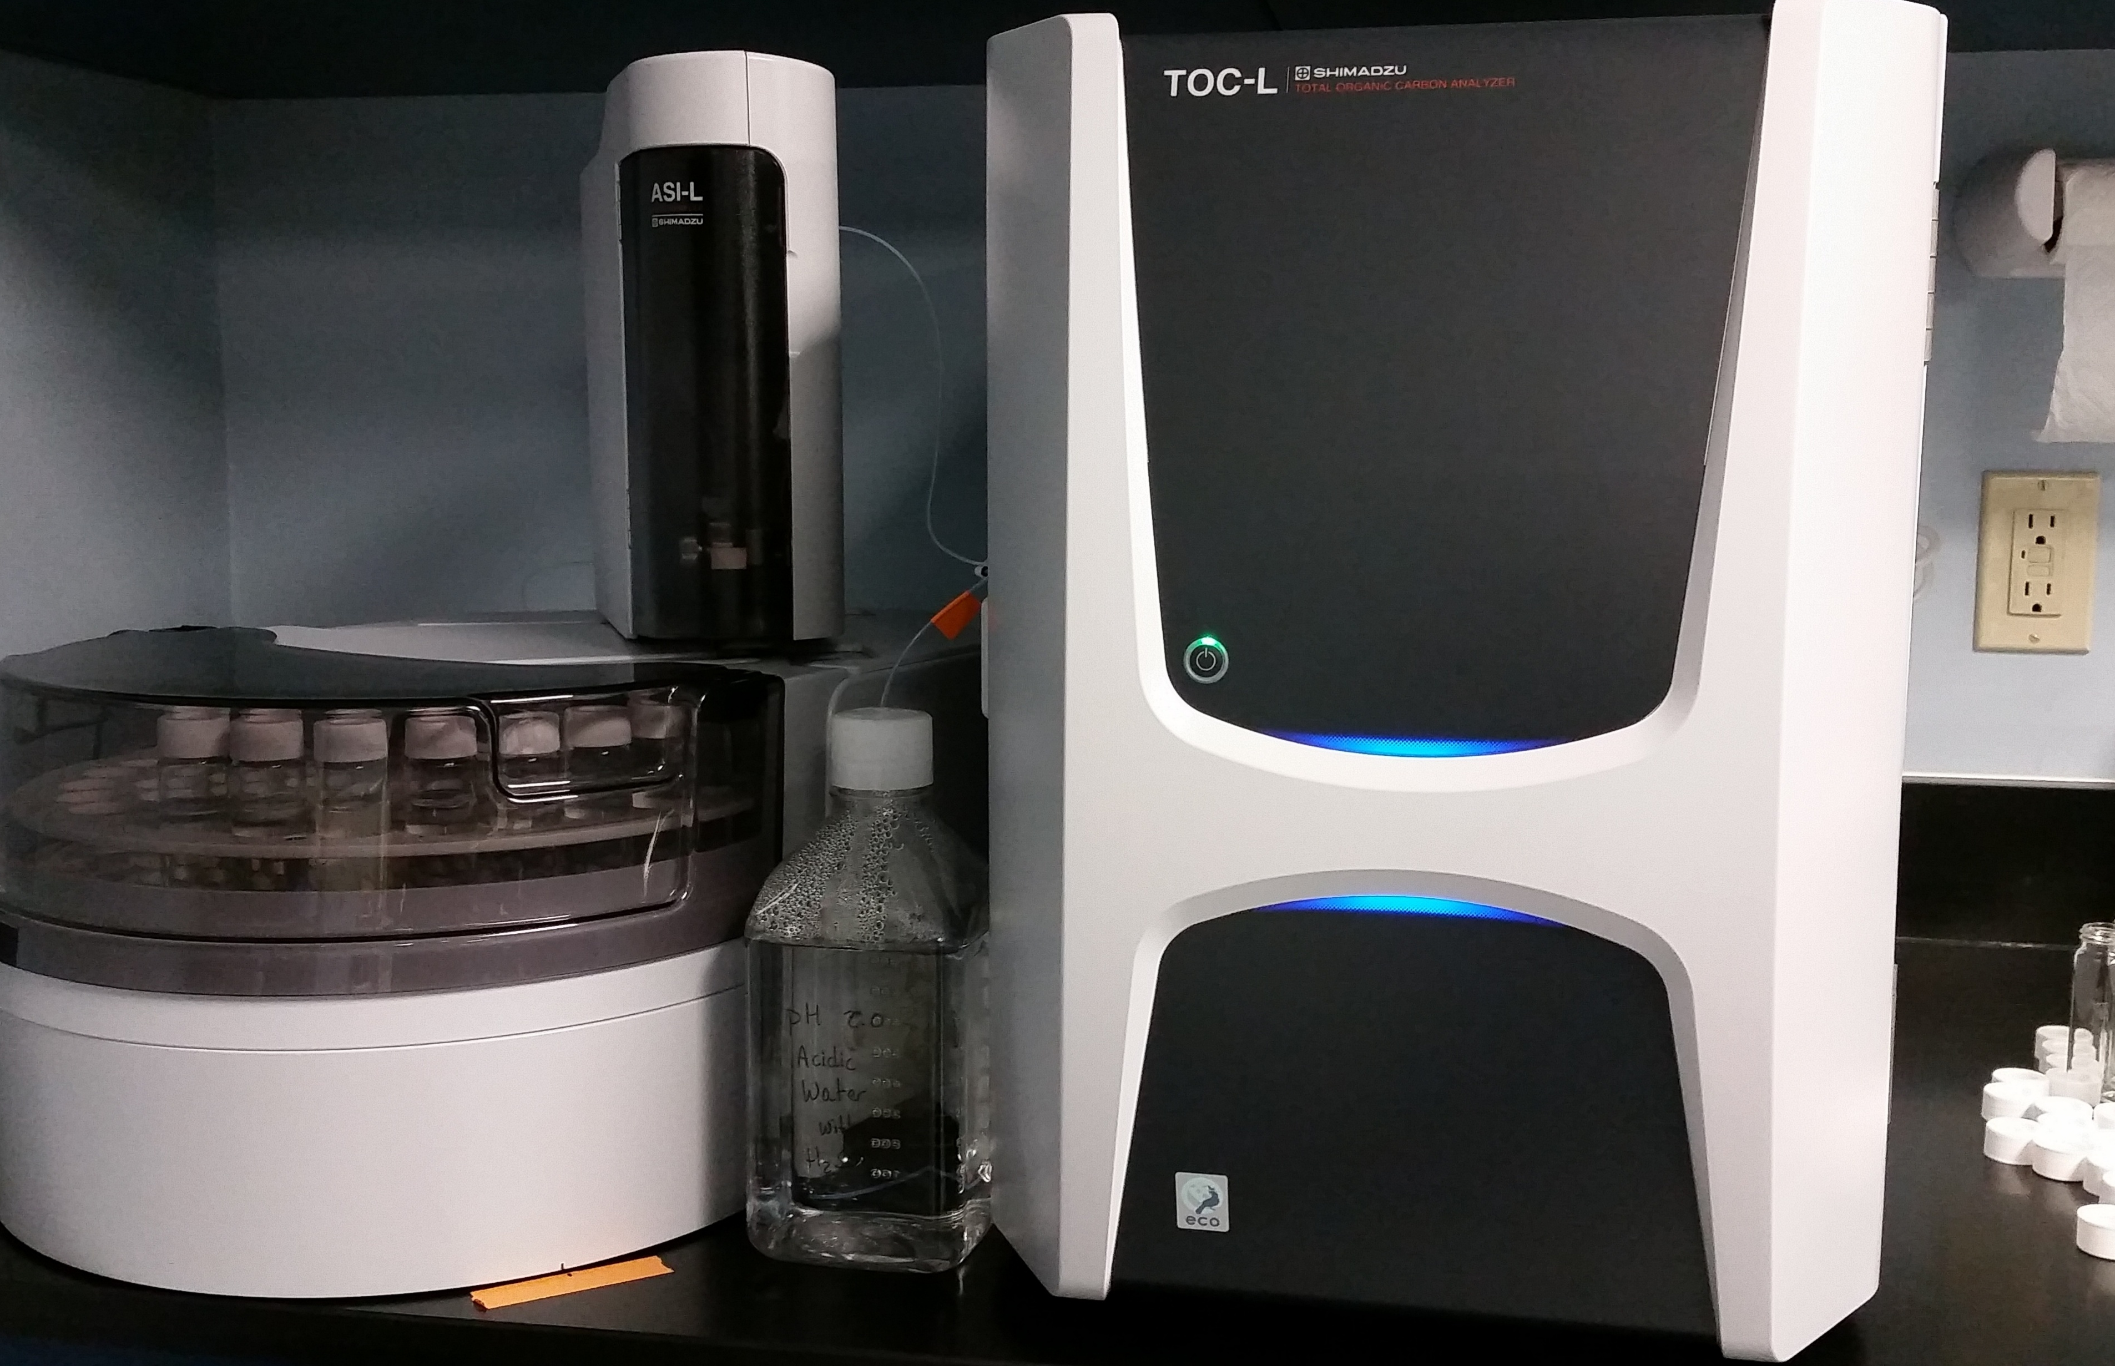

MAIN ANALYTICAL EQUIPMENT
HACH DR-6000 UV/VIS Spectrophotometer
>200 Analytical Methods
Used to measure dissolved ozone using Standard Methods Potassium Indigotrisulfonate
Free and Total Chlorine
Free and Total Bromine
Total Iron
Manganese
Nitrite
Hydrogen Sulfide
Chemical Oxygen Demand (COD)
True and Apparent Color
Total Ammonia Nitrogen & TKN
Copper

Slide 5
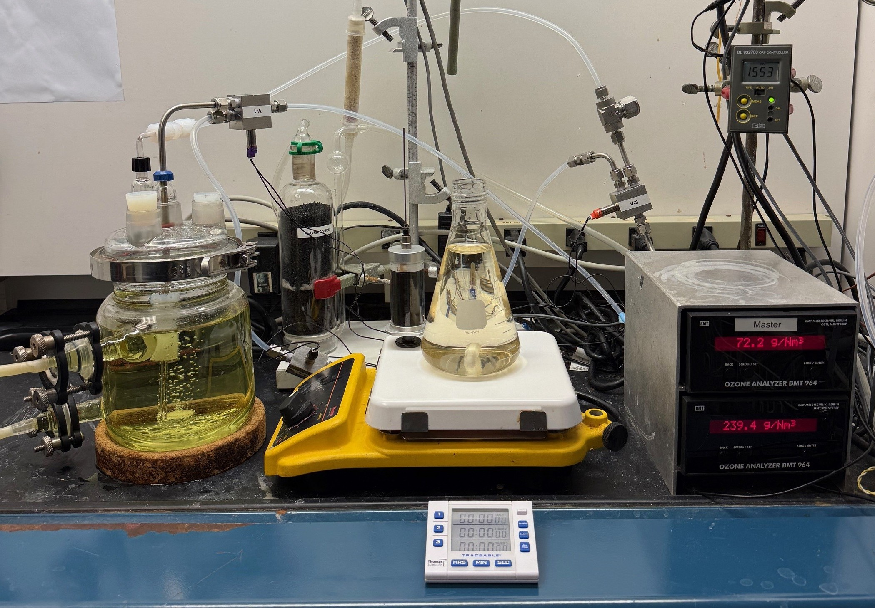
AQUEOUS OZONE DIRECT INJECTION
High Concentration Dissolved Ozone Reagent
MAIN ANALYTICAL EQUIPMENT
MAIN ANALYTICAL EQUIPMENT
Total Organic Carbon (NPOC)
Dissolved Organic Carbon
Total Organic Carbon Analyzer
Ion Chromatograph
Measure Anions in Water
Fluoride
Chloride
Bromide
Bromate
Sulfate
Phosphate
Ozone gas at >15 %wt is steadily bubbled into ultrapure water cooled down to 0.5 to 1 °C
It takes about 3 hours for the ozone solution to reach equilibrium
Typical dissolved ozone concentration is 120 to 135 mg/L
Depending on the TOD, a portion of the dissolved ozone reagent is directly injected into the reaction flask

Slide 6
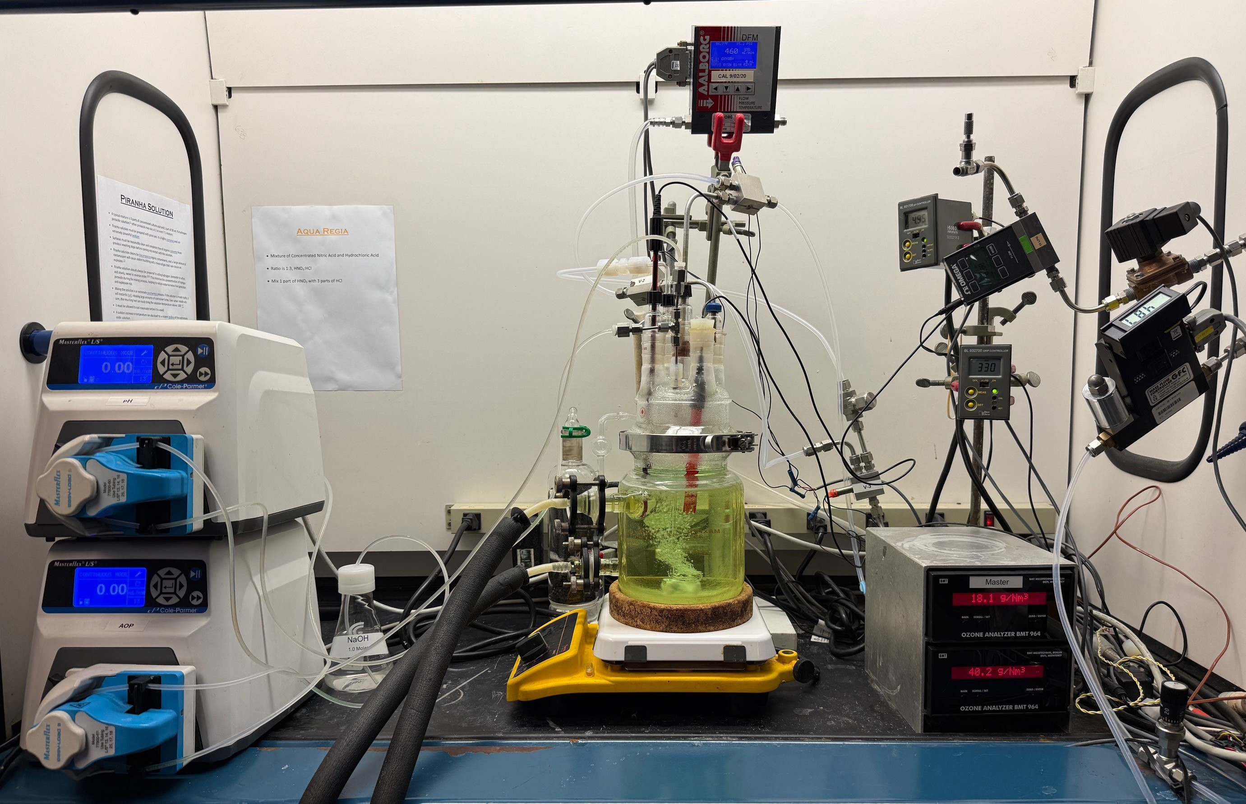
AQUEOUS OZONE DIRECT INJECTION
OZONE GAS BATCH INJECTION
High Concentration Dissolved Ozone Reagent
Direct Ozone Gas Injection
Ozone gas at >15 %wt is steadily bubbled into ultrapure water cooled down to 0.5 to 1 °C
It takes about 3 hours for the ozone solution to reach equilibrium
Typical dissolved ozone concentration is 120 to 135 mg/L
Depending on the TOD, a portion of the dissolved ozone reagent is directly injected into the reaction flask
Ozone gas at varying concentrations is directly bubbled into, using a glass dispersion tube, a 1 Liter reaction vessel
The flow rate and concentration of the inlet and outlet ozone gas is continuously measured using mass flow meters and BMT ozone analyzers
The ozone rates (mg/minute) are calculated for the inlet and outlet, the difference being what is transferred (TOD) into the sample water
The accumulated TOD is continuously calculated and logged via the HMI

Slide 7
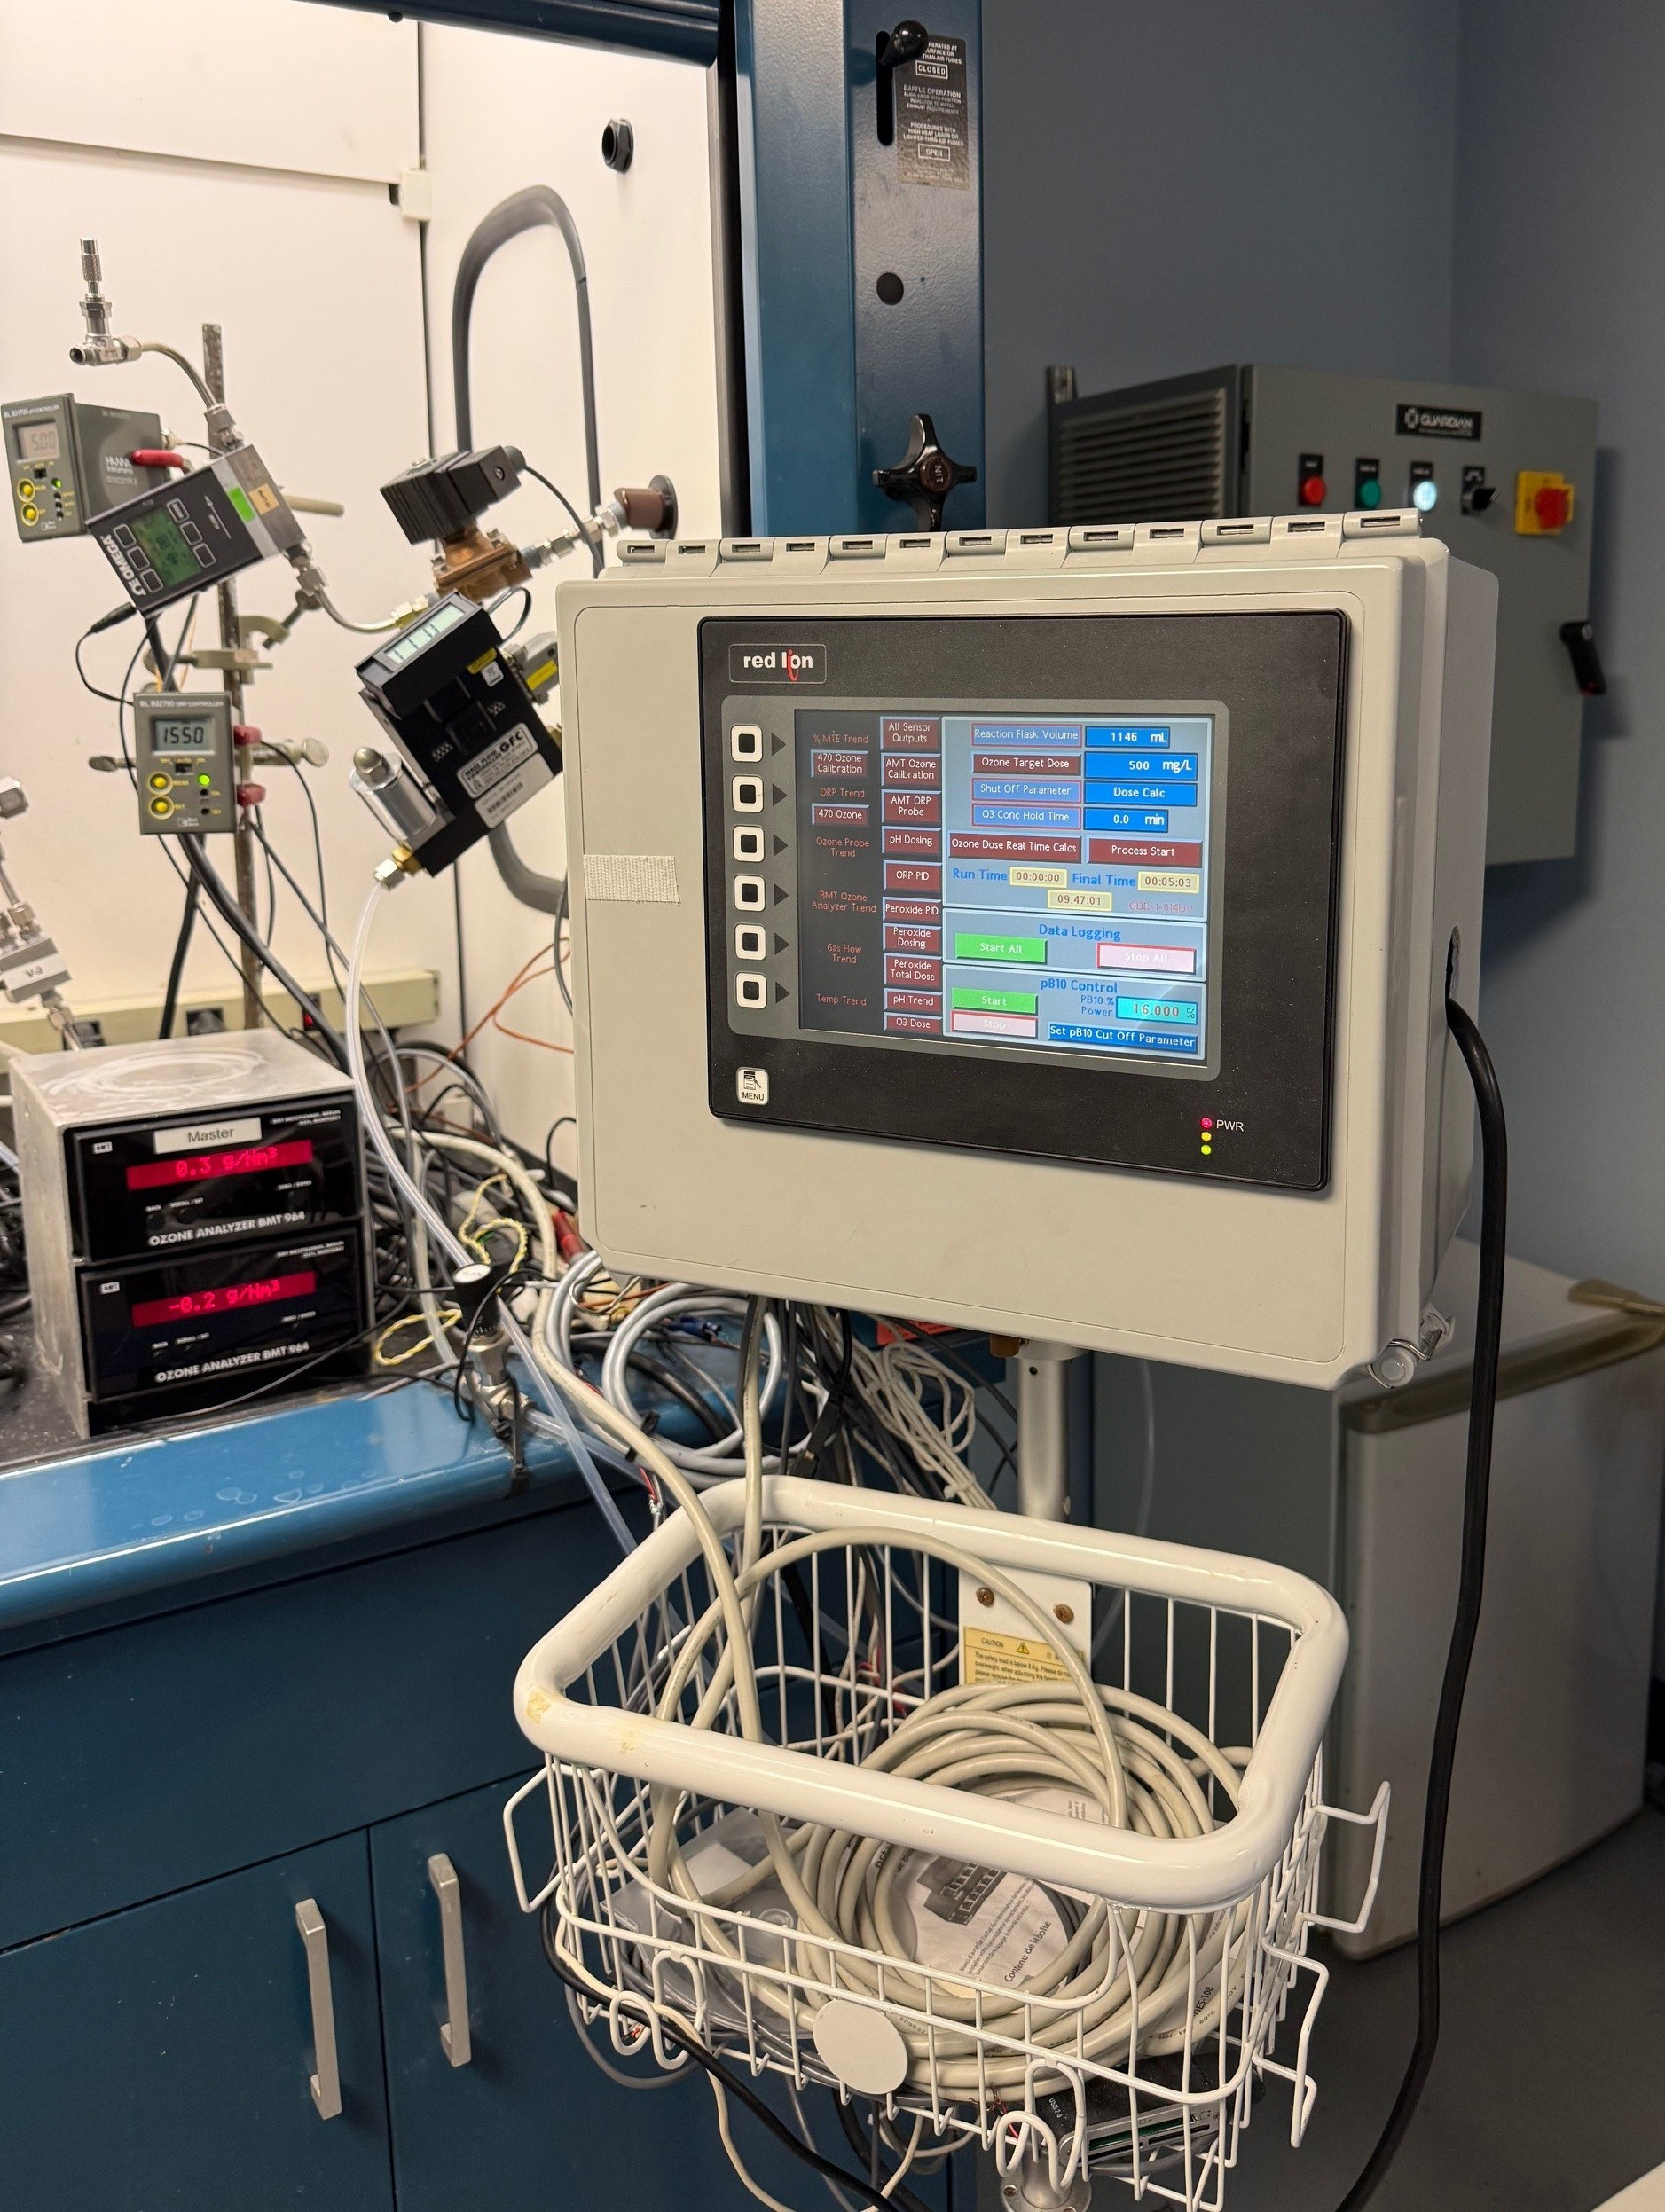

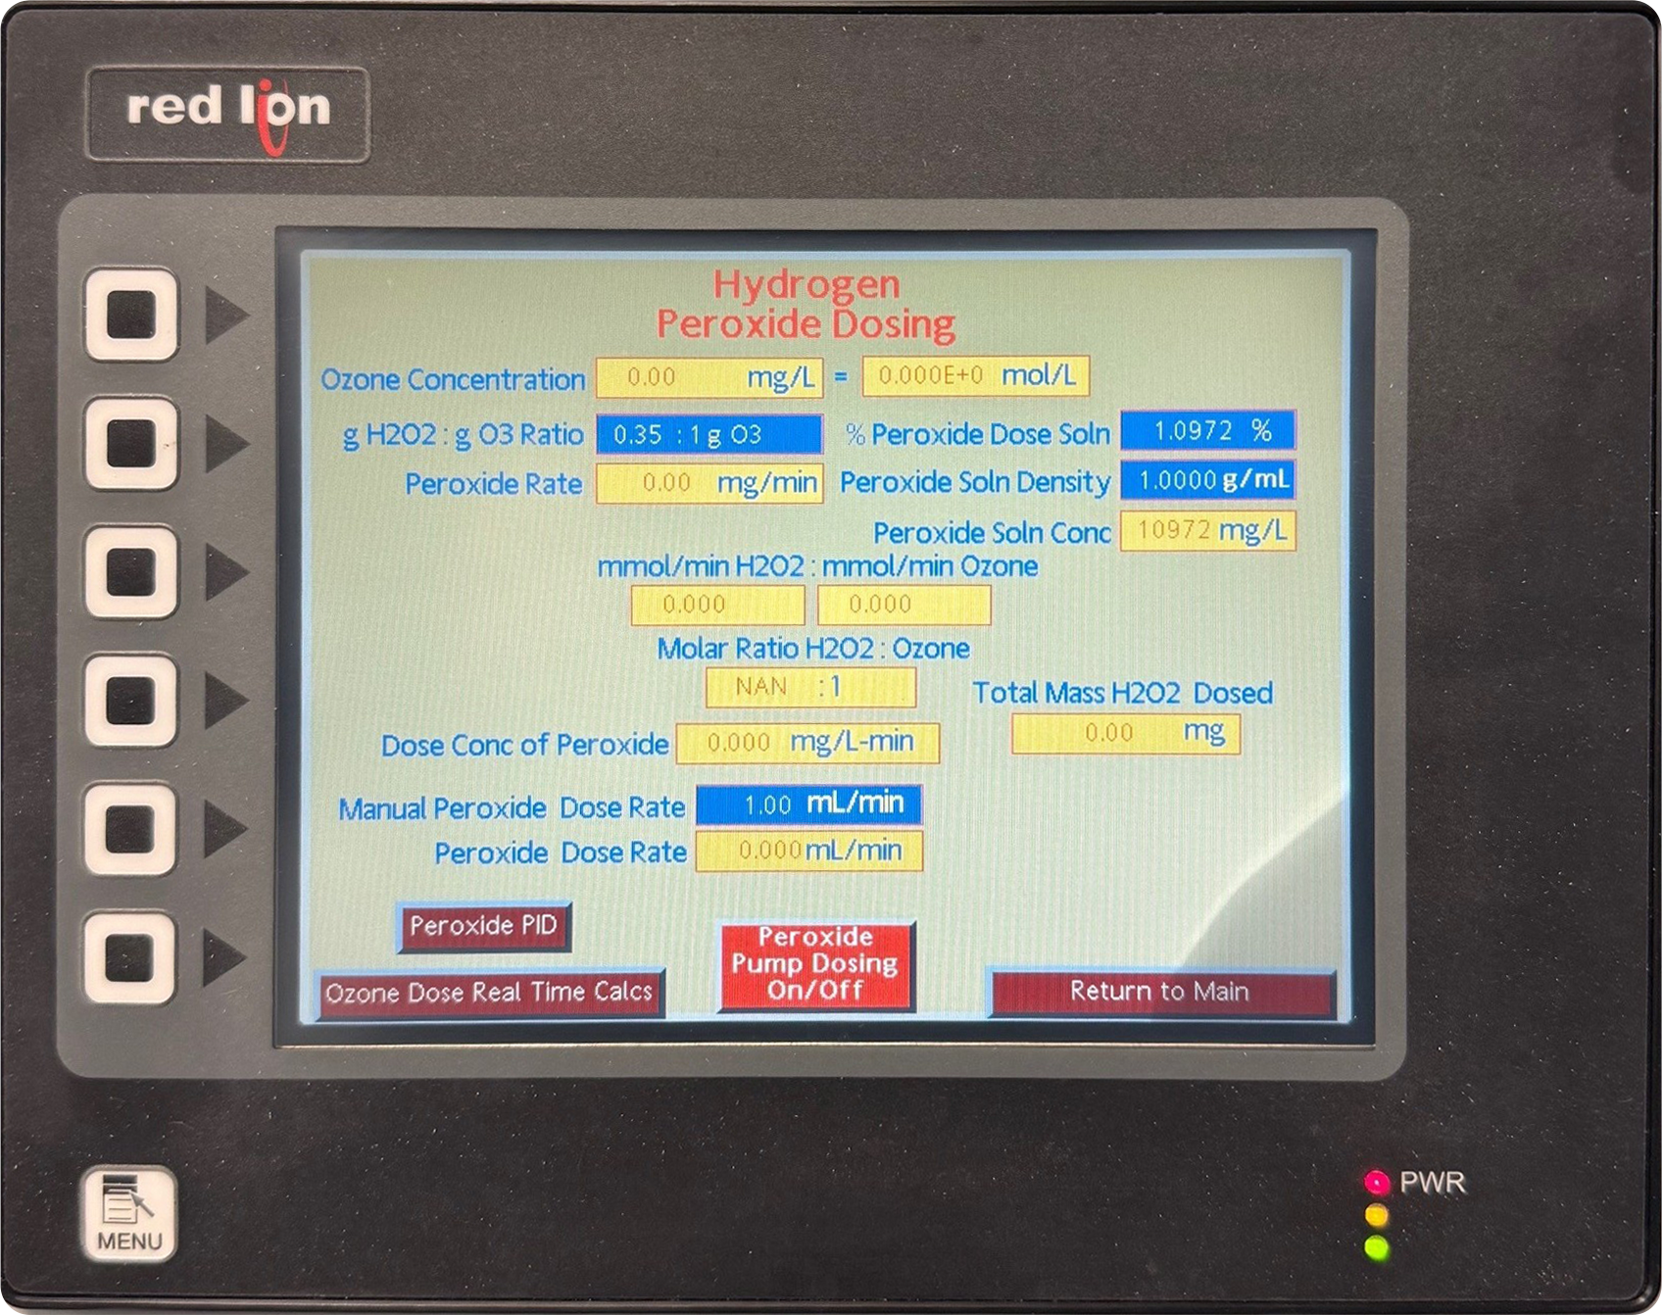
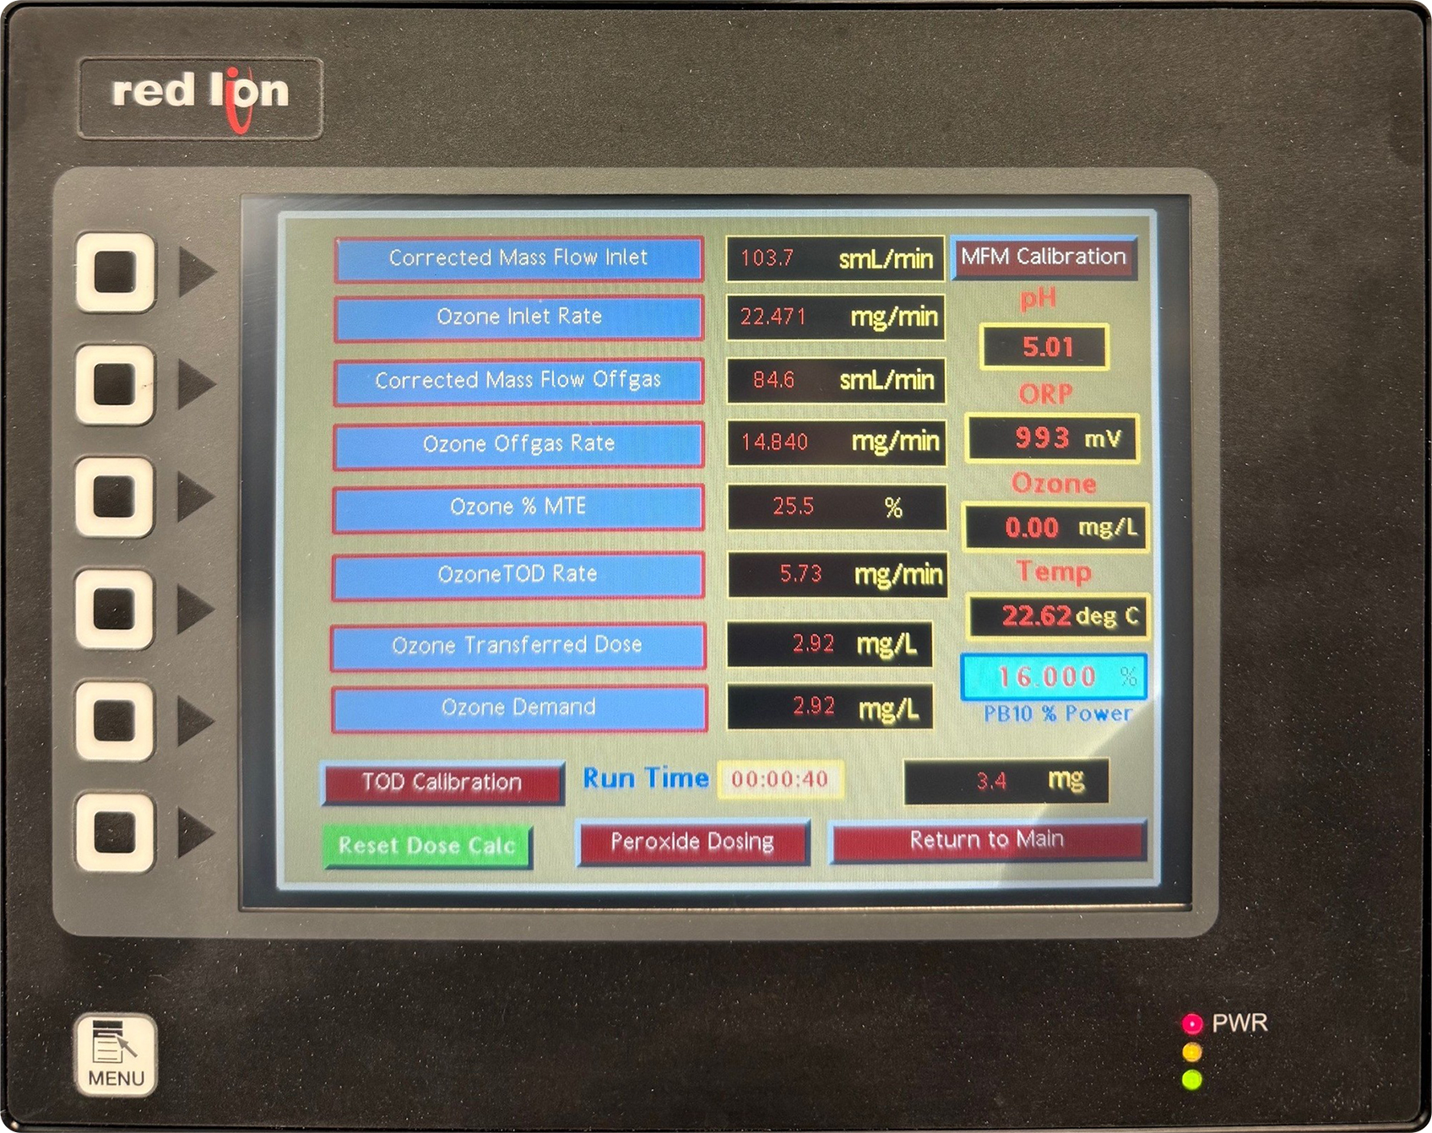
Ozone Gas Batch
Injection: HMI
OZONE GAS BATCH INJECTION
Direct Ozone Gas Injection
Ozone gas at varying concentrations is directly bubbled into, using a glass dispersion tube, a 1 Liter reaction vessel
The flow rate and concentration of the inlet and outlet ozone gas is continuously measured using mass flow meters and BMT ozone analyzers
The ozone rates (mg/minute) are calculated for the inlet and outlet, the difference being what is transferred (TOD) into the sample water
The accumulated TOD is continuously calculated and logged via the HMI
Hydrogen Peroxide AOP
Ozone gas at >15 %wt is steadily bubbled into ultrapure water cooled down to 0.5 to 1 °C
Ozone TOD Calculations
It takes about 3 hours for the ozone solution to reach equilibrium
Typical dissolved ozone concentration is 120 to 135 mg/L
Depending on the TOD, a portion of the dissolved ozone reagent is directly injected into the reaction flask

Slide 8
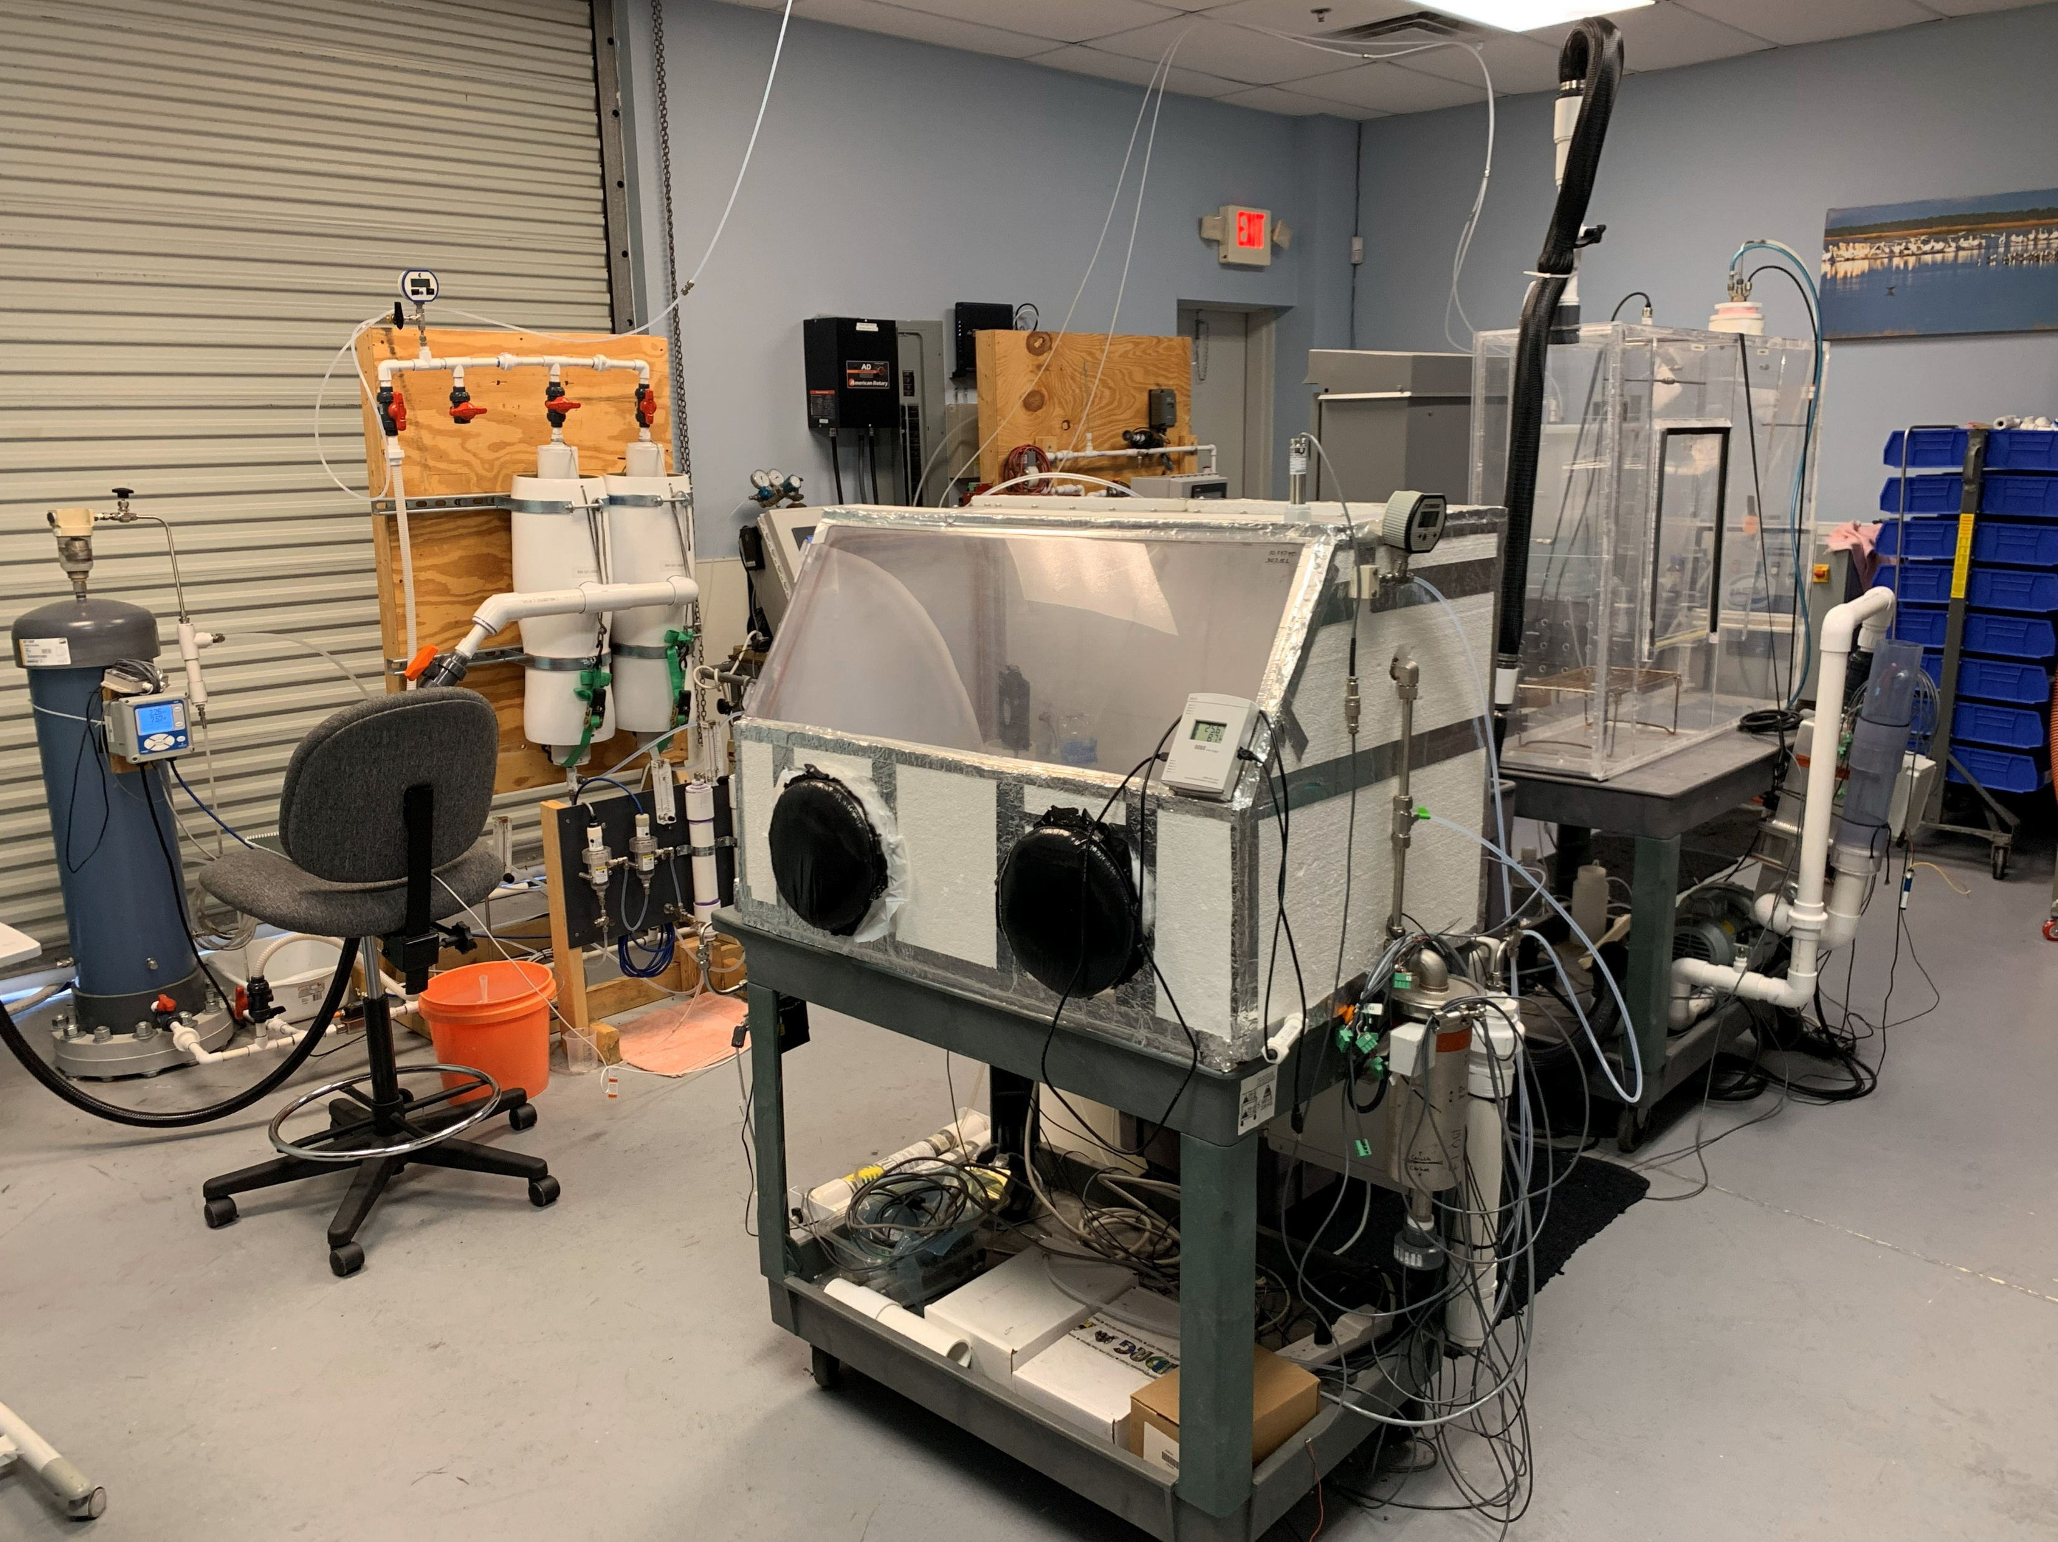
Ozone Application and Product Testing Area
Ozone Gas Batch
Injection: HMI
Ozone mass transfer efficiency (MTE) device testing: venturi, dynamic gas reactor, ozone mass transfer unit
Accelerated dissolved ozone exposure material testing
Ozone gas disinfection: direct and Vapex “Ohxyphog”
Sulfide gas ozone oxidation modeling
Ozone/Oxygen Nanobubble projects
Food product disinfection: wheat hulls, lettuce produce, apple, pears
Denim ozone bleaching
Boron doped diamond electrochemical oxidation
Hydrogen Peroxide AOP
Ozone TOD Calculations

Slide 9
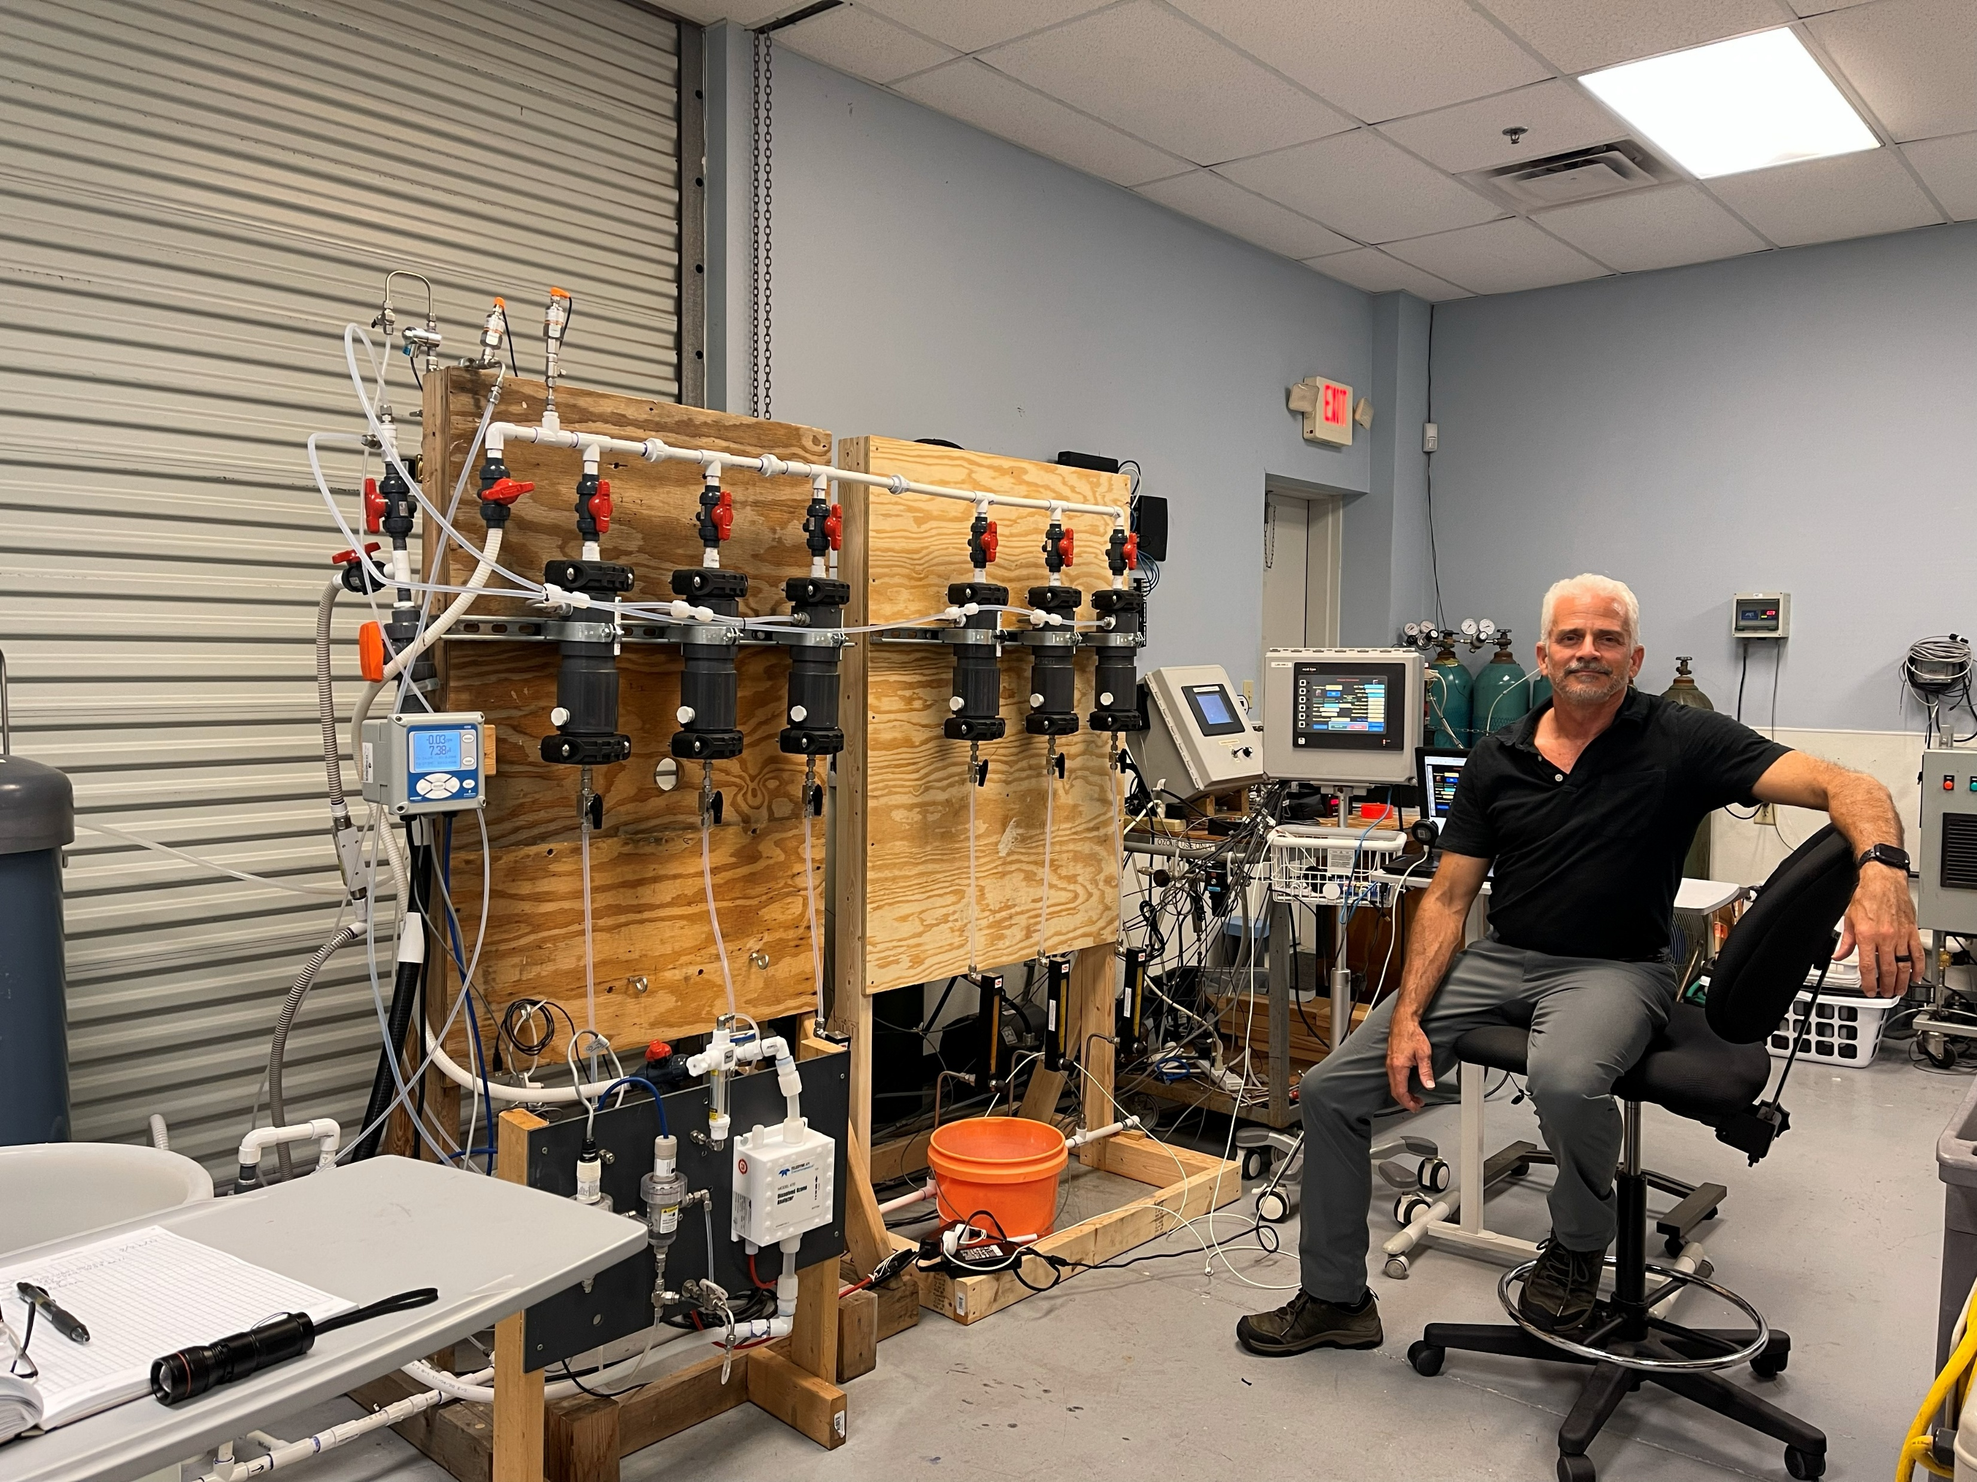
Ozone Application and Product Testing Area
Ozone mass transfer efficiency (MTE) device testing: venturi, dynamic gas reactor, ozone mass transfer unit
Accelerated dissolved ozone exposure material testing
Ozone gas disinfection: direct and Vapex “Ohxyphog”
Sulfide gas ozone oxidation modeling
Ozone/Oxygen Nanobubble projects
Food product disinfection: wheat hulls, lettuce produce, apple, pears
Denim ozone bleaching
Boron doped diamond electrochemical oxidation

Slide 10
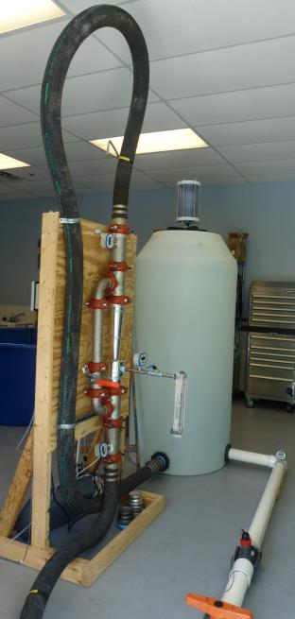
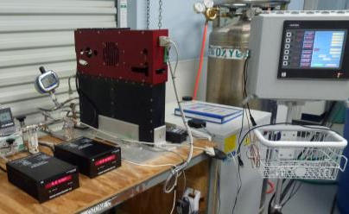
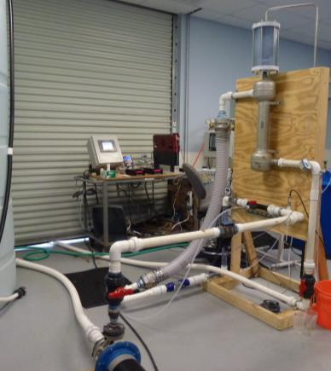
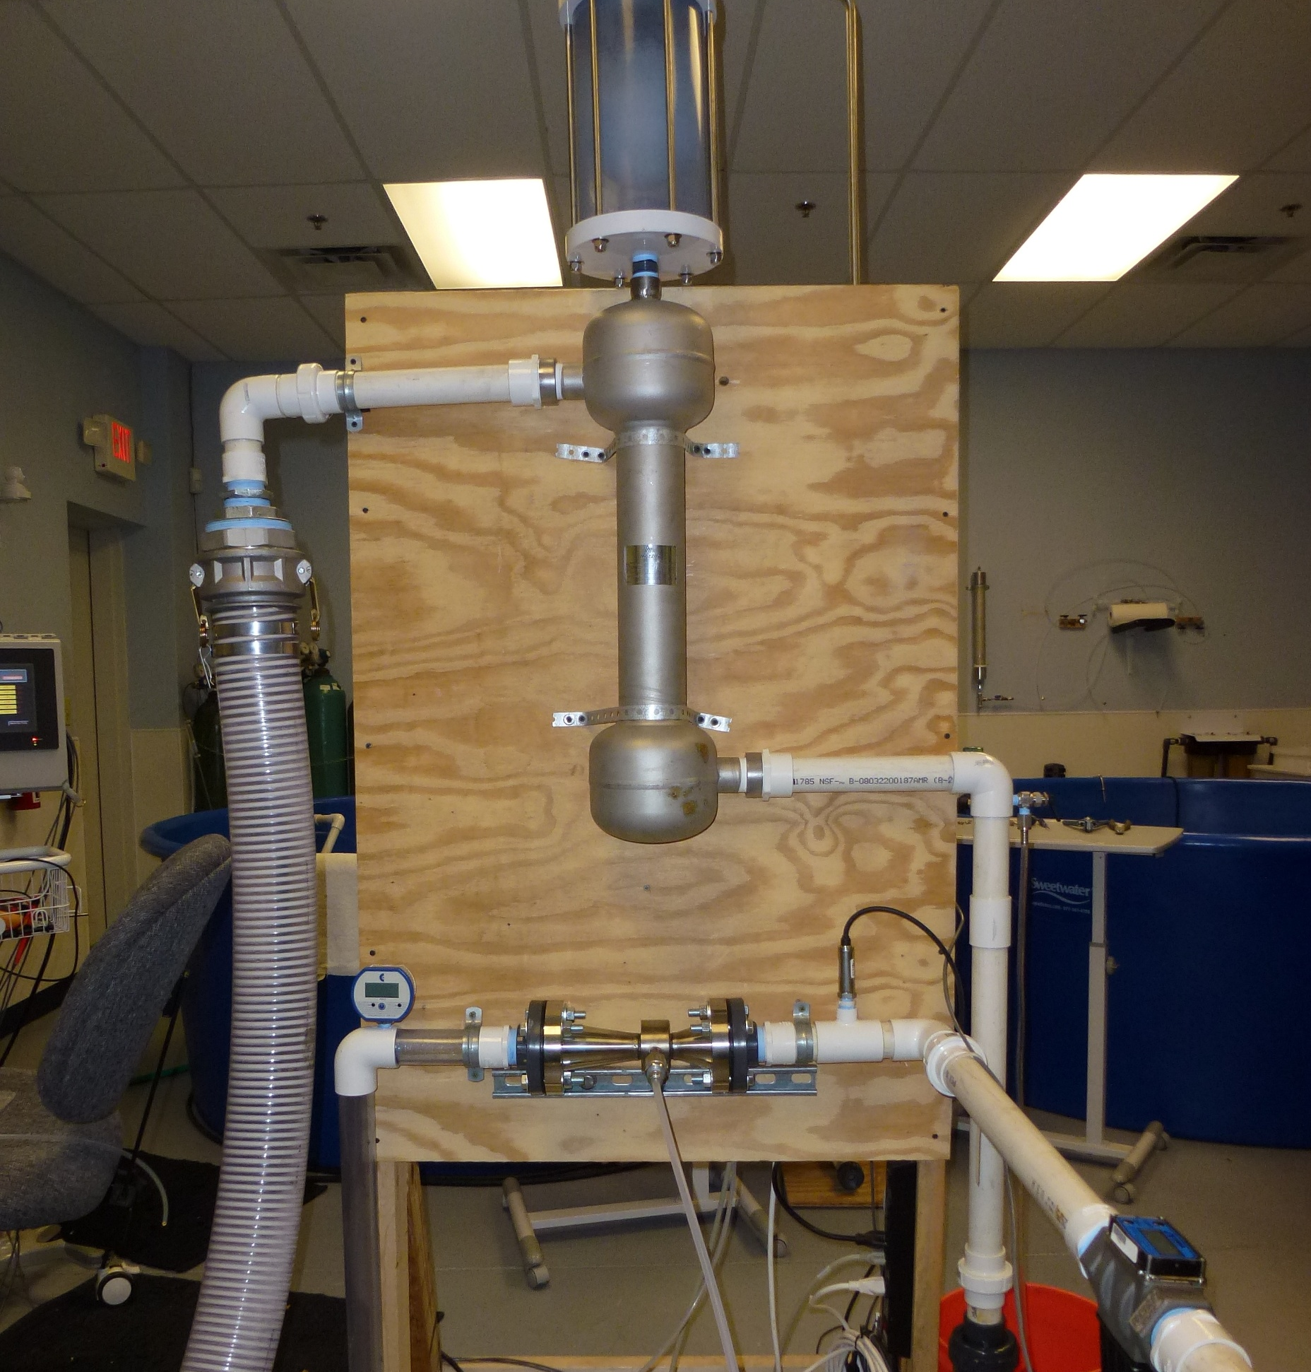
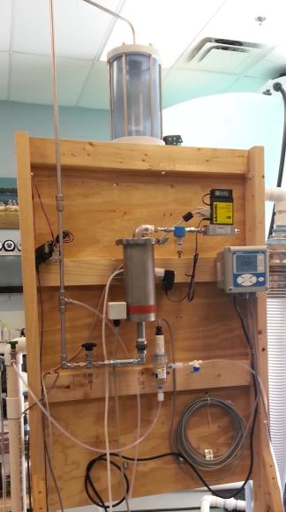
Accelerated Dissolved Ozone Exposure Product Testing
Accelerated dissolved ozone exposure test on monolith ultrafiltration ceramic membranes
System designed to produce a continuously recirculating 5 gpm 35 – 40 mg/L dissolved ozone stream
UV adsorption sensor was used to measure the very high level of dissolved ozone
HMI controlled the ozone dose based on a PID algorithm
QuadBlock was required to produce the high ozone concentration, >14%wt, necessary to create this level of dissolved ozone

Slide 11
Ozone Mass Transfer Unit
Ozone Mass Transfer Efficiency Tests
Enhances the mass transfer efficiency of the venturi
Increases the MTE by 15 to 20%
Designed for high exit velocities that re-shears to the 2-phase water/gas injection stream
Allows for higher levels of gas to liquid ratios
Easy to manufacture units specific to the requirements of the injection system
Made of robust 316L stainless steel
Designed for our high dose ozone cascade system, large contact vessels and basins

Slide 12
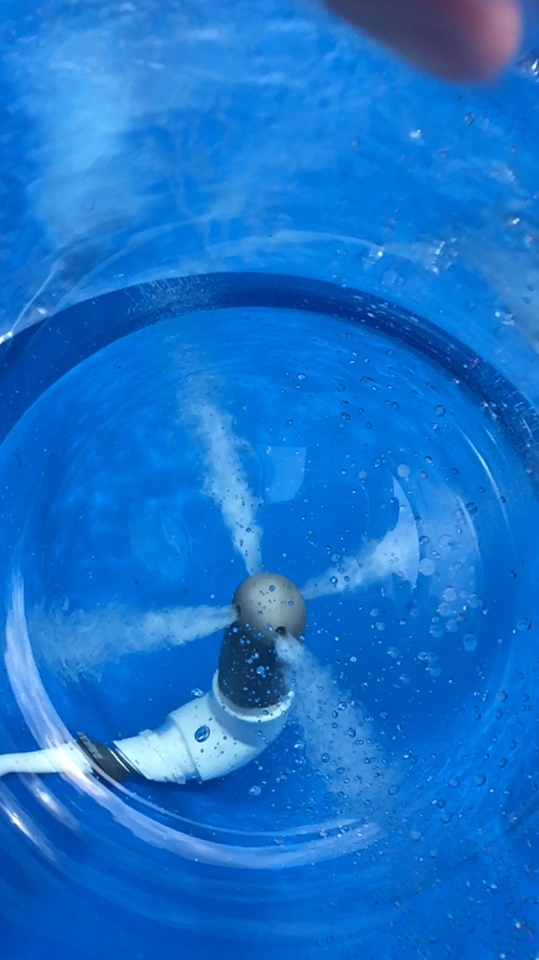
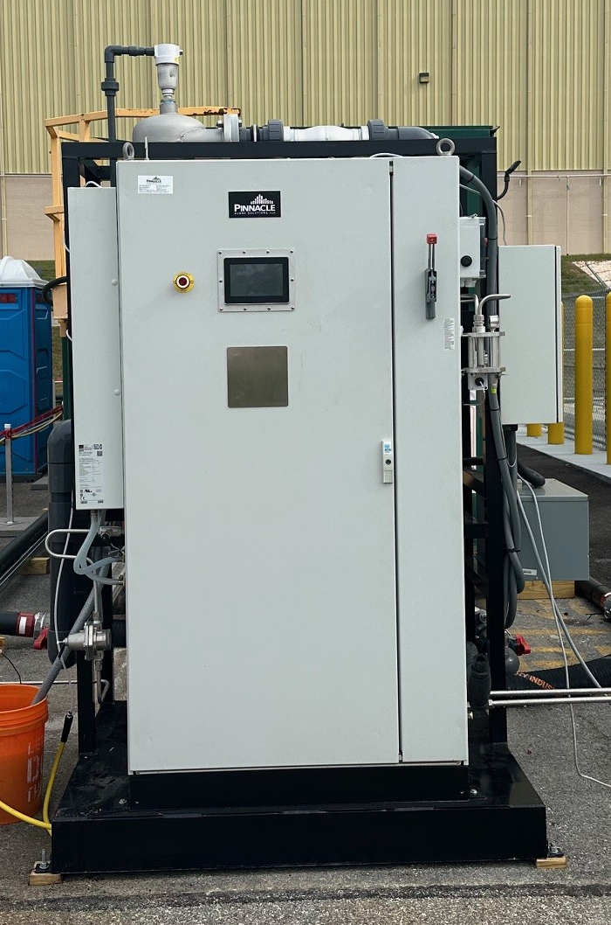
PINNACLE OZONE
Pilot Systems
Ozone Mass Transfer Unit
Enhances the mass transfer efficiency of the venturi
Increases the MTE by 15 to 20%
Designed for high exit velocities that re-shears to the 2-phase water/gas injection stream
Allows for higher levels of gas to liquid ratios
Easy to manufacture units specific to the requirements of the injection system
Made of robust 316L stainless steel
Designed for our high dose ozone cascade system, large contact vessels and basins

Slide 13
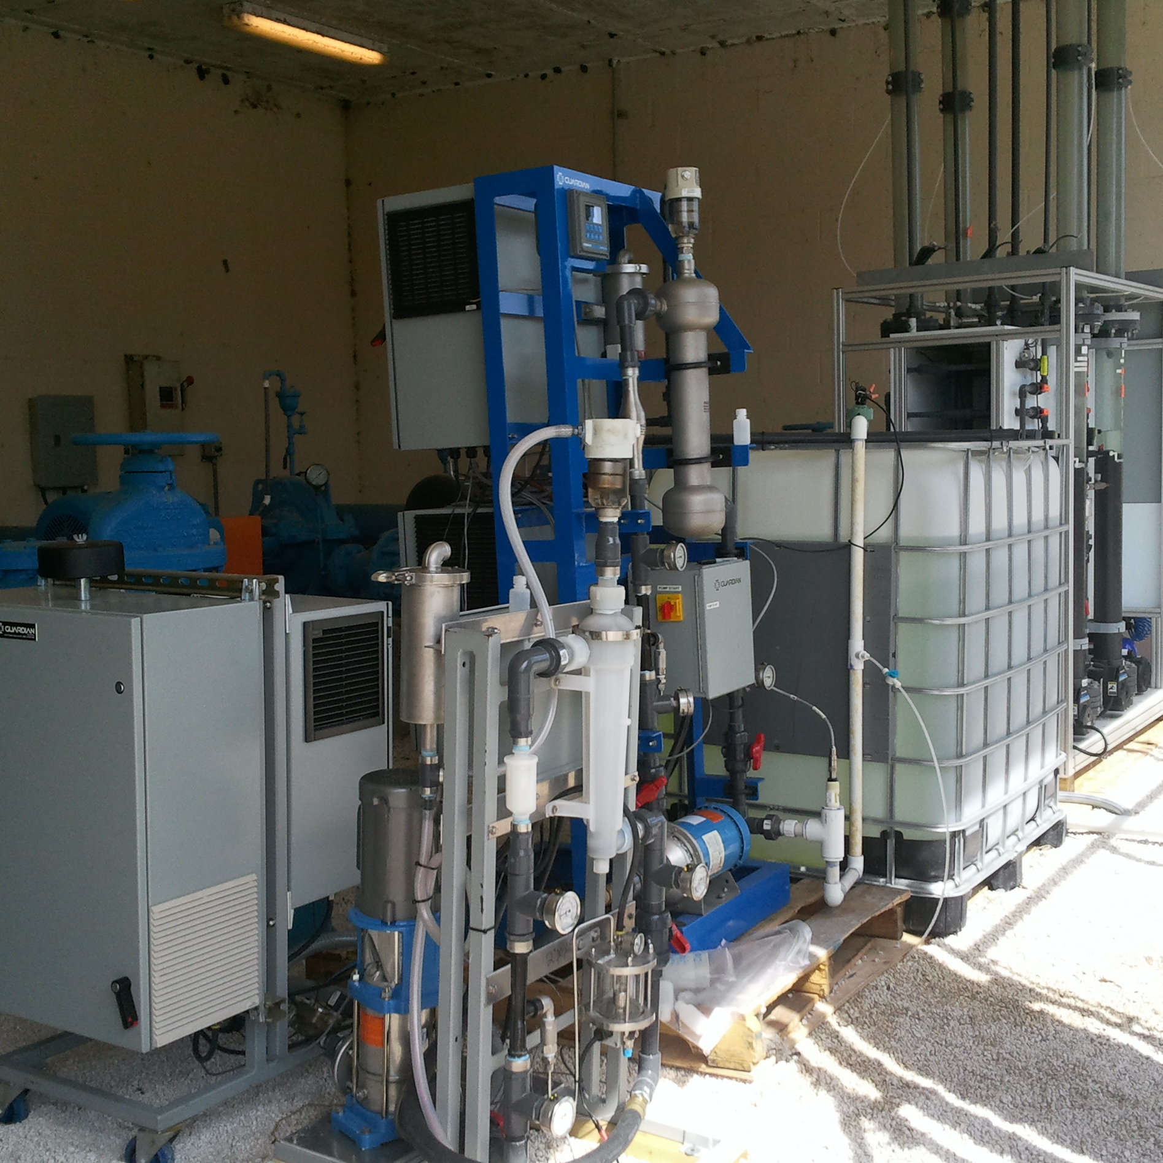
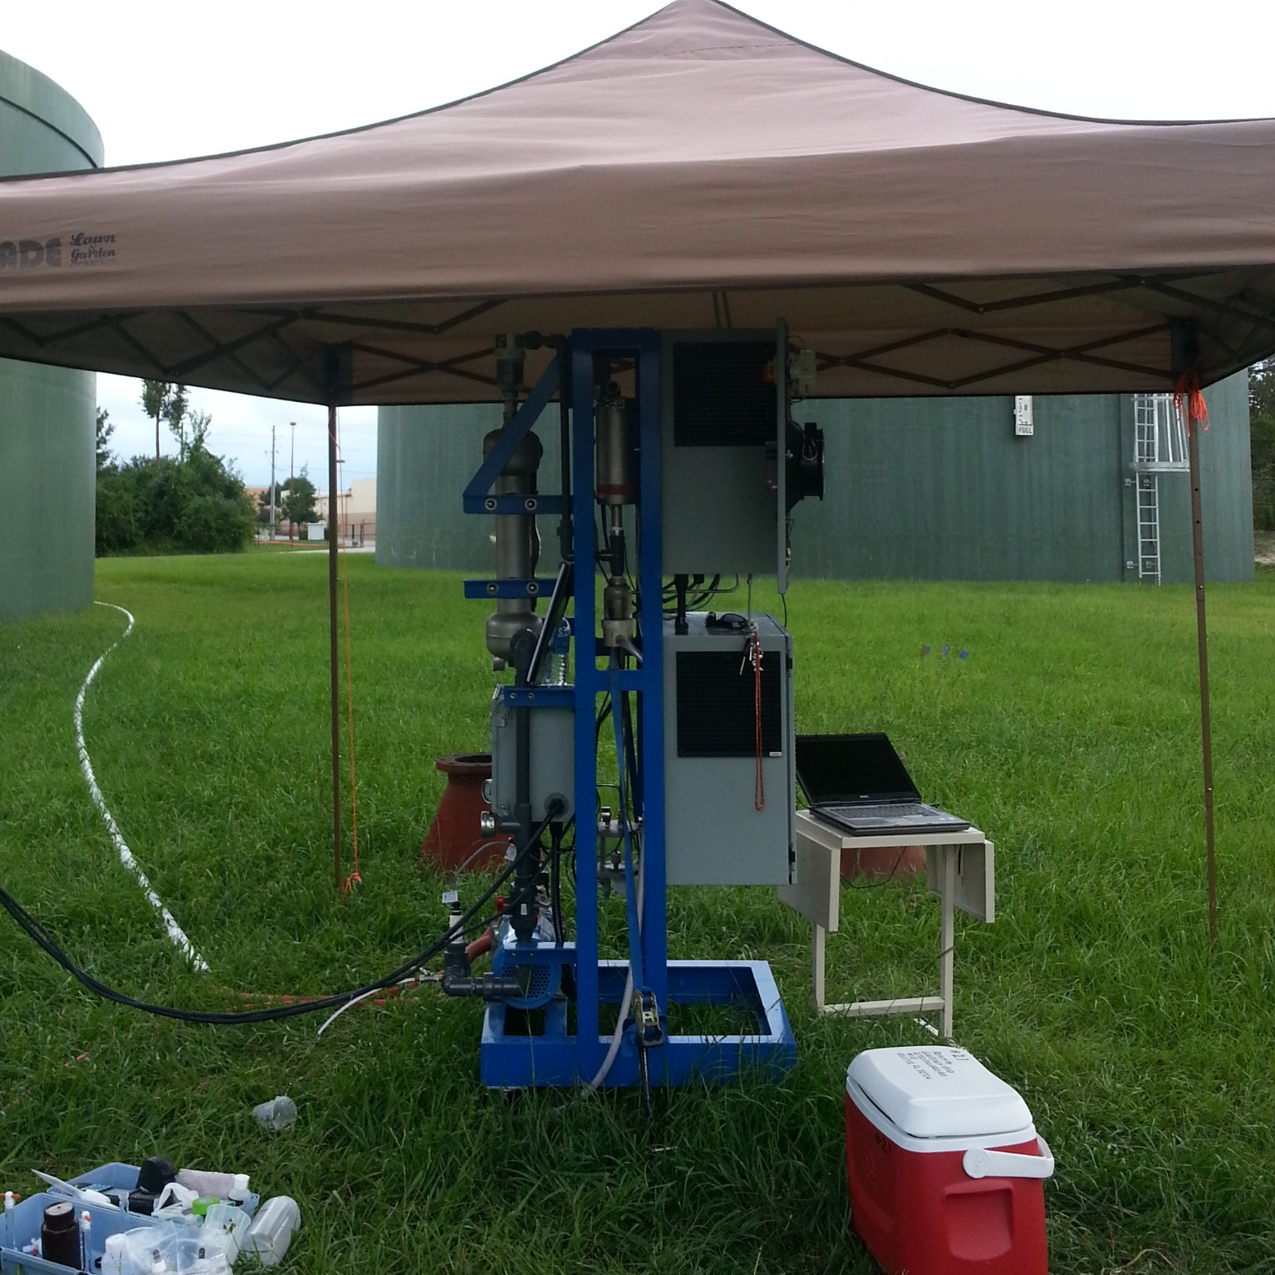
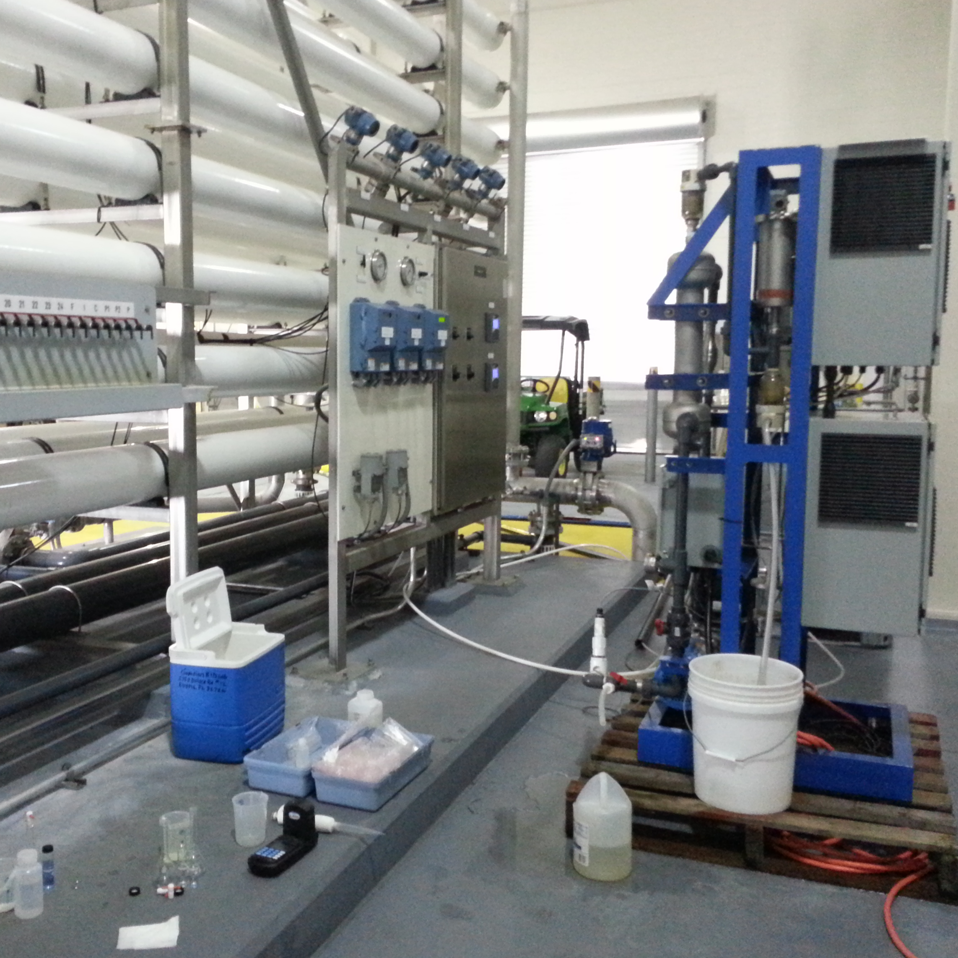
PINNACLE OZONE
Pilot Systems
Confirm Benchtop Ozone Demand and Decay Results under real and varying process water conditions
Verify Treatment Goals and Performance
Process Optimization: Ozone Dose, Contact Time, Flow Hydraulics and Water Chemistry Modifications
Evaluate Post Ozone Water Chemistries
Confirm Ozone Generator Sizing for Full Operational Scale Up
Support for Regulatory Compliance
High Sulfide Municipal Well Water
Pre Ozone Oxidation to Reduce THM’s
Oxidation of Color in RO Concentrate

Slide 14
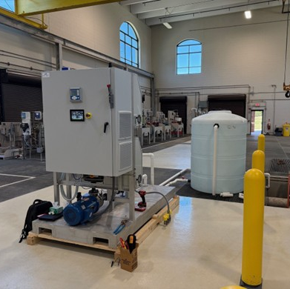
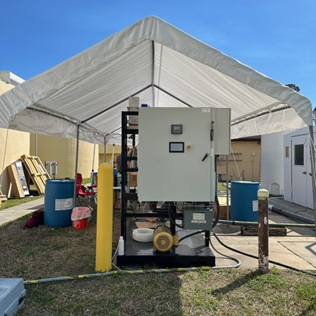

PINNACLE OZONE
Pilot Systems
High Sulfide Municipal Well Water
Pre Ozone Oxidation to Reduce THM’s
Oxidation of Color in RO Concentrate
Post Membrane Ozonation
to Remove Taste & Odor
High Ozone Dose in a Batch Process for BOD Reduction
Municipal Well Water for Ozone Pre-oxidation

Slide 15




High Sulfide Municipal Well Water
Pre Ozone Oxidation to Reduce THM’s
Oxidation of Color in RO Concentrate
PINNACLE OZONE
Pilot Systems
Thank You for Attending
We look forward to the journey ahead, where we can turn our shared vision into reality.
321-506-1850
www.pinnacleozone.com
Cocoa, Florida, USA
Post Membrane Ozonation
to Remove Taste & Odor
High Ozone Dose in a Batch Process for BOD Reduction
Municipal Well Water for Ozone Pre-oxidation

Slide 16
Thank You for Attending
We look forward to the journey ahead, where we can turn our shared vision into reality.
321-506-1850
www.pinnacleozone.com
Cocoa, Florida, USA

