Slide 1

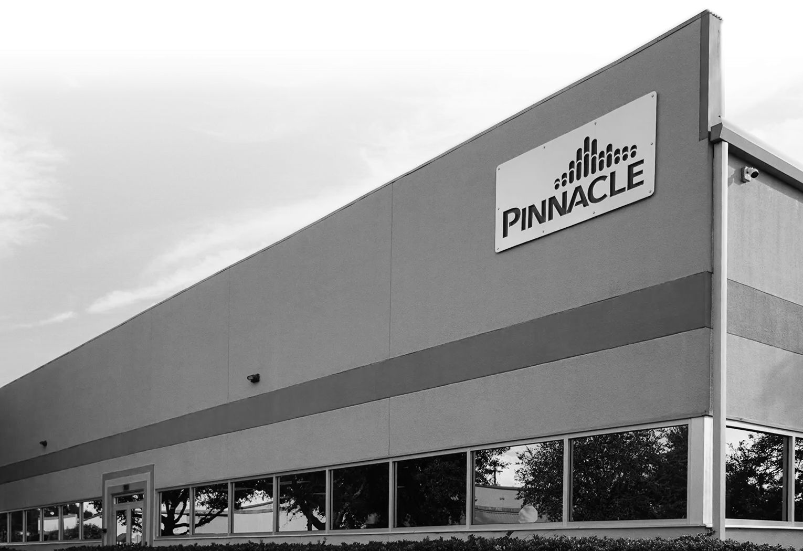


Shortly after 1906, other European cities—particularly in France, Germany and the Netherlands—adopted ozonation, aided by early electrical ozone generators developed by the few ozone companies of that time
Brief History of Ozone in Water Treatment
PINNACLE OZONE SOLUTIONS
Ozone Disinfection and the
Destruction of Taste, Odor & Color
1840
Christian Friedrich Schönbein isolated ozone and named it after the Greek word ozein (ὄζειν) meaning "to smell" because of its pungent odor (University of Basel in Switzerland)
1886
Europe recognized ability of ozone to disinfect polluted water
1891
German test results show ozone is effective against bacteria
1893
First full-scale ozone application for drinking water in the Netherlands
1906
The world’s first municipal ozonation plant began operating in Nice, treating drinking water from the Vésubie River, widely considered the birth of ozone water treatment
Thoram Charanda
CHIEF SCIENCE OFFICER

Slide 2
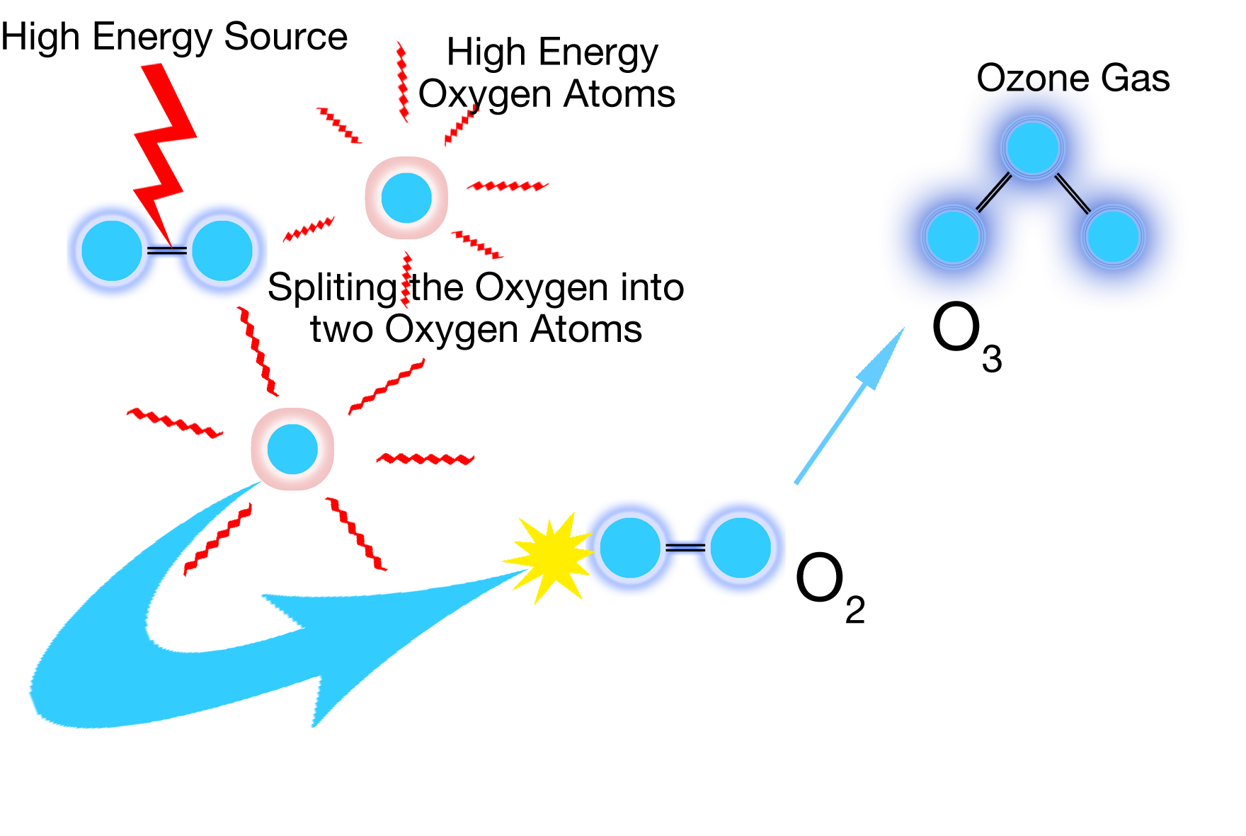
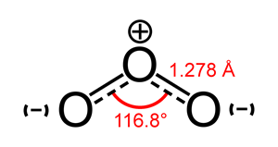
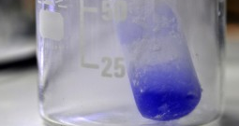
Ozone as the Molecule
Brief History of Ozone in Water Treatment
Shortly after 1906, other European cities—particularly in France, Germany and the Netherlands—adopted ozonation, aided by early electrical ozone generators developed by the few ozone companies of that time
1840
Christian Friedrich Schönbein isolated ozone and named it after the Greek word ozein (ὄζειν) meaning "to smell" because of its pungent odor (University of Basel in Switzerland)
1886
Europe recognized ability of ozone to disinfect polluted water
1891
German test results show ozone is effective against bacteria
1893
First full-scale ozone application for drinking water in the Netherlands
1906
The world’s first municipal ozonation plant began operating in Nice, treating drinking water from the Vésubie River, widely considered the birth of ozone water treatment
PINNACLE OZONE SOLUTIONS
Ozone Disinfection and the
Destruction of Taste, Odor & Color
Thoram Charanda
CHIEF SCIENCE OFFICER

Slide 3
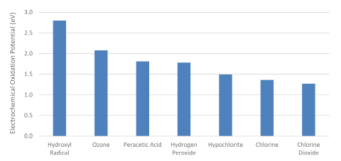
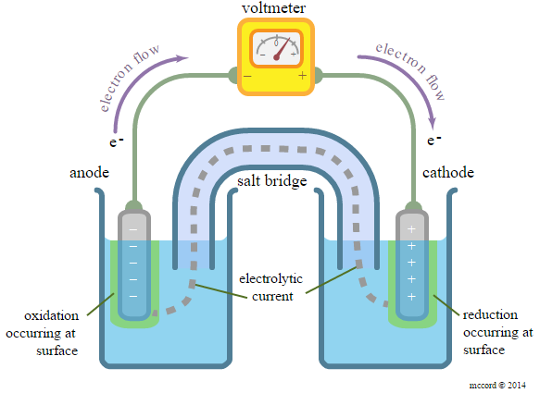

OZONE AS THE MOLECULE
Oxidative Power
Ozone as the Molecule
Symbol is O3
Triatomic molecule
Highly reactive form of oxygen gas
Very strong oxidizer
Denser than air
Deep blue color when liquefied
Strong odor
Produced in nature by lightning storms and UV radiation in the upper atmosphere
Man-made production mimics nature through corona discharge and UV type ozone generators
Electrochemical Oxidation Potential
SHE

Slide 4
OZONE AS THE MOLECULE
Oxidative Power
Redox Potential: 2.07 V
Electrochemical Oxidation Potential
SHE

Slide 5
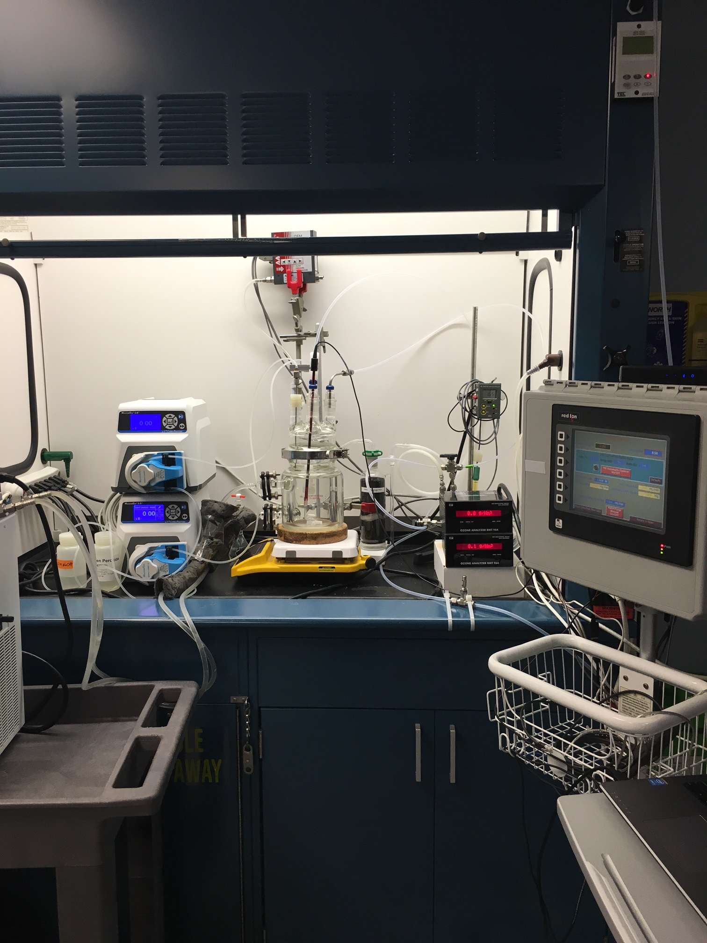
OZONE AS THE MOLECULE
OZONE AS THE MOLECULE
Reactivity
Oxidation Reactions
Reaction Rates
Ozone Decay In Fresh Water
SULFIDE S²⁻ + 4O₃ → SO₄²⁻ + 4O₂
IRON 2Fe²⁺ + O₃ → 2Fe³⁺ + 3H₂O + 3/2O₂ → 2Fe(OH)_{3(S)}
MANGANESE Mn²⁺ + O₃ → Mn⁴⁺ + H₂O → MnO₂ + 2OH⁻
AMMONIA 4O₃ + NH₃ → NO₃⁻ + 4O₂ + H₃O⁺
NITRITE NO₂⁻ + O₃ → NO₃⁻ + O₂
Half-Life: The time it takes for half of the ozone concentration to decay or react in an aqueous solution
k_{O3} = 4.7 x 10⁵ M⁻¹s⁻¹
k_{O3} = 8.2 x 10⁵ M⁻¹s⁻¹
Factors That Most Significantly Affect The Half-life
Inorganics: Sulfide, Nitrite, Iron, Manganese
Dissolved Organic Compounds: TOC, NOM, Humic and Fulvic Acids, Color
Total Suspended Solids
Temperature
pH
Reactive Surfaces
k_{O3} = 1.5 x 10³ M⁻¹s⁻¹
k_{O3} = 20 M⁻¹s⁻¹
k_{O3} = 3.7 x 10⁵ M⁻¹s⁻¹
Electrochemical Oxidation Potential
SHE

Slide 6
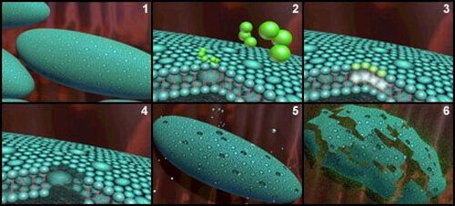
DISINFECTION POWER OF OZONE
Ozone Oxidative Attack on a Bacteria Cell Wall
OZONE AS THE MOLECULE
Reactivity
Ozone Decay In Fresh Water
Half-Life: The time it takes for half of the ozone concentration to decay or react in an aqueous solution
Ozone Damage on Cell Wall
Factors That Most Significantly Affect The Half-life
Inorganics: Sulfide, Nitrite, Iron, Manganese
Dissolved Organic Compounds: TOC, NOM, Humic and Fulvic Acids, Color
Total Suspended Solids
Temperature
pH
Reactive Surfaces

Slide 7
DISINFECTION POWER OF OZONE
Bacterial and Virus Destruction: CT Value
Ozone Oxidative Attack on a Bacteria Cell Wall
CT represents the amount of disinfectant exposure needed to achieve a specific level of microbial inactivation under defined conditions (temperature, pH)
Ozone Damage on Cell Wall
Method for Determining Ozone Concentration
Oxidizes lipids, proteins and glycoproteins
Leads to loss of membrane integrity
Leakage of cellular contents
Inactivation of key enzymes
Internal oxidation via secondary radicals damaging DNA
Standard Method 2350 D Indigo Trisulfonate
HACH Ozone Accuvac Vials (Indigo)
Amperometric Dissolved Ozone Probe
DPD (older method typically used or free chlorine)
CT = C x T (mg-min/L)
Key Parameters for Time Value
Hydraulic Residence Time: HRT
Baffling Factor: BF (0.2 to 0.9)
Effective Contact Time: t10
Contact Chamber Design
CT Value is the product of C (ozone concentration in mg/L) x T (effective contact time in minutes)

Slide 8
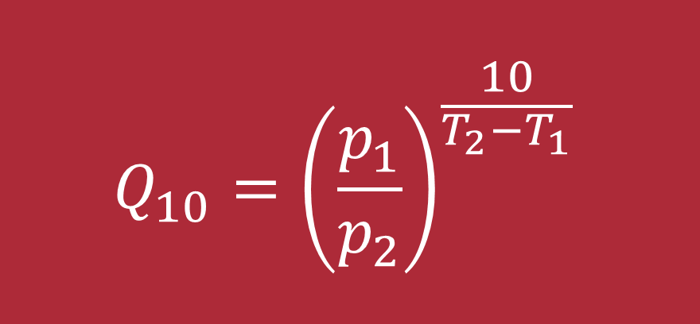
DISINFECTION POWER OF OZONE
Effect of Temperature on Ozone Disinfection: Temperature Coefficient Q₁₀
Bacterial and Virus Destruction: CT Value
CT represents the amount of disinfectant exposure needed to achieve a specific level of microbial inactivation under defined conditions (temperature, pH)
Method for Determining Ozone Concentration
Standard Method 2350 D Indigo Trisulfonate
HACH Ozone Accuvac Vials (Indigo)
Amperometric Dissolved Ozone Probe
DPD (older method typically used or free chlorine)
CT = C x T (mg-min/L)
Key Parameters for Time Value
Hydraulic Residence Time: HRT
Baffling Factor: BF (0.2 to 0.9)
Effective Contact Time: t10
Contact Chamber Design
CT Value is the product of C (ozone concentration in mg/L) x T (effective contact time in minutes)
$$Q_{10}={\left(\frac{p_{1}}{p_{2}}\right)}^{\frac{10}{T_{2}−T_{1}}}$$
Q10 is the temperature coefficient that is applied to CT to accommodate the fold reduction value induced by a 10°C decrease in temperature.
T1 is the temperature at the given p1 CT value required for a specific inactivation rate
T2 is the changed temperature and p2 the changed CT value required to achieve the same inactivation rate.

Slide 9
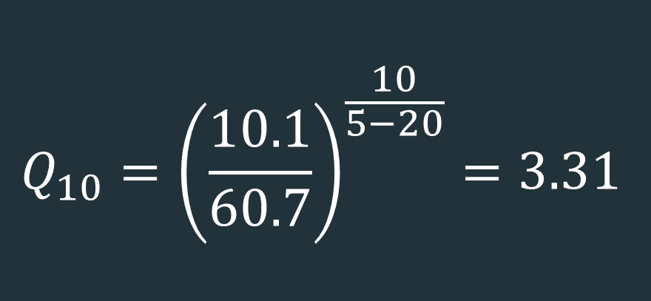
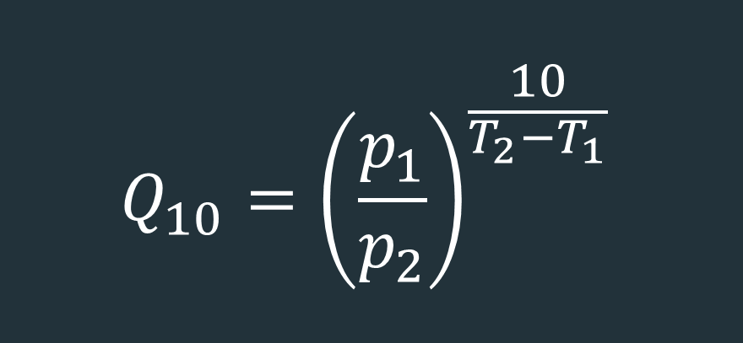
DISINFECTION POWER OF OZONE
Effect of Temperature on Ozone Disinfection
Effect of Temperature on Ozone Disinfection: Temperature Coefficient Q₁₀
Cryptosporidium parvum
$$Q_{10}={\left(\frac{10.1}{60.7}\right)}^{\frac{10}{5−20}}=3.31$$
$$Q_{10}={\left(\frac{p_{1}}{p_{2}}\right)}^{\frac{10}{T_{2}−T_{1}}}$$
Q10 is the temperature coefficient that is applied to CT to accommodate the fold reduction value induced by a 10°C decrease in temperature.
T1 is the temperature at the given p1 CT value required for a specific inactivation rate
T2 is the changed temperature and p2 the changed CT value required to achieve the same inactivation rate.

Slide 10
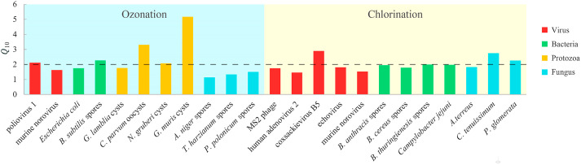
DISINFECTION POWER OF OZONE
Q10 values for different microorganisms by ozonation and chlorination
Effect of Temperature on Ozone Disinfection
Cryptosporidium parvum
$$Q_{10}={\left(\frac{10.1}{60.7}\right)}^{\frac{10}{5−20}}=3.31$$
For a 4-log (99.99%) kill of the Cryptosporidium parvum oocysts:
At 20 ​°C the CT value is 10.1 ​mg·min/L
At 5 ​°C the CT value is 60.7 ​mg·min/L
Escherichia coli Q₁₀ = 1.74
This indicates that E. coli is approximately 2x less sensitive to the change in water temperature.

Slide 11
DISINFECTION POWER OF OZONE
DISINFECTION POWER OF OZONE
Q10 values for different microorganisms by ozonation and chlorination
CT Value
The virus removal in UV irradiation, ozonation and chlorination
Jiayang Kong ¹, Yun Lu ^{1,∗}, Yunru Ren ¹, Zhuo Chen ¹, Menghao Chen ¹
Water Cycle. 2021 Jun 2;2:23-31.
BACTERIA | CT (MG-MIN/L) | % LOG KILL | TEMPERATURE (°C)
Escherichia coli | 0.034 – 0.05 | 99% | 5
Vibrio cholerae | 0.1 – 0.35 | 99.999% | 20
Giardia | 0.48 | 99.9% | 25
Cryptosporidium | 7 - 10 | 99.9% | 20 - 25

Slide 12
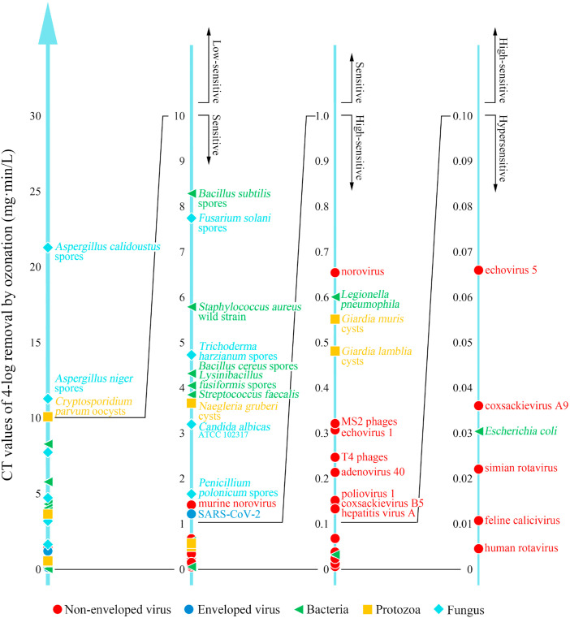
DISINFECTION POWER OF OZONE
CT Value
The values below are approximate ranges commonly used in drinking-water engineering and regulation for the inactivation of bacteria.
Range of CT Value
BACTERIA | CT (MG-MIN/L) | % LOG KILL | TEMPERATURE (°C)
Escherichia coli | 0.034 – 0.05 | 99% | 5
Vibrio cholerae | 0.1 – 0.35 | 99.999% | 20
Giardia | 0.48 | 99.9% | 25
Cryptosporidium | 7 - 10 | 99.9% | 20 - 25

Slide 13
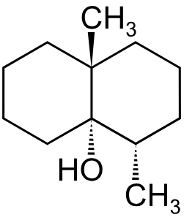
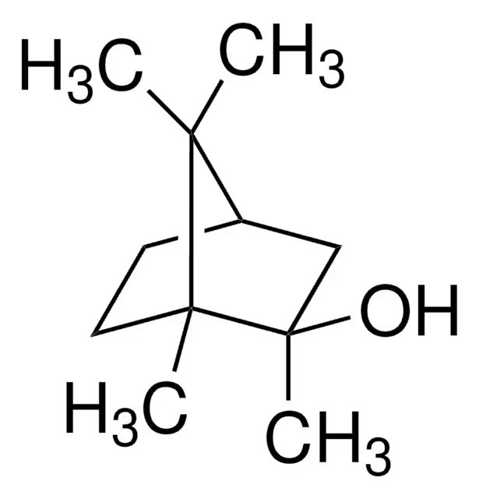
Ozone Destruction of Taste and Odor
DISINFECTION POWER OF OZONE
Range of CT Value
The virus removal in UV irradiation, ozonation and chlorination
Jiayang Kong ¹, Yun Lu ^{1,∗}, Yunru Ren ¹, Zhuo Chen ¹, Menghao Chen ¹
Water Cycle. 2021 Jun 2;2:23-31.

Slide 14

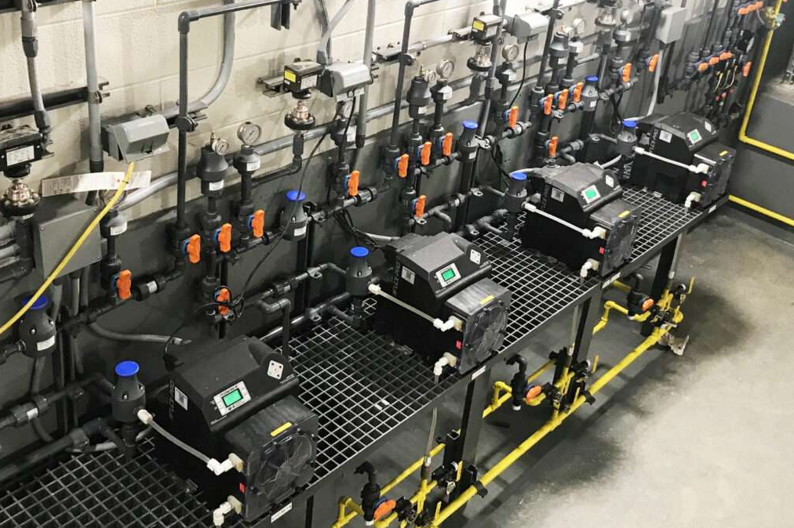
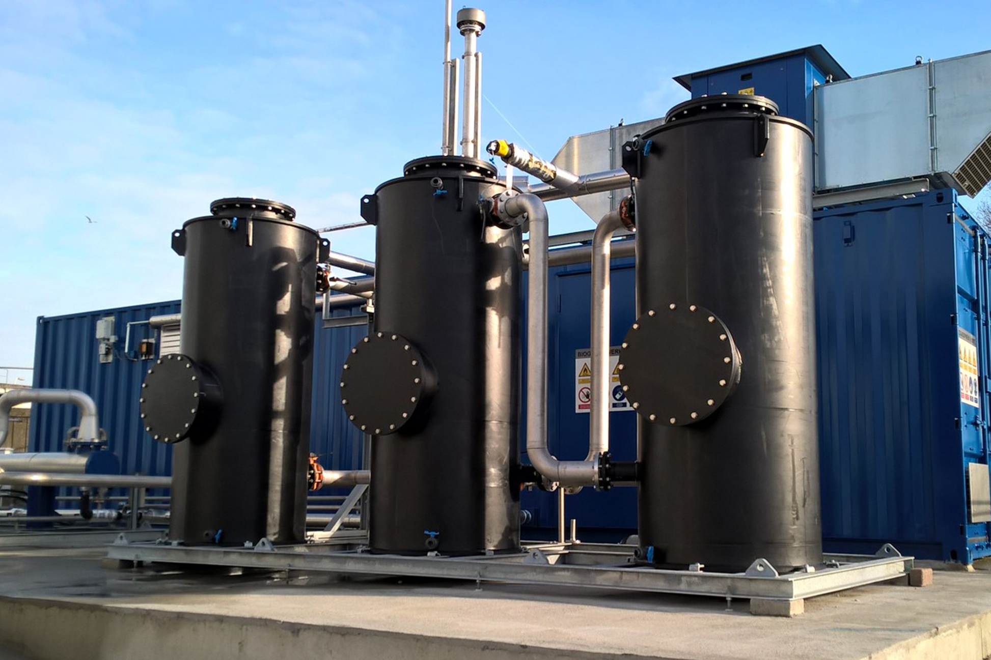
Ozone Destruction of Taste and Odor
Effect of Temperature on Ozone Disinfection
GEOSMIN
For drinking water municipalities with surface water sources, the most frequent cause for earthy and musty taste and odors is due to the presence of 2-methylisoborneol (2-MIB) and Geosmin.
2-MIB
These compounds are produced by blooms of certain species of cyanobacteria (blue-green algae) and other benthic and pelagic microorganisms.
Cryptosporidium parvum
$$Q_{10}={\left(\frac{10.1}{60.7}\right)}^{\frac{10}{5−20}}=3.31$$
Traditional oxidants used for water treatment such as chlorine gas, sodium or calcium hypochlorite or potassium permanganate are incapable of effectively removing the 2-MIB and Geosmin.
Granulated activated carbon (GAC) or powdered activated carbon (PAC) can effectively remove these taste and odor compounds through adsorption but this typically leads to very high operational expenses (OPEX) due to the quick exhaustion of the carbon, leading to a frequent need for replacement.

Slide 15
Ozone Destruction of Taste and Odor
DIRECT OXIDATION
O₃ +
Contaminant
Oxidized
Compound
AOP (INDIRECT OXIDATION)
O₃ + H₂O₂
O₃ + UV
O₃ + OH⁻
Traditional oxidants used for water treatment such as chlorine gas, sodium or calcium hypochlorite or potassium permanganate are incapable of effectively removing the 2-MIB and Geosmin.
Granulated activated carbon (GAC) or powdered activated carbon (PAC) can effectively remove these taste and odor compounds through adsorption but this typically leads to very high operational expenses (OPEX) due to the quick exhaustion of the carbon, leading to a frequent need for replacement.
OH• Radicals

Slide 16
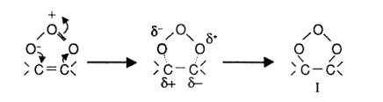
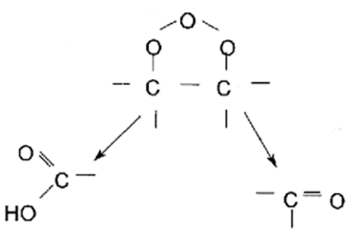
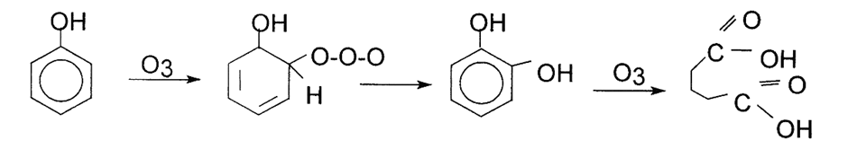

Ozone Destruction of Taste and Odor
Examples of Direct Ozone Attack on Carbon Double Bonds
DIRECT OXIDATION
O₃ +
Contaminant
Oxidized
Compound
Cyclo Addition Creating an Ozonide
Ozonide Quickly Degrades into Biodegradable Ketones and Aldehydes
AOP (INDIRECT OXIDATION)
O₃ + H₂O₂
O₃ + UV
O₃ + OH⁻
OH• Radicals
Ozone Attack on Aromatic Compounds, such as Phenols

Slide 17
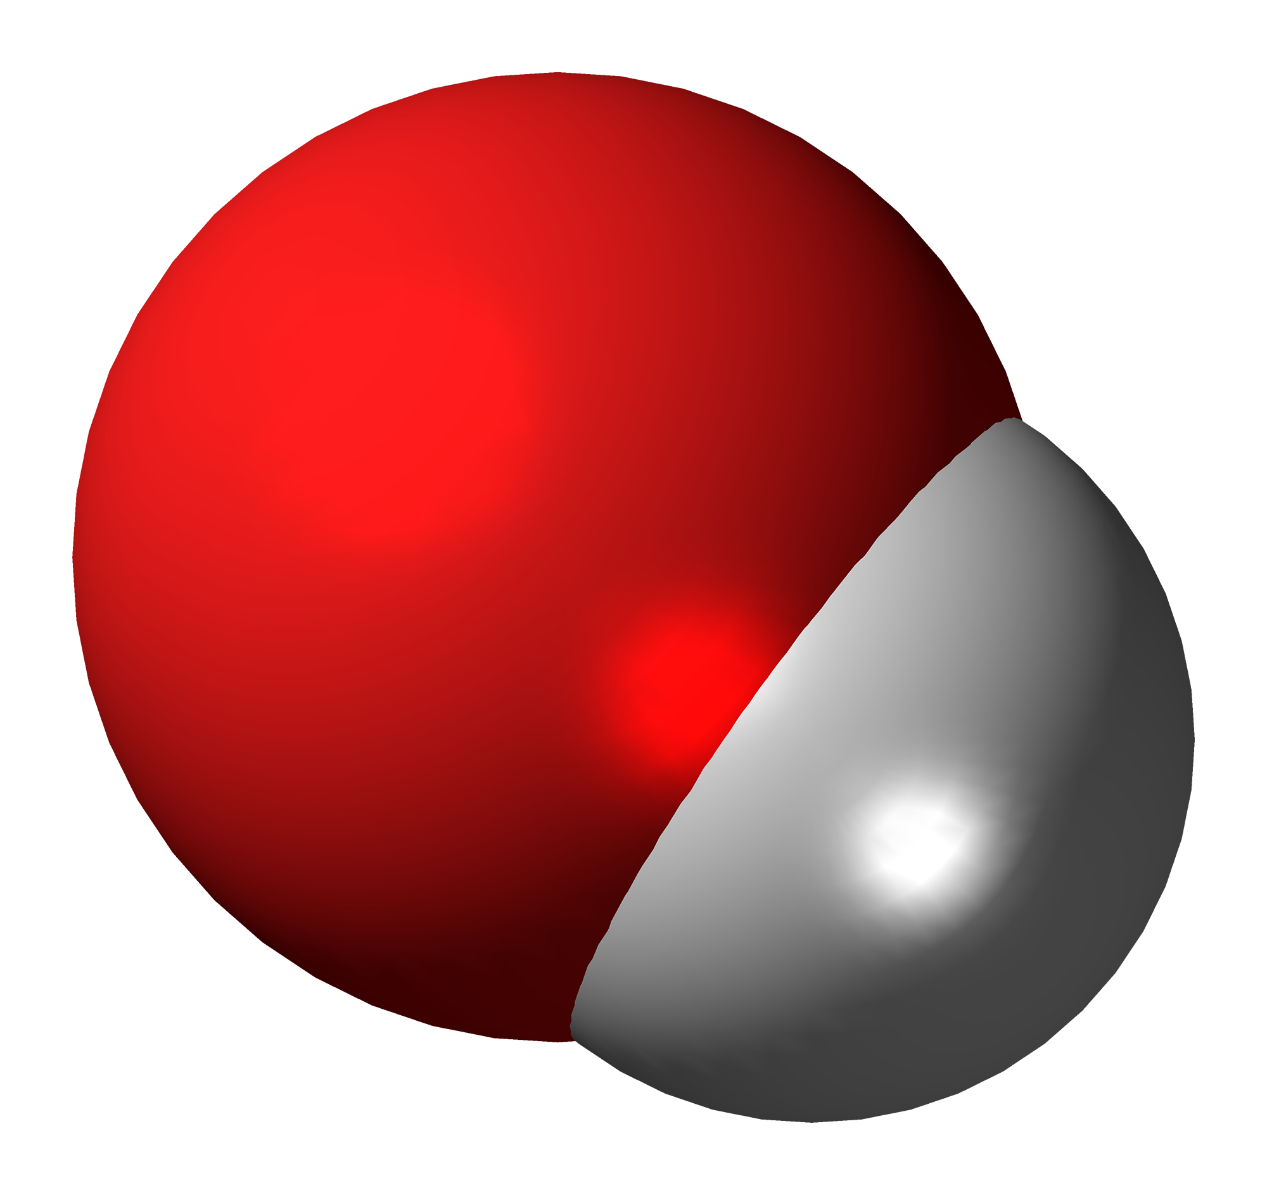
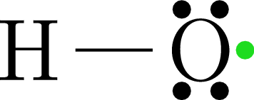
OZONE DESTRUCTION OF TASTE AND ODOR
Examples of Direct Ozone Attack on Carbon Double Bonds
Ozone Reaction Kinetics
It has been demonstrated through laboratory studies and at many surface water supplied municipal treatment plants with ozone installations that ozone is a very effective means for the oxidative removal of 2-MIB and Geosmin. To understand how this works it is important to have a basic knowledge of how ozone reacts with dissolved organic compounds.
There are two main reaction pathways that ozonation can lead to the oxidation of these dissolved organics, direct attack and indirect reactions.
Cyclo Addition Creating an Ozonide
Ozonide Quickly Degrades into Biodegradable Ketones and Aldehydes
Ozone Attack on Aromatic Compounds, such as Phenols
OH• HYDROXYL RADICAL

Slide 18
OZONE DESTRUCTION OF TASTE AND ODOR
OXIDANT | OXIDATION POTENTIAL (VOLTS)
Hydroxyl Radical OH· | 2.80
Ozone O₃ | 2.07
Hydrogen Peroxide H₂O₂ | 1.78
Potassium Permanganate KMnO₄ | 1.70
Hypochlorous Acid HOCl | 1.49
Chlorine Cl₂ | 1.36
Chlorine Dioxide ClO₂ | 1.27
Oxygen O₂ | 1.23
Ozone Reaction Kinetics
Due to the molecular nature of 2-MIB and Geosmin the reaction rate of direct ozone attack is very slow leading to inefficient oxidation.
Fortunately, the other main reaction pathway with ozonation, indirect reactions, can lead to the creation of hydroxyl radicals through either reaction with certain radical promoting organics or via advanced oxidation processes (AOP).
These hydroxyl radicals are very fast and efficient in the destruction of organic compounds, including 2-MIB and Geosmin.
OH• HYDROXYL RADICAL

Slide 19
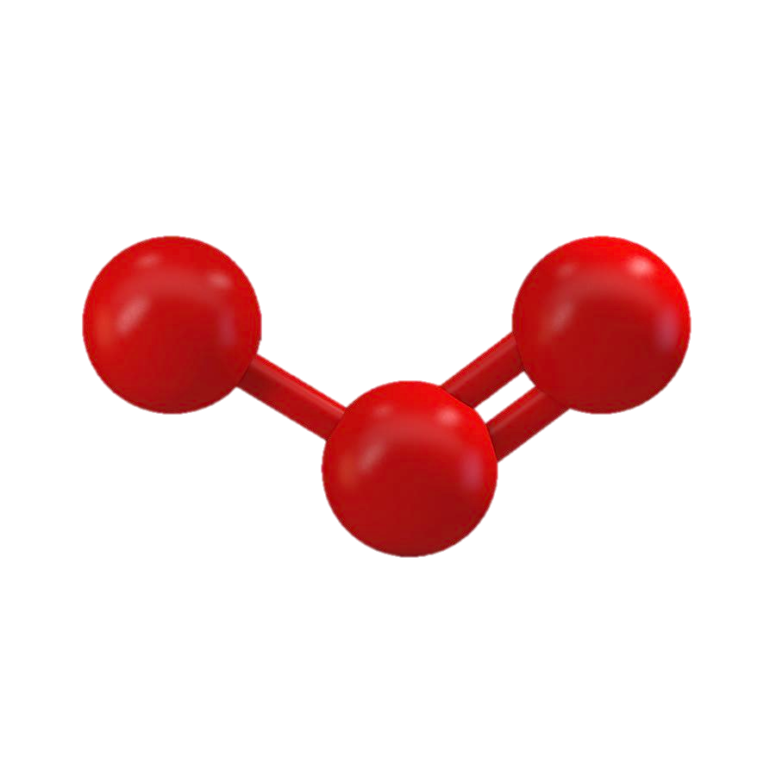
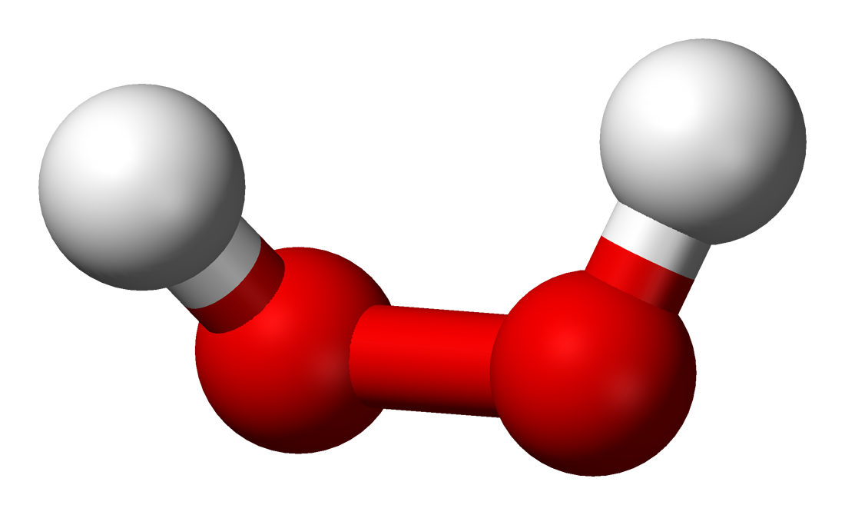






OZONE DESTRUCTION OF TASTE AND ODOR
OZONE DESTRUCTION OF TASTE AND ODOR
OXIDANT | OXIDATION POTENTIAL (VOLTS)
Hydroxyl Radical OH· | 2.80
Ozone O₃ | 2.07
Hydrogen Peroxide H₂O₂ | 1.78
Potassium Permanganate KMnO₄ | 1.70
Hypochlorous Acid HOCl | 1.49
Chlorine Cl₂ | 1.36
Chlorine Dioxide ClO₂ | 1.27
Oxygen O₂ | 1.23
PEROXONE
Ozone Reaction Kinetics
PEROXONE involves the combination of dissolved ozone and hydrogen peroxide, H2O2
Hydroxyl radicals, OH·, have an extremely high electrochemical potential at 2.8 volts, that is powerful enough to rip electrons out of organic chemical bonds leading to the oxidation and breakdown of the nearly any dissolved organic compound.
Profile of the Kinectic Reactions with O₃ and H₂O₂
$$H_{2}O_{2}↔HO_{2}^{−}+H^{+}$$
$$O_{3}+HO_{2}^{−}→HO^{∙}+O_{2}^{∙−}+O_{2}$$
$$O_{2}^{∙−}+H^{+}↔HO_{2}^{∙}$$
$$O_{3}+O_{2}^{∙−}↔O_{3}^{∙−}+O_{2}$$
$$O_{3}^{∙−}+H^{+}↔HO_{3}^{∙}$$
$$HO_{3}^{∙}→HO^{∙}+O_{2}$$

Slide 20






O₃
Use of Ozone for Color Removal in WTP Source Waters
OZONE DESTRUCTION OF TASTE AND ODOR
PEROXONE
PEROXONE involves the combination of dissolved ozone and hydrogen peroxide, H₂O₂
H₂O₂
Profile of the Kinectic Reactions with O₃ and H₂O₂
The series of reactions detail the interaction of ozone and H₂O₂ , leading to the generation of the OH· radical, which quickly reacts with the taste and odor compounds breaking them down into smaller molecules and to carbon dioxide, CO₂.
$$H_{2}O_{2}↔HO_{2}^{−}+H^{+}$$
$$O_{3}+HO_{2}^{−}→HO^{∙}+O_{2}^{∙−}+O_{2}$$
$$O_{2}^{∙−}+H^{+}↔HO_{2}^{∙}$$
$$O_{3}+O_{2}^{∙−}↔O_{3}^{∙−}+O_{2}$$
$$O_{3}^{∙−}+H^{+}↔HO_{3}^{∙}$$
$$HO_{3}^{∙}→HO^{∙}+O_{2}$$
In both well and surface waters for water treatment plants color can originate from a dissolved organic and inorganic compounds:
Tannins
Humic and Fulvic Acids
Algae
Undissolved Iron, Fe3+
Suspended Solids
When the color cannot be reduced, typically due to soluble organics, through traditional means, for example coagulation, precipitation and/or filtration, applying ozone injection is a very effective means for removing any remaining color post treatment.

Slide 21
Use of Ozone for Color Removal in WTP Source Waters
In both well and surface waters for water treatment plants color can originate from a dissolved organic and inorganic compounds:
Tannins
Humic and Fulvic Acids
Algae
Undissolved Iron, Fe3+
Suspended Solids
When the color cannot be reduced, typically due to soluble organics, through traditional means, for example coagulation, precipitation and/or filtration, applying ozone injection is a very effective means for removing any remaining color post treatment.
Use of Ozone for Color Removal in WTP Source Waters
The oxidative power ozone is capable of very quickly removing the electrons(i.e. bleaching) from the organic chemical bonds in the dissolved organics that are responsible for producing the observable color in source waters.
The chemical bonds in the dissolved organics that produce color are called chromophores.

Slide 22
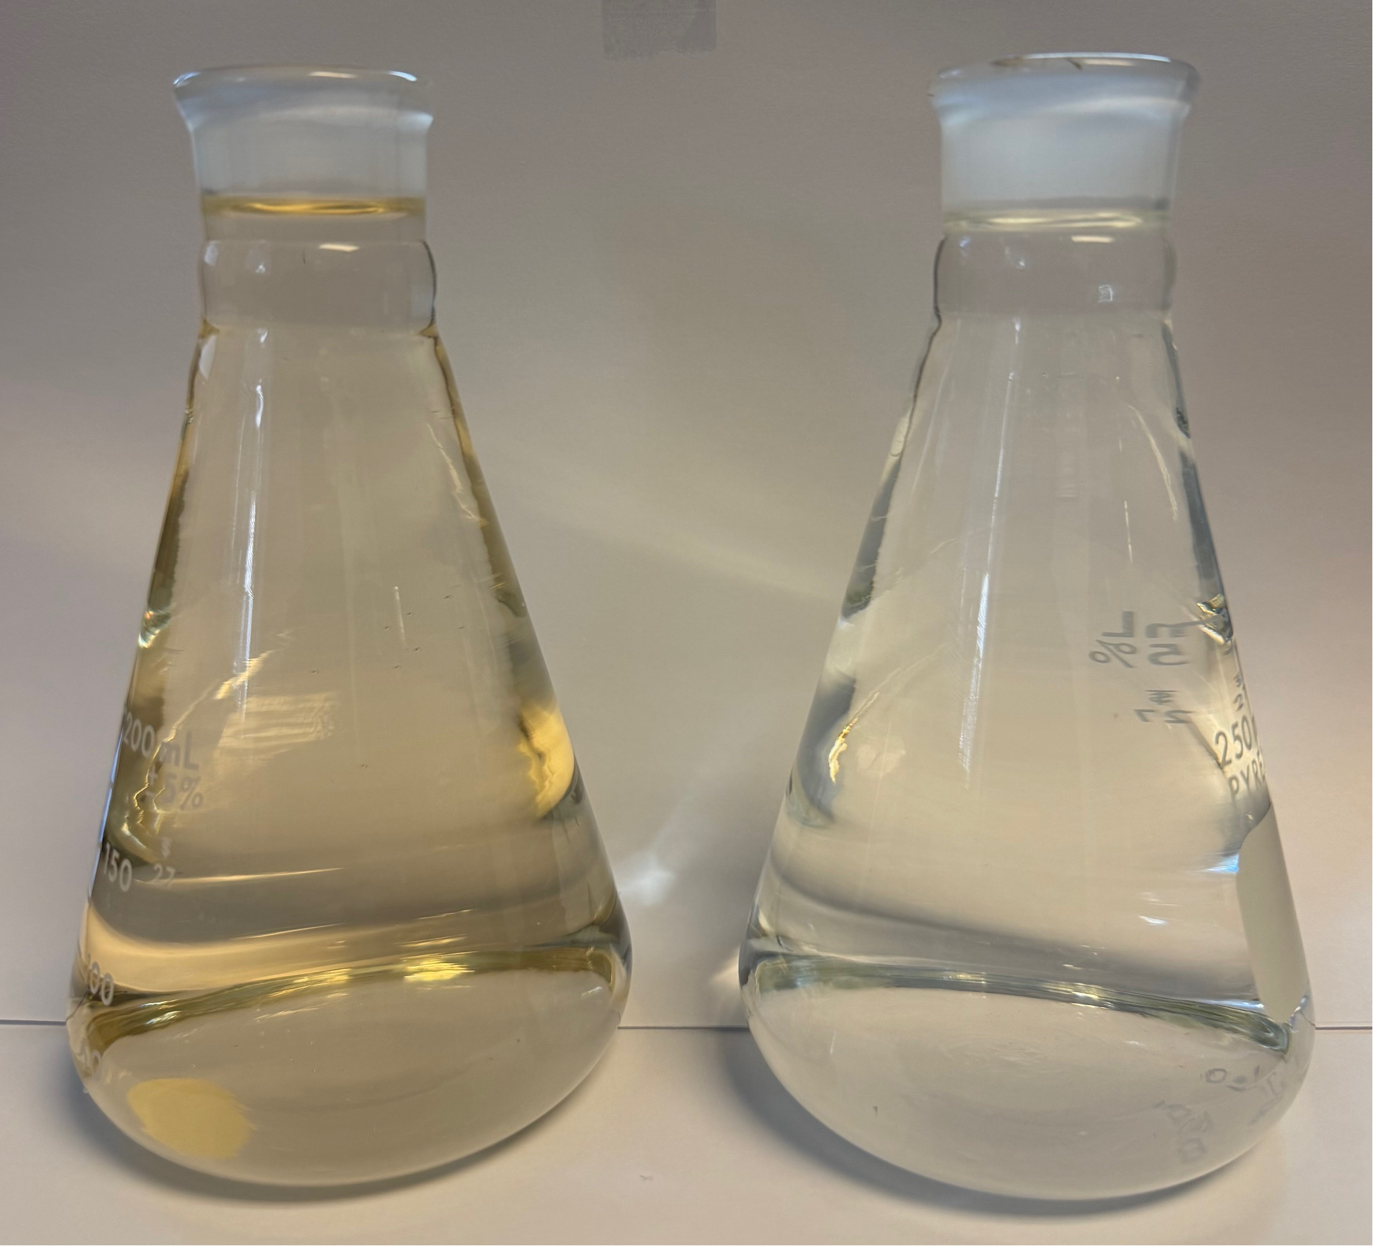
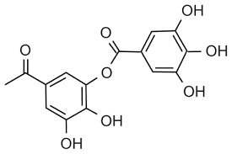
POST OZONATED RAW WATER
APPARENT COLOR : 6 PT-CO
Use of Ozone for Color Removal in WTP Source Waters
EXAMPLES OF CHROMOPHORES IN TANNIC ACID
The oxidative power ozone is capable of very quickly removing the electrons(i.e. bleaching) from the organic chemical bonds in the dissolved organics that are responsible for producing the observable color in source waters.
The chemical bonds in the dissolved organics that produce color are called chromophores.
RAW WATER APPARENT COLOR : 103 PT-CO

Slide 23
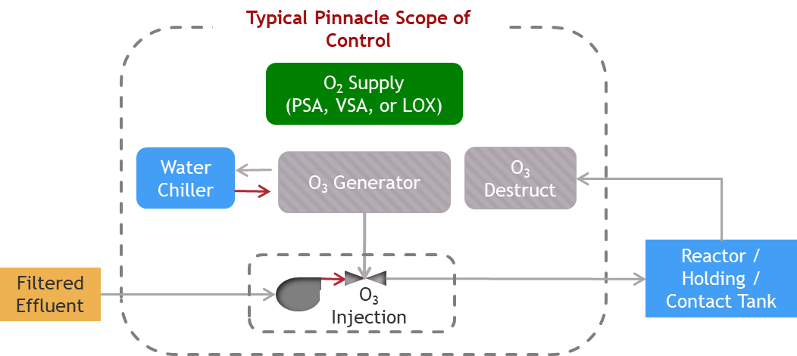
Use of Ozone for Color Removal in WTP Source Waters
POST OZONATED RAW WATER
APPARENT COLOR : 6 PT-CO
In the bleaching of the color in source waters, ozone directly attacks the chromophores in the dissolved organics, removing the carbon-carbon bonds. Once these bonds are broken, the organic molecule can no longer adsorb the visible light that led to the appearance of color.
RAW WATER APPARENT COLOR : 103 PT-CO

Slide 24

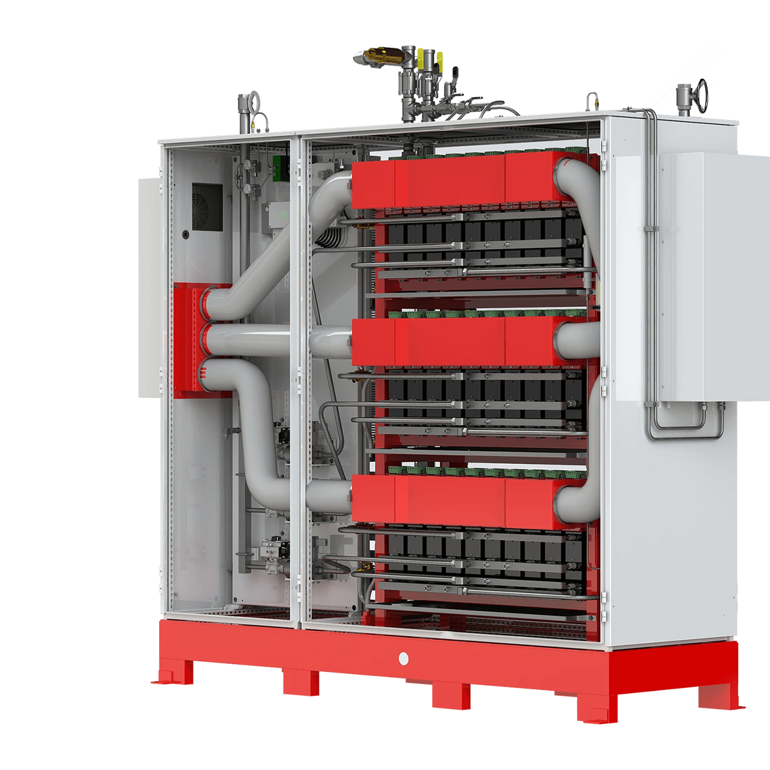
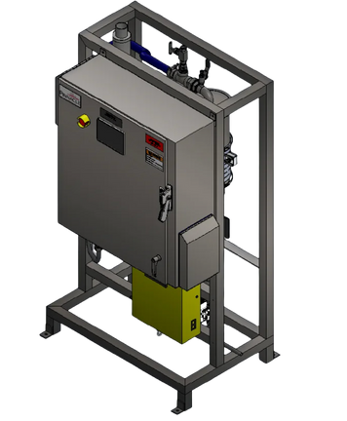
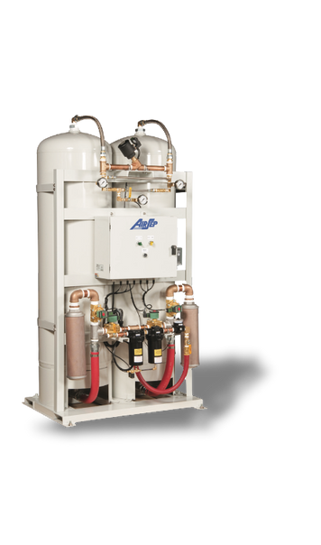
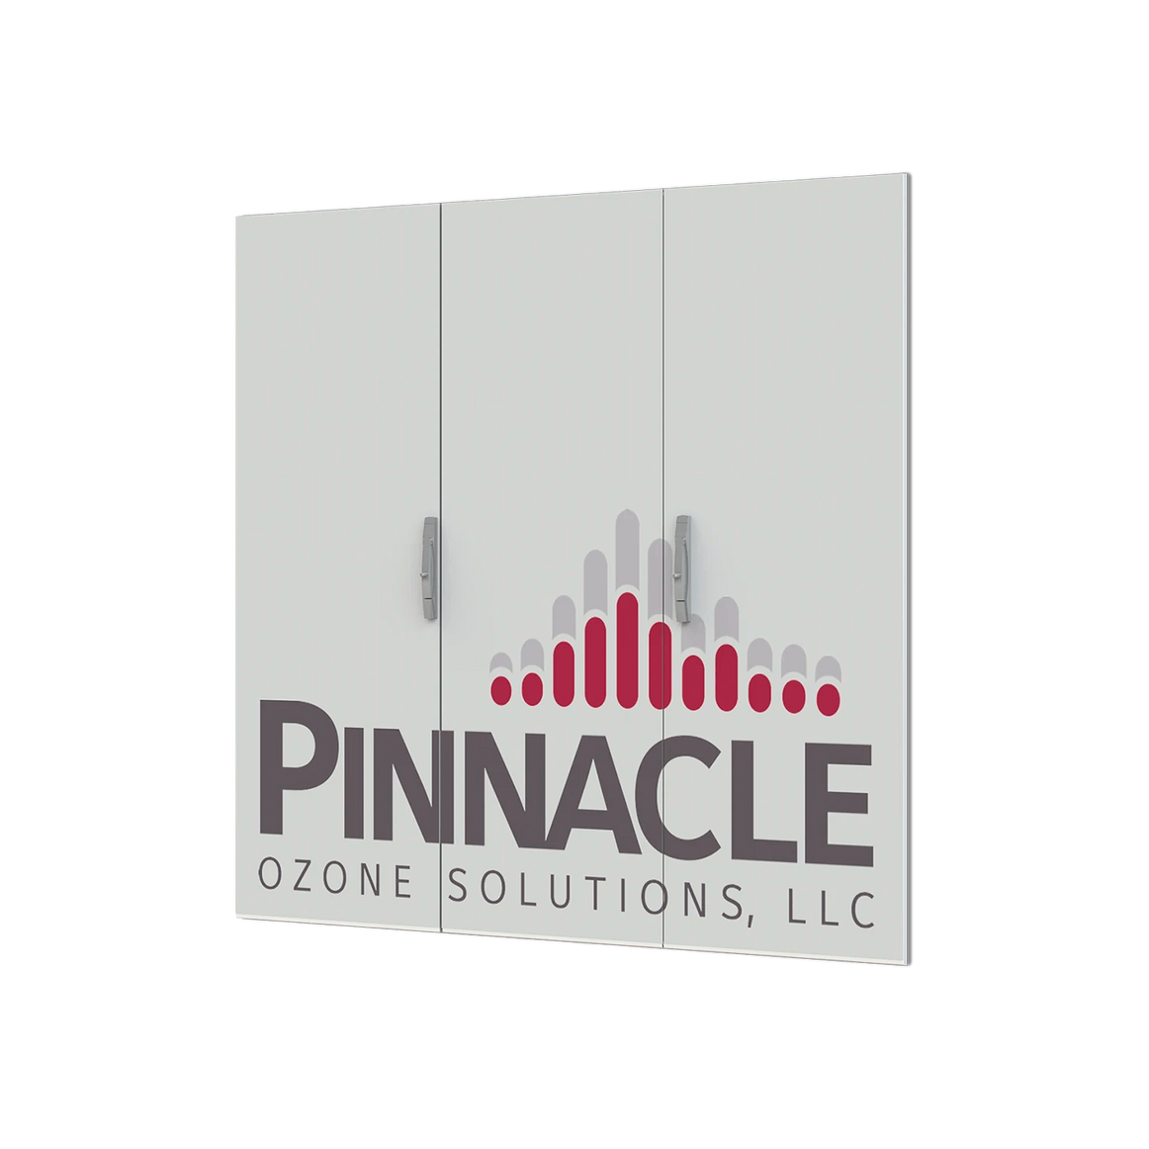
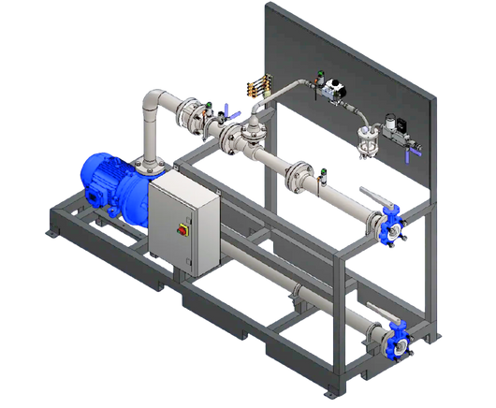
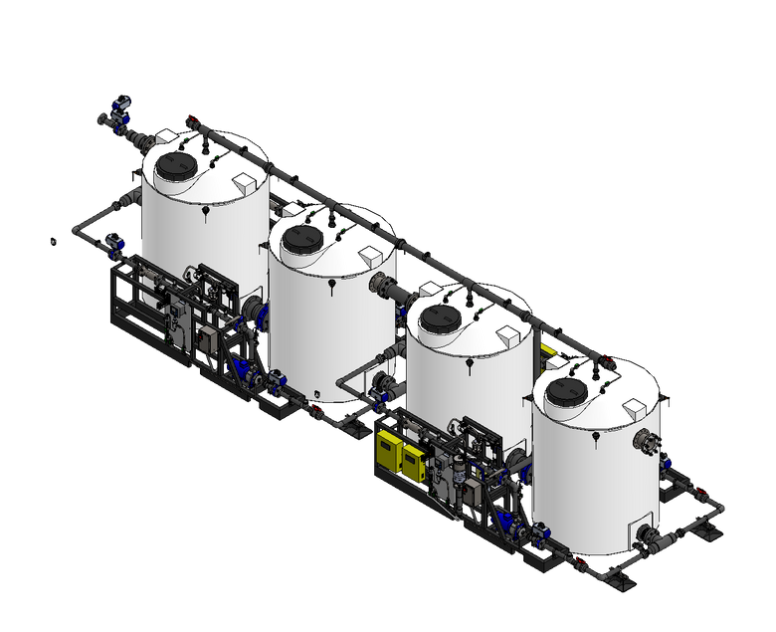
  Oxygen Supply:
    Liquid Oxygen (LOX) or
    Onsite generation (PSA / VSA) or delivered oxygen for feed to ozone generator
    Min Quality: >93% O₂ @ Dewpoint = -65°F
  Ozone Generator:
    Converts Oxygen to ~10% O₃ (typically) using electrified plasma field
    Pinnacle generators offer constant %BW output at any turn-down
    Market Leading Energy Efficiency (3.5 kWh/lb)
  Water Chiller:
    Closed-loop cooling for ozone generator
    Glycol based fluid preserves unit efficiency
  O₃ Injection
    Dissolves Ozone Gas Into Solution for Reaction
    Custom Design (based on dose, flow, etc)
    Typical Transfer Efficiency >93%
  O₃ Destruct
    Captures un-dissolved Ozone gas to prevent exposure
    Autocatalytic Reaction w/ Monitoring
    Assures no release / exposure to Ozone
Typical Ozone System
Process Diagram
FEED GAS
GENERATOR
INJECTION SKID
CONTACT TANK & DIFFUSION
DESTRUCT
MODULES
Control Panel
Cooling
Sensors

Slide 25
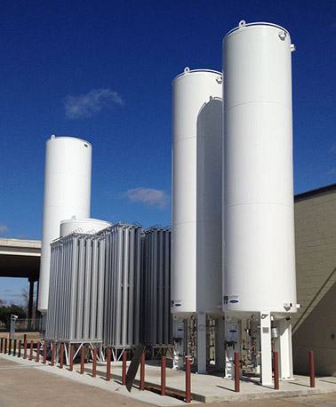

System Architecture
FEED GAS
GENERATOR
INJECTION SKID
CONTACT TANK & DIFFUSION
DESTRUCT
MODULES
Control Panel
Cooling
Sensors
Notes:
Let’s walk through the full system architecture — what it takes to build a reliable, high-performance ozone treatment system. This is where ozone moves from chemistry to engineering.
First, we start with the feed gas.
We use either PSA/VSA oxygen Concentrator - PSA(pressure swing absorption)/VSA (vacuum swing absorption) or liquid oxygen, depending on the application size. What matters most is that the oxygen is clean and dry. Moisture or impurities will reduce ozone yield and damage the generator. PSA units typically produce around 93% purity, while LOX gives us near 100%.
Next is the ozone generator itself.
This is where corona discharge occurs. High-voltage AC current splits O₂ into individual oxygen atoms, which then form ozone. This process is sensitive to temperature, gas pressure, and electrical stability, so systems must be actively cooled and precisely controlled. Pinnacle systems are built around plasma block technology that maximizes energy efficiency and reliability.
After generation, we move to ozone injection — the mass transfer stage.
This is where the gas is dissolved into the water stream. Depending on flow rate and application, we use venturi injectors, static mixers, or fine bubble diffusers. The goal here is over 90% transfer efficiency — getting as much ozone into solution as possible, as fast as possible.
Once the ozone is in the water, it enters the contact chamber.
This is where the actual oxidation and disinfection reactions occur. Design is critical here — you need the right CT, plug-flow hydraulics, and adequate detention time. If you shortcut this step, you lose treatment power.
Any unused ozone gas is sent to a destruct unit.
This prevents environmental release and protects operators. We use either catalytic or thermal destructors depending on the volume of off-gas and site conditions. These safely convert ozone back to oxygen before it’s vented.
Throughout the system, we rely on real-time instrumentation and automation.
Inline dissolved ozone sensors measure residuals. ORP sensors can track broader redox trends. PLCs with PID control maintain dosage based on flow and water quality. Safety interlocks and gas detectors ensure ambient exposure stays below OSHA limits.
In larger systems, we may also include recirculation pumps or multi-point injection.
This helps balance the dose across changing loads and maximize oxidation in specific process zones.
The takeaway here is that a successful ozone system isn’t just about having a generator. It’s about how every piece — from oxygen prep to injection, control, and destruct — is engineered to work together.”

Slide 26
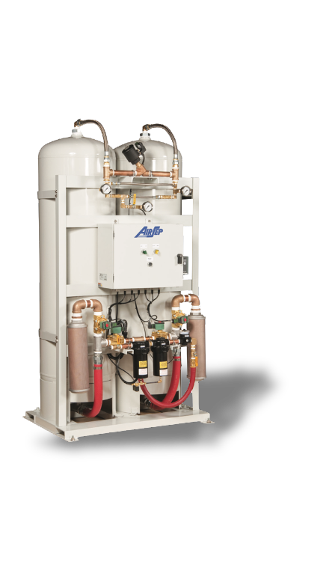
Oxygen Supply
Liquid Oxygen (LOX)
High Purity: Typically >99.5% oxygen
Consistent Supply: Delivered in bulk, stable and continuous ozone production
Low Maintenance: No on-site oxygen generation equipment needed
Applications in Ozone Systems:
Municipal and industrial projects
Ensures optimal performance for ozone generators with minimal operational intervention

Slide 27
Ozone Supply
VSA/PSA (Vacuum/Pressure Swing Adsorption)
On-site systems that extract oxygen from ambient air using molecular sieves
Produce oxygen at 93–95% purity, suitable for ozone generation
Why Use VSA/PSA?
On-Demand Production: No dependency on external oxygen deliveries
Cost-Effective: Lower long-term operational cost for small to mid-size systems
Compact & Modular: Easily integrated into plant layout
Air-to-water cooling
Water-to-water cooling
Heat exchanger

Slide 28
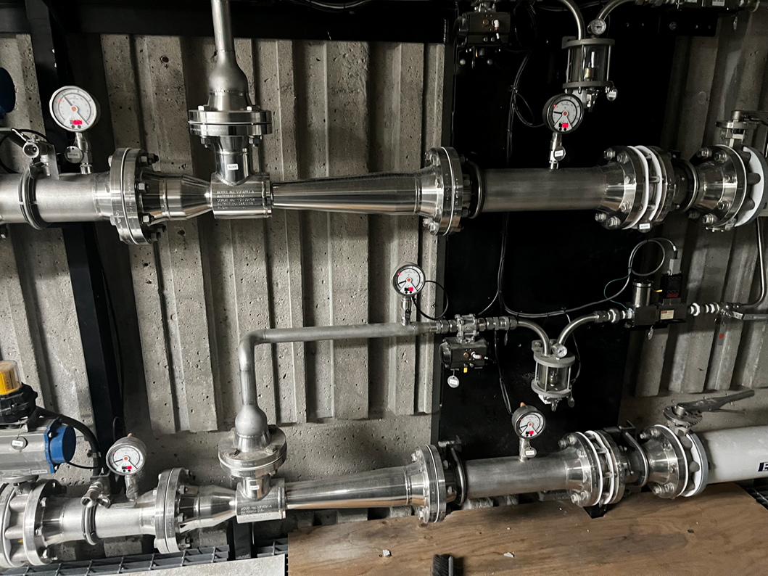
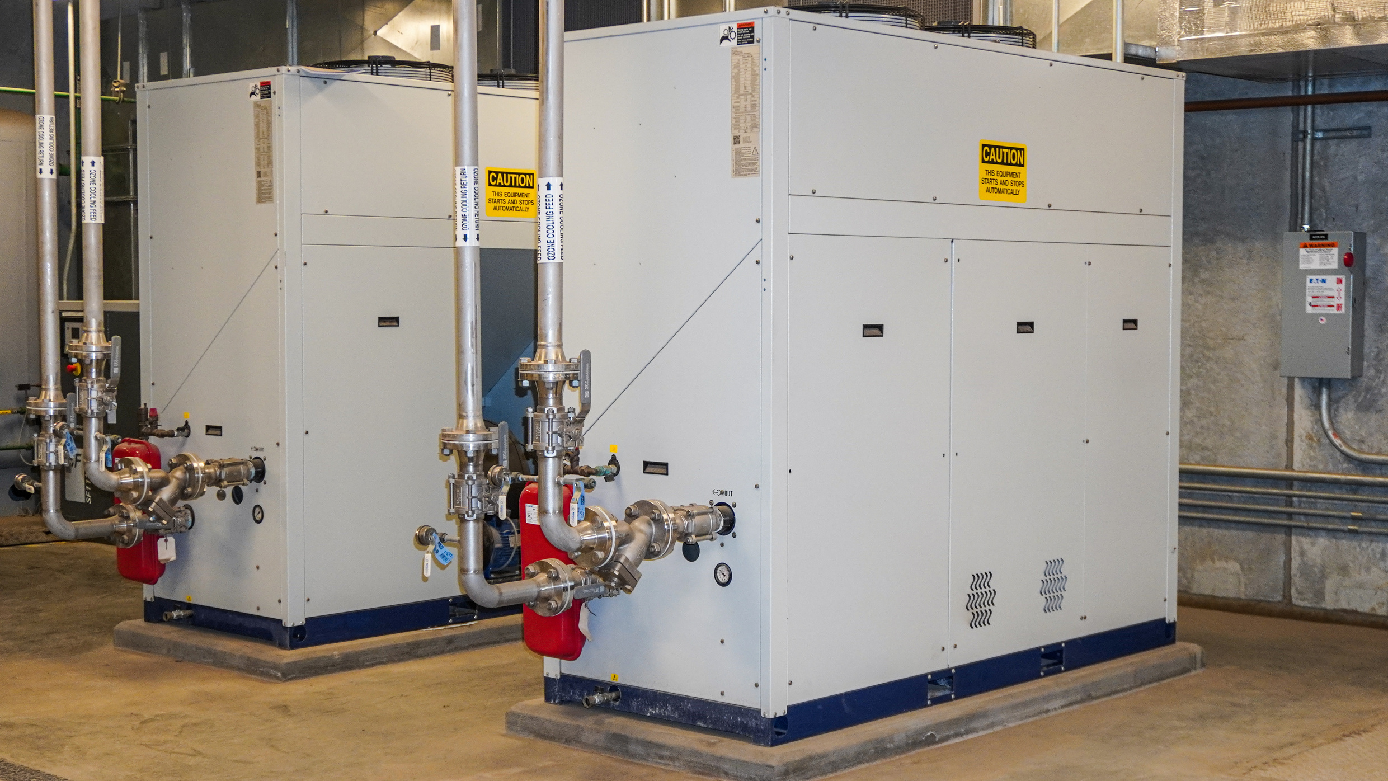
Ozone
Generator Cooling
Injection
DIFFERENT OPTIONS
Air-to-water cooling
Side Stream injection
Venturi mixing
Dissolution
  Jet Nozzles
  Pipe injection
Water-to-water cooling
Heat exchanger

Slide 29
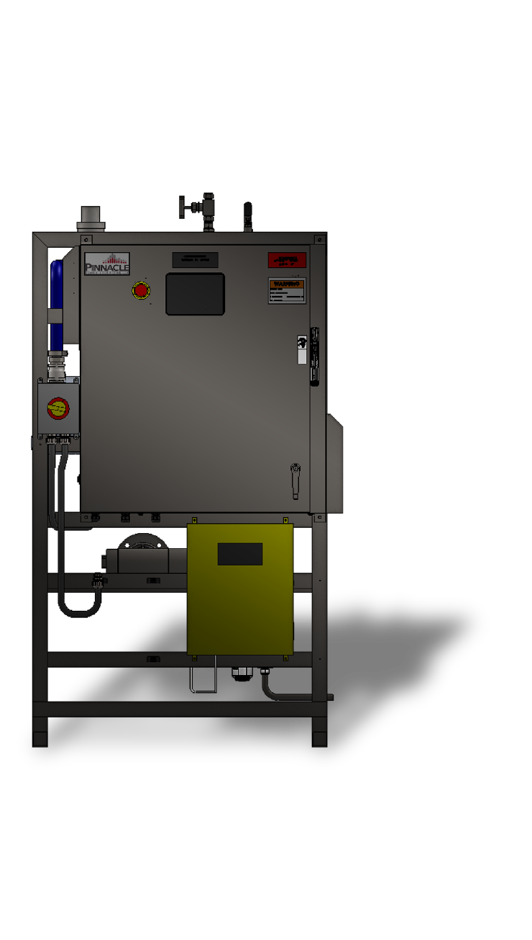
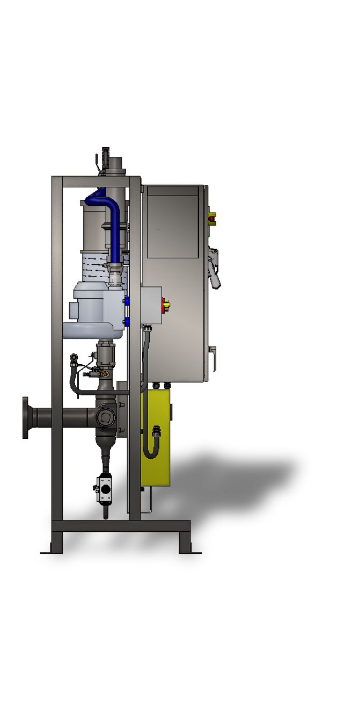
Injection
Side Stream injection
Venturi mixing
Dissolution
  Jet Nozzles
  Pipe injection

Slide 30



Ozone Off Gas Destruct Unit
Thank You for Attending
We look forward to the journey ahead, where we can turn our shared vision into reality.
Ozone destruct sizing
Gas production​
Level variation in the tank
Features
Safely removes residual ozone
Catalytic destruction
Compact stainless-steel design
Fits various system sizes
321-506-1850
www.pinnacleozone.com
Cocoa, Florida, USA

Slide 31

Thank You for Attending
We look forward to the journey ahead, where we can turn our shared vision into reality.
321-506-1850
www.pinnacleozone.com
Cocoa, Florida, USA

