Slide 1

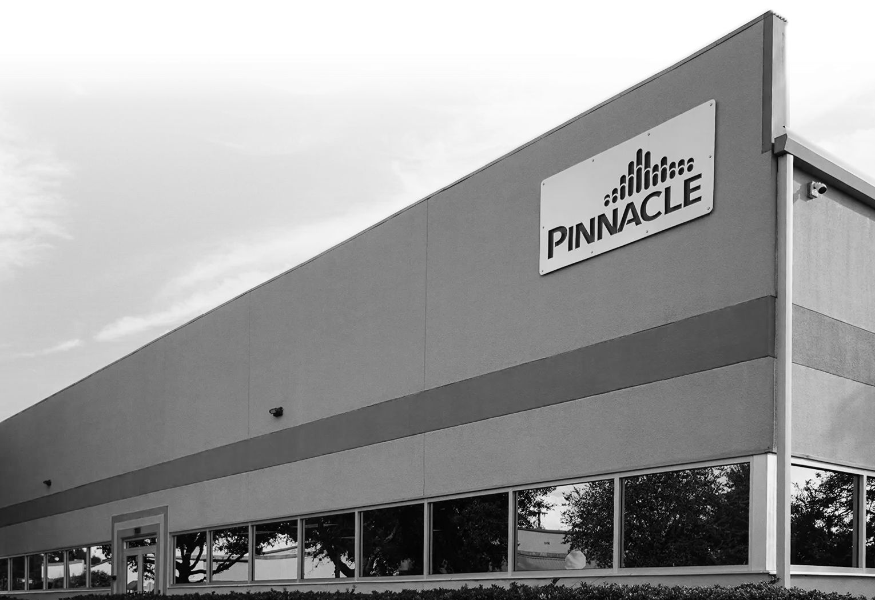


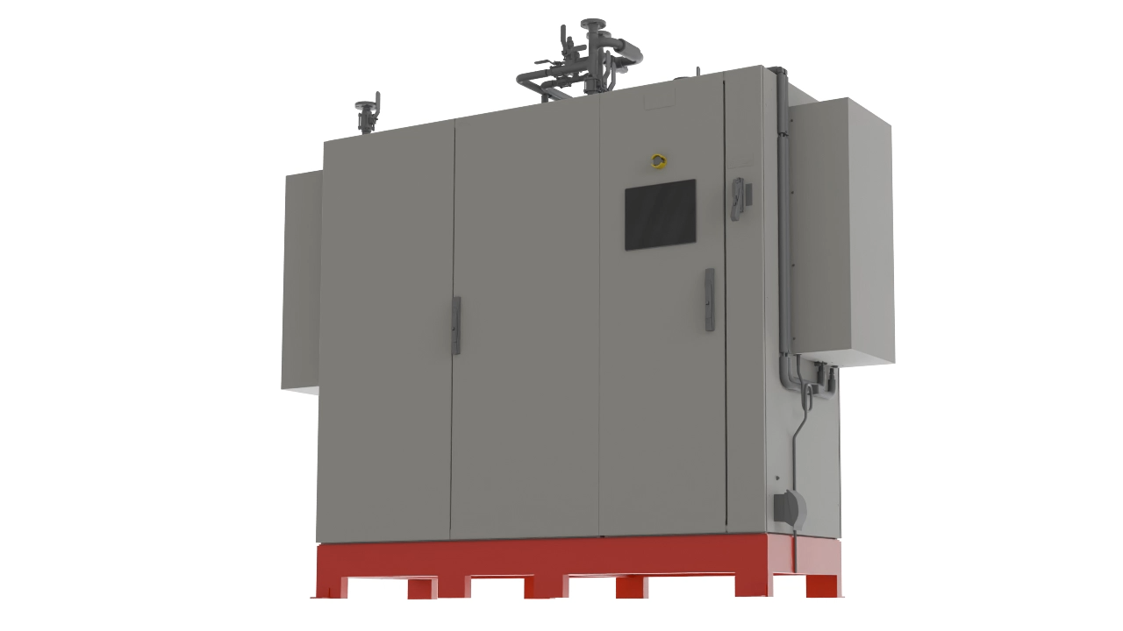
1
Pinnacle Academy
  Train, educate, and differentiate through professional video content.
PINNACLE OZONE SOLUTIONS
2
Marketing: The Pinnacle Toolkit
Resource Hub
  Access product sheets, case studies, and sales tools, all in one place.
3
Website Strategy
  Case studies, White Papers, and blogs that build credibility and support proposals.
4
Trade Shows & Visibility
  Show up, speak up, and follow up. Key events + industry content.
AGENDA
5
Social Media & Campaigns
Sannel Patel, MBA
DIRECTOR OF BUSINESS DEVELOPMENT & MARKETING
CHEMICAL ENGINEER
  Educate the market. Share. Tag. Build trust before the first call.

Slide 2


Pinnacle Academy
Training library built for engineers, operators, and sales reps.
1
Pinnacle Academy
PINNACLE OZONE SOLUTIONS
  Train, educate, and differentiate through professional video content.
Marketing: The Pinnacle Toolkit
2
Resource Hub
  Access product sheets, case studies, and sales tools, all in one place.
3
Website Strategy
  Case studies, White Papers, and blogs that build credibility and support proposals.
4
Trade Shows & Visibility
  Show up, speak up, and follow up. Key events + industry content.
AGENDA
Sannel Patel, MBA
DIRECTOR OF BUSINESS DEVELOPMENT & MARKETING
CHEMICAL ENGINEER
5
Social Media & Campaigns
  Educate the market. Share. Tag. Build trust before the first call.
FEATURES
Video-based technical training — not marketing content
Modules on ozone generation, AOP, system design, and maintenance
Created by engineers with real-world field experience
HOW YOU CAN USE IT
Share with prospects after demos or technical conversations
Use it for self-training or onboarding new team members
Reinforce Pinnacle’s role as the trusted educator, not just a vendor

Slide 3

Pinnacle Academy
A centralized library for all Sales/Marketing tools & content
FEATURES
HOW YOU CAN USE IT
Video-based technical training — not marketing content
Modules on ozone generation, AOP, system design, and maintenance
Created by engineers with real-world field experience
Share with prospects after demos or technical conversations
Use it for self-training or onboarding new team members
Reinforce Pinnacle’s role as the trusted educator, not just a vendor

Slide 4

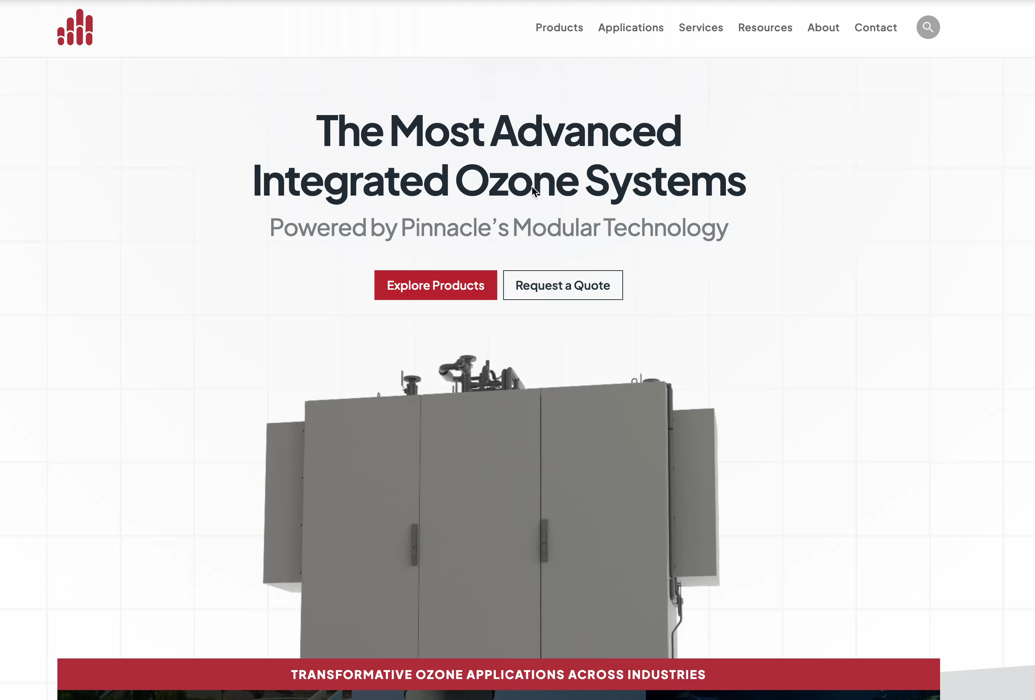

Resource Hub
WHAT YOU’LL FIND
Product spec sheets and technical brochures
Sales decks and approved presentations
Case studies and graphics
Brand logos and trade show materials
Training library built for engineers, operators, and sales reps.
HOW YOU CAN USE IT
Download the latest version of any file before a meeting
Drop case studies into follow-up emails
Build smarter proposals using up-to-date materials
Prep for tradeshows or demos with exactly what you need
WEBSITE
pinnacleozone.com/resource_hub
PASSWORD
pinnacle_vip

Slide 5
Resource Hub
WHAT YOU’LL FIND
Product spec sheets and technical brochures
Sales decks and approved presentations
Case studies and graphics
Brand logos and trade show materials
Training library built for engineers, operators, and sales reps.
HOW YOU CAN USE IT
Download the latest version of any file before a meeting
Drop case studies into follow-up emails
Build smarter proposals using up-to-date materials
Prep for tradeshows or demos with exactly what you need
WEBSITE
pinnacleozone.com/resource_hub
PASSWORD
pinnacle_vip

Slide 6

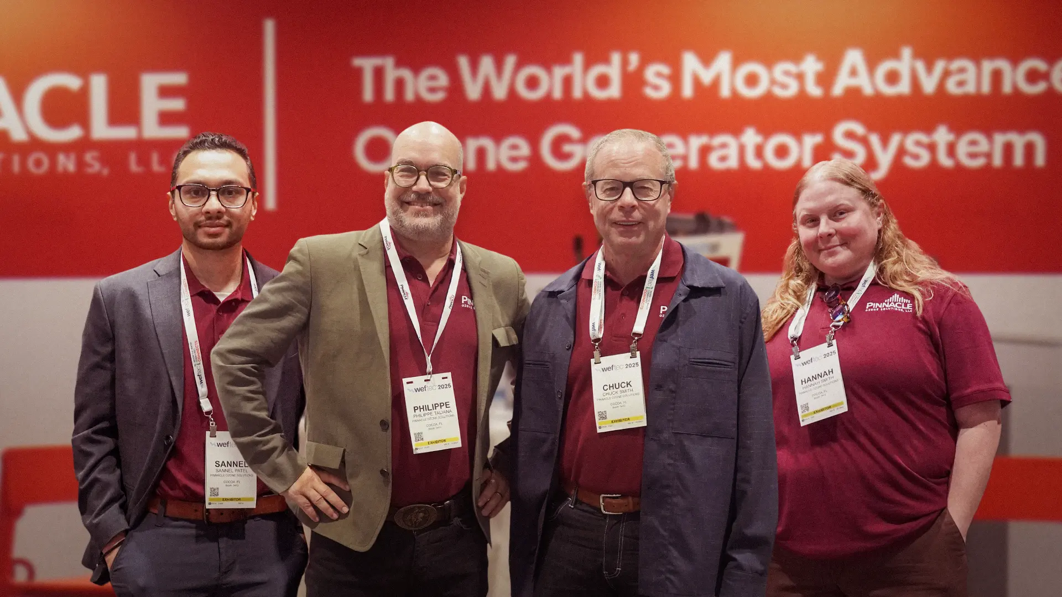
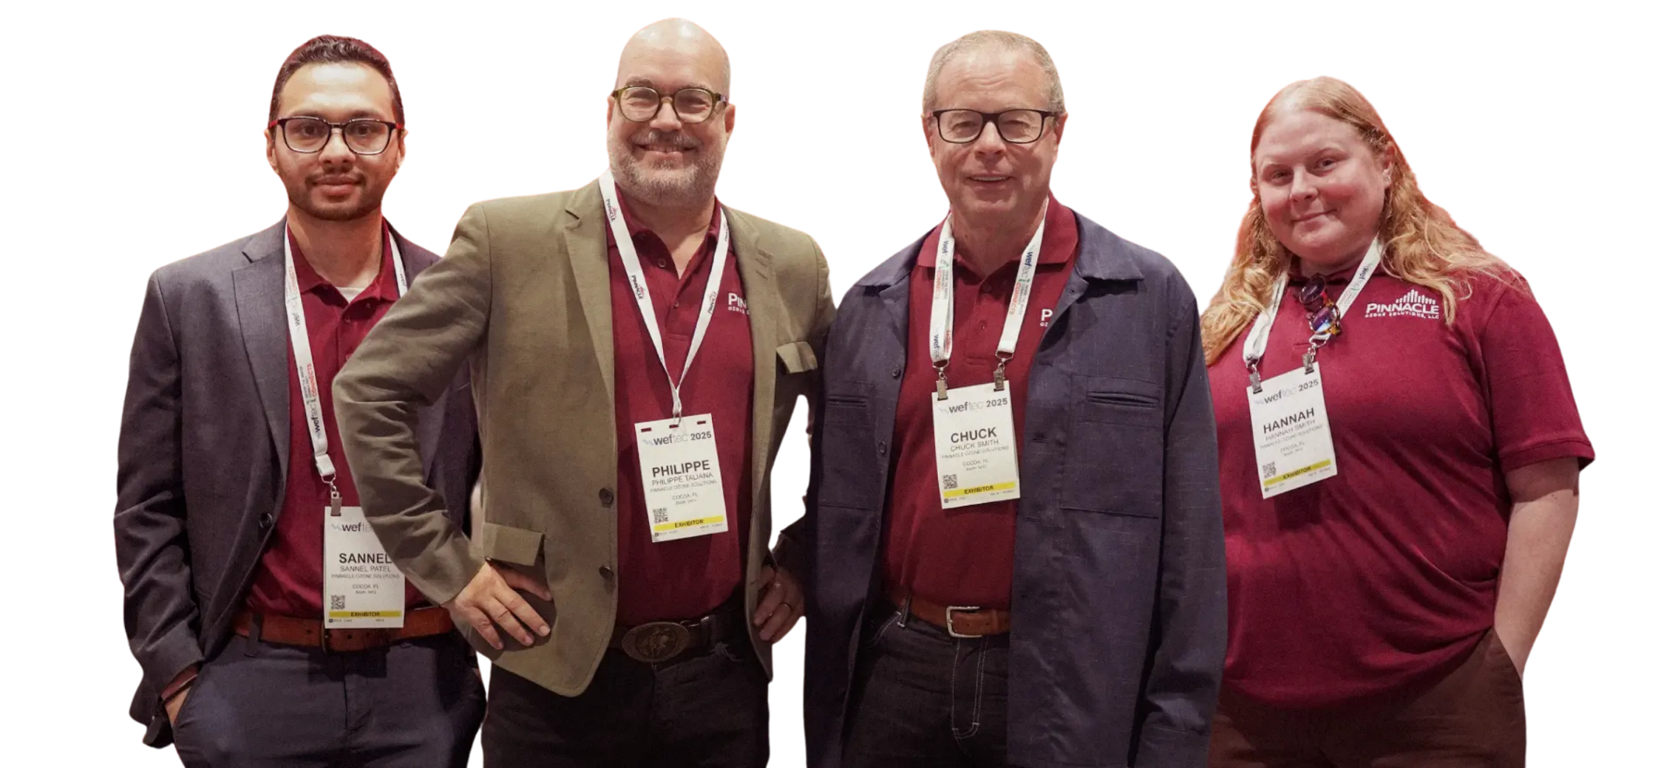
Trade Shows & Industry Visibility
Website Strategy
We support you before, during, and after every event. Your visibility = Our visibility.
The website isn’t just for customers; it’s a toolkit for you.
FEATURES
WEFTEC, AWWA, regional water events
Speaking sessions, panels, and roundtables
Published features in Water Online & Magazines
BLOGS
CASE STUDIES
Educational content that positions us as ozone experts
Real-world results that prove performance and reliability.
HOW WE HELP YOU GET SEEN
WHITE PAPERS
VIDEOS
Rep banners and shareable graphics
Pre-show & post-show content you
News & Press page on website
Deep technical resources to support engineers and specs.
Visual examples that make complex ozone systems easy to understandable.

Slide 7
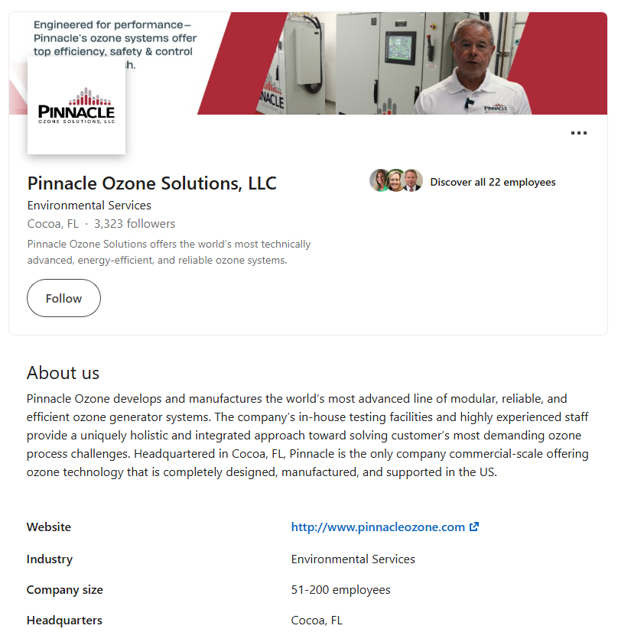
Social Media
Your visibility = Our visibility.
Trade Shows & Industry Visibility
We support you before, during, and after every event. Your visibility = Our visibility.
FEATURES
WEFTEC, AWWA, regional water events
Speaking sessions, panels, and roundtables
Published features in Water Online & Magazines
WHAT YOU CAN DO
Follow us on LinkedIn (@Pinnacle Ozone)
Post on LinkedIn — use your event photo
Tag us (@Pinnacle Ozone) so we can amplify your reach
Invite prospects to stop by and mention you
HOW WE HELP YOU GET SEEN
Rep banners and shareable graphics
Pre-show & post-show content you
News & Press page on website

Slide 8
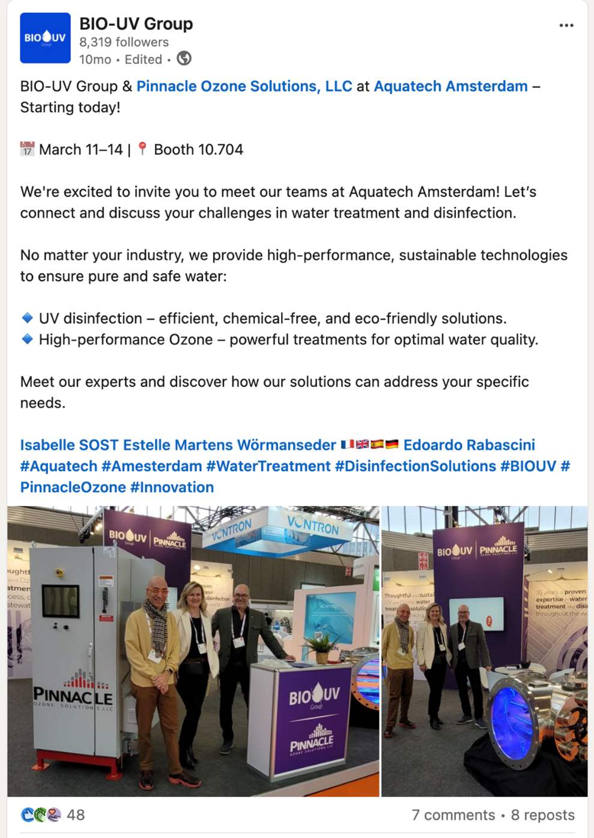
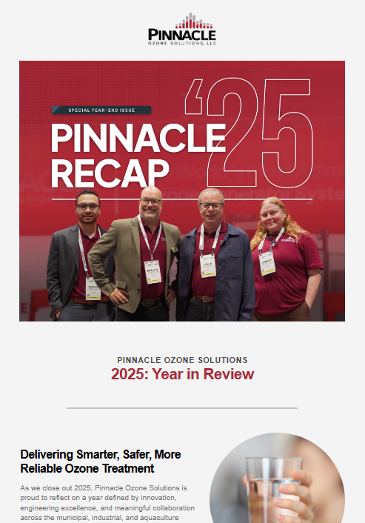
Social Media
Your visibility = Our visibility.
WHAT WE'RE DOING
Targeted ads and outreach around tradeshows, industries, and regions
Driving traffic to case studies, videos, and Academy content
WHAT YOU CAN DO
Follow us on LinkedIn (@Pinnacle Ozone)
Post on LinkedIn — use your event photo
Tag us (@Pinnacle Ozone) so we can amplify your reach
Invite prospects to stop by and mention you
WHY IT MATTERS
Warms up leads before you call
Supports your outreach with real visibility

Slide 9
Campaigns
What’s coming this year?
Increasing visibility.
1
2
WHAT WE'RE DOING
Website & brochures in multiple languages
New Pinnacle Academy videos featuring Reps
Targeted ads and outreach around tradeshows, industries, and regions
Driving traffic to case studies, videos, and Academy content
3
4
Ozone Application Guide
Service dashboard videos
WHY IT MATTERS
Warms up leads before you call
Supports your outreach with real visibility
5
6
Engineers & Reps speaking at major tradeshows
Better Resource Hub navigation

Slide 10



What’s coming this year?
Thank You for Attending
1
2
Website & brochures in multiple languages
New Pinnacle Academy videos featuring Reps
We look forward to the journey ahead, where we can turn our shared vision into reality.
3
4
321-506-1850
Ozone Application Guide
Service dashboard videos
www.pinnacleozone.com
Cocoa, Florida, USA
5
6
Engineers & Reps speaking at major tradeshows
Better Resource Hub navigation

Slide 11

Thank You for Attending
We look forward to the journey ahead, where we can turn our shared vision into reality.
321-506-1850
www.pinnacleozone.com
Cocoa, Florida, USA

