Slide 1

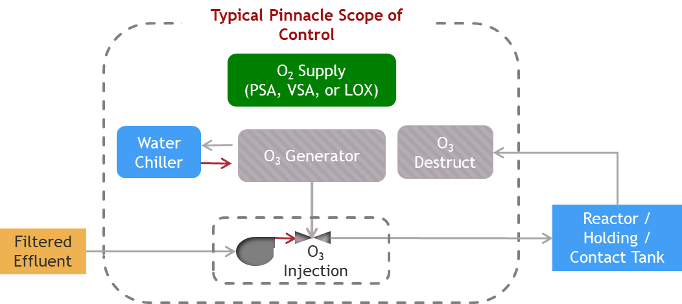

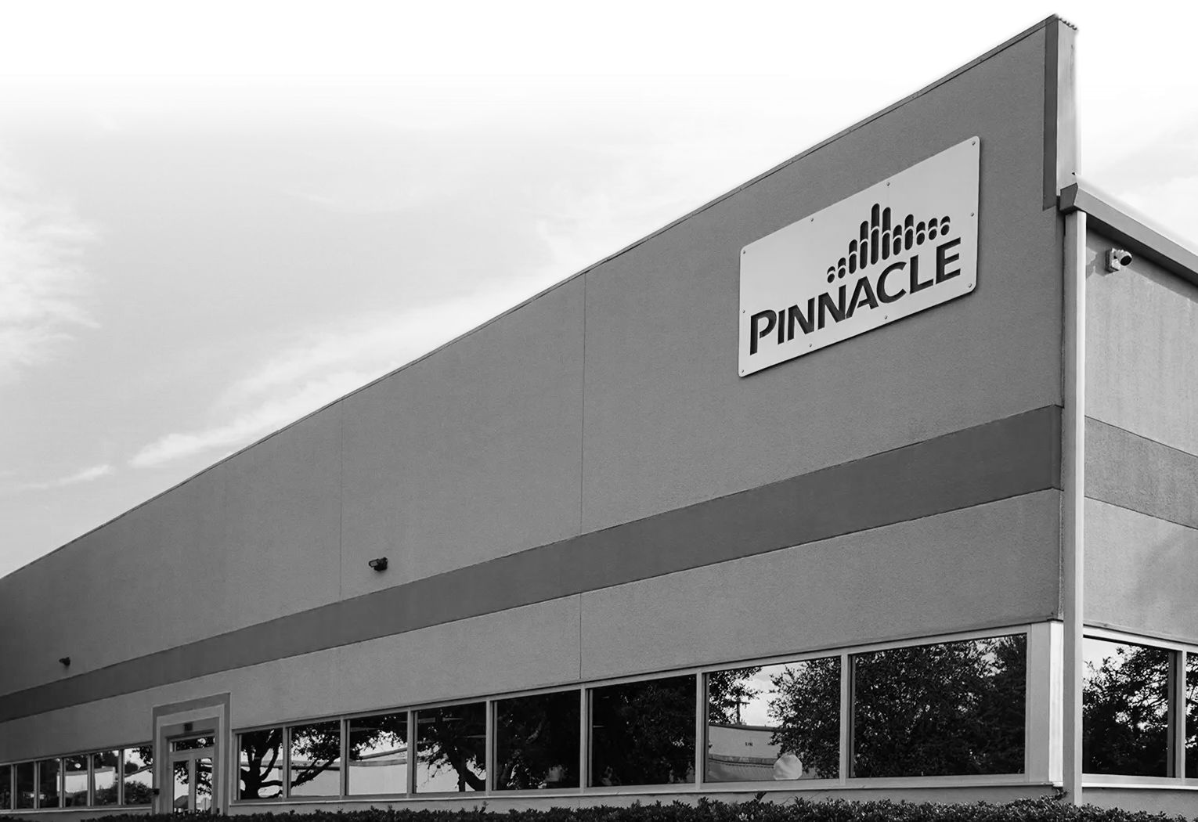


Typical Ozone System Process Diagram
PINNACLE OZONE SOLUTIONS
The World’s Most Advanced
Ozone Technology
Philippe Taliana
GLOBAL SALES MANAGER
OXYGEN SUPPLY
Liquid Oxygen (LOX) or
Onsite generation (PSA / VSA) or delivered oxygen for feed to ozone generator
Min Quality: >93% O₂ @ Dewpoint = -65°F
O₃ GENERATOR
Converts O₂ to ~10% O₃ (typ) using electrified plasma field
Pinnacle generators offer constant %BW output at any turn-down
Market Leading Energy Efficiency (3.5 kWh/lb)
WATER CHILLER
Closed-loop cooling for ozone generator
Glycol based fluid preserves unit efficiency
O₃ INJECTION
Dissolves O₃ Gas Into Solution for Reaction
Custom Design (based on dose, flow, etc)
Typical Transfer Efficiency >93%
O₃ DESTRUCT
Captures un-dissolved O₃ gas to prevent exposure
Autocatalytic Reaction w/ Monitoring
Assures no release / exposure to O₃

Slide 2
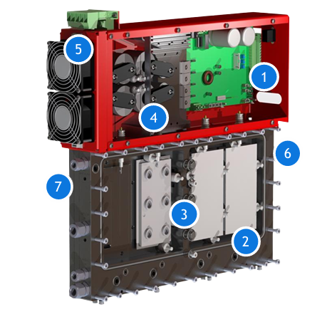

Modular Generator Cells
Developed as the world’s most energy efficient ozone technology​
Completely Integrated / Standalone Ozone Generator Cells​
Ruggedized Service-Free Cell Design​
Advanced Materials, Power Supply & Controls Technology
Integrated Controls — individual optimization & monitoring of each ozone cell​
Ruggedized Construction — immune to vibration & shock​
Advanced Materials — Ceramic Dielectrics and Maintenance-Free Operation
​Built-In Hi-Frequency PSU — virtually silent 23 kHz operation
​Dual Air / Water Cooling — reduces cooling by 40-60%
​Constant %BW Output — 0-100% turn-down via variable gas-flow operation
​Industry Leading Efficiency — 3.5 kWh/lb operation
PINNACLE OZONE SOLUTIONS
Typical Ozone System Process Diagram
The World’s Most Advanced
Ozone Technology
OXYGEN SUPPLY
Liquid Oxygen (LOX) or
Onsite generation (PSA / VSA) or delivered oxygen for feed to ozone generator
Min Quality: >93% O₂ @ Dewpoint = -65°F
O₃ GENERATOR
Converts O₂ to ~10% O₃ (typ) using electrified plasma field
Pinnacle generators offer constant %BW output at any turn-down
Market Leading Energy Efficiency (3.5 kWh/lb)
WATER CHILLER
Closed-loop cooling for ozone generator
Glycol based fluid preserves unit efficiency
O₃ INJECTION
Dissolves O₃ Gas Into Solution for Reaction
Custom Design (based on dose, flow, etc)
Typical Transfer Efficiency >93%
O₃ DESTRUCT
Captures un-dissolved O₃ gas to prevent exposure
Autocatalytic Reaction w/ Monitoring
Assures no release / exposure to O₃
Philippe Taliana
GLOBAL SALES MANAGER

Slide 3
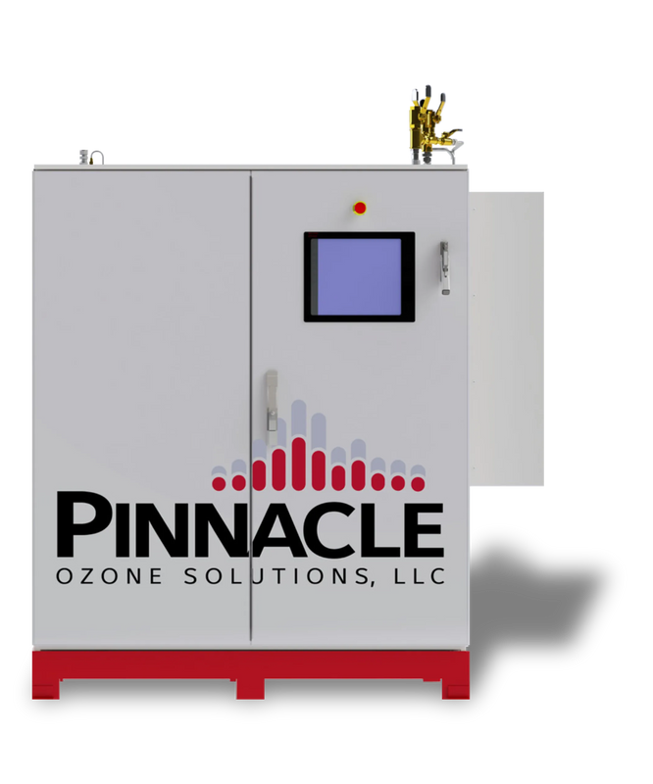
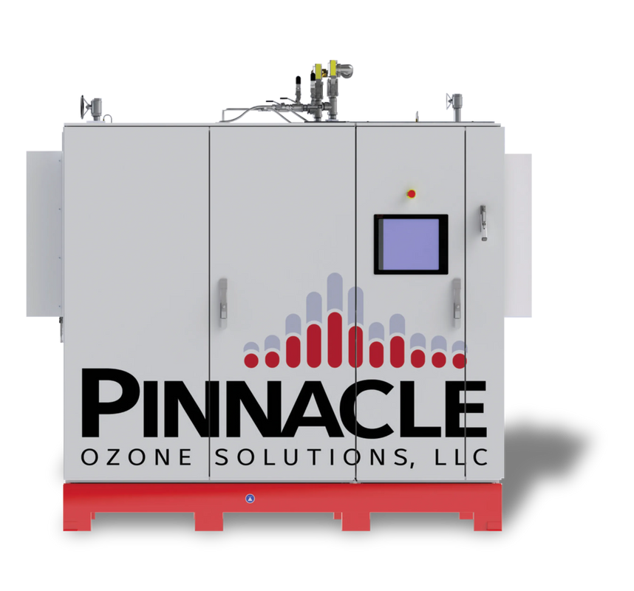
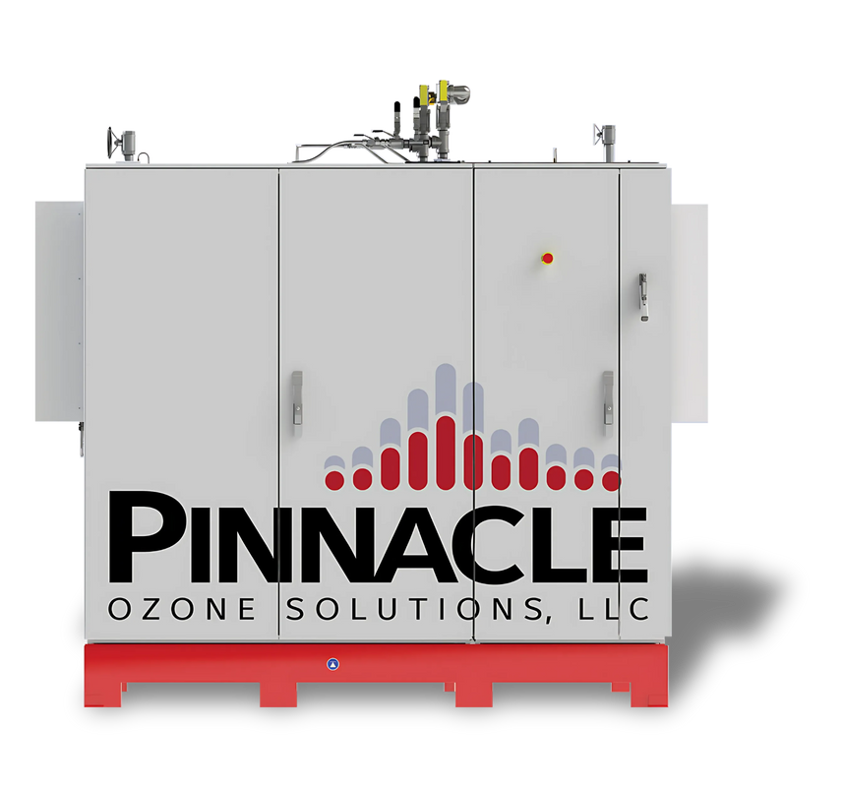
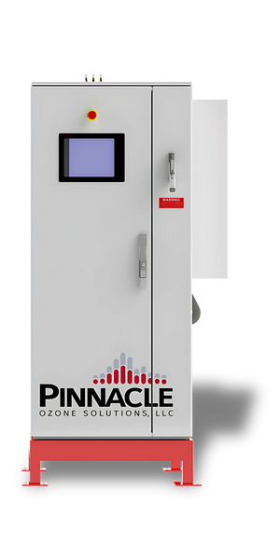

PINNACLE OZONE SOLUTIONS
A Family of Ozone Generator Platforms
Modular Generator Cells
Developed as the world’s most energy efficient ozone technology​
Completely Integrated / Standalone Ozone Generator Cells​
Ruggedized Service-Free Cell Design​
Advanced Materials, Power Supply & Controls Technology
Integrated Controls — individual optimization & monitoring of each ozone cell​
Ruggedized Construction — immune to vibration & shock​
Advanced Materials — Ceramic Dielectrics and Maintenance-Free Operation
​Built-In Hi-Frequency PSU — virtually silent 23 kHz operation
​Dual Air / Water Cooling — reduces cooling by 40-60%
​Constant %BW Output — 0-100% turn-down via variable gas-flow operation
​Industry Leading Efficiency — 3.5 kWh/lb operation
THE PEAK
THE SUMMIT
THE ZENITH
THE APEX
5X
10X
12X
20X
30X
36X

Slide 4
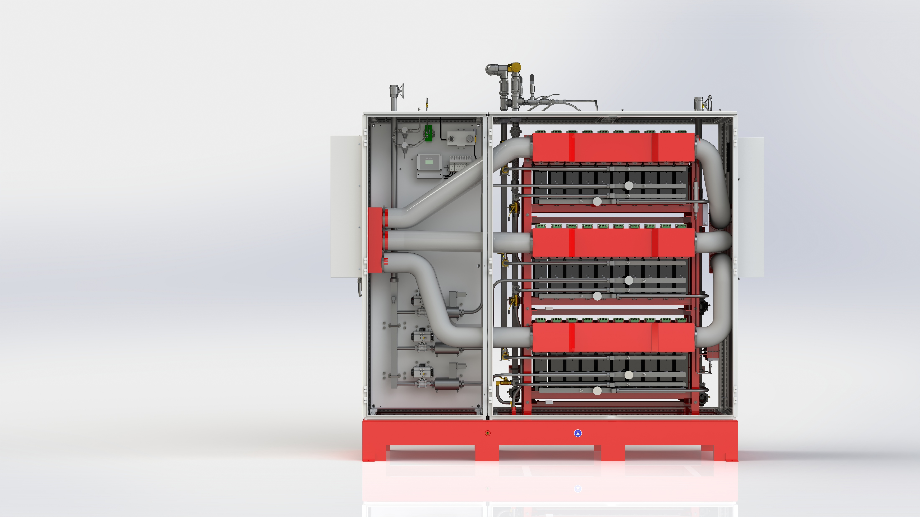

PINNACLE OZONE SOLUTIONS
A Family of Ozone Generator Platforms
1
Common QuadBlock / 10X -12X rack design common to ALL platforms ​
2
Only dimensions & connection
sizes change
3
Modular enclosure and pedestal allows flexible design
THE PEAK
THE SUMMIT
THE ZENITH
THE APEX
5X
10X
12X
20X
30X
36X

Slide 5
Scalability
1
Common QuadBlock / 10X -12X rack design common to ALL platforms ​
2
Only dimensions & connection
sizes change
3
Modular enclosure and pedestal allows flexible design
MODULAR
  Family of Modular Ozone Process Platforms​
  Flexibly Adapts Capacity to Meet Project Needs​
  Fully Integrated O3 Process Controls & Instrumentation​
  Built-In Multi-Mode Process Control​
  Self-Optimizing Process
RELIABLE
  Constant 6-18 %BW at Any Output​
  True 0-100% Turn-Down ​
  Industry Leading Power Efficiency​
  Less Cooling​
  Smaller Footprint​
  Ultra-Quiet Operation​
  Built-In Cooling / Heating (no HVAC required)​
  Appliance Like Installation (5 connections)​
  10-40% Lower OPEX and 20yr NPV
RELIABLE
  Zero-Maintenance Ozone Cells​
  +25yr QuadBlock Ozone Cell Life​
  Built-In Redundancy​
  Auto-Compensating Performance​
  100% US Made & Supported
24-7 REMOTE & ONLINE SUPPORT
  Onsite Service
THE PEAK
THE SUMMIT
THE ZENITH
THE APEX
5X
10X
12X
20X
30X
36X

Slide 6
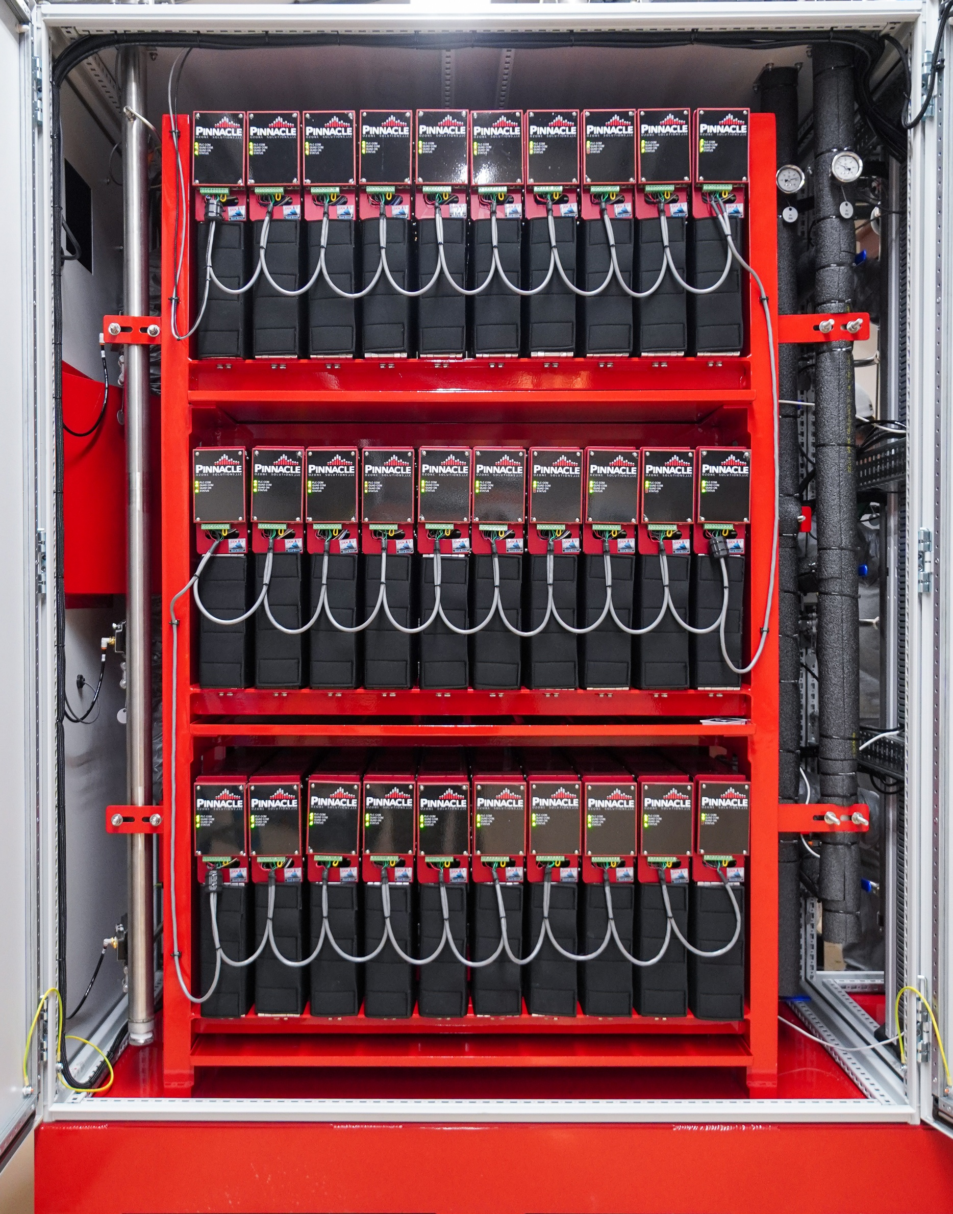
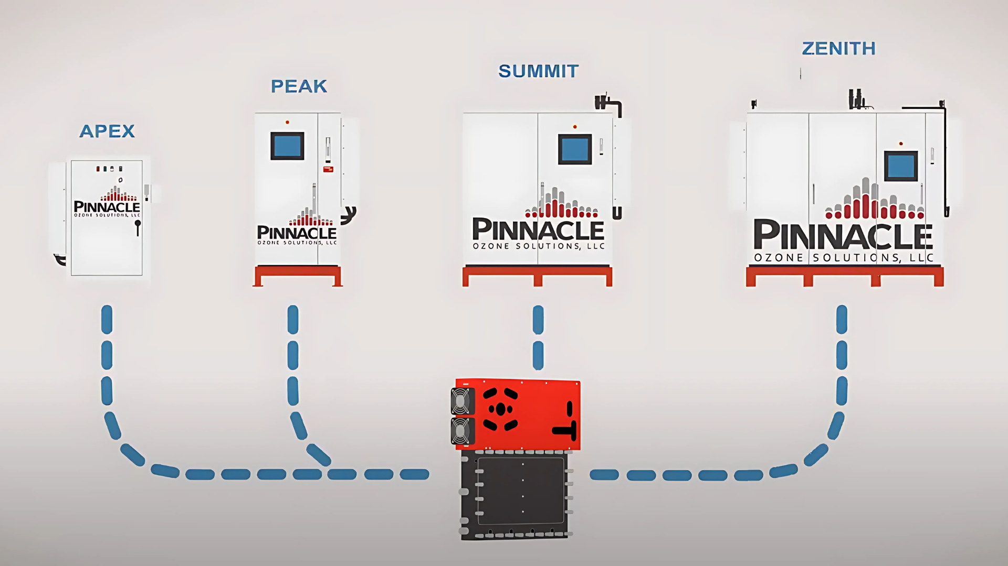


The World Most Advanced Ozone Technology
MODULAR
RELIABLE
SYSTEM PREVIEW
QuadBlocks in a system
  Family of Modular Ozone Process Platforms​
  Flexibly Adapts Capacity to Meet Project Needs​
  Fully Integrated O3 Process Controls & Instrumentation​
  Built-In Multi-Mode Process Control​
  Self-Optimizing Process
  Constant 6-18 %BW at Any Output​
  True 0-100% Turn-Down ​
  Industry Leading Power Efficiency​
  Less Cooling​
  Smaller Footprint​
  Ultra-Quiet Operation​
  Built-In Cooling / Heating (no HVAC required)​
  Appliance Like Installation (5 connections)​
  10-40% Lower OPEX and 20yr NPV
RELIABLE
  Zero-Maintenance Ozone Cells​
  +25yr QuadBlock Ozone Cell Life​
  Built-In Redundancy​
  Auto-Compensating Performance​
  100% US Made & Supported
24-7 REMOTE & ONLINE SUPPORT
  Onsite Service

Slide 7
SYSTEM PREVIEW
QuadBlocks in a system

Slide 8

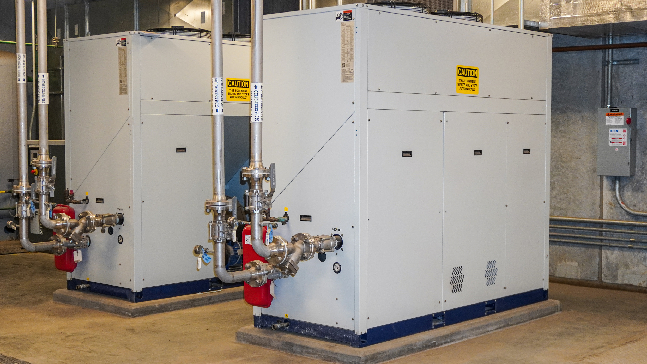
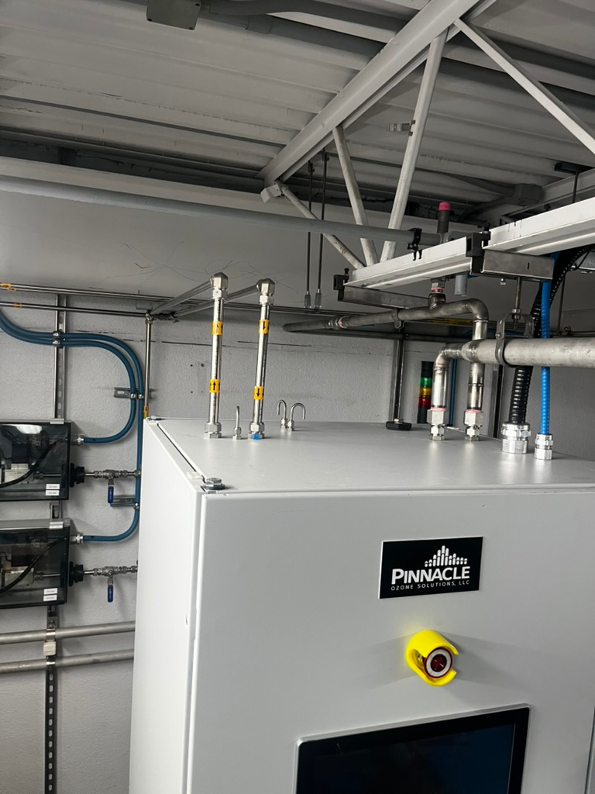
Easy to install
Enclosed cabinets
All equipment is on skids
Six (6) connections
Air-to-water cooling
    Gas in & out
    Water in & out
    Power compressed air
Water-to-water cooling
Heat exchanger

Slide 9
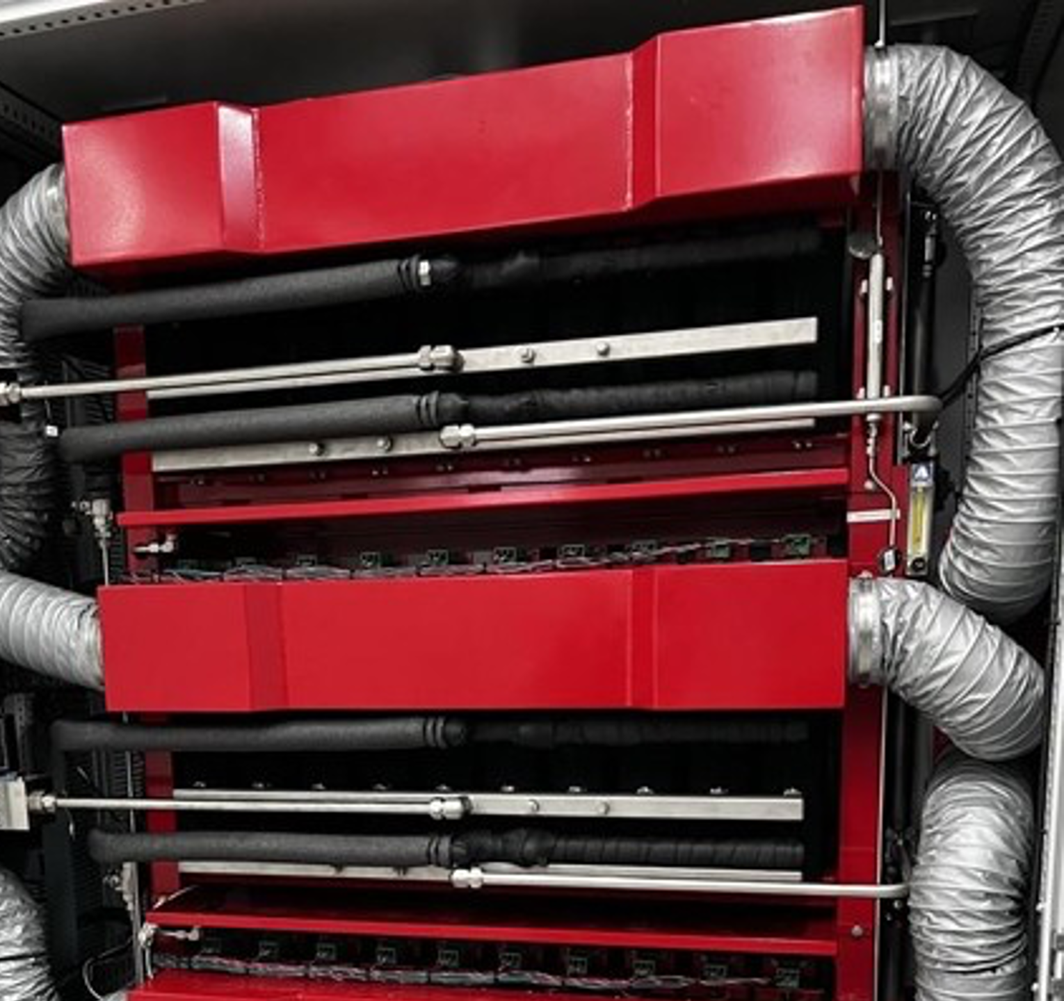
Ozone
Cooling
Ozone
Generator Cooling
DIFFERENT OPTIONS
Air-to-water cooling
Water-to-water cooling
Heat exchanger
Air cooling for the electronics
Water cooling for the Dielectrics

Slide 10
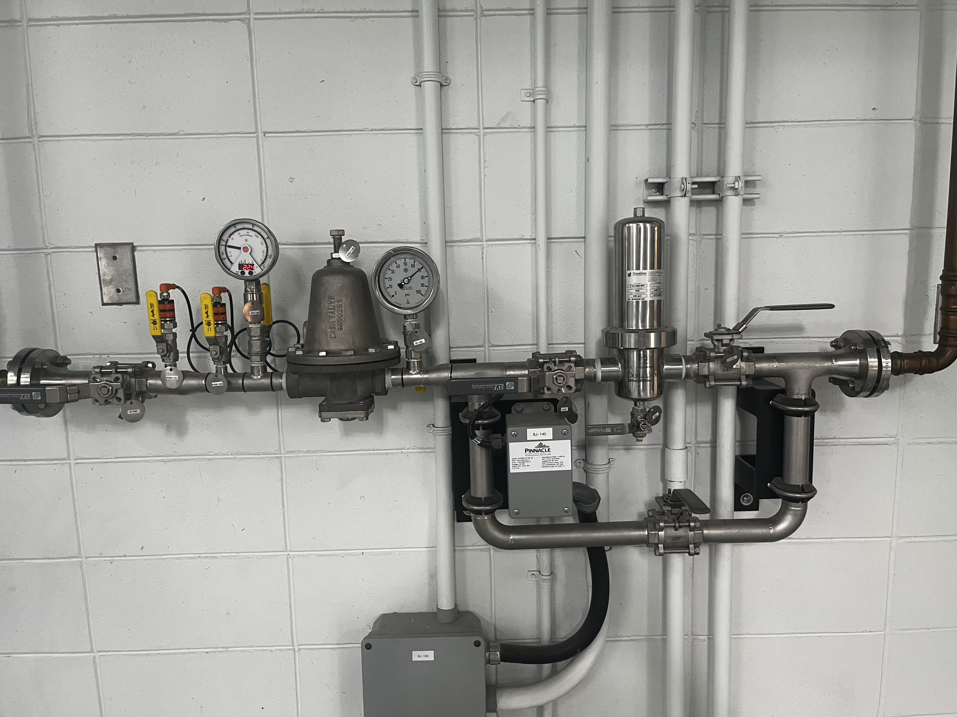
Ozone
Cooling
Oxygen Treatment
Manifold
  Donaldson filter
  Demister
  Pressure
Air cooling for the electronics
Water cooling for the Dielectrics

Slide 11
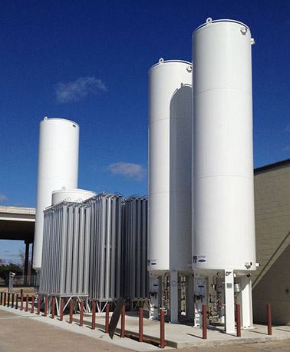
Oxygen Supply
Liquid Oxygen (LOX)
High Purity: Typically >99.5% oxygen
Consistent Supply: Delivered in bulk, stable and continuous ozone production
Low Maintenance: No on-site oxygen generation equipment needed
Applications in Ozone Systems:
Municipal and industrial projects
Ensures optimal performance for ozone generators with minimal operational intervention
Oxygen Treatment
Manifold
  Donaldson filter
  Demister
  Pressure
Air cooling for the electronics
Water cooling for the Dielectrics

Slide 12
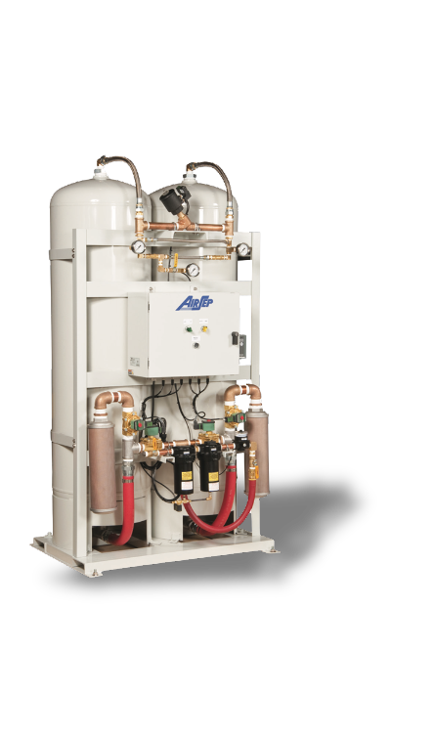
Oxygen Supply
Liquid Oxygen (LOX)
High Purity: Typically >99.5% oxygen
Consistent Supply: Delivered in bulk, stable and continuous ozone production
Low Maintenance: No on-site oxygen generation equipment needed
Applications in Ozone Systems:
Municipal and industrial projects
Ensures optimal performance for ozone generators with minimal operational intervention
Ozone Supply
VSA/PSA (Vacuum/Pressure Swing Adsorption)
On-site systems that extract oxygen from ambient air using molecular sieves
Produce oxygen at 93–95% purity, suitable for ozone generation
Why Use VSA/PSA?
On-Demand Production: No dependency on external oxygen deliveries
Cost-Effective: Lower long-term operational cost for small to mid-size systems
Compact & Modular: Easily integrated into plant layout

Slide 13
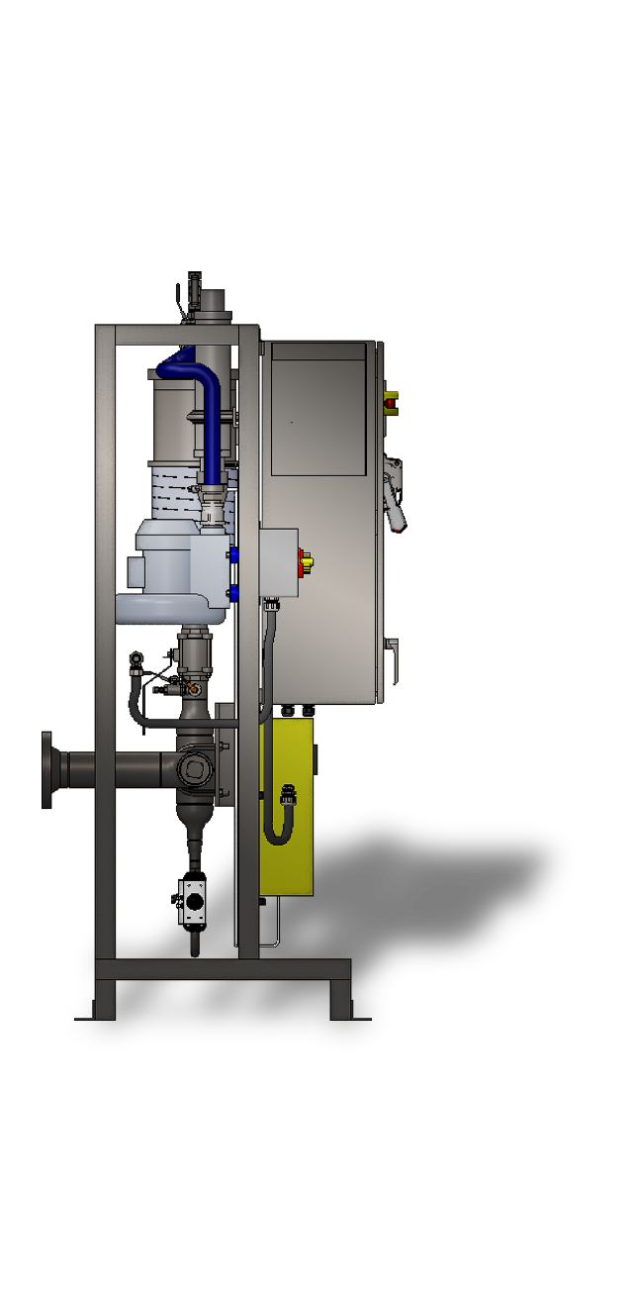
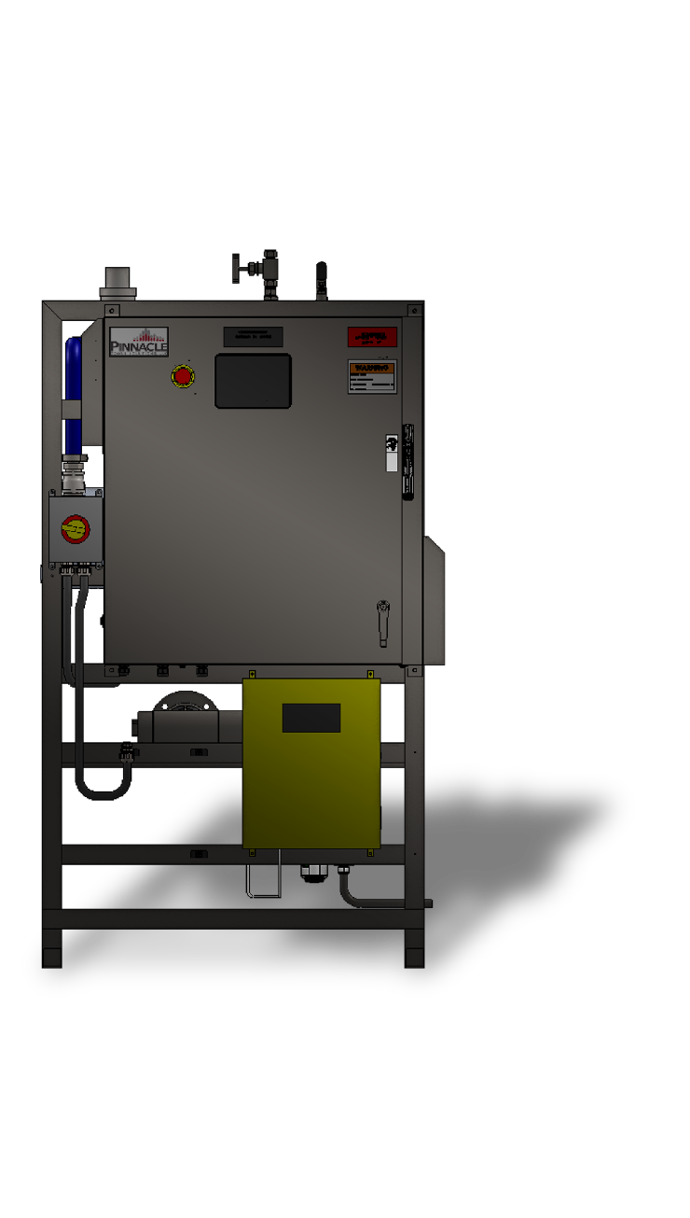
Ozone Supply
Ozone Off Gas Destruct Unit
VSA/PSA (Vacuum/Pressure Swing Adsorption)
On-site systems that extract oxygen from ambient air using molecular sieves
Produce oxygen at 93–95% purity, suitable for ozone generation
Why Use VSA/PSA?
On-Demand Production: No dependency on external oxygen deliveries
Cost-Effective: Lower long-term operational cost for small to mid-size systems
Compact & Modular: Easily integrated into plant layout
Air-to-water cooling
Water-to-water cooling
Heat exchanger

Slide 14



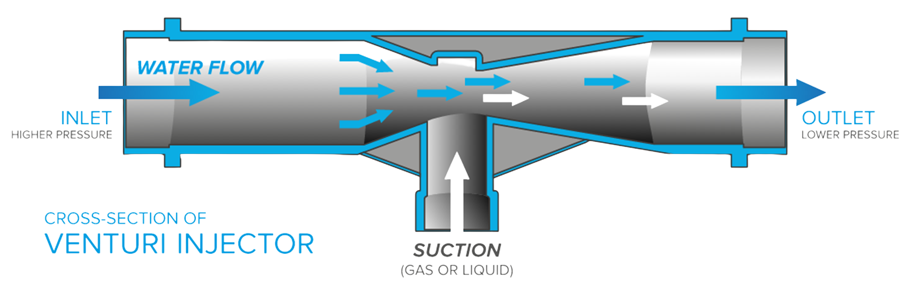
Injection: Venturi
  Uses pressure differential to pull in gas or liquid (e.g., ozone)
  High-velocity flow creates suction at the injector throat
  Efficient, reliable mixing with no moving parts
Ozone Off Gas Destruct Unit
Thank You for Attending
We look forward to the journey ahead, where we can turn our shared vision into reality.
Ozone destruct sizing
Gas production​
Level variation in the tank
Features
Safely removes residual ozone
Catalytic destruction
Compact stainless-steel design
Fits various system sizes
321-506-1850
www.pinnacleozone.com
Cocoa, Florida, USA

Slide 15
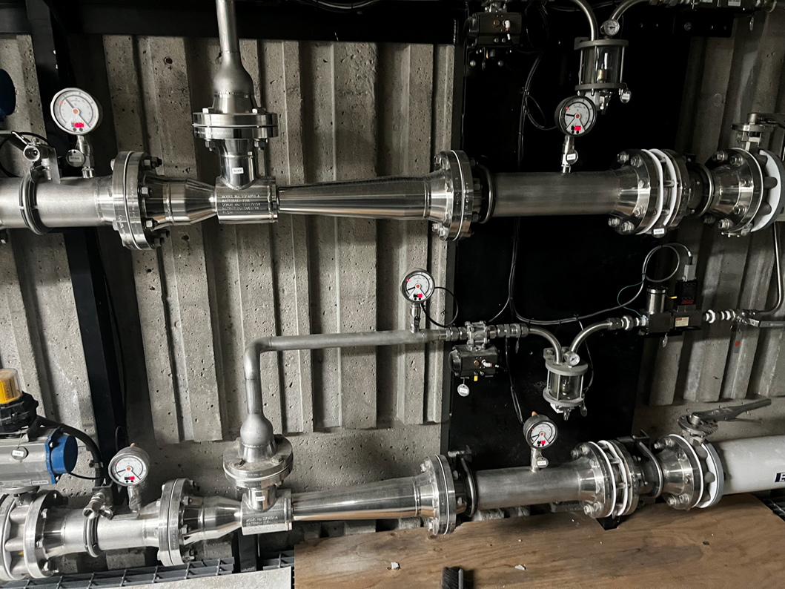
Injection: Venturi
  Uses pressure differential to pull in gas or liquid (e.g., ozone)
  High-velocity flow creates suction at the injector throat
  Efficient, reliable mixing with no moving parts
Injection
  Side Stream injection
  Venturi mixing
  Dissolution
    Jet nozzle
    Pipe injection
    Ceramic diffusers

Slide 16
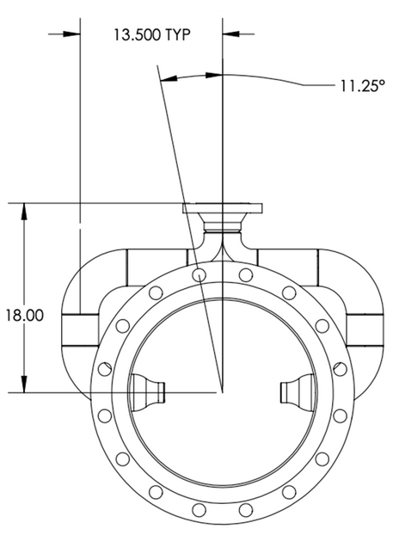
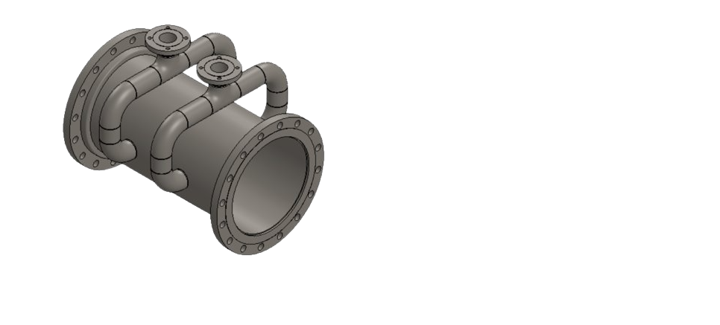
OZONE MIXING
Mazzei
Injection
  Side Stream injection
  Venturi mixing
  Dissolution
    Jet nozzle
    Pipe injection
    Ceramic diffusers
  Evenly distributes ozone into water for maximum contact and efficiency
  Engineered internal design promotes thorough mixing and gas transfer
  Ideal for high-flow applications requiring reliable disinfection or oxidation

Slide 17
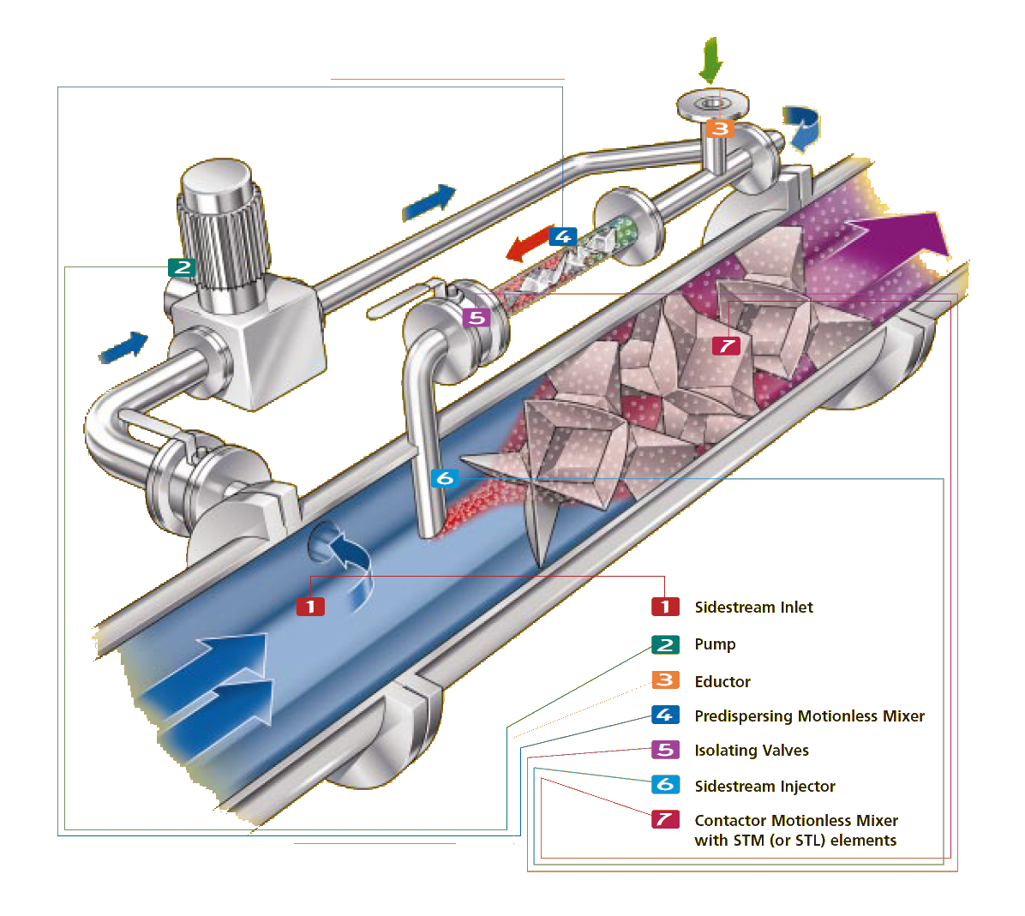
OZONE MIXING
Mazzei
OZONE MIXING
Statiflo
Injection
  Evenly distributes ozone into water for maximum contact and efficiency
  Engineered internal design promotes thorough mixing and gas transfer
  Ideal for high-flow applications requiring reliable disinfection or oxidation
  Side Stream injection
  Venturi mixing
  Dissolution
    Jet nozzle
    Pipe injection
    Ceramic diffusers
Evenly distributes ozone into water for maximum contact and efficiency
Engineered internal design promotes thorough mixing and gas transfer
Ideal for high-flow applications requiring reliable disinfection or oxidation

Slide 18
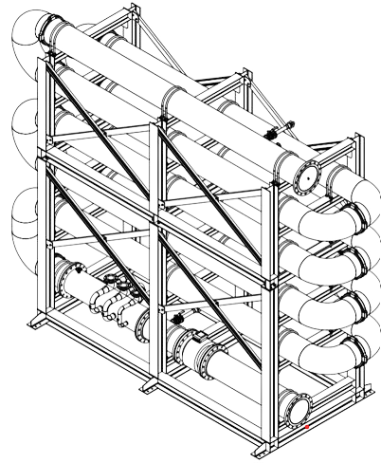
OZONE MIXING
Mazzei
  Evenly distributes ozone into water for maximum contact and efficiency
  Engineered internal design promotes thorough mixing and gas transfer
  Ideal for high-flow applications requiring reliable disinfection or oxidation
TECHNOLOGY OVERVIEW
Pipe Loop Reactor
OZONE MIXING
Statiflo
Maximizes ozone contact time and transfer efficiency in a compact footprint
Engineered for high-flow, high-concentration disinfection processes
Corrosion-resistant materials and rugged frame for long service life
Evenly distributes ozone into water for maximum contact and efficiency
Engineered internal design promotes thorough mixing and gas transfer
Ideal for high-flow applications requiring reliable disinfection or oxidation

Slide 19
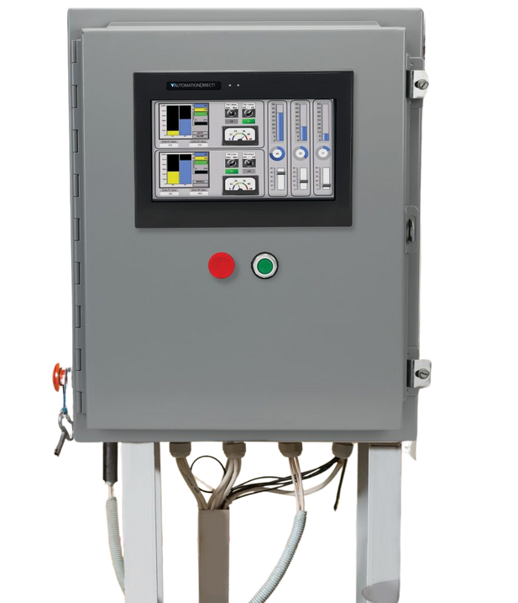
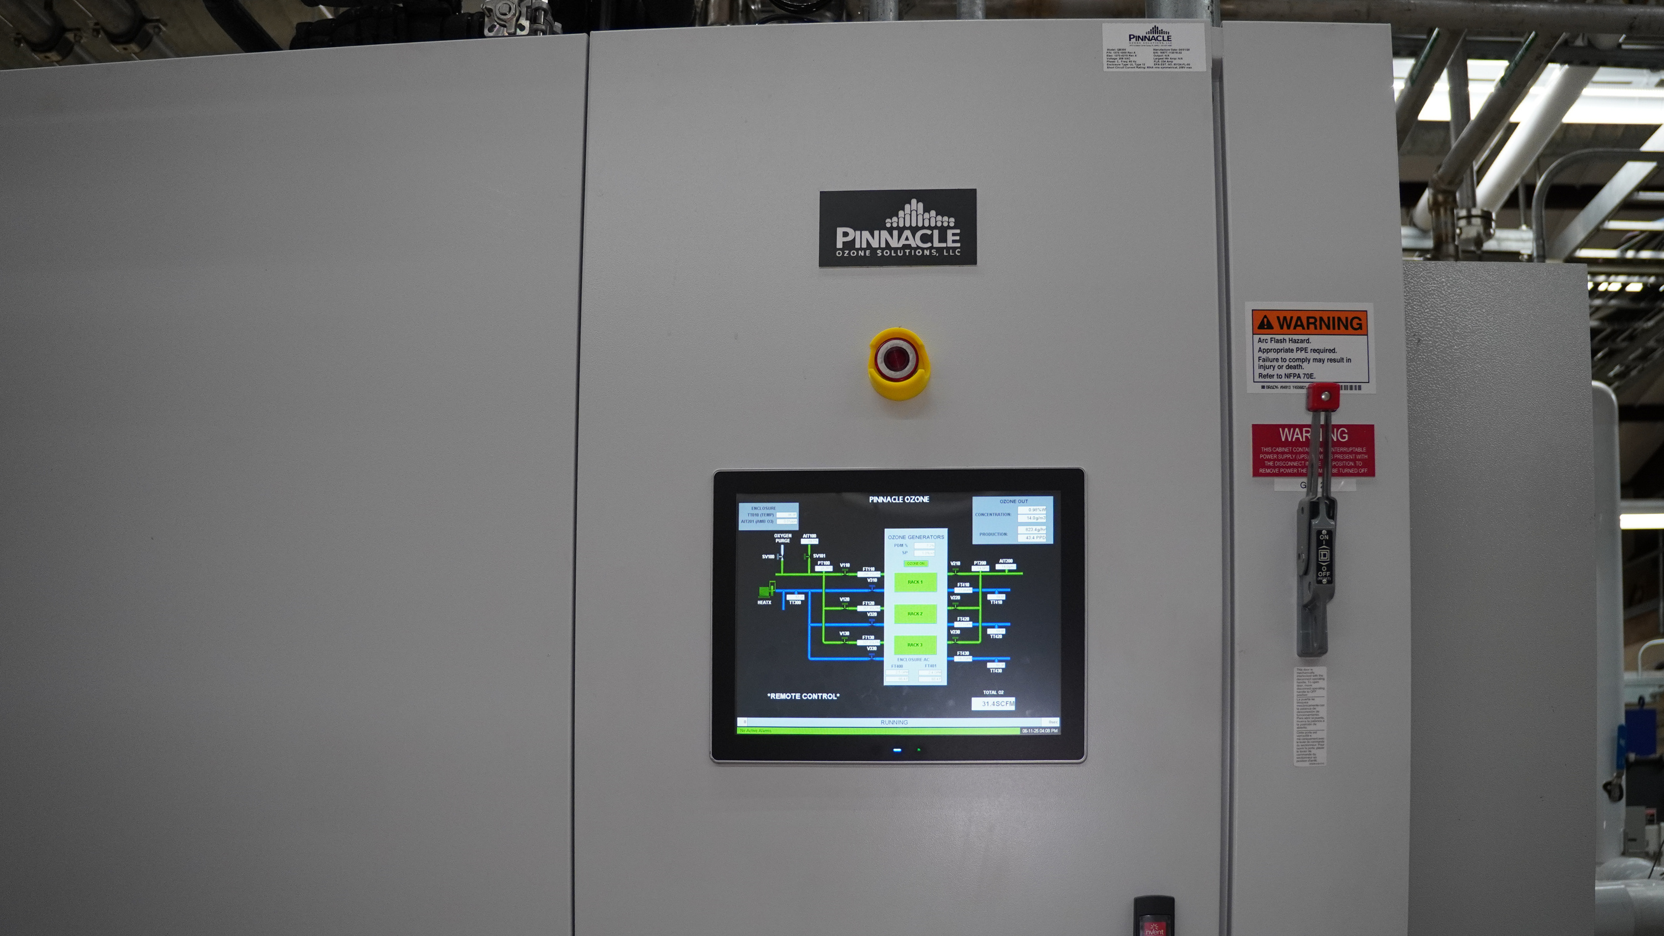
TECHNOLOGY OVERVIEW
Pipe Loop Reactor
Instrumentation & Controls
EXTERNAL INSTRUMENTATION
  Dissolved O3 residual analysers​
  Ambient O2 and O3 analysers​
  Demister​
  Mass flow controler​
  Dissolved ozone analyser or ORP
Maximizes ozone contact time and transfer efficiency in a compact footprint
Engineered for high-flow, high-concentration disinfection processes
Corrosion-resistant materials and rugged frame for long service life
MASTER OPERATOR
CONTROL PANEL (MCOP)
OZONE GENERATOR
  Schneider PLC M251. Allen Bradley available upon request
  HMI Red Lion 15"

Slide 20
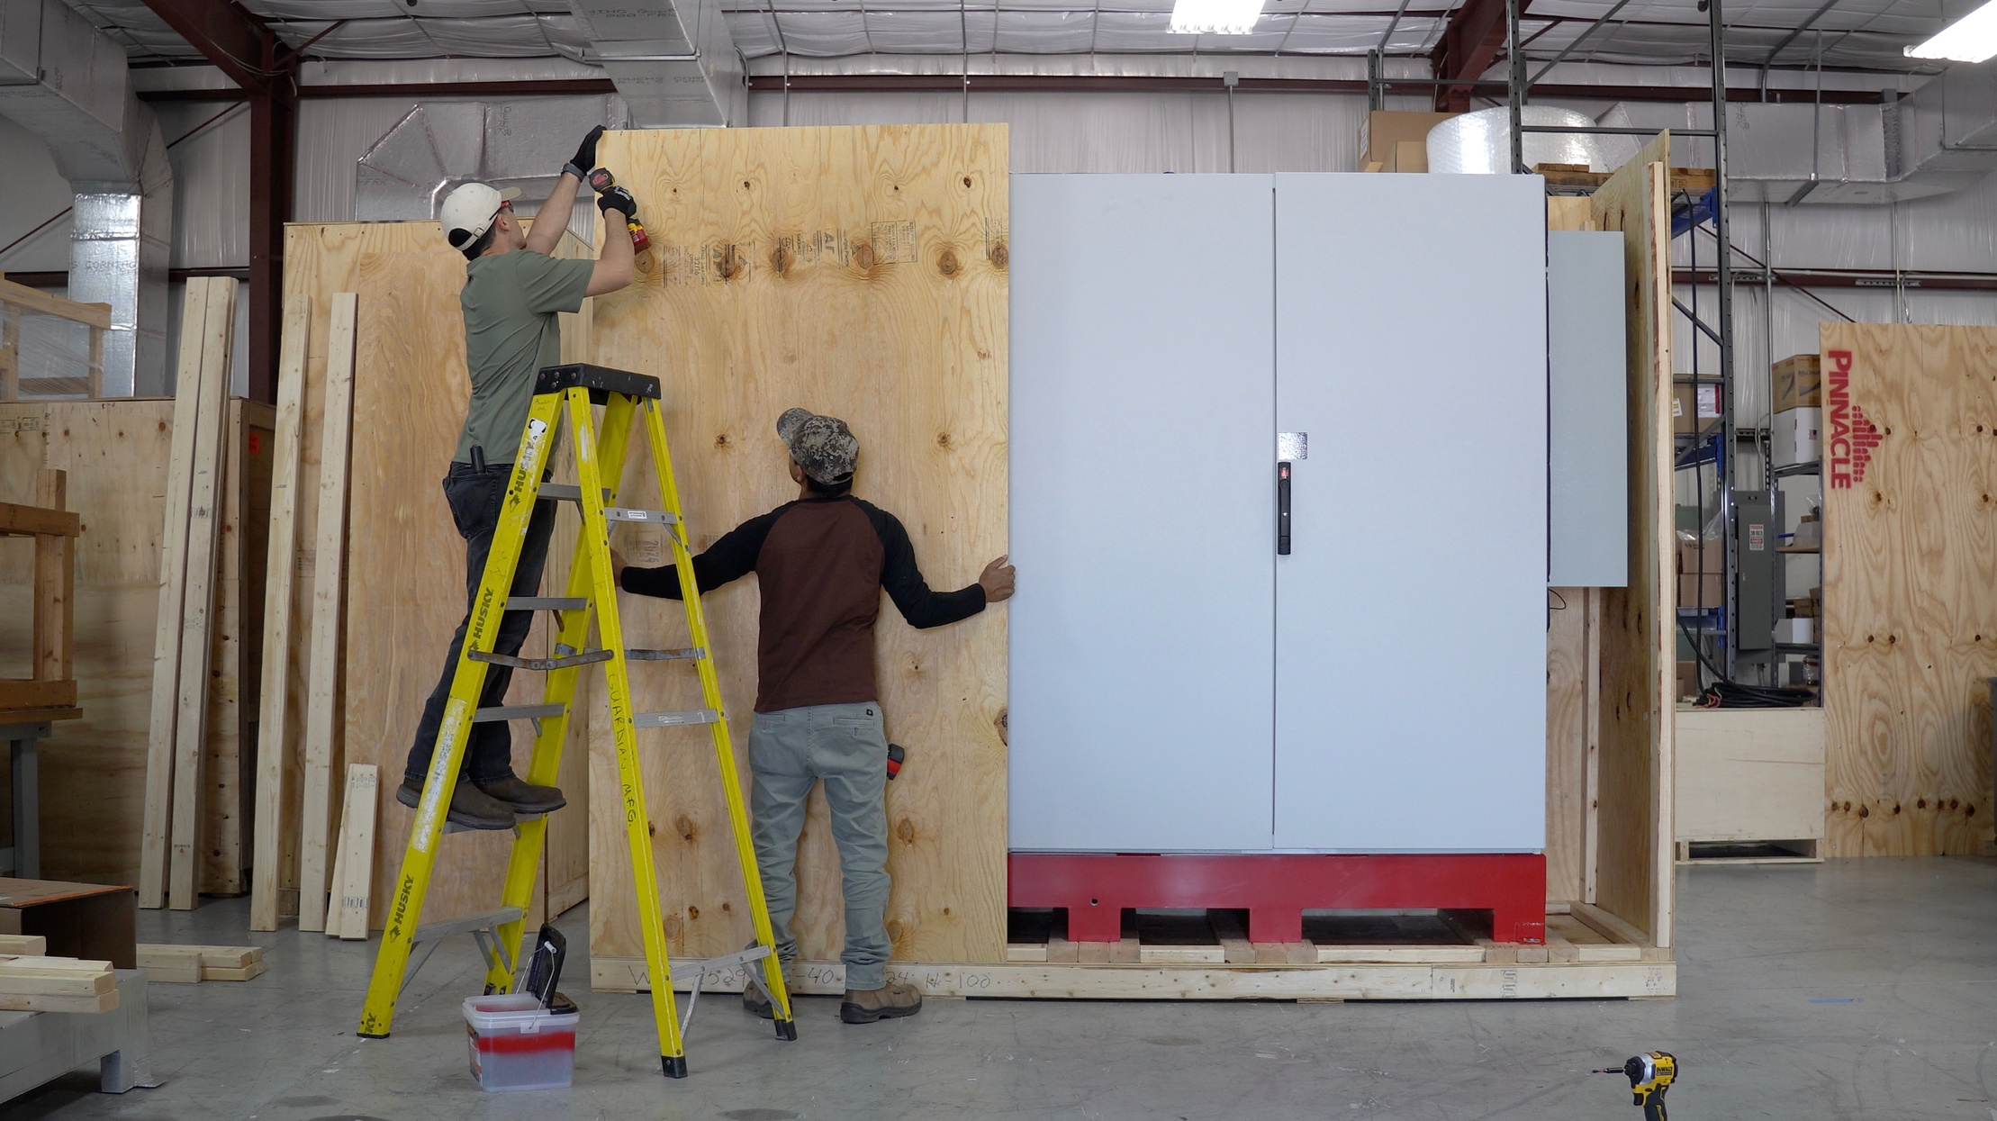
Project Considerations
Instrumentation & Controls
SUBMITTALS
6 Weeks
DELIVERY
Up to 22 weeks after approval​
EXTERNAL INSTRUMENTATION
  Dissolved O3 residual analysers​
  Ambient O2 and O3 analysers​
  Demister​
  Mass flow controler​
  Dissolved ozone analyser or ORP
Equipment availability and lead-times
Recommended useful Life/mechanical warrantee
Performance warrantee
Output (ppd) warrantee vs MTE
MASTER OPERATOR
CONTROL PANEL (MCOP)
OZONE GENERATOR
  Schneider PLC M251. Allen Bradley available upon request
  HMI Red Lion 15"

Slide 21
Project Considerations
SUBMITTALS
6 Weeks
DELIVERY
Up to 22 weeks after approval​
Equipment availability and lead-times
Recommended useful Life/mechanical warrantee
Performance warrantee
Output (ppd) warrantee vs MTE
MASTER OPERATOR
CONTROL PANEL (MCOP)
OZONE GENERATOR
  Schneider PLC M251. Allen Bradley available upon request
  HMI Red Lion 15"
EXTERNAL INSTRUMENTATION
  Dissolved O3 residual analysers​
  Ambient O2 and O3 analysers​
  Demister​
  Mass flow controler​
  Dissolved ozone analyser or ORP

Slide 22

Thank You for Attending
We look forward to the journey ahead, where we can turn our shared vision into reality.
321-506-1850
www.pinnacleozone.com
Cocoa, Florida, USA

