Slide 1

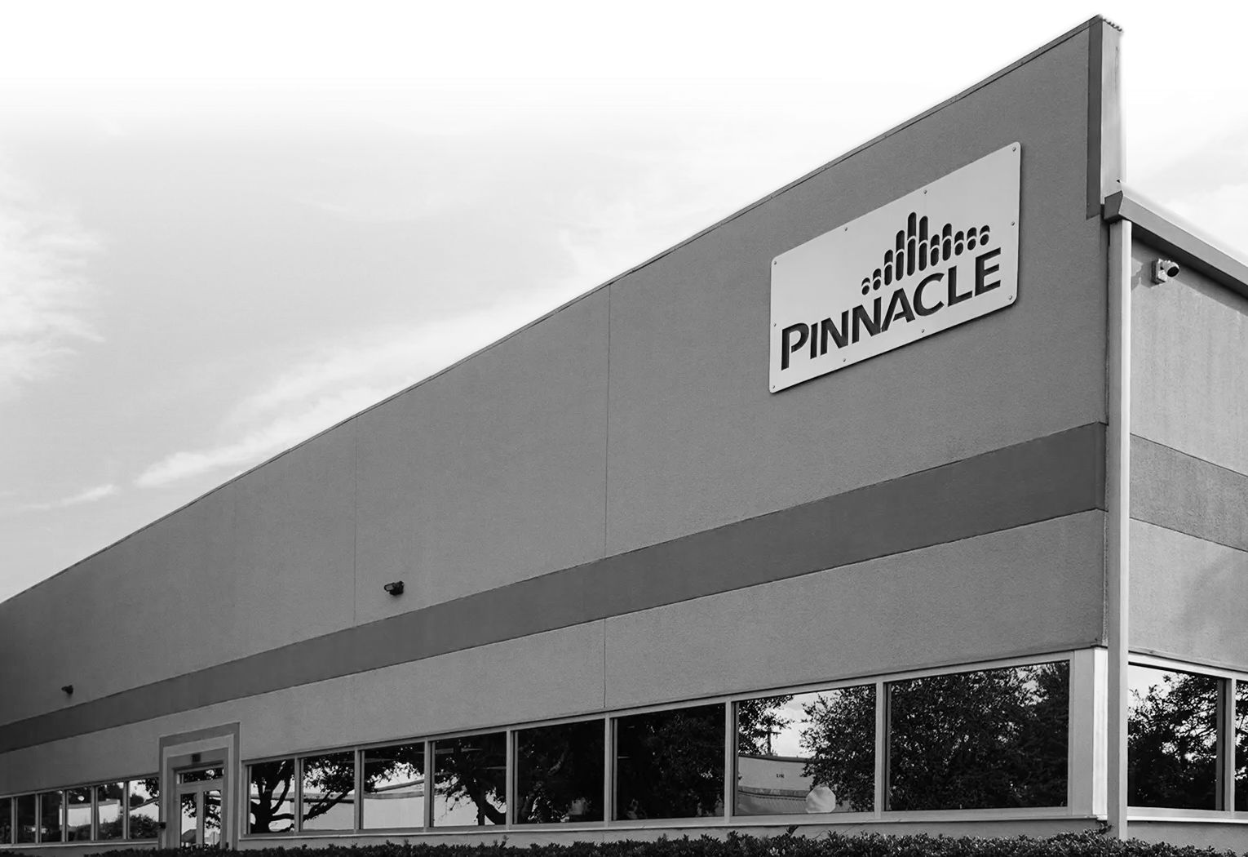
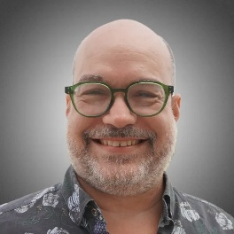

PINNACLE OZONE SOLUTIONS
Pinnacle vs Competition
Philippe Taliana
GLOBAL SALES MANAGER
COMPETITION
Competitive technologies: UV
PARAMETER | OZONE / OZONE–H₂O₂ | UV / UV–H₂O₂
UV Transmittance (UVT) | Unaffected by UVT | UVT dependent
Impact on UVT | Ozone can improve UVT by reducing color and organics | No improvement to UVT
Combined Processes | O₃ + UV possible in select advanced oxidation applications | UV + H₂O₂ is standard AOP
Color & TOC Removal | Effective for color and TOC reduction | Not effective
EDC / Micropollutant Oxidation | Effective oxidation, especially with O₃/H₂O₂ | Limited effectiveness without high UV dose
Disinfection Capability | Can combine disinfection and oxidation | Primary role is disinfection
Oxidant / Chemical Demand | Moderate H₂O₂ demand when used as AOP | Typically requires higher H₂O₂ dosage

Slide 2

COMPETITION
COMPETITION
Chlorine
Competitive technologies: UV
PINNACLE OZONE SOLUTIONS
Pinnacle vs Competition
PARAMETER | OZONE / OZONE–H₂O₂ | UV / UV–H₂O₂
UV Transmittance (UVT) | Unaffected by UVT | UVT dependent
Impact on UVT | Ozone can improve UVT by reducing color and organics | No improvement to UVT
Combined Processes | O₃ + UV possible in select advanced oxidation applications | UV + H₂O₂ is standard AOP
Color & TOC Removal | Effective for color and TOC reduction | Not effective
EDC / Micropollutant Oxidation | Effective oxidation, especially with O₃/H₂O₂ | Limited effectiveness without high UV dose
Disinfection Capability | Can combine disinfection and oxidation | Primary role is disinfection
Oxidant / Chemical Demand | Moderate H₂O₂ demand when used as AOP | Typically requires higher H₂O₂ dosage
CATEGORY | CHLORINE | OZONE
Primary role | Disinfection & residual | Disinfection & oxidation
Disinfection strength | Effective, slower | Extremely fast & powerful
Oxidation capability | Limited | Very strong
Taste & odor control | Minimal | Excellent
EDC / micropollutants | Limited effectiveness | Effective oxidation
Disinfection byproducts | THMs & HAAs | No THMs or HAAs
Chemical handling | Bulk chemical storage | Generated on-site
Residual in system | Yes (advantage) | No (by design)
Sannel Patel, MBA
DIRECTOR OF BUSINESS DEVELOPMENT & MARKETING
CHEMICAL ENGINEER

Slide 3
COMPETITION
COMPETITION
Chlorine
Existing Ozone Technology
CATEGORY | CHLORINE | OZONE
Primary role | Disinfection & residual | Disinfection & oxidation
Disinfection strength | Effective, slower | Extremely fast & powerful
Oxidation capability | Limited | Very strong
Taste & odor control | Minimal | Excellent
EDC / micropollutants | Limited effectiveness | Effective oxidation
Disinfection byproducts | THMs & HAAs | No THMs or HAAs
Chemical handling | Bulk chemical storage | Generated on-site
Residual in system | Yes (advantage) | No (by design)
TECHNOLOGY TYPE | KEY CHARACTERISTICS | LIMITATIONS
Air-fed ozone systems | Uses ambient air | Low ozone concentration, moisture issues
Oxygen-fed ozone systems | Uses PSA or LOX | Higher cost and complexity
Glass dielectric generators | Common legacy design | Fragile, dielectric failures
High-voltage power supplies | Traditional approach | Heat, reliability concerns
Skid-mounted systems | Modular, packaged | Still require skilled operation
Custom-built systems | Application specific | Long lead times, hard to service

Slide 4
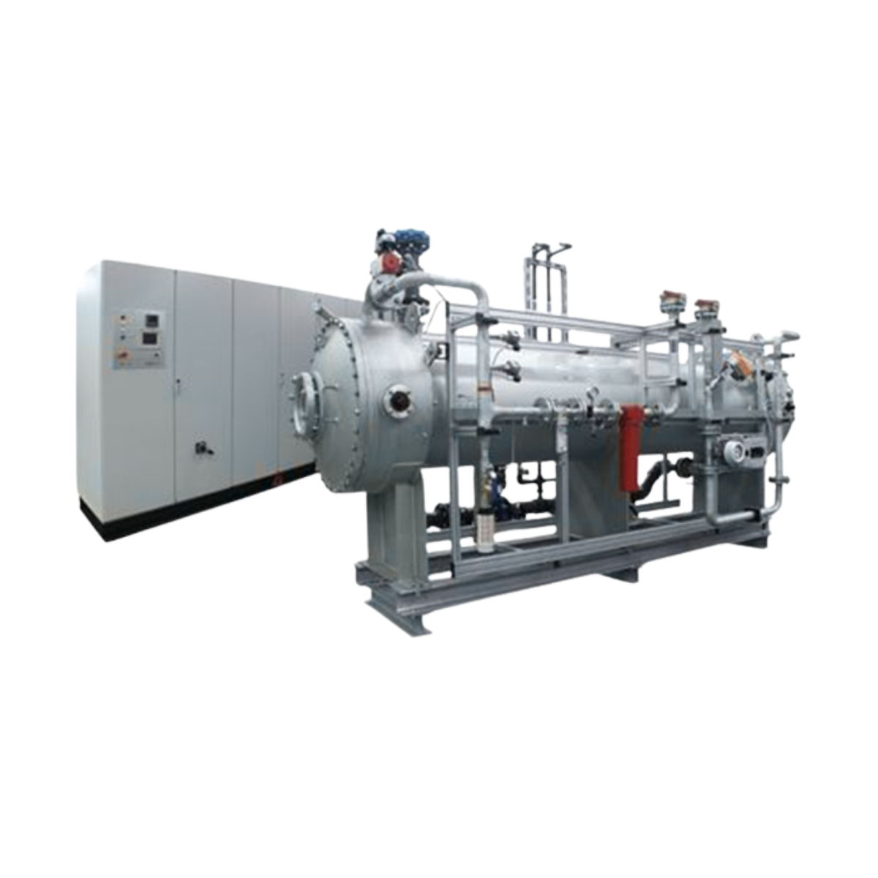
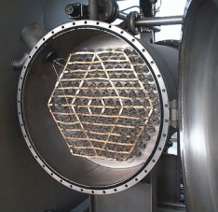
COMPETITION
COMPETITION
Existing Ozone
Technology
Existing Ozone Technology
3
8
5
6
8
4
TECHNOLOGY TYPE | KEY CHARACTERISTICS | LIMITATIONS
Air-fed ozone systems | Uses ambient air | Low ozone concentration, moisture issues
Oxygen-fed ozone systems | Uses PSA or LOX | Higher cost and complexity
Glass dielectric generators | Common legacy design | Fragile, dielectric failures
High-voltage power supplies | Traditional approach | Heat, reliability concerns
Skid-mounted systems | Modular, packaged | Still require skilled operation
Custom-built systems | Application specific | Long lead times, hard to service
2
9
7
10
11
1
12
Large / Heavy Systems
Complicated Design & Installation
Separate PSU
Audible & Harmonic Noise Issues
Frequent / Difficult Dielectric Maintenance
Limited Turn-Down
Energy Inefficient
Poor Heating / Cooling
Hi OPEX Cost
Safety Concerns
Poor Process Integration
Poor Service & Support

Slide 5
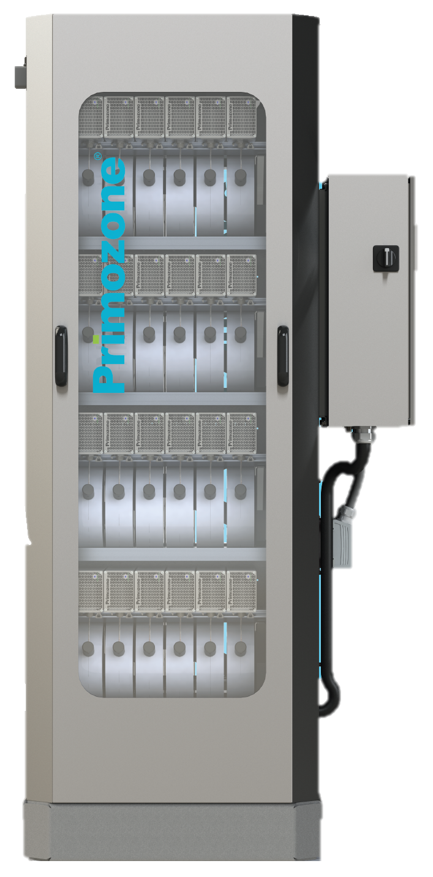

COMPETITION
ADVANTAGES
Compact footprint
Modular architecture
High ozone concentration capability (up to ~20% wt)
DISADVANTAGES
Uneven reference base by region
Power supply reliability concerns in some installations
Condensation management issues
High ozone concentration is marketed as a primary differentiator, though not always required by the process
Not fully modular across all capacity ranges
Existing Ozone
Technology
8
5
3
6
8
4
2
9
7
10
11
1
12
Large / Heavy Systems
Complicated Design & Installation
Separate PSU
Audible & Harmonic Noise Issues
Frequent / Difficult Dielectric Maintenance
Limited Turn-Down
Energy Inefficient
Poor Heating / Cooling
Hi OPEX Cost
Safety Concerns
Poor Process Integration
Poor Service & Support

Slide 6
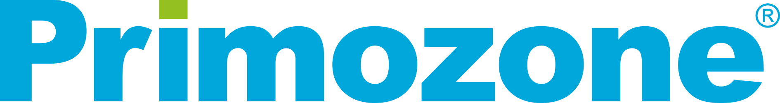

ADVANTAGES
Compact footprint
Modular architecture
High ozone concentration capability (up to ~20% wt)
DISADVANTAGES
Uneven reference base by region
Power supply reliability concerns in some installations
Condensation management issues
High ozone concentration is marketed as a primary differentiator, though not always required by the process
Not fully modular across all capacity ranges
Founded in 2000
Based in Sweden
Market Positioning
Operates exclusively through distributors (no direct sales)
Promotes high-concentration ozone (~18%)
Higher ozone concentration can increase corrosion risk, material stress, and leak sensitivity
Pinnacle can achieve high concentrations when required — but system reliability and longevity drive design decisions
Notes:
Guardian Manufacturing Experience.

Slide 7
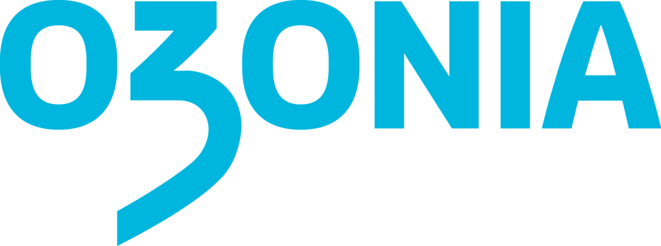

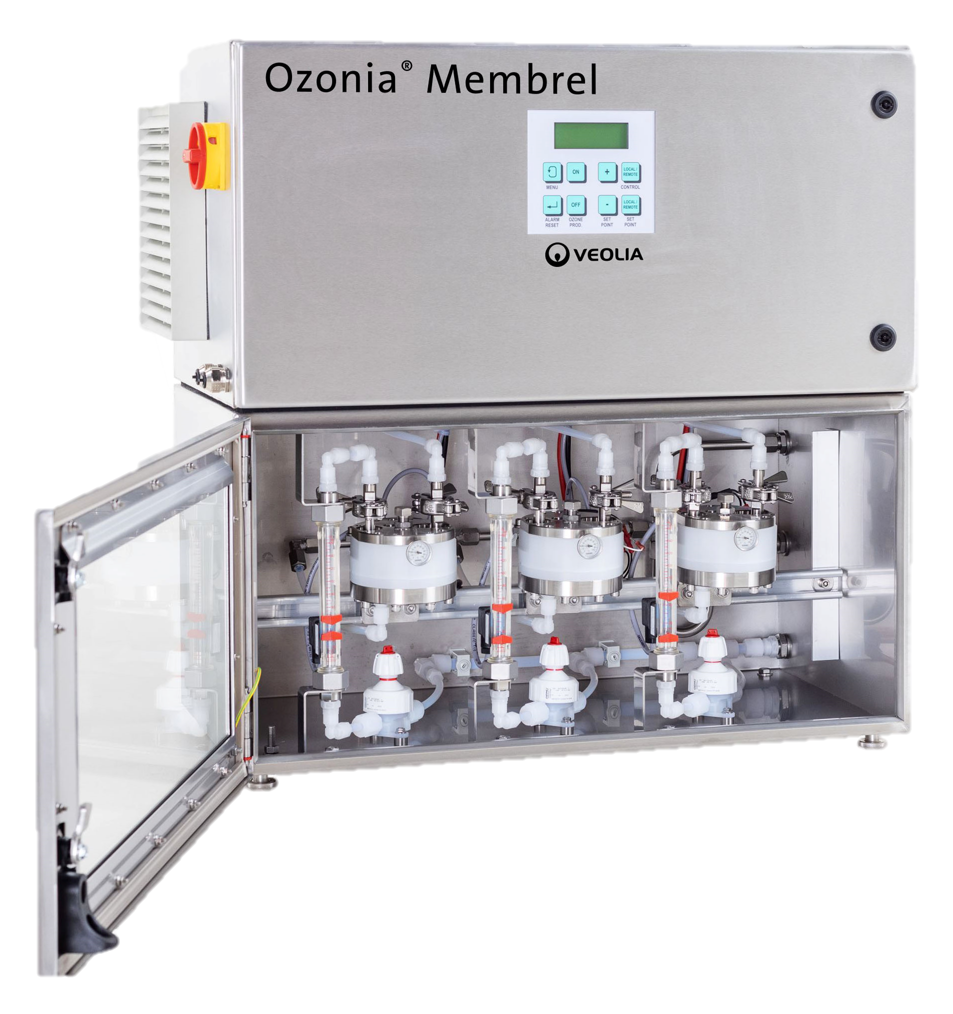
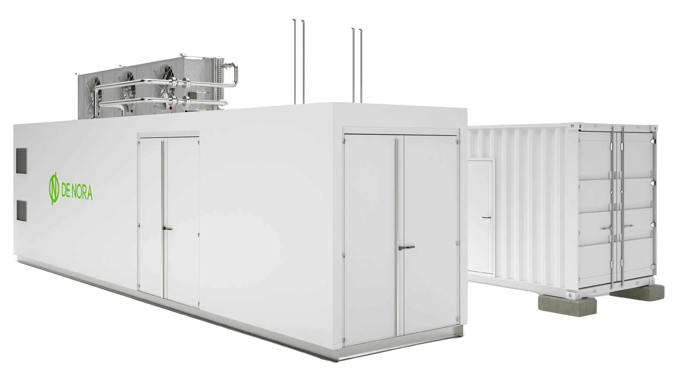
OZONIA NORTH AMERICA
(DEGREMONT / SUEZ/VEOLIA)
Legacy ozone supplier with roots going back over 50 years
Long-standing presence in large municipal projects
Italian-based multinational conglomerate
Water treatment is a small portion of overall business
ADVANTAGES
Strong industrial footprint
Competitive initial pricing
DISADVANTAGES
High operating costs
Conventional tube-and-shell designs
Large and heavy systems
Lower power efficiency compared to newer technologies
Limited focus on North American municipal ozone market
ADVANTAGES
Compact footprint
Modular architecture
High ozone concentration capability (up to ~20% wt)
DISADVANTAGES
Uneven reference base by region
Power supply reliability concerns in some installations
Condensation management issues
High ozone concentration is marketed as a primary differentiator, though not always required by the process
Not fully modular across all capacity ranges
Market Positioning
Operates exclusively through distributors (no direct sales)
Promotes high-concentration ozone (~18%)
Higher ozone concentration can increase corrosion risk, material stress, and leak sensitivity
Pinnacle can achieve high concentrations when required — but system reliability and longevity drive design decisions
Founded in 2000
Based in Sweden
ADVANTAGES
Extensive reference base
Wide product portfolio
Often specified as a “default” technology
DISADVANTAGES
Dated generator designs
Large, heavy, and fragile systems
Limited turndown flexibility
Service and responsiveness challenges reported by end users
Commoditized solutions with limited innovation
Notes:
Guardian Manufacturing Experience.

Slide 8
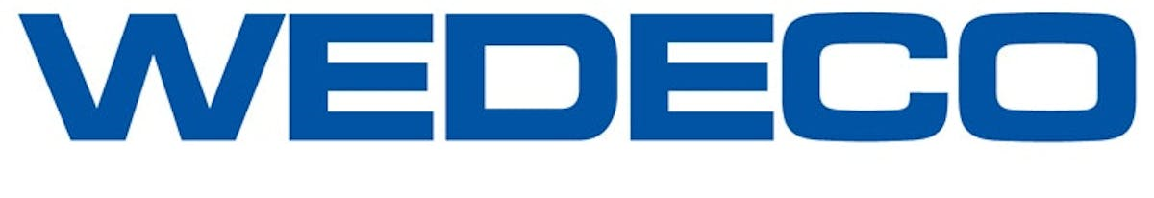
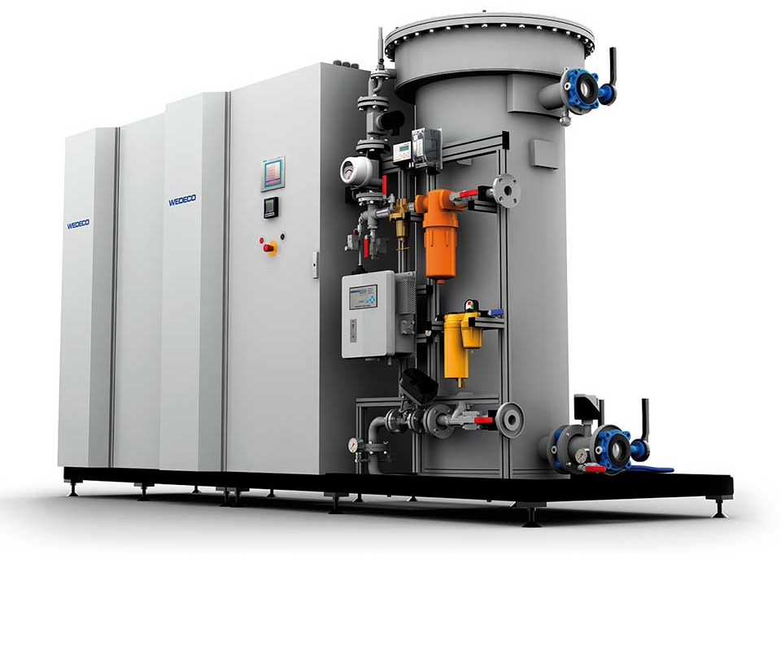
ADVANTAGES
Strong industrial footprint
Competitive initial pricing
DISADVANTAGES
High operating costs
Conventional tube-and-shell designs
Large and heavy systems
Lower power efficiency compared to newer technologies
Limited focus on North American municipal ozone market
formerly Trailgaz
Over 30 years in ozone technology
Acquired and integrated into Xylem
Italian-based multinational conglomerate
Water treatment is a small portion of overall business
Market Positioning
Operates exclusively through distributors (no direct sales)
Promotes high-concentration ozone (~18%)
Higher ozone concentration can increase corrosion risk, material stress, and leak sensitivity
Pinnacle can achieve high concentrations when required — but system reliability and longevity drive design decisions
Notes:
Guardian Manufacturing Experience.

Slide 9
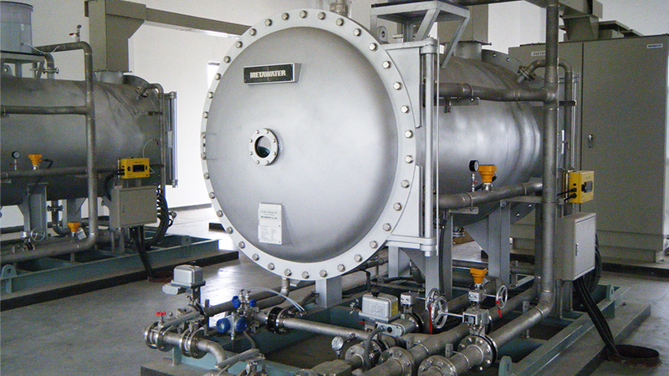
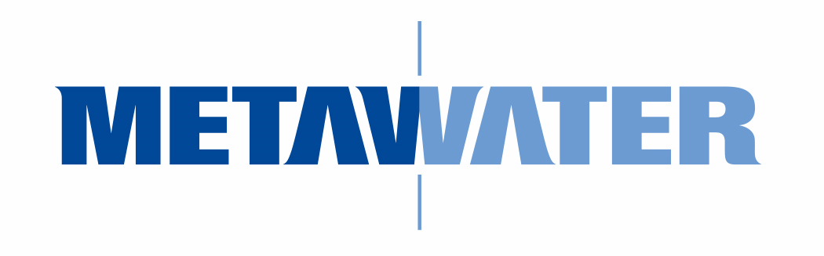
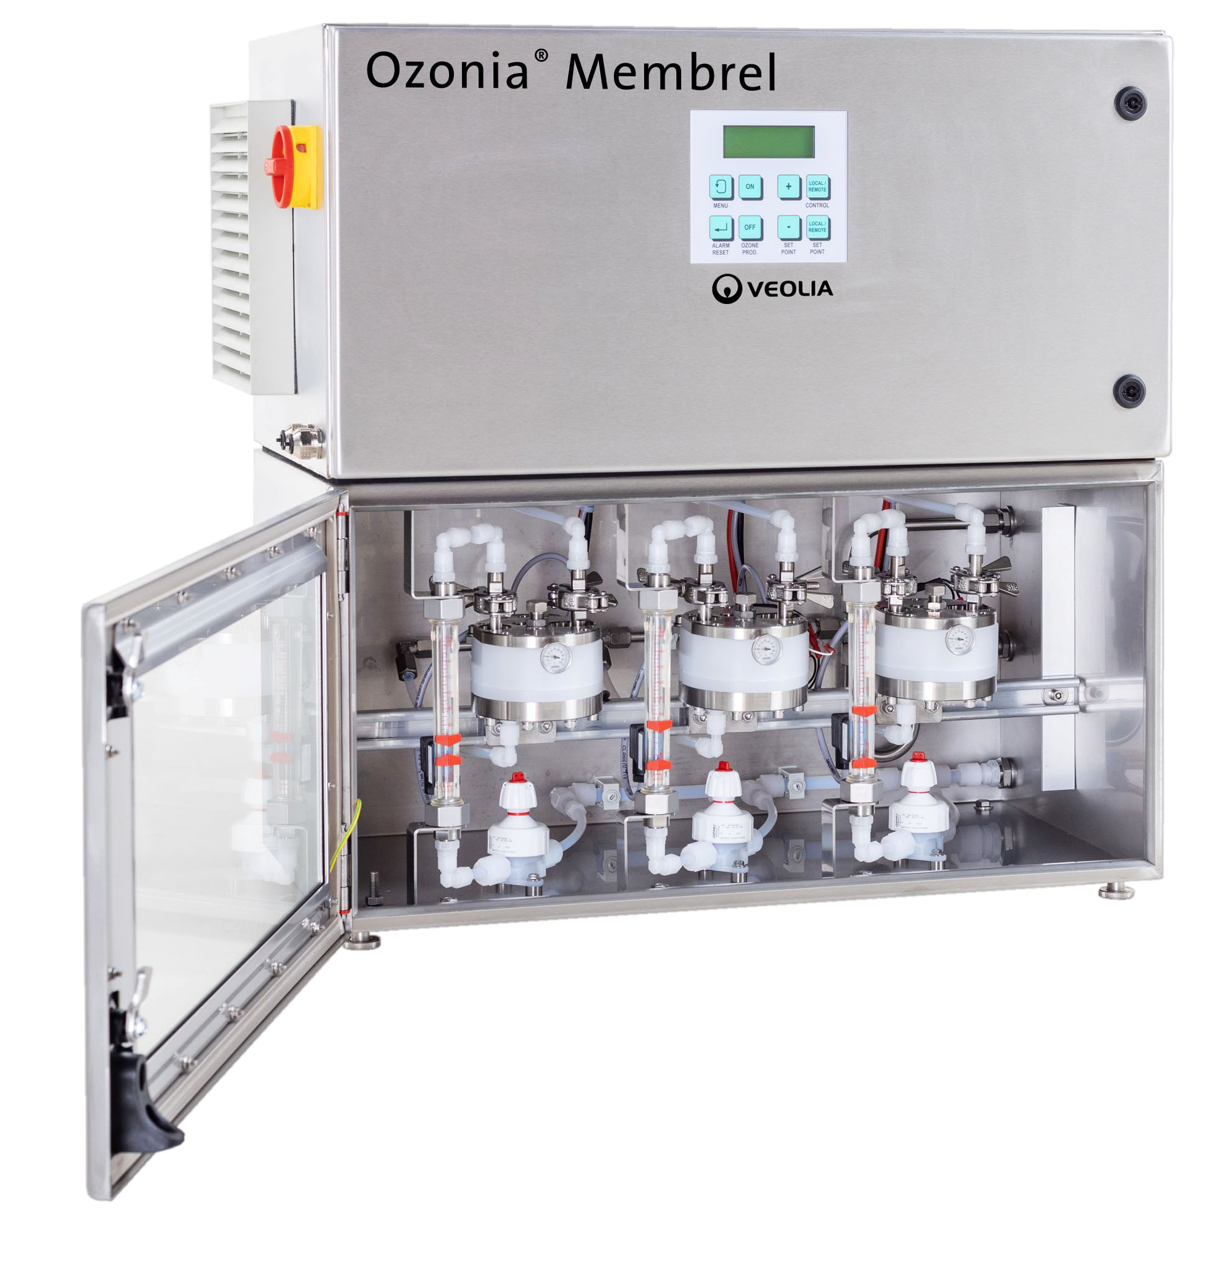
Legacy Japanese water technology provider
Italian-based multinational conglomerate
Water treatment is a small portion of overall business
OZONIA NORTH AMERICA (DEGREMONT / SUEZ/VEOLIA)​
ADVANTAGES
Large installed base
Strong parent company
Introduction of newer product lines (EFFIZON™)
DISADVANTAGES
Aging installed base
Most systems operate at lower ozone concentrations
Poor turndown performance
Large footprint and fragile components
Mixed service and reliability reputation
ADVANTAGES
Strong industrial footprint
Competitive initial pricing
DISADVANTAGES
High operating costs
Conventional tube-and-shell designs
Large and heavy systems
Lower power efficiency compared to newer technologies
Limited focus on North American municipal ozone market
formerly Trailgaz
Over 30 years in ozone technology
Acquired and integrated into Xylem
Market Positioning
Operates exclusively through distributors (no direct sales)
Promotes high-concentration ozone (~18%)
Higher ozone concentration can increase corrosion risk, material stress, and leak sensitivity
Pinnacle can achieve high concentrations when required — but system reliability and longevity drive design decisions
Legacy ozone supplier with roots going back over 50 years​
Long-standing presence in large municipal projects
Notes:
Guardian Manufacturing Experience.

Slide 10
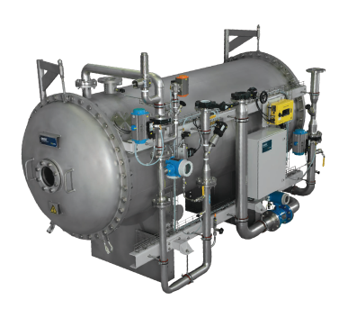
Legacy Japanese water technology provider
Italian-based multinational conglomerate
Water treatment is a small portion of overall business
ADVANTAGES
Extensive reference base​
Wide product portfolio​
Often specified as a “default” technology
DISADVANTAGES
Dated generator designs​
Large, heavy, and fragile systems​
Limited turndown flexibility​
Service and responsiveness challenges reported by end users​
Commoditized solutions with limited innovation
ADVANTAGES
Strong industrial footprint
Competitive initial pricing
DISADVANTAGES
High operating costs
Conventional tube-and-shell designs
Large and heavy systems
Lower power efficiency compared to newer technologies
Limited focus on North American municipal ozone market
formerly Trailgaz
Over 30 years in ozone technology
Acquired and integrated into Xylem
OZONIA NORTH AMERICA (DEGREMONT / SUEZ/VEOLIA)​
Legacy ozone supplier with roots going back over 50 years​
Long-standing presence in large municipal projects
Market Positioning
Operates exclusively through distributors (no direct sales)
Promotes high-concentration ozone (~18%)
Higher ozone concentration can increase corrosion risk, material stress, and leak sensitivity
Pinnacle can achieve high concentrations when required — but system reliability and longevity drive design decisions
Notes:
Guardian Manufacturing Experience.

Slide 11

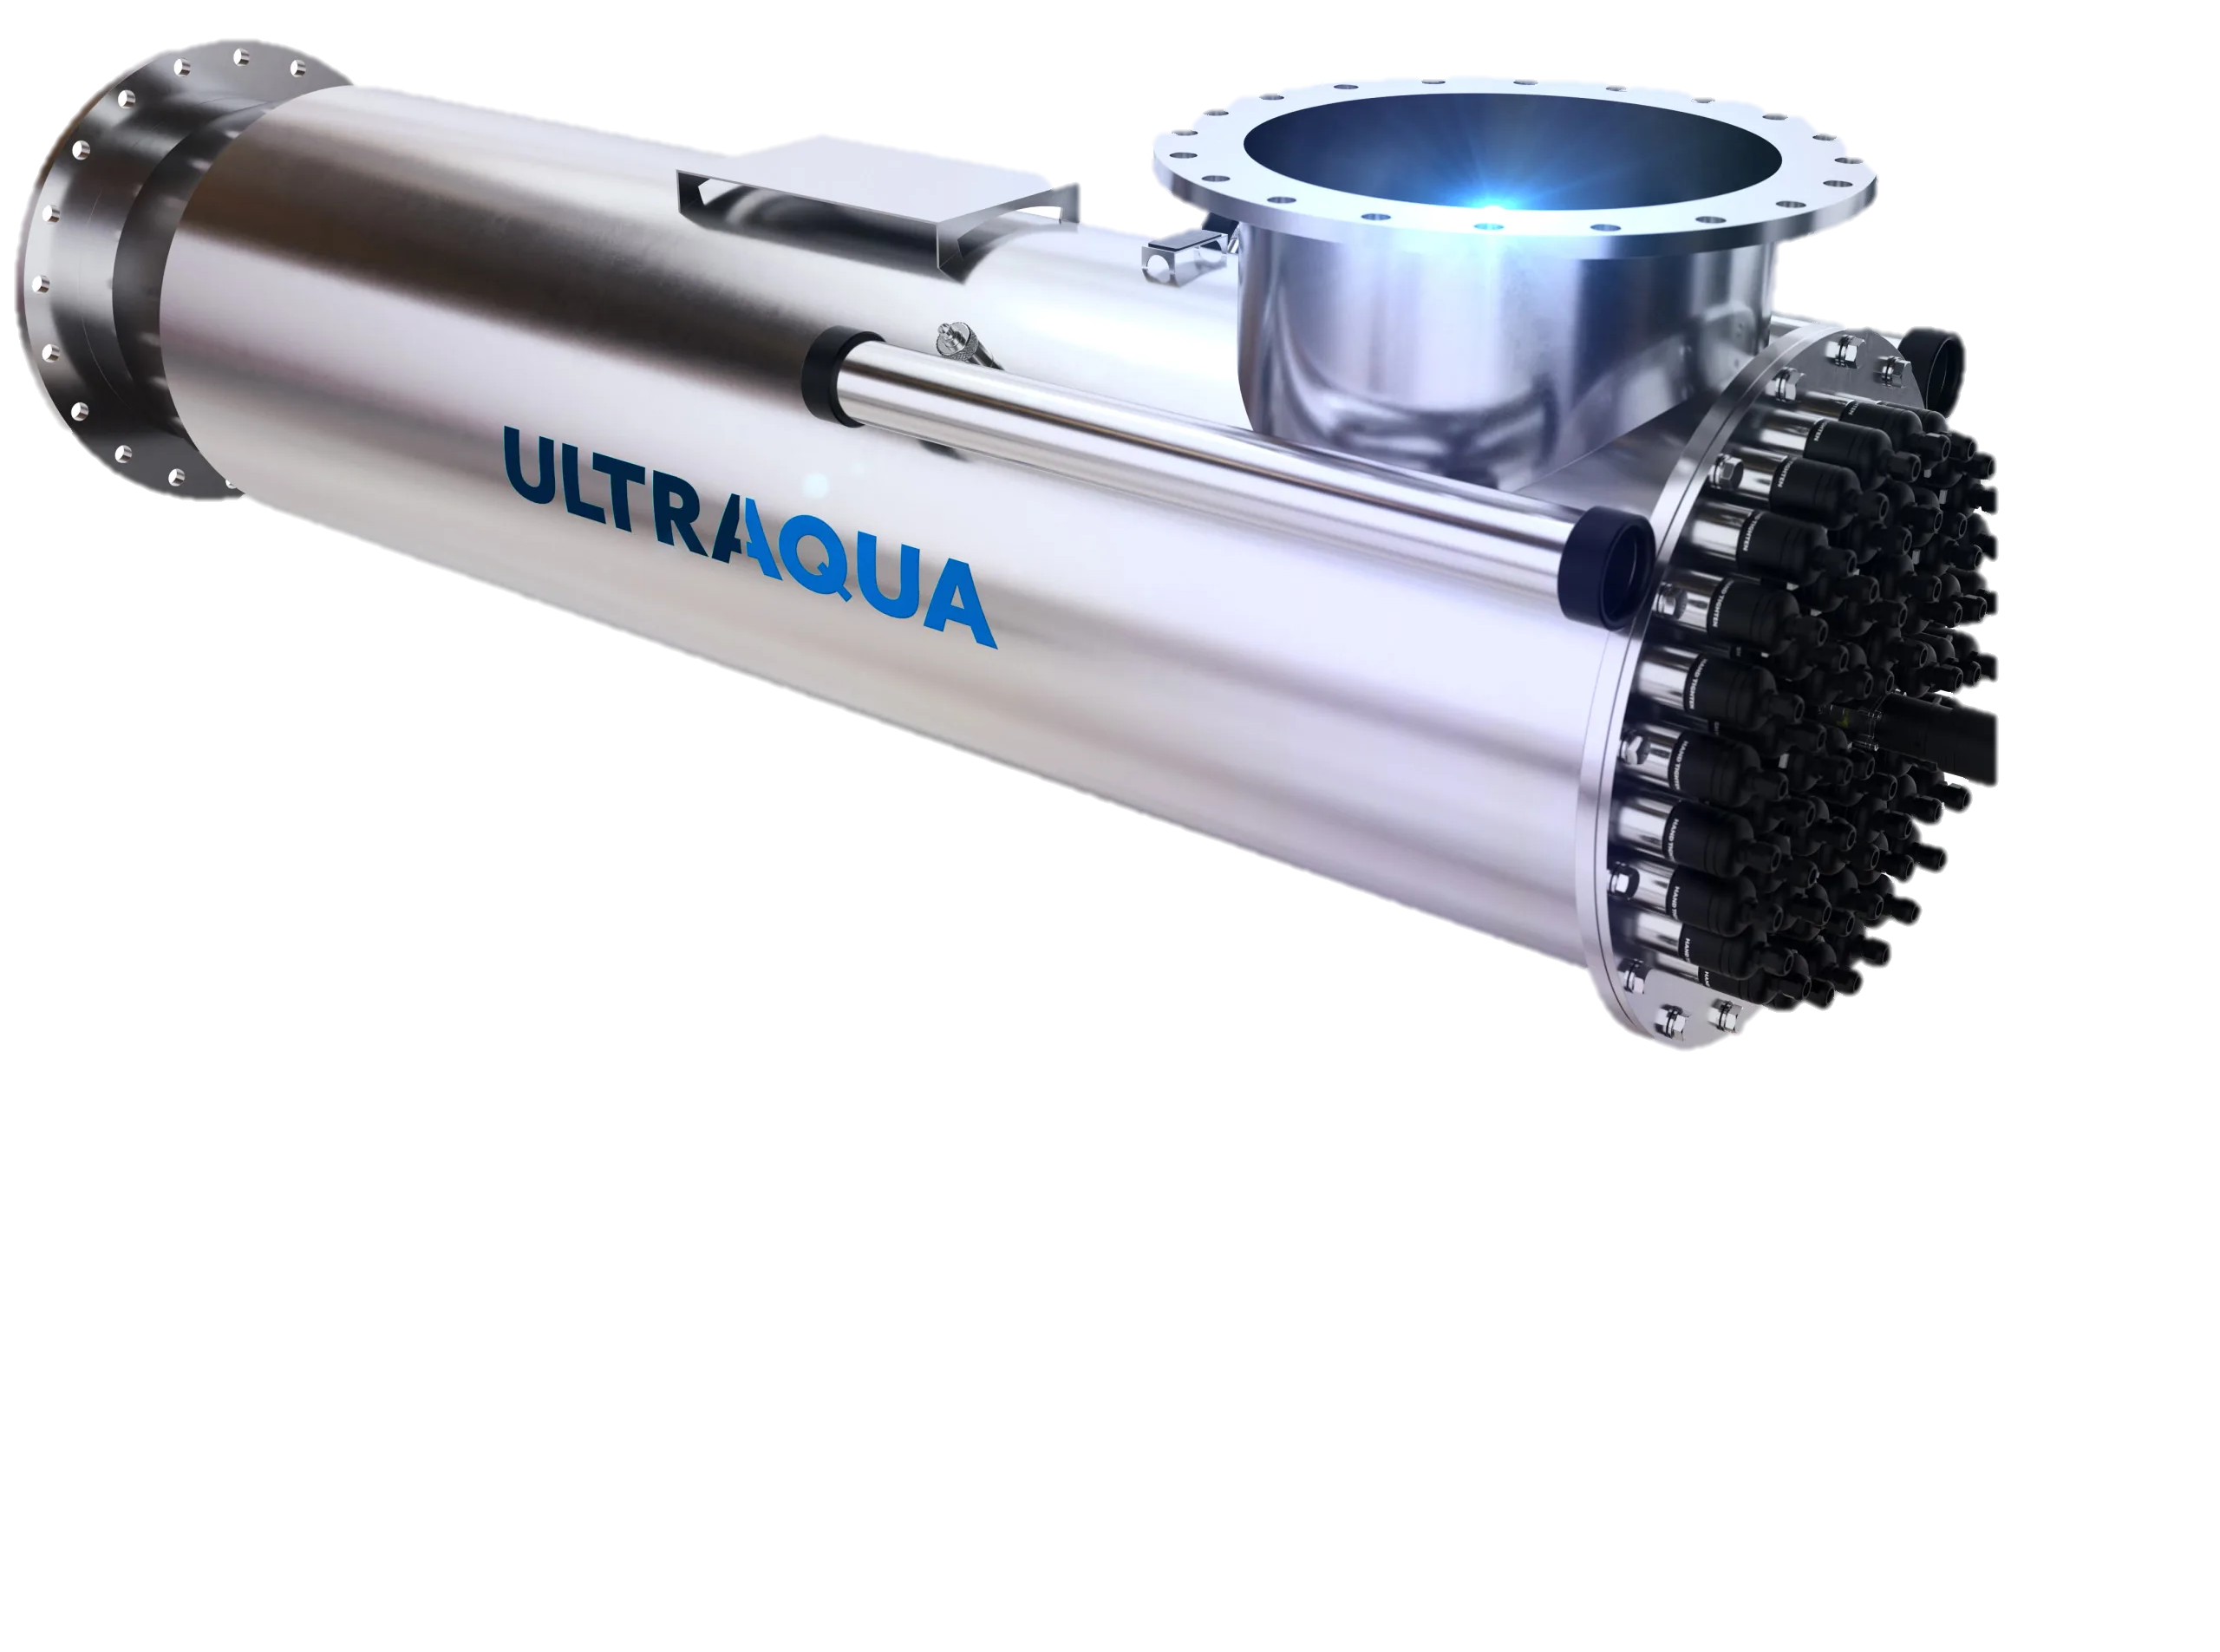
OZONIA NORTH AMERICA (DEGREMONT / SUEZ/VEOLIA)​
Legacy ozone supplier with roots going back over 50 years​
Long-standing presence in large municipal projects
formerly Trailgaz
Over 30 years in ozone technology
Acquired and integrated into Xylem
Denmark-based manufacturer
Strong presence in aquaculture and industrial markets
Market Positioning
Legacy Japanese water technology provider
Operates exclusively through distributors (no direct sales)
Promotes high-concentration ozone (~18%)
Higher ozone concentration can increase corrosion risk, material stress, and leak sensitivity
Pinnacle can achieve high concentrations when required — but system reliability and longevity drive design decisions
ADVANTAGES
Solid engineering reputation
High ozone concentration capability (up to ~15%)
Established municipal references
DISADVANTAGES
Higher capital cost
Larger, heavier equipment
Power efficiency concerns
Slower service response
Ozone is not a core strategic focus
Notes:
Guardian Manufacturing Experience.

Slide 12
Legacy Japanese water technology provider
ADVANTAGES
Strong reference base in aquaculture and industrial applications
Established distributor relationships (including Pureflow)
Compact, packaged system design
DISADVANTAGES
Limited municipal drinking water references
Municipal teams cannot directly leverage Primozone references
Smaller unit sizes make large-flow applications challenging
Denmark-based manufacturer
Strong presence in aquaculture and industrial markets
Notes:
Guardian Manufacturing Experience.

Slide 13
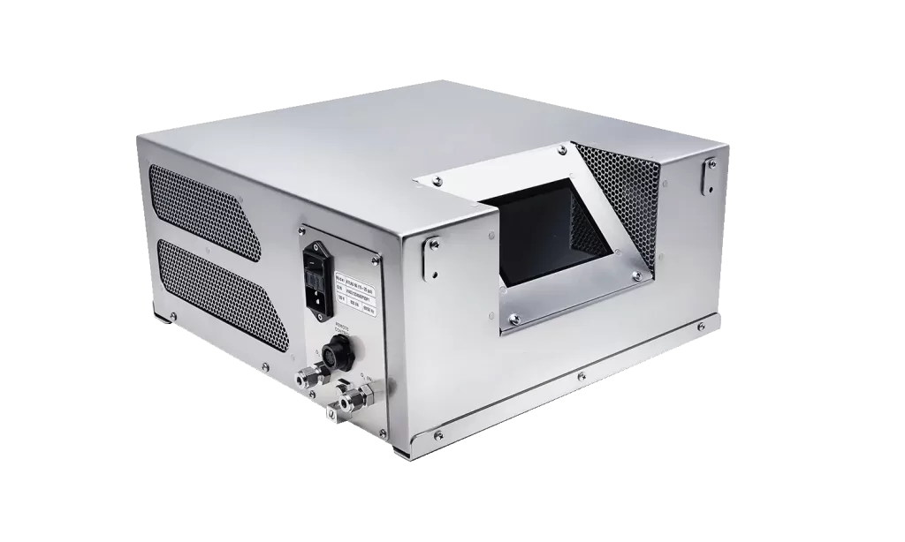
Denmark-based manufacturer
Strong presence in aquaculture and industrial markets
Air-cooled units
Market Position
Typically limited to ~1.2–1.5 kg/hr.
Suitable for small industrial or niche municipal applications
Considerations
Cooling limitations impact reliability at higher outputs
Water-cooled systems often preferred for larger municipal applications
Specifying water-cooled designs can reduce unsuitable competition
System Comparison
FEATURE | PINNACLE | OZONIA/WEDECO | AASI | PRIMOZONE
Modularity | True modular architecture | Not modular | Not modular | Limited modularity
Redundancy | Built-in module redundancy | Standby unit required | Standby unit required | Built-in module redundancy
Ozone % by Weight | 6–20% | 6–15% | 6–15% | 6–20%
Turn-Down Capability | 0–100% | 40–100% | 40–100% | 0–100%(?)
Power Supply | Integrated, modular, high-frequency | External, line-frequency | External, line-frequency | Integrated, modular, high-frequency,
Power Efficiency | ~3.5 kW/lb @ 10% | ~5.45 kW/lb @ 10% | ~4.5 kW/lb @ 10% | ~4.5 kW/lb @ 10%
Service & Reliability | Ruggedized, sealed-cell design; minimal cleaning | Glass/ceramic components; regular cleaning required | Glass/ceramic components; regular cleaning required | Condensation sensitivity; PSU window exposure
Footprint | Lowest | Large | Large | Low

Slide 14
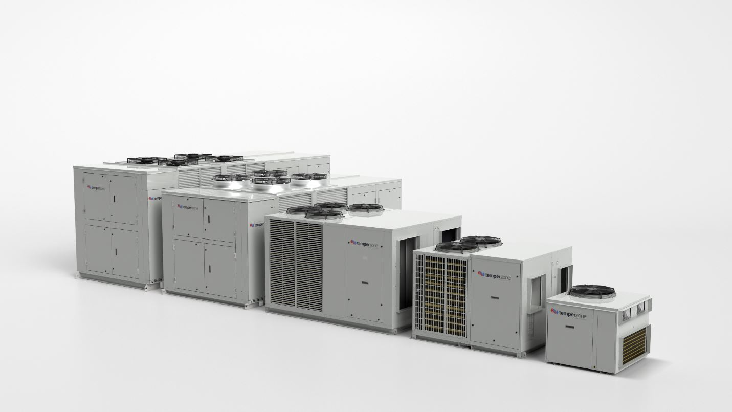
Air-cooled units
System Comparison
Market Position
Typically limited to ~1.2–1.5 kg/hr.
Suitable for small industrial or niche municipal applications
Considerations
Cooling limitations impact reliability at higher outputs
Water-cooled systems often preferred for larger municipal applications
Specifying water-cooled designs can reduce unsuitable competition
FEATURE | PINNACLE | OZONIA/WEDECO | AASI | PRIMOZONE
Modularity | True modular architecture | Not modular | Not modular | Limited modularity
Redundancy | Built-in module redundancy | Standby unit required | Standby unit required | Built-in module redundancy
Ozone % by Weight | 6–20% | 6–15% | 6–15% | 6–20%
Turn-Down Capability | 0–100% | 40–100% | 40–100% | 0–100%(?)
Power Supply | Integrated, modular, high-frequency | External, line-frequency | External, line-frequency | Integrated, modular, high-frequency,
Power Efficiency | ~3.5 kW/lb @ 10% | ~5.45 kW/lb @ 10% | ~4.5 kW/lb @ 10% | ~4.5 kW/lb @ 10%
Service & Reliability | Ruggedized, sealed-cell design; minimal cleaning | Glass/ceramic components; regular cleaning required | Glass/ceramic components; regular cleaning required | Condensation sensitivity; PSU window exposure
Footprint | Lowest | Large | Large | Low
Pinnacle vs Competition
More Features. More Reliable. Higher Performance. Safer.

Slide 15
Pinnacle vs Competition
More Features. More Reliable. Higher Performance. Safer.
CATEGORY | FEATURE | LEGACY SYSTEMS | OTHER MODULAR SYSTEMS | PINNACLE OZONE (QUADBLOCK®)
Design | Modular / Scalable Architecture | Fixed cabinets | Rack-based designs | QuadBlock® modular & scalable
Design | Integrated O₃ Control (PLC/HMI) | PLC + HMI | Varies by vendor | Native PLC + HMI with full diagnostics
Performance | Standard 8–10% wt Ozone Output | 6–12% | 6–20% | Optimized for efficiency
Performance | Constant %BW Across Turndown Range | Output varies with flow | Depends on model | Stable %BW even at low flow
Performance | No Nitrogen Feed Required | Always needed | Always needed | PSA/LOX-based
Reliability | Hot-Swappable Ozone Cells | Extensive work needed | Extensive work needed | 45 minutes
Reliability | Low / No Routine Maintenance | Frequent PM needed | Varies with design | Low service burden
Safety | Leak Safety Isolation Protocol | Not Installed | Current Issues | Standard Install
Pinnacle vs Competition
Better Support. Best Service. Less Costly. Greater Value.

Slide 16



Pinnacle vs Competition
Better Support. Best Service. Less Costly. Greater Value.
Thank You for Attending
CATEGORY | FEATURE | LEGACY SYSTEMS | OTHER MODULAR SYSTEMS | PINNACLE OZONE (QUADBLOCK®)
Project Delivery | In-House O₃ Application Development | Minimum | Minimum | Lab Services + PTI R&D
Project Delivery | Single Point Project Responsibility | Often split across vendors | Shared with integrators | One team, one owner
Project Delivery | Pilot Engineering Support Team | Available | Available | Available
Ownership & Cost | Lowest Total Lifetime Cost (CAPEX + OPEX) | High service + energy | Mixed performance | Proven with low OPEX + reliability
Ownership & Cost | Manufacturing location | Partially overseas | Partially overseas | Built in Florida
Ownership & Cost | Proven Install References (All Sizes) | Small, medium, and large installs | Still building | Small & Medium Installs
Warranty | 12-Month Warranty Option | Offered standard | Offered standard | Offered standard (Extension available)
Warranty | 5–20 Year Dielectric Warranty | 5-year typical | 5-year typical | 20 Year Warranty on Dielectric
We look forward to the journey ahead, where we can turn our shared vision into reality.
321-506-1850
www.pinnacleozone.com
Cocoa, Florida, USA

Slide 17

Thank You for Attending
We look forward to the journey ahead, where we can turn our shared vision into reality.
321-506-1850
www.pinnacleozone.com
Cocoa, Florida, USA

