Slide 1





PINNACLE OZONE SOLUTIONS
Technical Applications & Proposals
MJ Quessy
DIRECTOR OF OPERATIONAL EXCELLENCE & STRATEGIC EXECUTION

Slide 2
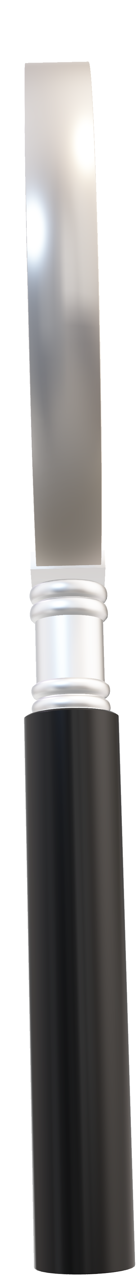


Project name
PINNACLE OZONE SOLUTIONS
Location
(Facility name, city, country)
Technical Applications & Proposals
The objective is simple:
Client contact person
(Name, email, phone)
Eliminate guesswork, avoid under‑ or over‑sizing, and make sure the proposal aligns with the client’s real needs.
Type of facility
(Municipal, industrial, direct potable reuse, leachate, aquaculture, etc.)
Project type
(New construction, retrofit, upgrade)
Project timeline
(Project design stage, delivery date)
MJ Quessy
DIRECTOR OF OPERATIONAL EXCELLENCE & STRATEGIC EXECUTION

Slide 3
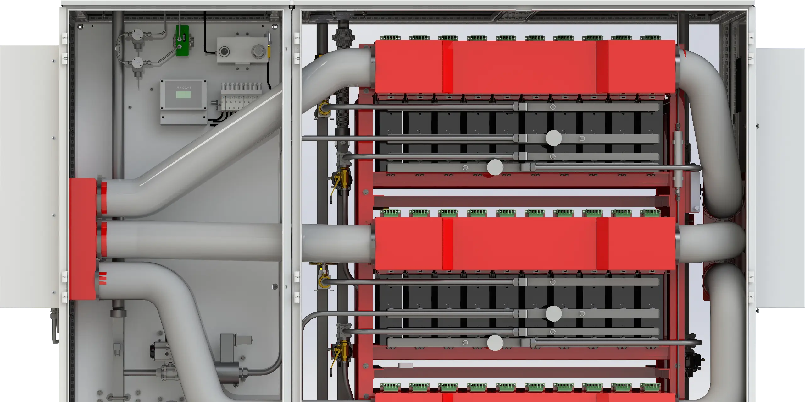

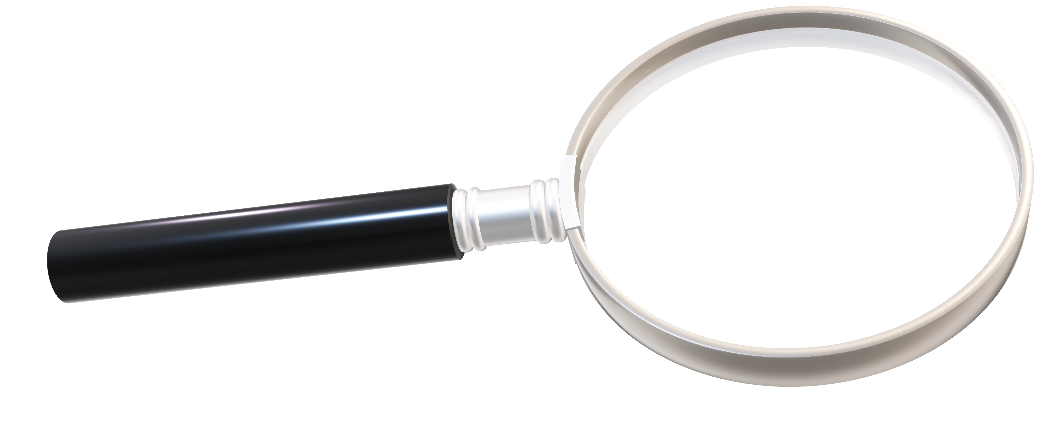
Project name
Location
(Facility name, city, country)
Client contact person
TECHNICAL APPLICATIONS & PROPOSALS
1. Project Basics
(Name, email, phone)
Type of facility
(Municipal, industrial, direct potable reuse, leachate, aquaculture, etc.)
Project type
(New construction, retrofit, upgrade)
Project timeline
(Project design stage, delivery date)
Ozone production capacity
(ppd, kg/d, kg/h)
Design flow
(MGD, gpm, m3/d, m3/h)
Dosage
(PPM, mg/L)
Oxygen feed gas
(liquid oxygen LOX, PSA, VSA)
Redundancy needed
(N+1)

Slide 4


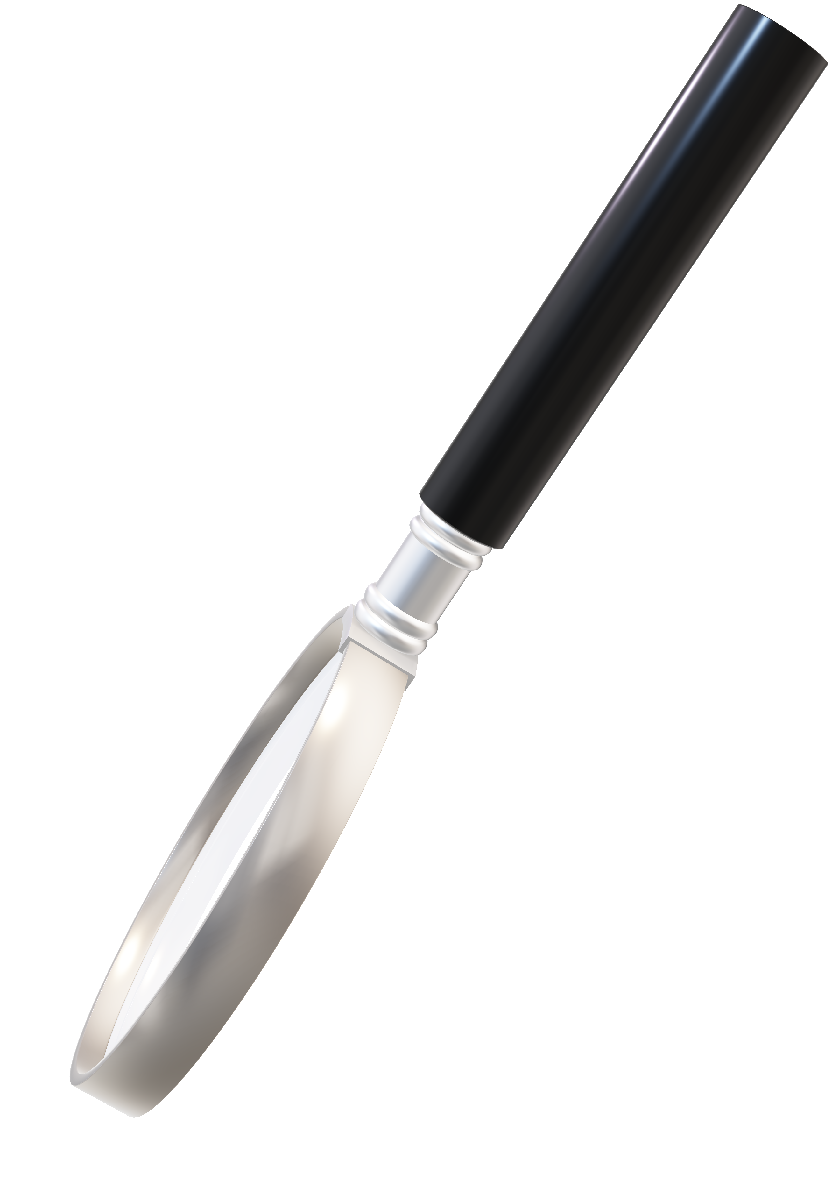
TECHNICAL APPLICATIONS & PROPOSALS
2. Design Conditions
Ozone production capacity
Ozone Concentration
(ppd, kg/d, kg/h)
(10%)
Design flow
Mass transfer efficiency
(MGD, gpm, m3/d, m3/h)
(MTE: 93%)
Dosage
Inlet process pressure
(PPM, mg/L)
(20 psig standard)
Oxygen feed gas
Cooling water temperature
(liquid oxygen LOX, PSA, VSA)
(50ºF , 10º C)
Redundancy needed
(N+1)

Slide 5
TECHNICAL APPLICATIONS & PROPOSALS
3. Standard Assumptions
Ozone Concentration
(10%)
Mass transfer efficiency
(MTE: 93%)
Inlet process pressure
(20 psig standard)
Cooling water temperature
(50ºF , 10º C)
Ozone generator
Standard instrumentation
(Standard Schneider M251 PLC & RedLion 15-inch HMI)
(1) Ambient Ozone Monitor
(1) Ambient Oxygen Monitor
(1) Dissolved Ozone Panel
Stepdown transformer
(480/575V -> 230v)
Master ozone control panel (MOCP)
(Schneider M251 PLC & RedLion 15’”HMI)
GOX manifold
(filters and regulates oxygen feed to the ozone generator​)
Spare Parts
(Consumables only)
Ozone Destruct
Start-up & commissioning
(1 per ozone generator)
(1 trip – 2 technicians – 5 days])
Air-cooled chiller​
Delivery to site

Slide 6
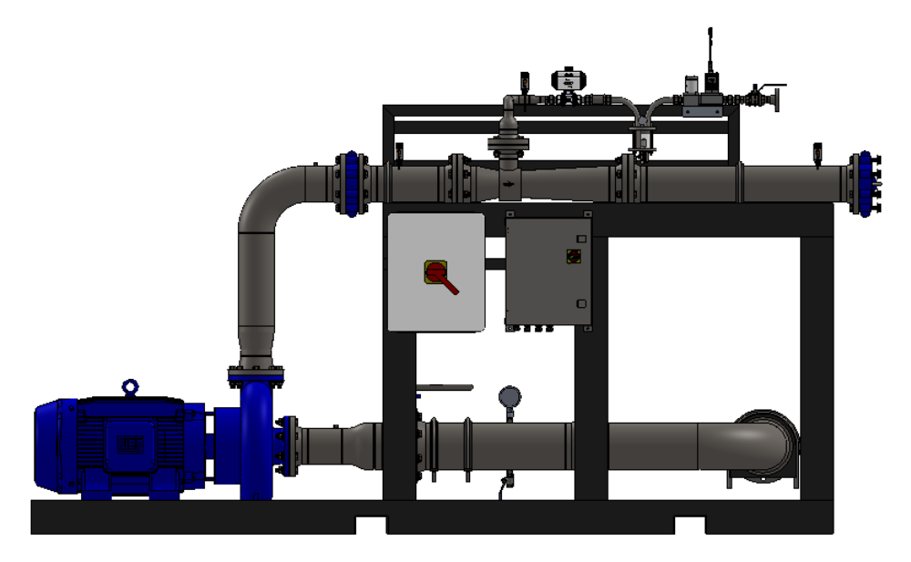
TECHNICAL APPLICATIONS & PROPOSALS
4. Standard Scope
Ozone generator
Standard instrumentation
(Standard Schneider M251 PLC & RedLion 15-inch HMI)
(1) Ambient Ozone Monitor
(1) Ambient Oxygen Monitor
(1) Dissolved Ozone Panel
Who?
(Pinnacle, Mazzei, Statiflo)
Stepdown transformer
Sizing Requirements
(480/575V -> 230v)
Master ozone control panel (MOCP)
(flow, dosage required and MTE)
(Schneider M251 PLC & RedLion 15’”HMI)
GOX manifold
Injection type
(filters and regulates oxygen feed to the ozone generator​)
Spare Parts
(side stream, diffusion, static mixer, OMTU nozzles)
(Consumables only)
Ozone Destruct
Start-up & commissioning
Contactor dimensions
(1 per ozone generator)
(1 trip – 2 technicians – 5 days])
Mainline Diameter
Air-cooled chiller​
Delivery to site

Slide 7

TECHNICAL APPLICATIONS & PROPOSALS
5. Ozone Injection
Who?
(Pinnacle, Mazzei, Statiflo)
Sizing Requirements
(flow, dosage required and MTE)
Injection type
(side stream, diffusion, static mixer, OMTU nozzles)
Contactor dimensions
Mainline Diameter
Who?
(Mechanical: 4-6 weeks after receipt of approved contract. Controls: 2-4 weeks after mechanical approval)
Delivery Lead-time
(18-22 weeks after approval)
Equipment Warranty
(12 months from final acceptance not exceeding 18 months from delivery)
Dielectric Warranty
([20 years from ship date])

Slide 8





TECHNICAL APPLICATIONS & PROPOSALS
6. Lead-time &Warranties
Thank You for Attending
Who?
(Mechanical: 4-6 weeks after receipt of approved contract. Controls: 2-4 weeks after mechanical approval)
We look forward to the journey ahead, where we can turn our shared vision into reality.
Delivery Lead-time
321-506-1850
(18-22 weeks after approval)
www.pinnacleozone.com
Equipment Warranty
Cocoa, Florida, USA
(12 months from final acceptance not exceeding 18 months from delivery)
Dielectric Warranty
([20 years from ship date])

Slide 9
Thank You for Attending
We look forward to the journey ahead, where we can turn our shared vision into reality.
321-506-1850
www.pinnacleozone.com
Cocoa, Florida, USA

