Slide 1

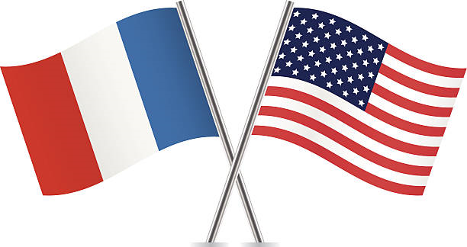
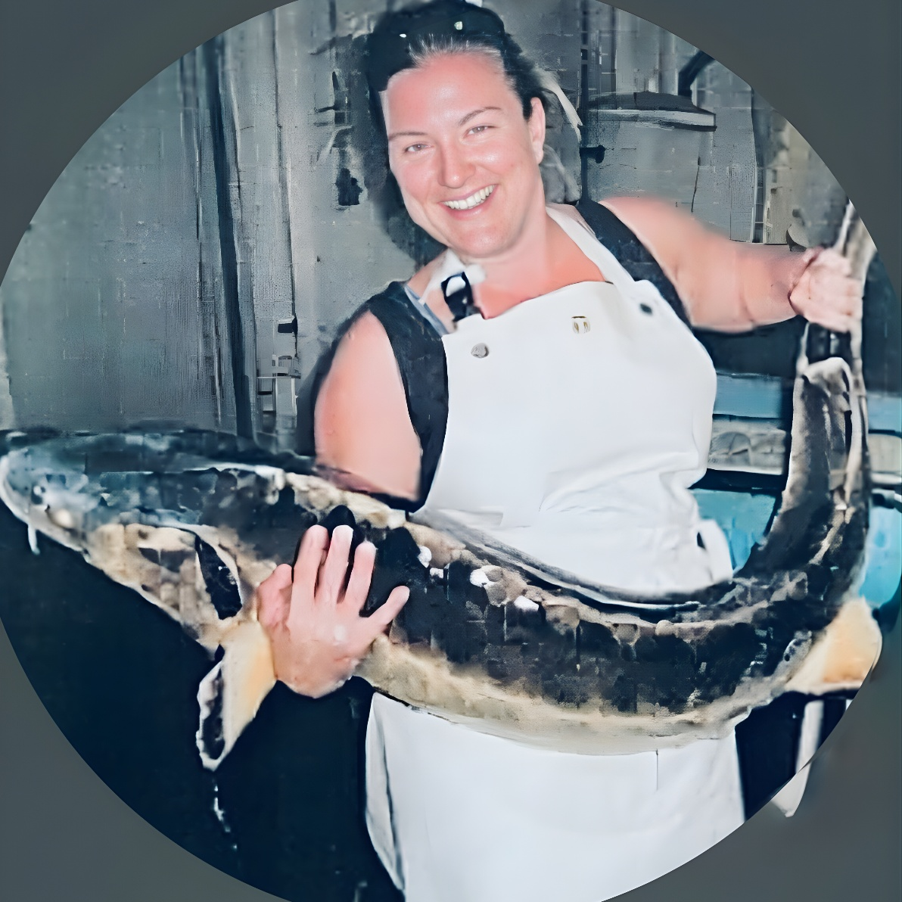
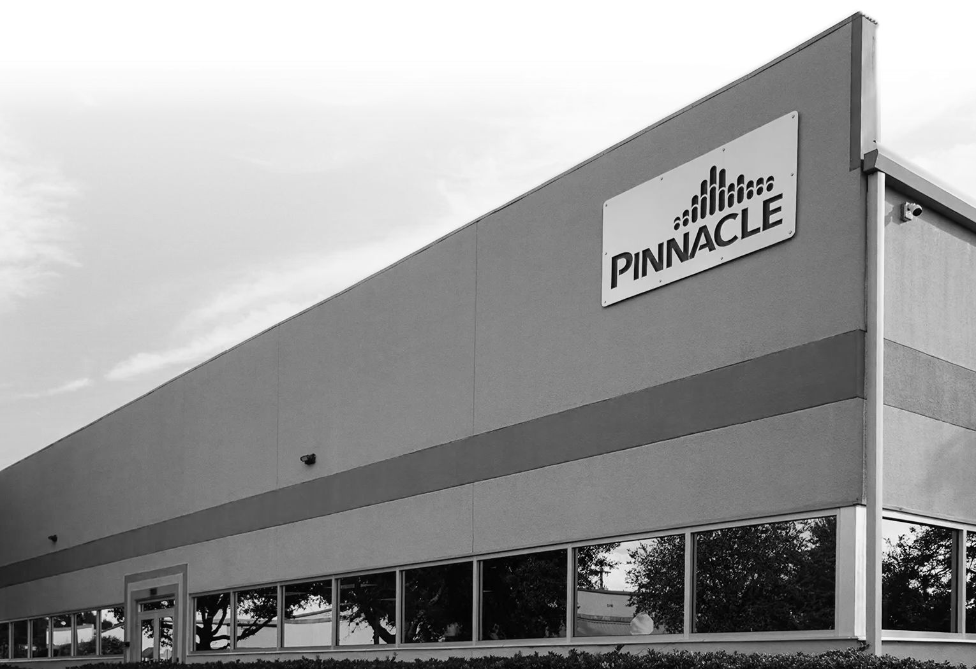
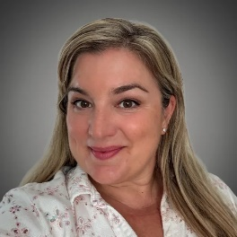
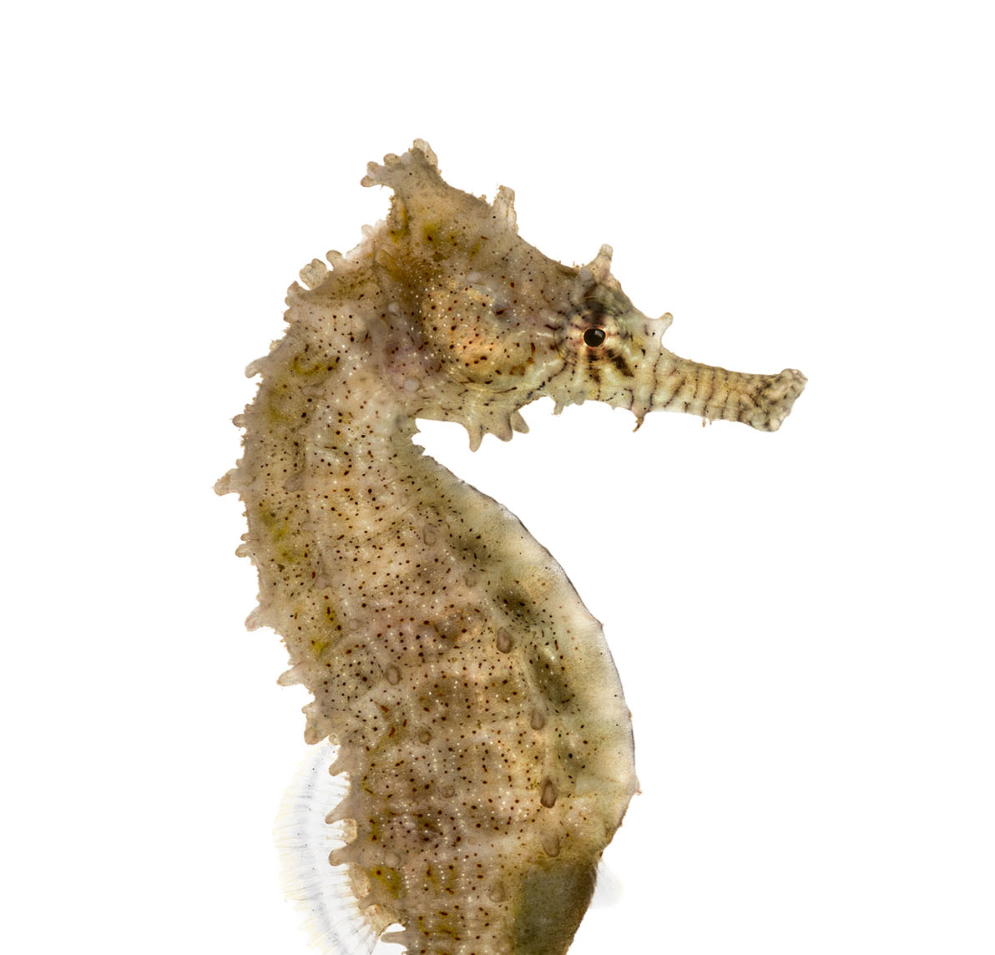
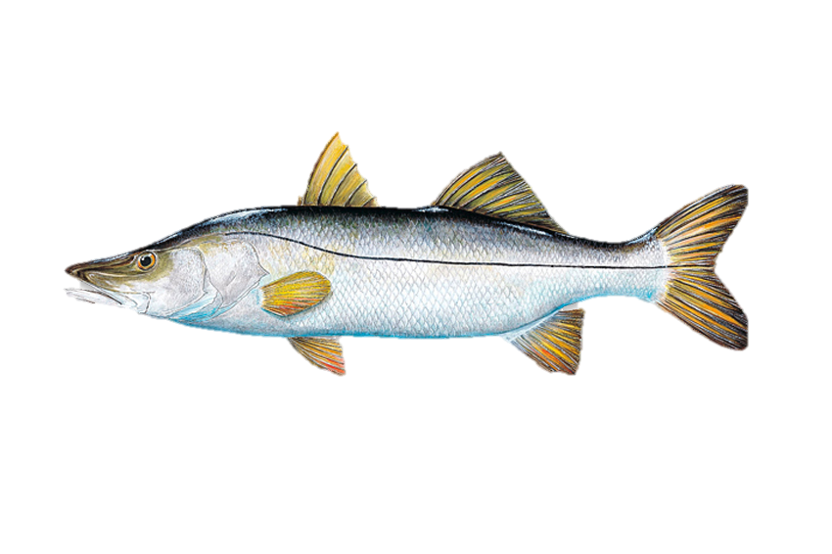
Introduction
PINNACLE OZONE SOLUTIONS
Industrial Ozone Applications
Constance Beaulaton
INDUSTRIAL SALES MANAGER

Slide 2



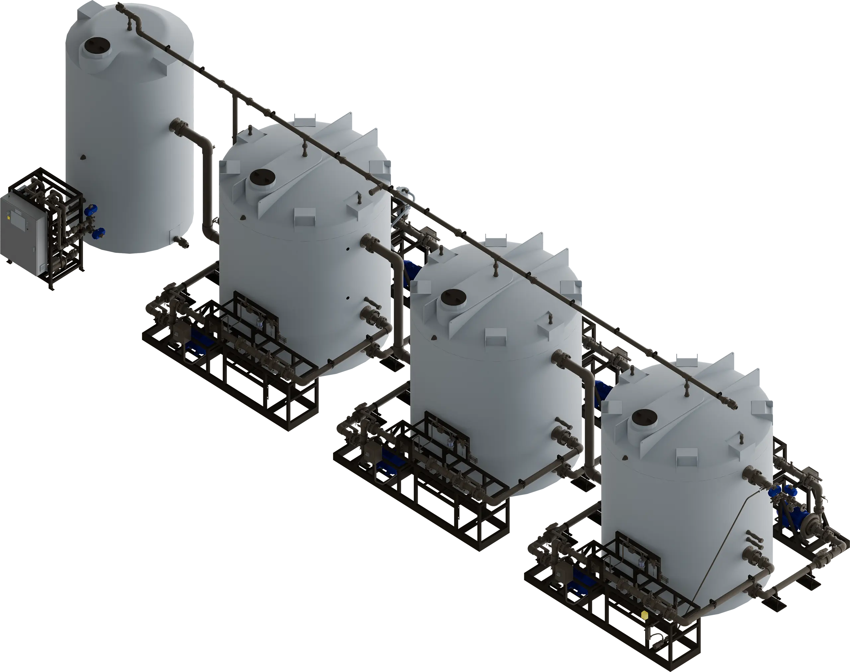


Pharmaceutical Treatments
Pharmaceutical
Treatments
Introduction
PINNACLE OZONE SOLUTIONS
Industrial Ozone Applications
Used to destroy pharmaceutical compounds
  Regulatory
  Environment
  Proprietary
  Before wastewater treatment plan
  Increased regulations & validations
High Ozone Transfer Dose of 50-100mg/L
Cascade > 25 mg/L per cascade unit
Combination of ozone & AOP
Studied at FIT, Melbourne FL.
Fish Farmer for 13 years Mote Marine Lab, Sarasota FL
Snook: Stock Enhancement
Sturgeon: Meat & Caviar
Experiments on denitrification, feeding and purging
Seahorses for aquarium business
12 years in aquaculture sales for Commercial RAS
Northeast & US
Industrial Sales Manager at Pinnacle Ozone Solutions
Northeast & US
Industrial Sales Manager at Pinnacle Ozone Solutions
Constance Beaulaton
INDUSTRIAL SALES MANAGER

Slide 3

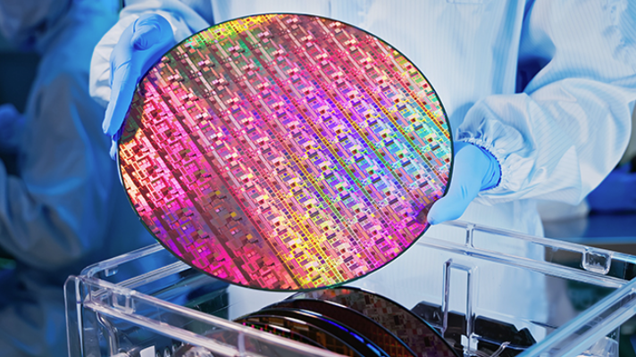
Micro-conductors
Pharmaceutical
Treatments
Used to destroy pharmaceutical compounds
  Regulatory
  Environment
  Proprietary
  Before wastewater treatment plan
  Increased regulations & validations
High Ozone Transfer Dose of 50-100mg/L
Cascade > 25 mg/L per cascade unit
Combination of ozone & AOP

Slide 4
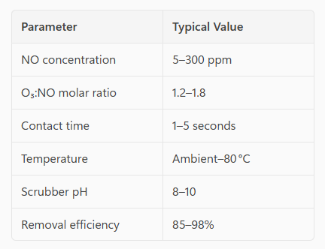
No Removal Exhaust
Micro-conductors
Nitric Oxide (NO) used for:
  Etching plasma processes
  High-temperature oxidation steps
  Ion Implantation into crystal lattice
  Thermal abatement systems (NO formed as a secondary byproduct)
Most semiconductor NO is:
  Low concentration (ppm to low hundreds ppm)
  High volumetric flow
  Mixed with moisture, acids, and fluorinated gases
NO is poorly water-soluble and chemically stable:
  NO does not absorb efficiently in wet scrubbers
  NO does not react quickly without oxidation
  Traditional alkaline or acid scrubbers show <20% NO removal
  Therefore, oxidation of NO to NO₂ or N₂O₅ is essential before absorption
Key Parameters Needed:
  Ozone converts NO → NO2 & N2O5
  Wet Scrubbers absorb the resulting Nitric Acid
  High Efficiency at low concentrations
  Aligns with semiconductors fabrication requirements: CHIPS Act, EUBAT and EPA NESHAP

Slide 5
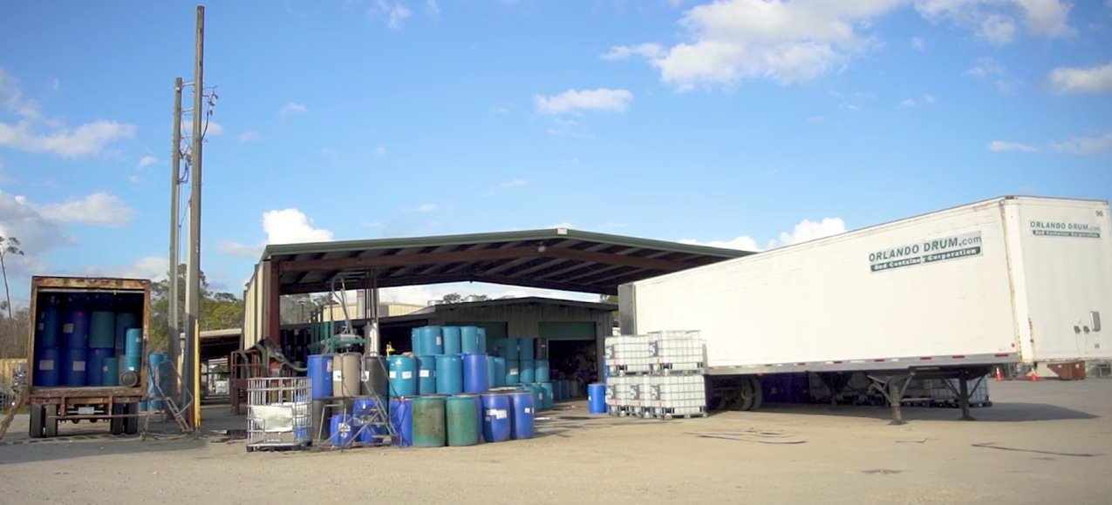
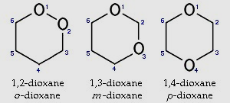
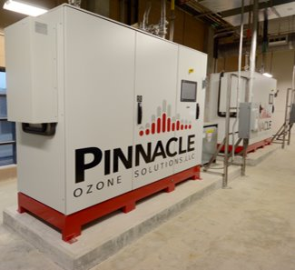
Ozone for 1,4-Dioxane Remediation
NO Removal Exhaust
Key Parameters Needed:
  Best Removal Technique:
  Ozone-based NO oxidation + wet scrubbing
  Step 1: Oxidation of NO using ozone
  NO+O3→NO2+O2
  With excess ozone: 2NO2+O3→N2O5+O2
  ​N2O5 readily hydrolyzes to nitric acid: N2O5+H2O→2HNO3
  Step 2: Absorption in a wet scrubber
  HNO₃ is highly water soluble (strong acid)
  Easily removed by: Water & alkaline solution (NaOH, KOH)
  NO removal efficiency:85–98% depending on O₃:NO ratio & contact time
  Ozone converts NO → NO2 & N2O5
  Wet Scrubbers absorb the resulting Nitric Acid
  High Efficiency at low concentrations
  Aligns with semiconductors fabrication requirements: CHIPS Act, EUBAT and EPA NESHAP

Slide 6
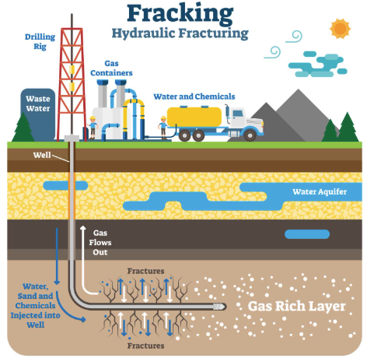
Oil & Gas Fracking
Water handling is one of the largest operating cost in shale development
Ozone for 1,4-Dioxane Remediation
  1,4-Dioxane is a highly soluble, persistent organic contaminant resistant to conventional treatment.
  Ideal for Superfund sites and groundwater remediation
  Ozone alone has limited reactivity with 1,4-dioxane.
  Advanced Oxidation Process (AOP) using ozone + hydrogen peroxide generates hydroxyl radicals (•OH) that effectively break down 1,4-dioxane.
  Requires optimized dosing (ozone/H₂O₂ ratio) and contact time.
  Proven field results: >97% reduction of 1,4-dioxane with no harmful byproducts.

Slide 7
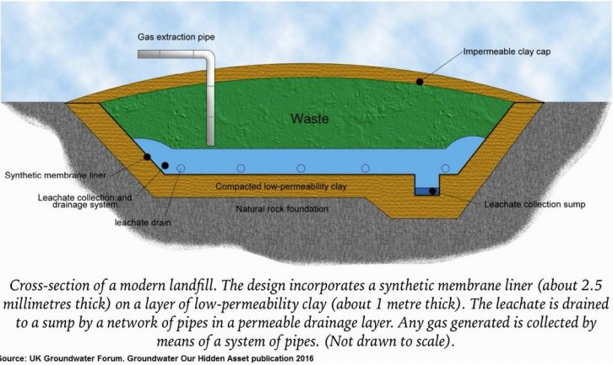
Landfill
Leachate
Oil & Gas Fracking
Water handling is one of the largest operating cost in shale development
  TREAT FLOW BACK
  Millions of gallons with chemicals, Hydrocarbons (BTEX),sulfides, high COD, bacteria, iron, manganese, iron sulfide (FeS).
  OZONE HELPS:
    Oxidizes hydrocarbons & organics, reducing COD and toxicity
    Breaks down BTEX and frac additives, improving reuse quality
    Destroys bacteria and biofilms, sulfate‑reducing bacteria (SBR)
    Oxidizes iron and sulfides, preventing downstream fouling & equipment corrosion ($$)
  ON-SITE RECYCLING:
    Cuts freshwater demands
    Cuts disposal costs
    Increases ROI

Slide 8

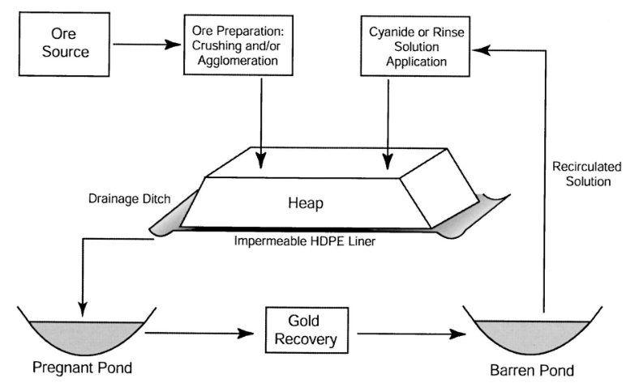
Heap-Leaching Tank Leaching
Gold Cyanidation
Landfill
Leachate
  Decomposition process in landfill → Liquid by-product rich in:
    Dissolved organic matters; high BOD, COD
    Inorganics like Salts, metals, heavy metals
    Xenobiotic compounds: pesticides, pharmaceuticals, industrial chemicals
  Issues for surface waters, ground waters, harm species diversity, accumulate in food chains, pollutants
  Biological treatment + Ozone to decrease toxicity & disinfect with Ozone or AOP.

Slide 9
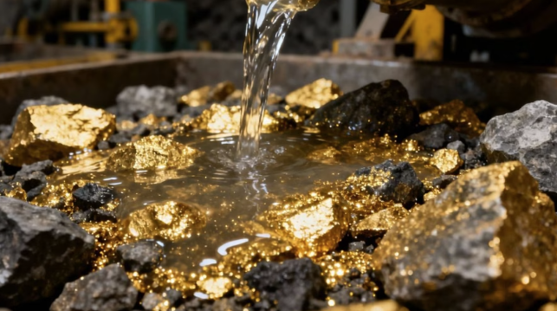
Heap-Leaching Tank Leaching
Gold Cyanidation
  Gold Cyanidation: Hydrometallurgical technique to extract gold from low grade ore.
  75% of global gold is extracted using cyanide-based processes
  Sodium Cyanide is added to crushed rocks → “Gold Cyanide”.
  Liquid Gold [Au(CN)2)]-
  Maintain alkaline pH above 10.5
  Use of lime to prevents HCN gas formation
  Add Zinc/ activated carbon to precipitate the gold
  Add sulfuric acid, which removes the zinc → GOLD.
Gold Cyanidation
  How Ozone destroys Cyanide:
  CN−+O3​→CNO− +O2 (cyanate =less toxic than cyanide)
  With enough O3 & contact time, with pH >9
  2CNO−+H2​O+3O3​→2CO32−​+N2​+3O2+2H+

Slide 10
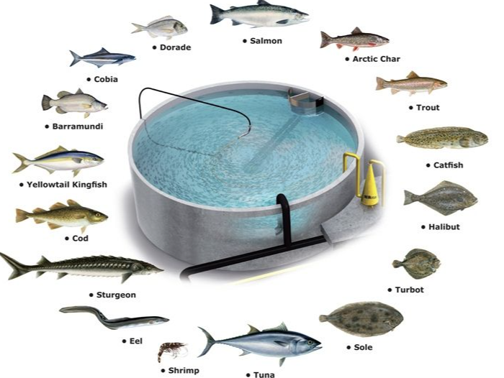
Aquaculture
Gold Cyanidation
  Final products
  Carbonate / bicarbonate & Nitrogen gas or nitrate
  Dosage
  2-3 g of O3/ gram of CN-
  Typical Injection Methods
  Fine-bubble contactors, Static mixers, Venturi injectors
  Reaction Rate
  1min
  Gold Mines in the US:
  Nevada- 70% of the US output
  Alaska
  Colorado
  Utah
  How Ozone destroys Cyanide:
  CN−+O3​ → CNO− +O2 (cyanate = less toxic than cyanide)
  With enough O3 & contact time, with pH >9
  2CNO−+H2​O+3O3 ​→2CO32−​+N2​+3O2+2H+

Slide 11

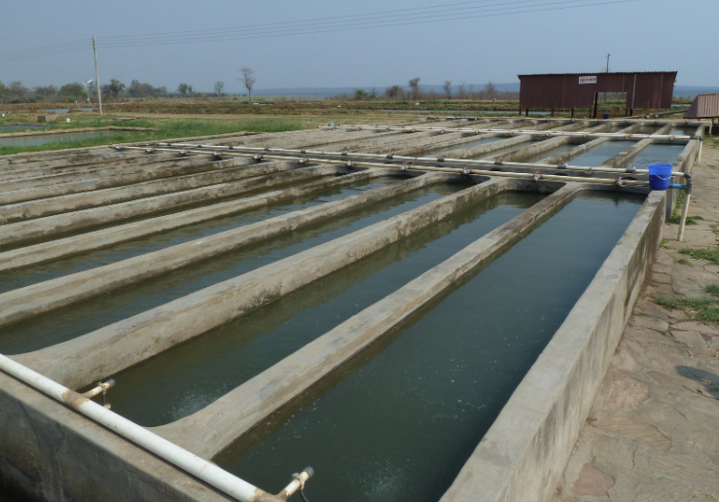
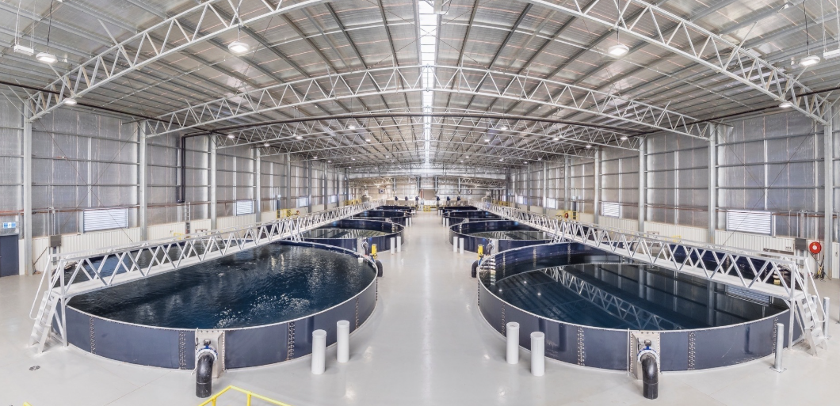
Land-Based Aquaculture Systems
Aquaculture
Aquaculture is the breeding, rearing, and harvesting of fish, shellfish, algae, and other organisms in all types of water environments.
Purpose: Food, research, stock enhancements
Species Diversity: Catfish, Salmon, Trout, Shrimp & Bass
Top Producing States (55% of sales): Mississippi, Washington, Louisiana, Florida, Alabama
Production Systems: pond culture, cage culture, tank culture, recirculating aquaculture systems (RAS), and integrated multi-trophic aquaculture (IMTA)
US ranks 17th in the world Aquaculture production
Regulatory bottlenecks, high production costs, limited coastal space, heavy reliance on imports.

Slide 12
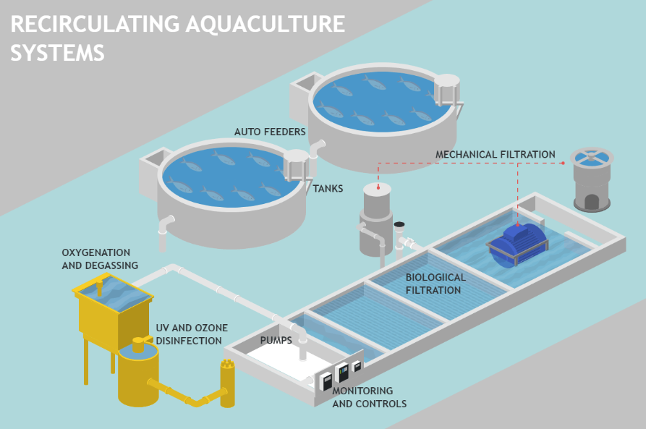
Recirculating
Aquaculture
Systems
Land-Based Aquaculture Systems
Flow Through: Lots of water available. Allow for a single pass through the tanks / raceways. Hard to control environment.
RAS: Very limited amount of make-up water (<10%). System water is filtered mechanically & biologically. Highly controlled environment.
P-RAS: Good amount of water available- System has mechanical filtration only. Water chemistry is kept good by the higher water exchange %/daily.

Slide 13
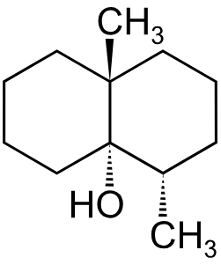
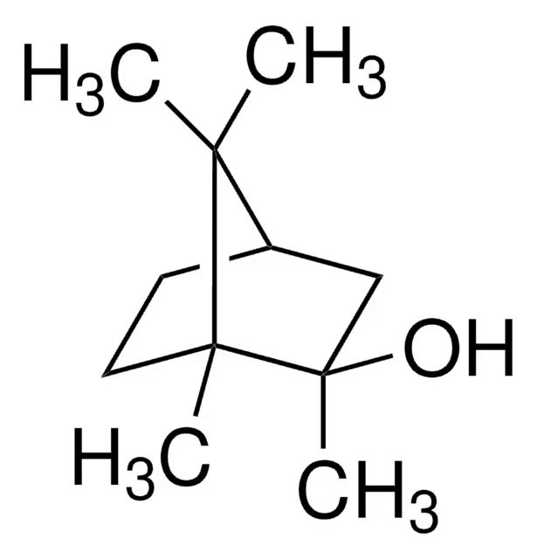
Off-flavor Compounds
Influent & Effluent disinfection
Off-Flavor Treatments in Purge targeting MIB & Geosmin
GEOSMIN
2-MIB
Recirculating
Aquaculture
Systems

Slide 14
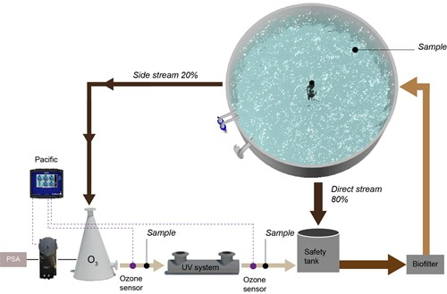
GEOSMIN
2-MIB
Ozone in Purge Systems
Off-flavor Compounds
How to shorten the purge time to clean fish for human consumption?
Influent & Effluent disinfection
Off-Flavor Treatments in Purge targeting MIB & Geosmin
RAS → Accumulation of OFCs:
Even Small amount of OFCs affect the flesh flavor
Detectible at low [C] 5-10 parts/ trillion.
Essential to allow fish to depurate and remove off flavor prior to harvest.
Purge systems: Side tank or systems where incoming water is either abundant or treated.
Purge takes time & resources
Fish lose weight >5% BW
Extra system to maintain
Overall Costly
Most frequent cause for earthy and musty taste:
2-methylisoborneol (2-MIB) and Geosmin
From Cyanobacteria (blue-green algae) & microorganisms
Accumulates in system/ feed
Test taste might be needed prior to harvest to ensure proper resell value

Slide 15

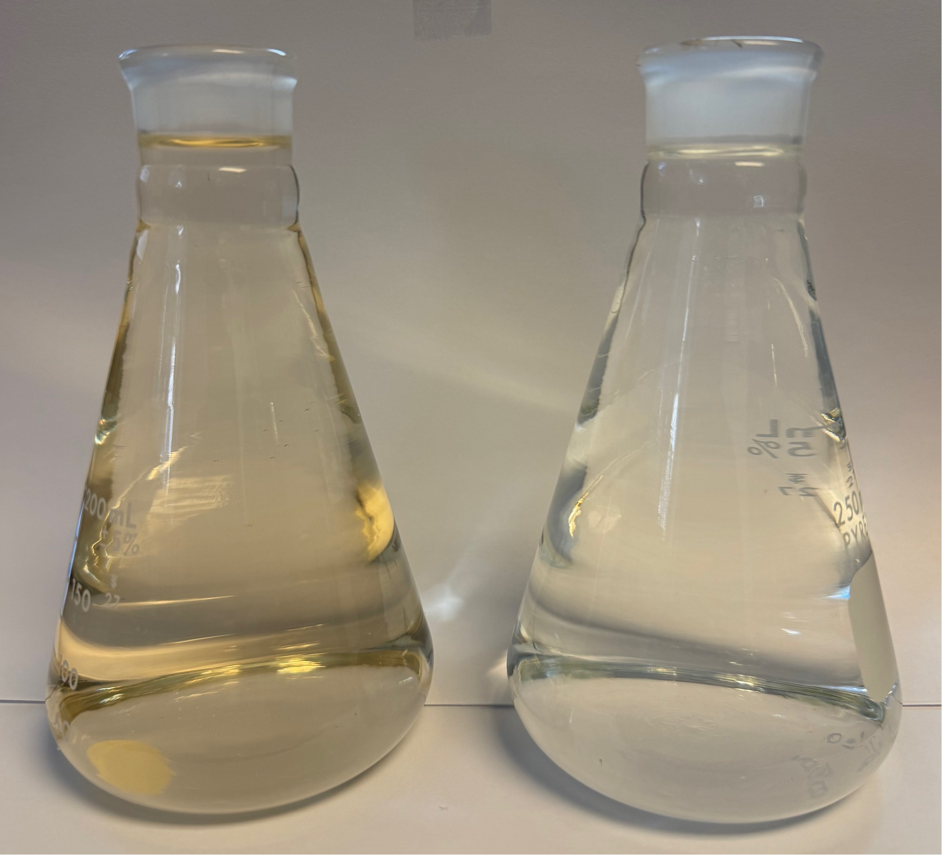
Ozone in Purge Systems
How to shorten the purge time to clean fish for human consumption?
There is more…
POST OZONATED RAW WATER
APPARENT COLOR : 6 PT-CO
Textile Industry/ Color Removal
Papermills
Amusement Parks & Spas
Cooling Towers
Water Remediation: Toxin, Algae…
Purge Time will depend on:
Fish Species
Fatty tissues content as Geosmin & MIB anchor in fat cells
Limiting Rate Factor: initial [C] in fish and depurating rate
Contact Time for O3 reaction
Water temperature
Feeding rate if any
Ozone can be followed by UV & carbon treatment (AOP solution)
RAW WATER APPARENT COLOR : 103 PT-CO
Test taste might be needed prior to harvest to ensure proper resell value

Slide 16




Thank You for Attending
There is more…
POST OZONATED RAW WATER
APPARENT COLOR : 6 PT-CO
We look forward to the journey ahead, where we can turn our shared vision into reality.
Textile Industry/ Color Removal
Papermills
Amusement Parks & Spas
Cooling Towers
Water Remediation: Toxin, Algae…
321-506-1850
www.pinnacleozone.com
Cocoa, Florida, USA
RAW WATER APPARENT COLOR : 103 PT-CO

Slide 17


Thank You for Attending
We look forward to the journey ahead, where we can turn our shared vision into reality.
321-506-1850
www.pinnacleozone.com
Cocoa, Florida, USA

