Slide 1

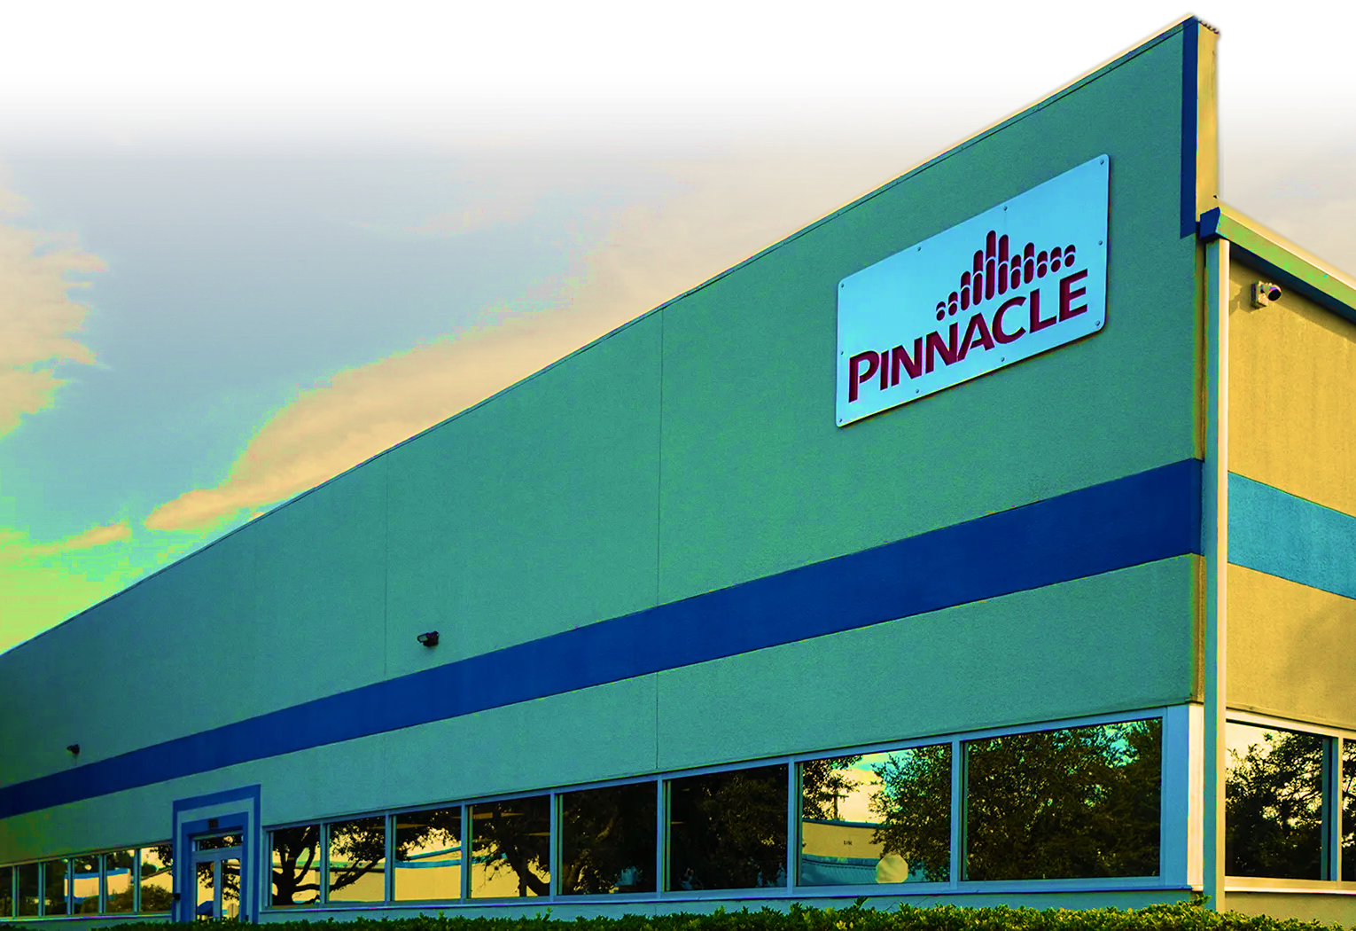
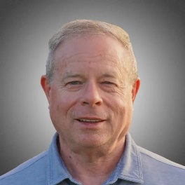
PINNACLE OZONE SOLUTIONS
STATE OF THE COMPANY
Chuck Smith
PRESIDENT & CEO
Welcome

Slide 2
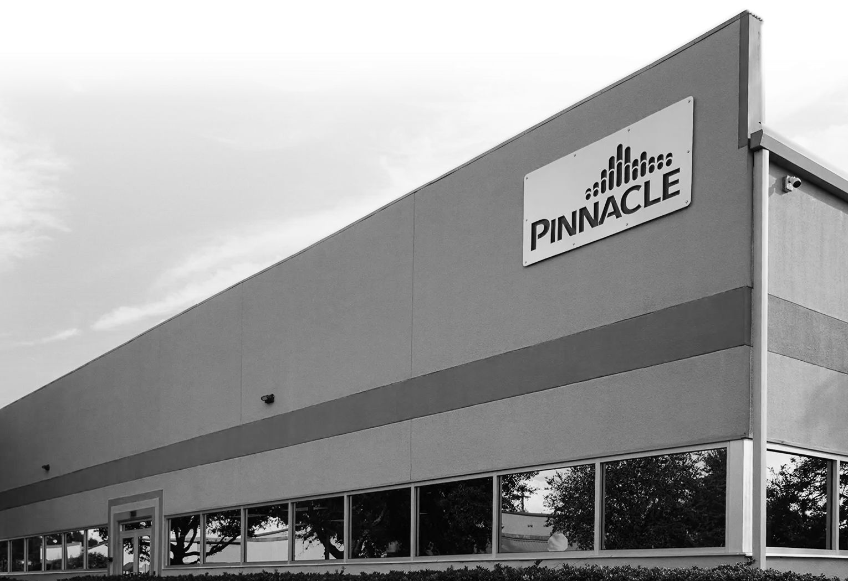

Welcome
PINNACLE OZONE SOLUTIONS
STATE OF THE COMPANY
Chuck Smith
PRESIDENT & CEO
Keys To
Our Success

Slide 3

















Keys To
Our Success
Our Reps

Slide 4
Our Reps
TIMELINE OF OUR SUCCESS
2009
2010
2011
2011
2014
2016
2023
2024
2025
2026

Slide 5
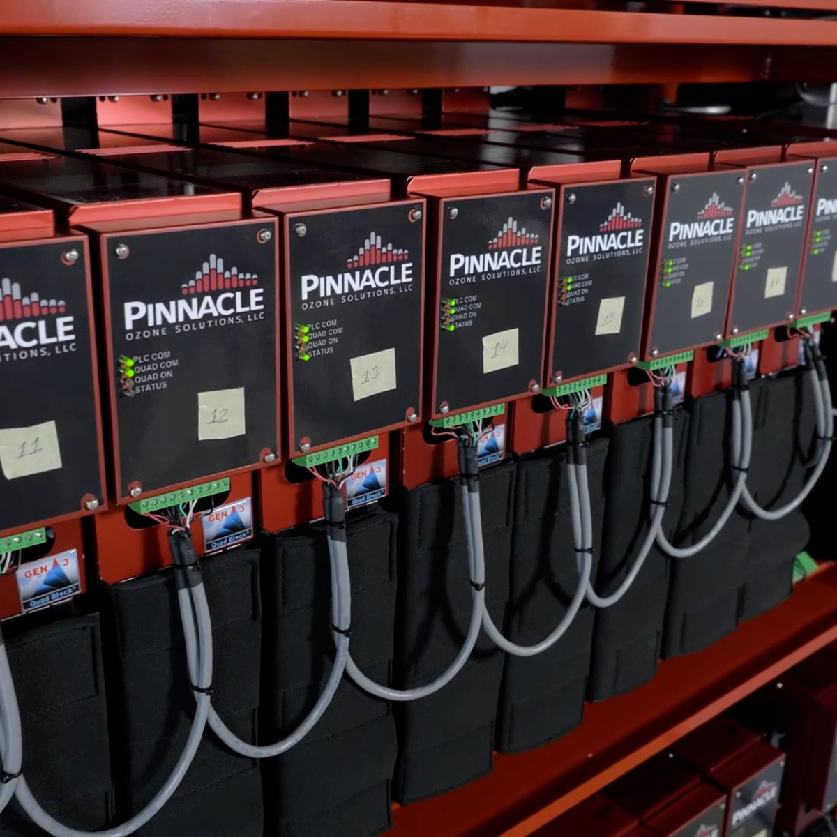


TIMELINE OF OUR SUCCESS
Pinnacle Core Focus
in the Beginning
Pinnacle Ozone Solutions was formed
ISO 9001 Certification for Quality Systems
Start of EOS
TODAY
First municipal ozone installation in Canada, Fort Coulonge, Quebec
QuadBlock Gen 4,
20 ppd @ 10%
Rep Meeting:
Cocoa Beach
Build a reliable ozone generator.
  No Dielectric Failure
  No Power Supply Failures
  No Service-Related Issues
  Avoid the pitfalls of the “other” ozone companies.
Build a supportable ozone generator (service and components)
Build an ozone “system” that anyone can operate. Use our system integration skills to make a system that didn’t exist in the marketplace. One button operation.
2009
2010
2011
2011
2014
2016
2023
2024
2025
2026
UL Listing for the QuadBlock Ozone Generator
First aquaculture installation at Superior Fresh Farms, Wisconsin
BIO-UV Agreement
& Signed
QuadBlock Gen 1,
10 ppd @ 10%
First municipal ozone installation in Bismarck, North Dakota
First Central American
Project for Hanes Brands in El Salvador
CE Certified

Slide 6
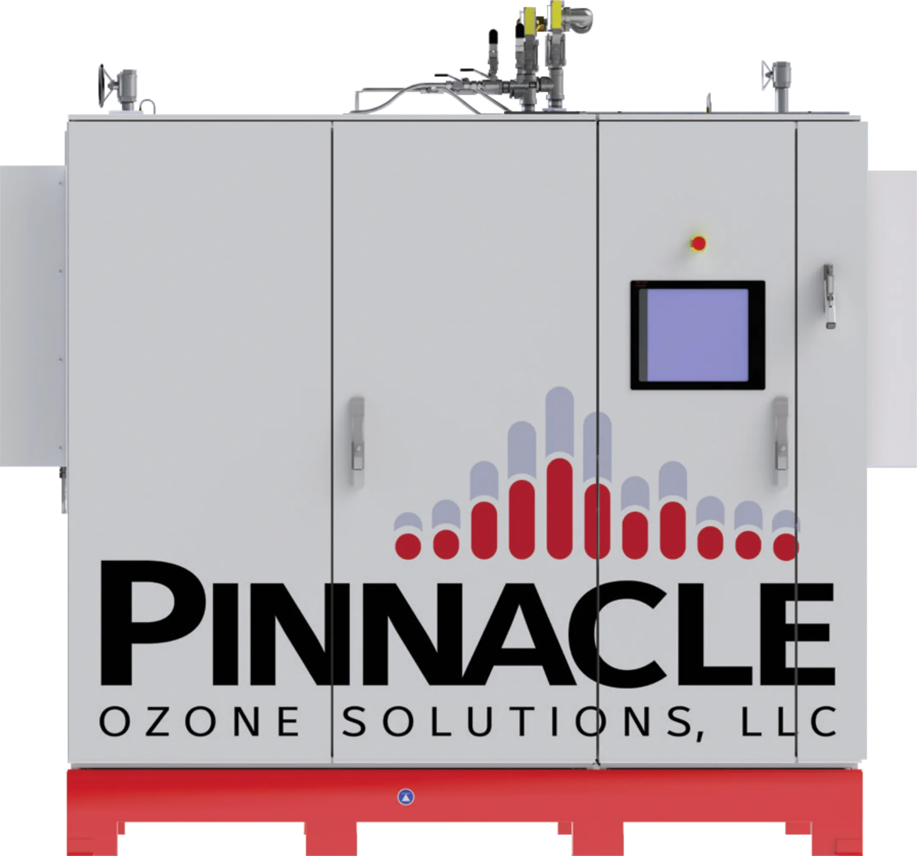
PINNACLE’S FIRST REP MEETING
Pinnacle Core Focus
in the Beginning
JUNE 2013
Build a reliable ozone generator.
  No Dielectric Failure
  No Power Supply Failures
  No Service-Related Issues
  Avoid the pitfalls of the “other” ozone companies.
Build a supportable ozone generator (service and components)
Build an ozone “system” that anyone can operate. Use our system integration skills to make a system that didn’t exist in the marketplace. One button operation.
NOTES FROM THE PREVIOUS MEETING
Integration - Big Issue - Double down on your system Integration
If you say you will have a proposal tomorrow, then have it tomorrow.
Branding type campaigns - who are you? Global Specifications, etc.

Slide 7


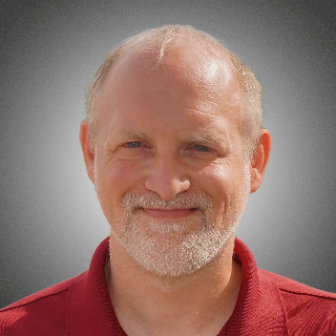
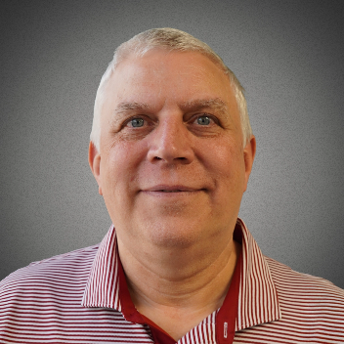
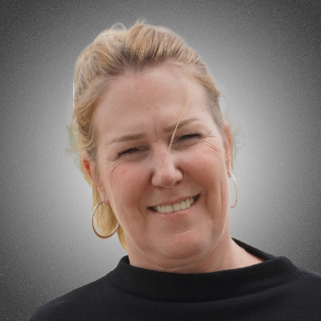
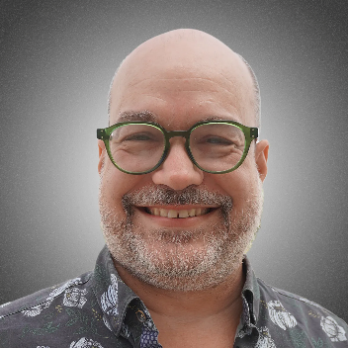
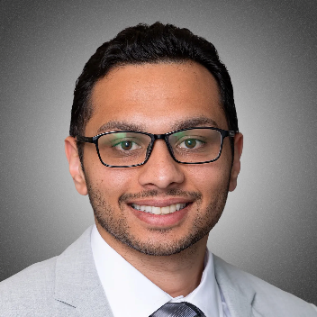
Strong Leadership Team
PINNACLE’S FIRST REP MEETING
JUNE 2013
NOTES FROM THE PREVIOUS MEETING
Integration - Big Issue - Double down on your system Integration
If you say you will have a proposal tomorrow, then have it tomorrow.
Branding type campaigns - who are you? Global Specifications, etc.
Chuck Smith
President & Chief Executive Officer
Ely Wineland
Operations Manager & Principal Mechanical Engineer
Guy Begin, Jr
Senior Financial Accountant
MJ Quessy
Director of Operational Excellence & Strategic Execution
Philippe Taliana
Global Sales Manager
Sannel Patel
Director of Business Development & Marketing

Slide 8

OCT 2024 TO DEC 2025
Pinnacle is Growing at a Rapid Pace
Strong Leadership Team
Order Value
$11, 690,480.17
Backlog
$7,995,494.56
FROM OCTOBER 2024
Order Value
$25,178,217.83
Backlog
$16,605,909.52
Chuck Smith
President & Chief Executive Officer
Ely Wineland
Operations Manager & Principal Mechanical Engineer
Guy Begin, Jr
Senior Financial Accountant
MJ Quessy
Director of Operational Excellence & Strategic Execution
Philippe Taliana
Global Sales Manager
Sannel Patel
Director of Business Development & Marketing
FROM DECEMBER 2025

Slide 9
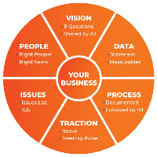
PINNACLE’S PLAN FOR RAPID GROWTH
Entrepreneurial Operating System (EOS)
OCT 2024 TO DEC 2025
Pinnacle is Growing at a Rapid Pace
In just 15 months, our manufacturing order value and backlog have more than doubled.
A direct reflection of the demand for Pinnacle’s technology and our team’s execution.
Order Value
$11,690,480.17
Backlog
$7,995,494.56
FROM OCTOBER 2024
Order Value
$25,178,217.83
Backlog
$16,605,909.52
FROM DECEMBER 2025
Every number here reflects a shared goal. This is our path to growing together with clarity, purpose, and opportunity.

Slide 10
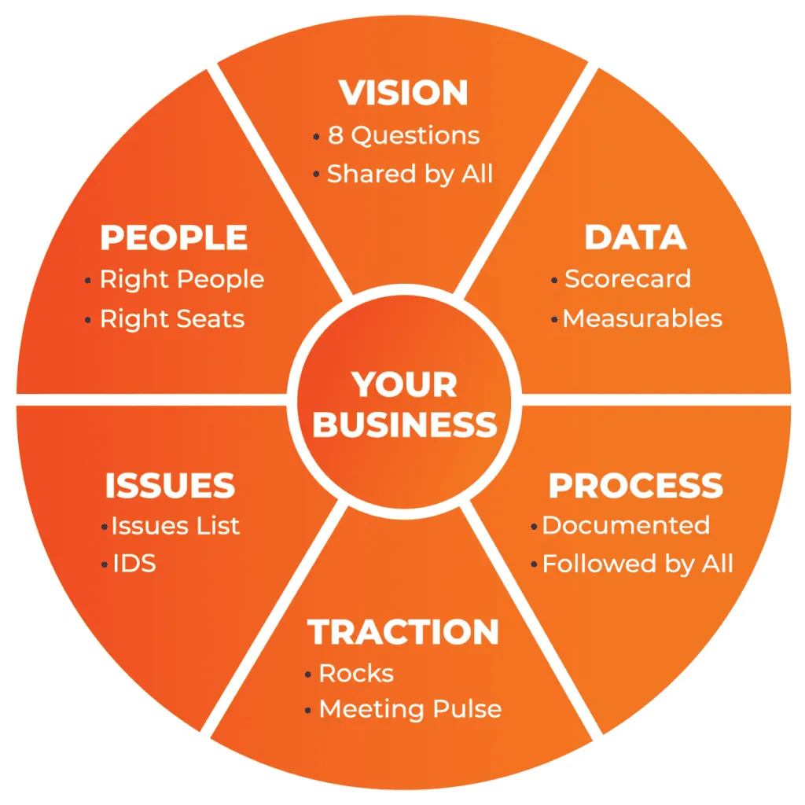
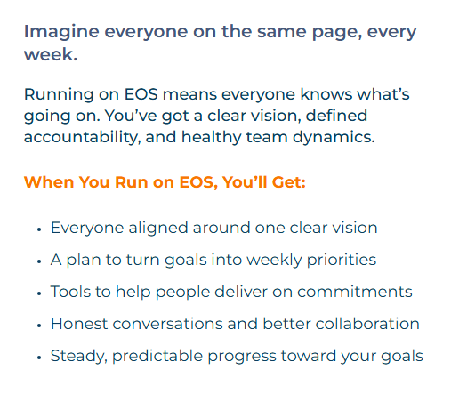
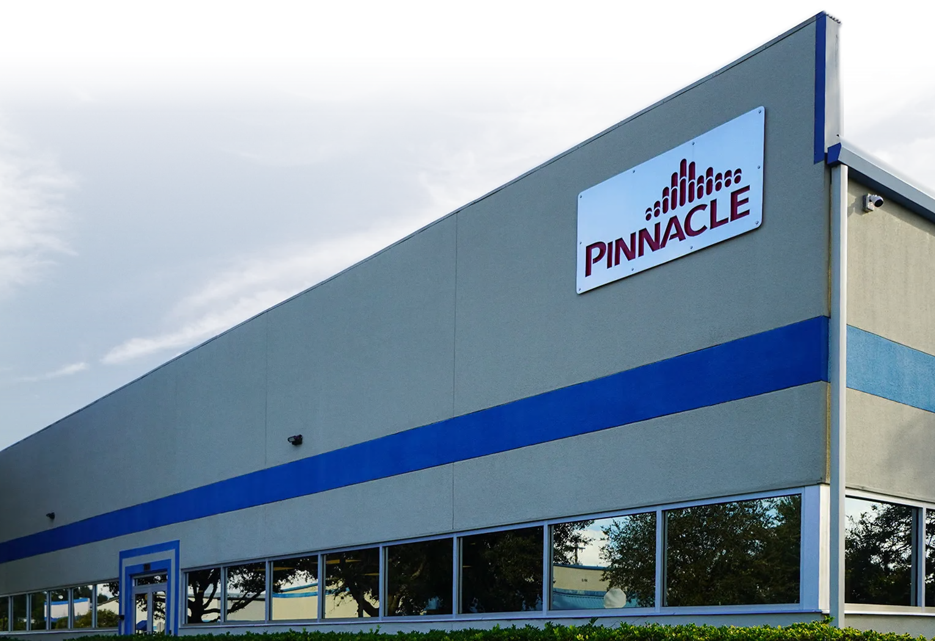

PINNACLE’S PLAN FOR RAPID GROWTH
Pinnacle’s Future
Looks Bright
Entrepreneurial Operating System (EOS)
Strong Rep Network
$300M Quote Backlog
Win Rate of 67% on all projects that go to bid
$14M in Equipment Manufacturing Back
Staff and Facility on board with a capacity to produce $30M in annual revenue
Sales Forecast of $27M in the next 12-18 months

Slide 11



Pinnacle’s Future
Looks Bright
Thank You for Attending
We look forward to the journey ahead, where we can turn our shared vision into reality.
Strong Rep Network
$300M Quote Backlog
Win Rate of 67% on all projects that go to bid
$16M in Equipment Manufacturing Back
Staff and Facility on board with a capacity to produce $30M in annual revenue
Sales Forecast of $27M in the next 12-18 months
321-506-1850
www.pinnacleozone.com
Cocoa, Florida, USA

Slide 12

Thank You for Attending
We look forward to the journey ahead, where we can turn our shared vision into reality.
321-506-1850
www.pinnacleozone.com
Cocoa, Florida, USA

