Slide 1

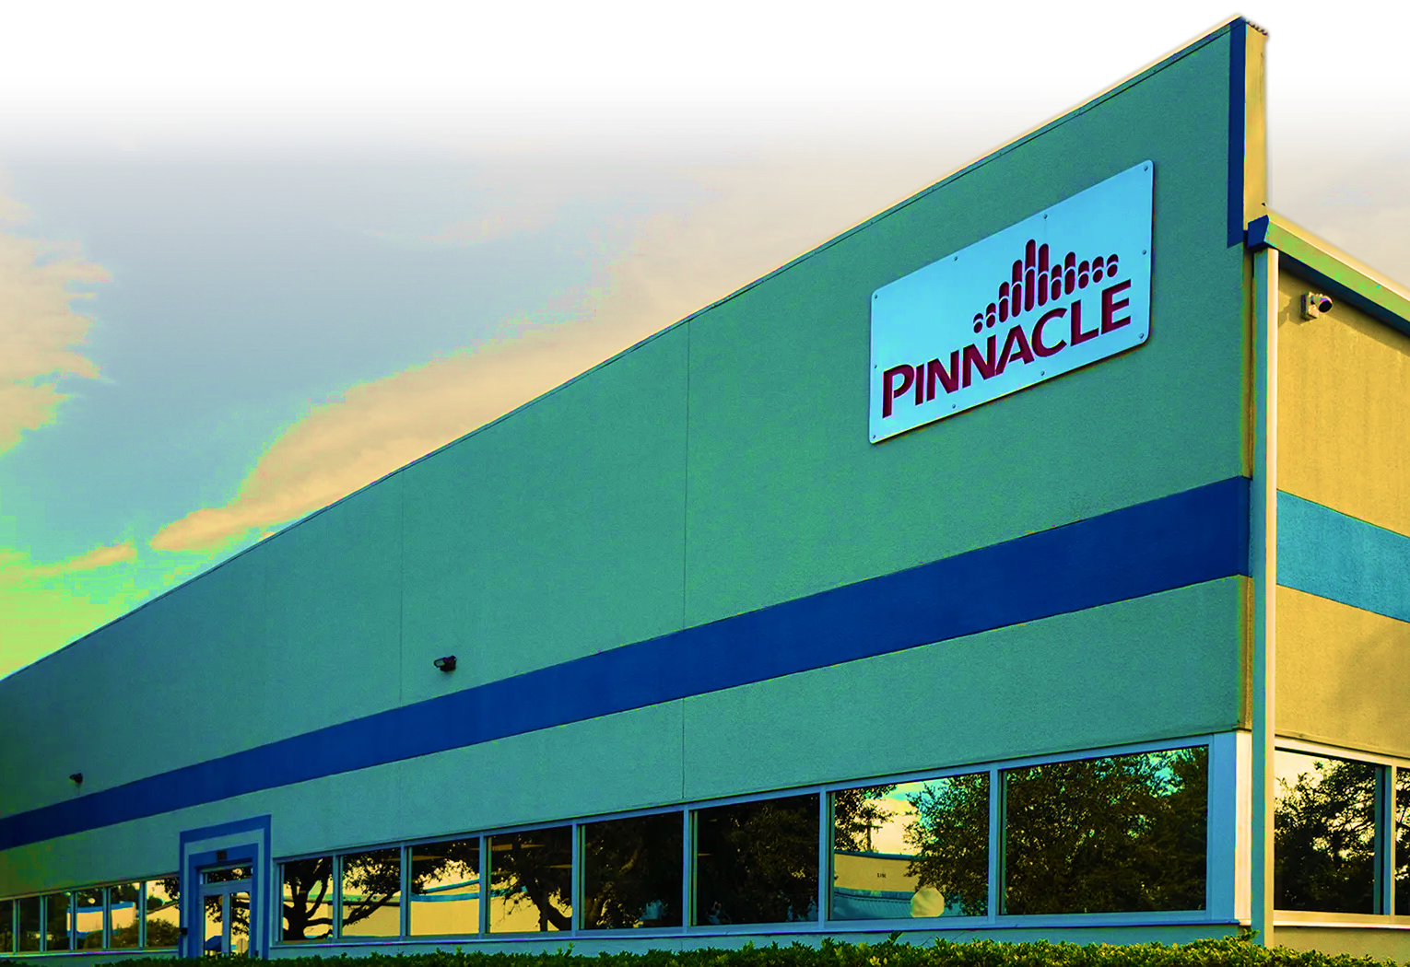


Pinnacle’s Service Philosophy
PINNACLE OZONE SOLUTIONS
Built on Service. Proven Over Time.
Service and support were a founding priority in 2009
Competitors struggled with long response times.
Service & Support:
A Foundational Pillar Since 2009
Replacement parts were quoted in months, not days.
Pinnacle set the standard with same-day parts shipment
(orders placed before 2:00 p.m.)
20 Year Warranty on Dielectrics is an industry first!
Chuck Smith
PRESIDENT & CEO

Slide 2
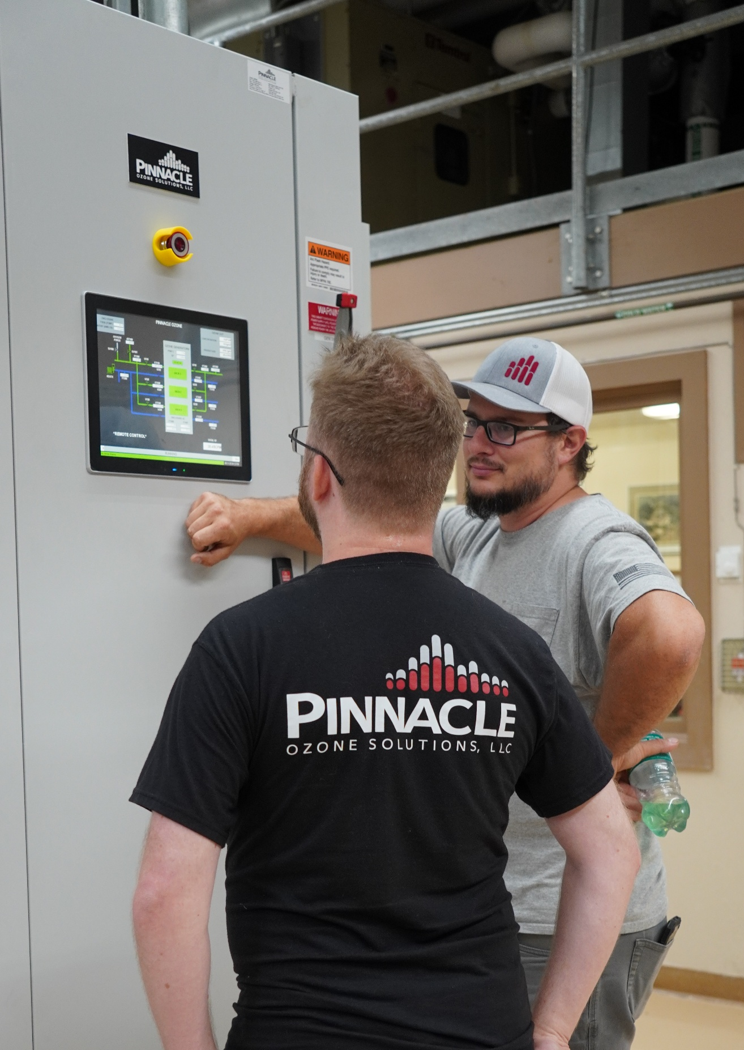


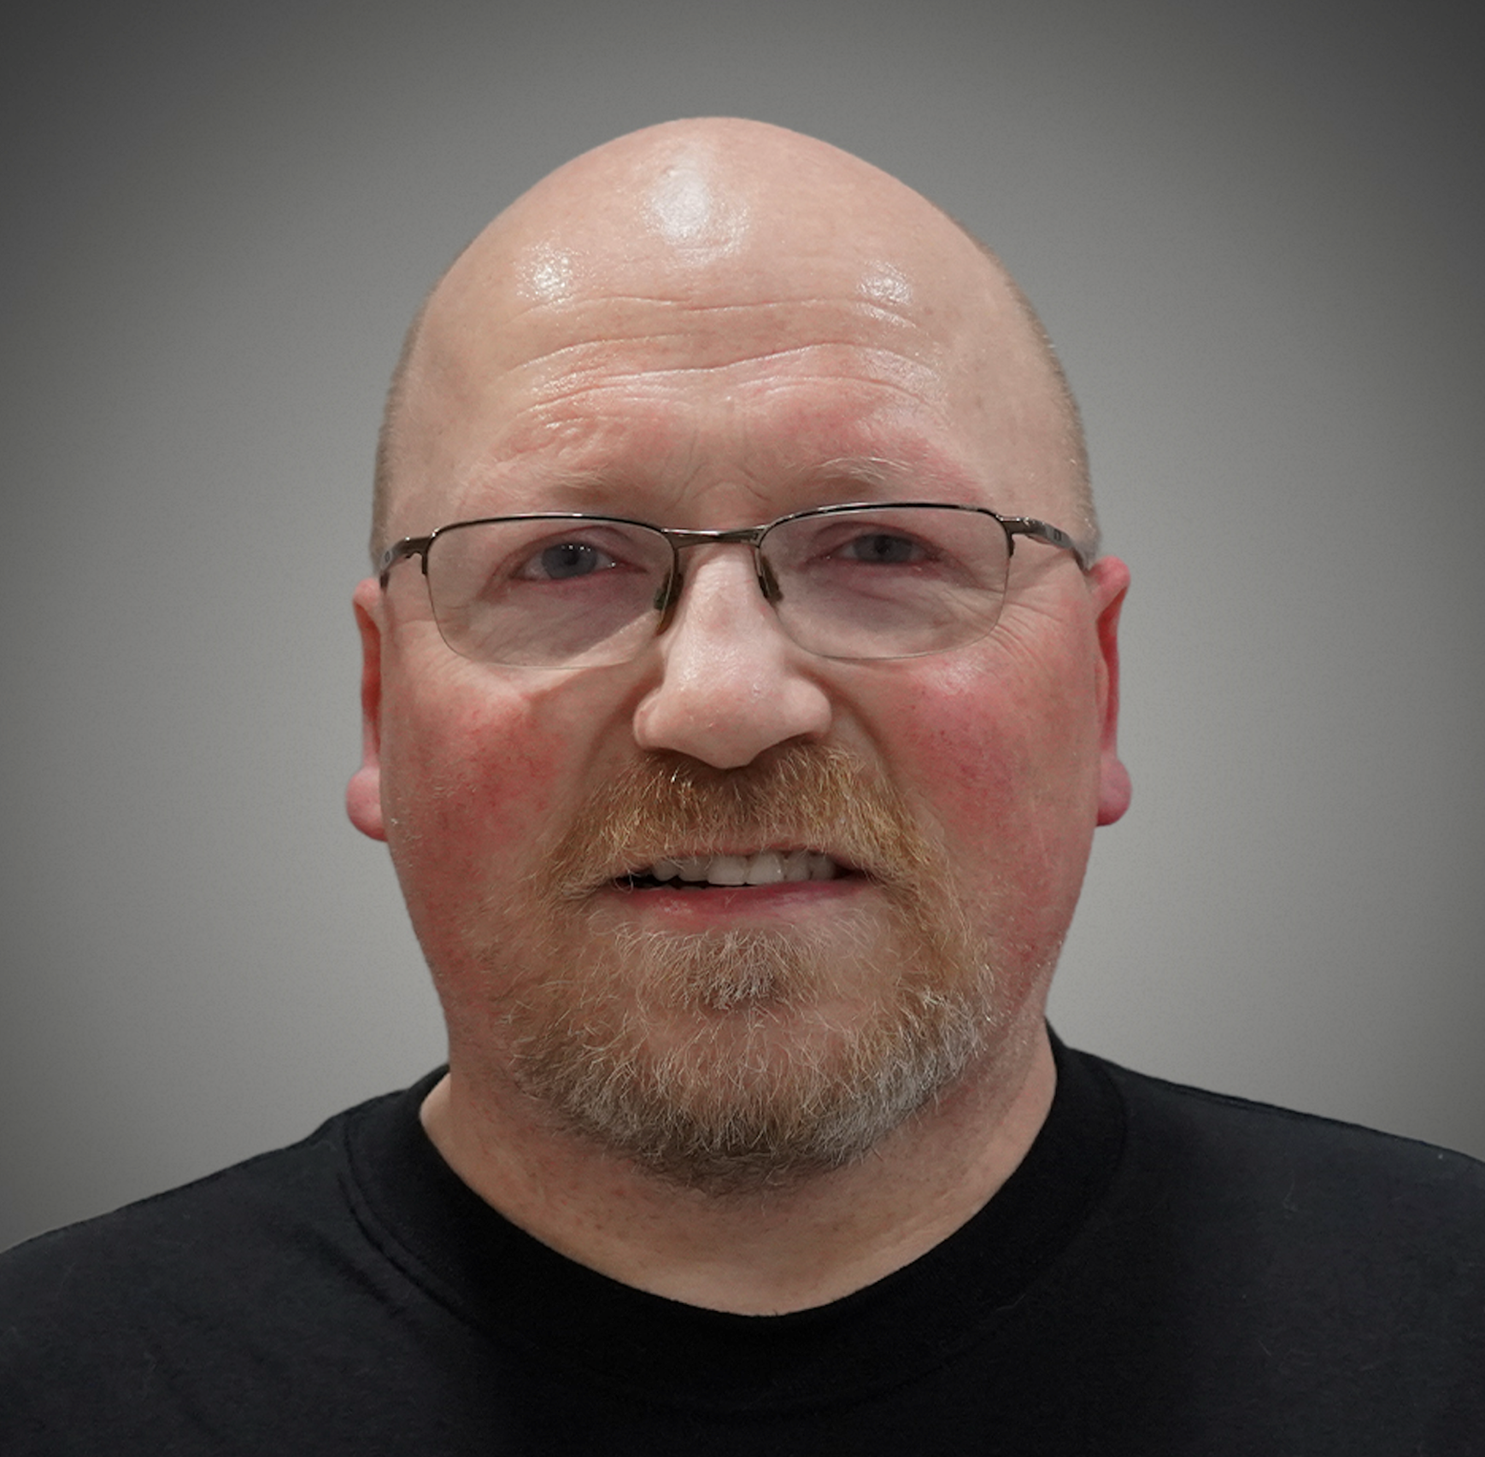


Pinnacle’s Service Philosophy
PINNACLE OZONE SOLUTIONS
Built on Service. Proven Over Time.
Service and support were a founding priority in 2009
Competitors struggled with long response times.
Service & Support:
A Foundational Pillar Since 2009
Replacement parts were quoted in months, not days.
Pinnacle set the standard with same-day parts shipment
(orders placed before 2:00 p.m.)
20 Year Warranty on Dielectrics is an industry first!
Chuck Smith
PRESIDENT & CEO
Chandler Bobo
Service Manager
Muhammad Allie
Mechatronics
Service Tech
Doug Townsend
Senior Service Tech
Amber Cooper
Service Technician
Mandy Rogers
Employee & Customer Relations Manager

Slide 3

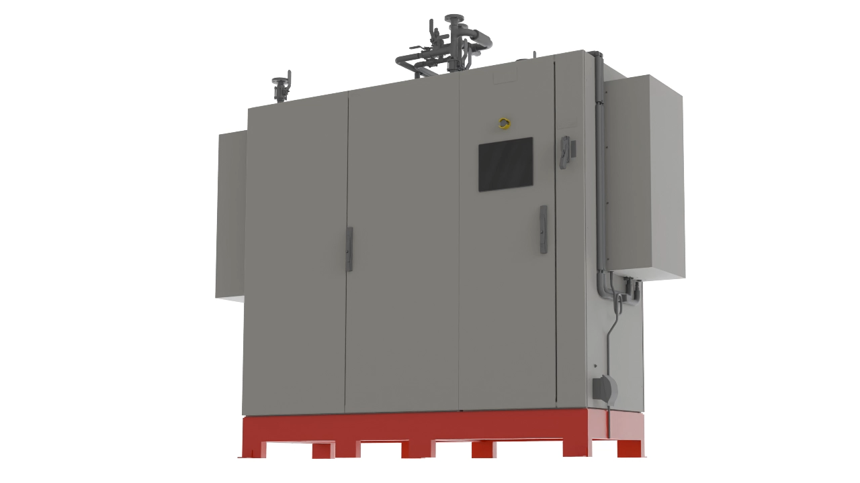
PROVEN PERFORMANCE SINCE 2009
Our Service Team
100%
of Pinnacle Systems installed since 2009 are still operational
Chandler Bobo
Service Manager
Muhammad Allie
Mechatronics
Service Tech
Doug Townsend
Senior Service Tech
Amber Cooper
Service Technician
Mandy Rogers
Employee & Customer Relations Manager

Slide 4


What we do
PROVEN PERFORMANCE SINCE 2009
100%
of all municipal Pinnacle Systems installed since 2009 are still operational
Mandy Rogers
Employee & Customer Relations Manager
Amber Cooper
Service Technician
Doug Townsend
Senior Service Tech
Muhammad Allie
Mechatronics
Service Tech
Full-service support
Chandler Bobo
Service Manager
From installation and ongoing maintenance, we offer comprehensive support to ensure optimal performance and customer satisfaction.

Slide 5
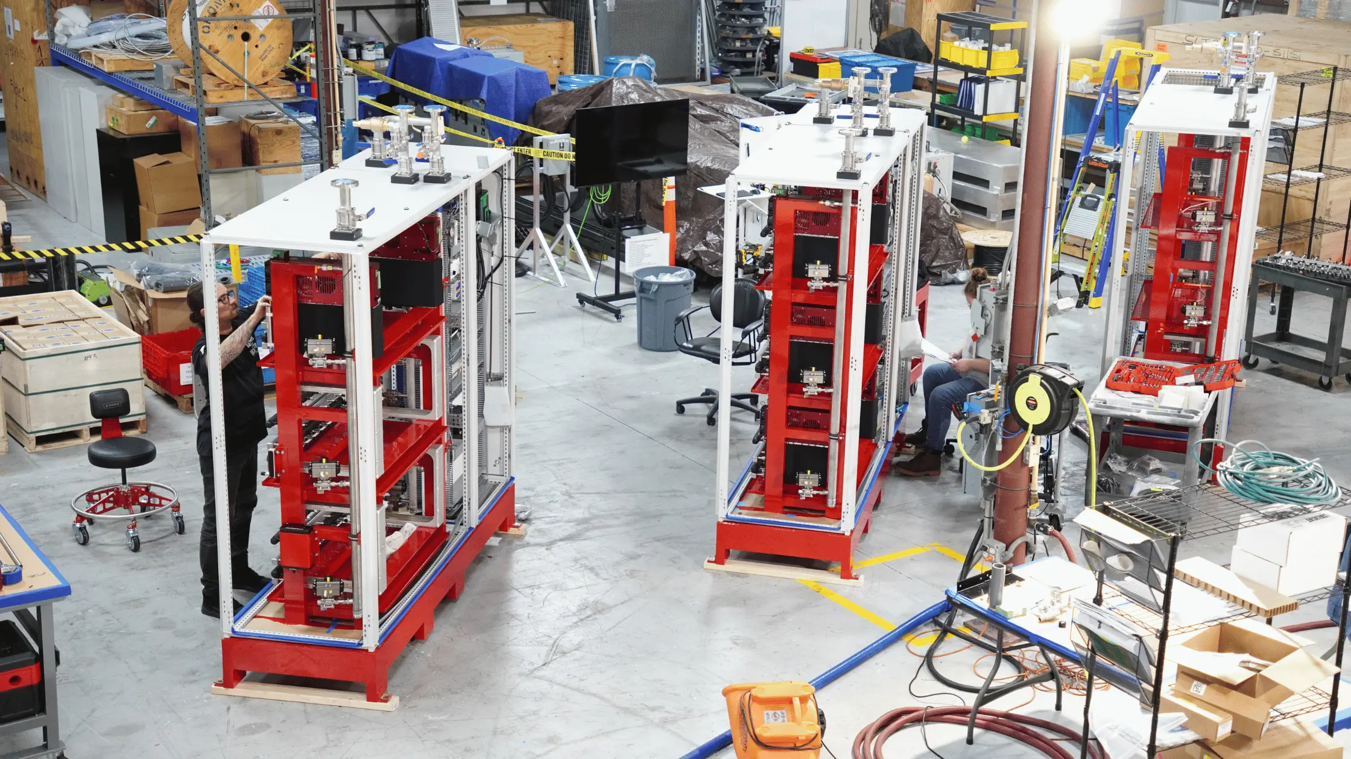

What we offer
What we do
Keeping Pinnacle Systems Running — Always
Support the entire Pinnacle installed base
Rapid diagnosis and issue resolution
Remote and onsite service capabilities
Partnering with customers and sales representatives
1
Preventative Maintenance
2
Remote and Onsite Support
3
Replacement Parts & Upgrades
4
Full-service support
From installation and ongoing maintenance, we offer comprehensive support to ensure optimal performance and customer satisfaction.
Long-Terms Customer Partnership

Slide 6



Service Plans
What we offer
1
Preventative Maintenance
2
Remote and Onsite Support
3
Replacement Parts & Upgrades
4
Long-Terms Customer Partnership
WARRANTY PLAN
Pinnacle Promise
Designed for new systems under warranty. It ensures foundational coverage, helping detect and resolve early issues through remote support and diagnostics.
STANDARD PLAN
Pinnacle Essential
Offers ongoing maintenance and proactive care, including annual visits and on-site troubleshooting for peace of mind.
CUSTOMIZED PLAN
Pinnacle Paramount
A flexible plan customized to meet unique operational demands. Whether you need multiple visits, upgrades, or specialized care, this plan grows with your requirements.

Slide 7
What do these plans look like?
Service Plans
WARRANTY PLAN
STANDARD PLAN
CUSTOMIZED PLAN
Pinnacle Promise
Pinnacle Essential
Pinnacle Paramount
Designed for new systems under warranty. It ensures foundational coverage, helping detect and resolve early issues through remote support and diagnostics.
Offers ongoing maintenance and proactive care, including annual visits and on-site troubleshooting for peace of mind.
A flexible plan customized to meet unique operational demands. Whether you need multiple visits, upgrades, or specialized care, this plan grows with your requirements.
FEATURES | PROMISE | ESSENTIAL | PARAMOUNT
Remote Technical Support | ✓ | ✓ | ✓
System Diagnostics | ✓ | ✓ | ✓
On-Site Troubleshooting | ✗ | ✓ | ✓
Annual Preventative Visits | ✗ | One (1) Visit | Custom (4+ Visits)
Advanced System Upgrades | ✗ | ✗ | ✓
Remote Monitoring | ✗ | ✗ | ✓
Service Frequency | Standard (Warranty) | Annual | Flexible/Custom

Slide 8


What do these plans look like?
Support is Always within Reach
When You Sell Pinnacle, You’re never selling alone!
FEATURES | PROMISE | ESSENTIAL | PARAMOUNT
Remote Technical Support | ✓ | ✓ | ✓
System Diagnostics | ✓ | ✓ | ✓
On-Site Troubleshooting | ✗ | ✓ | ✓
Annual Preventative Visits | ✗ | One (1) Visit | Custom (4+ Visits)
Advanced System Upgrades | ✗ | ✗ | ✓
Remote Monitoring | ✗ | ✗ | ✓
Service Frequency | Standard (Warranty) | Annual | Flexible/Custom
(210) 321-205-1717
Service@pinnacleozone.com

Slide 9



Support is Always within Reach
Thank You!
When You Sell Pinnacle, You’re never selling alone!
Service isn’t what we do after the sale – it’s why customers choose Pinnacle.
321-506-1850
(210) 321-205-1717
www.pinnacleozone.com
Cocoa, Florida, USA
Service@pinnacleozone.com

Slide 10

Thank You!
Service isn’t what we do after the sale – it’s why customers choose Pinnacle.
321-506-1850
www.pinnacleozone.com
Cocoa, Florida, USA

