Slide 1
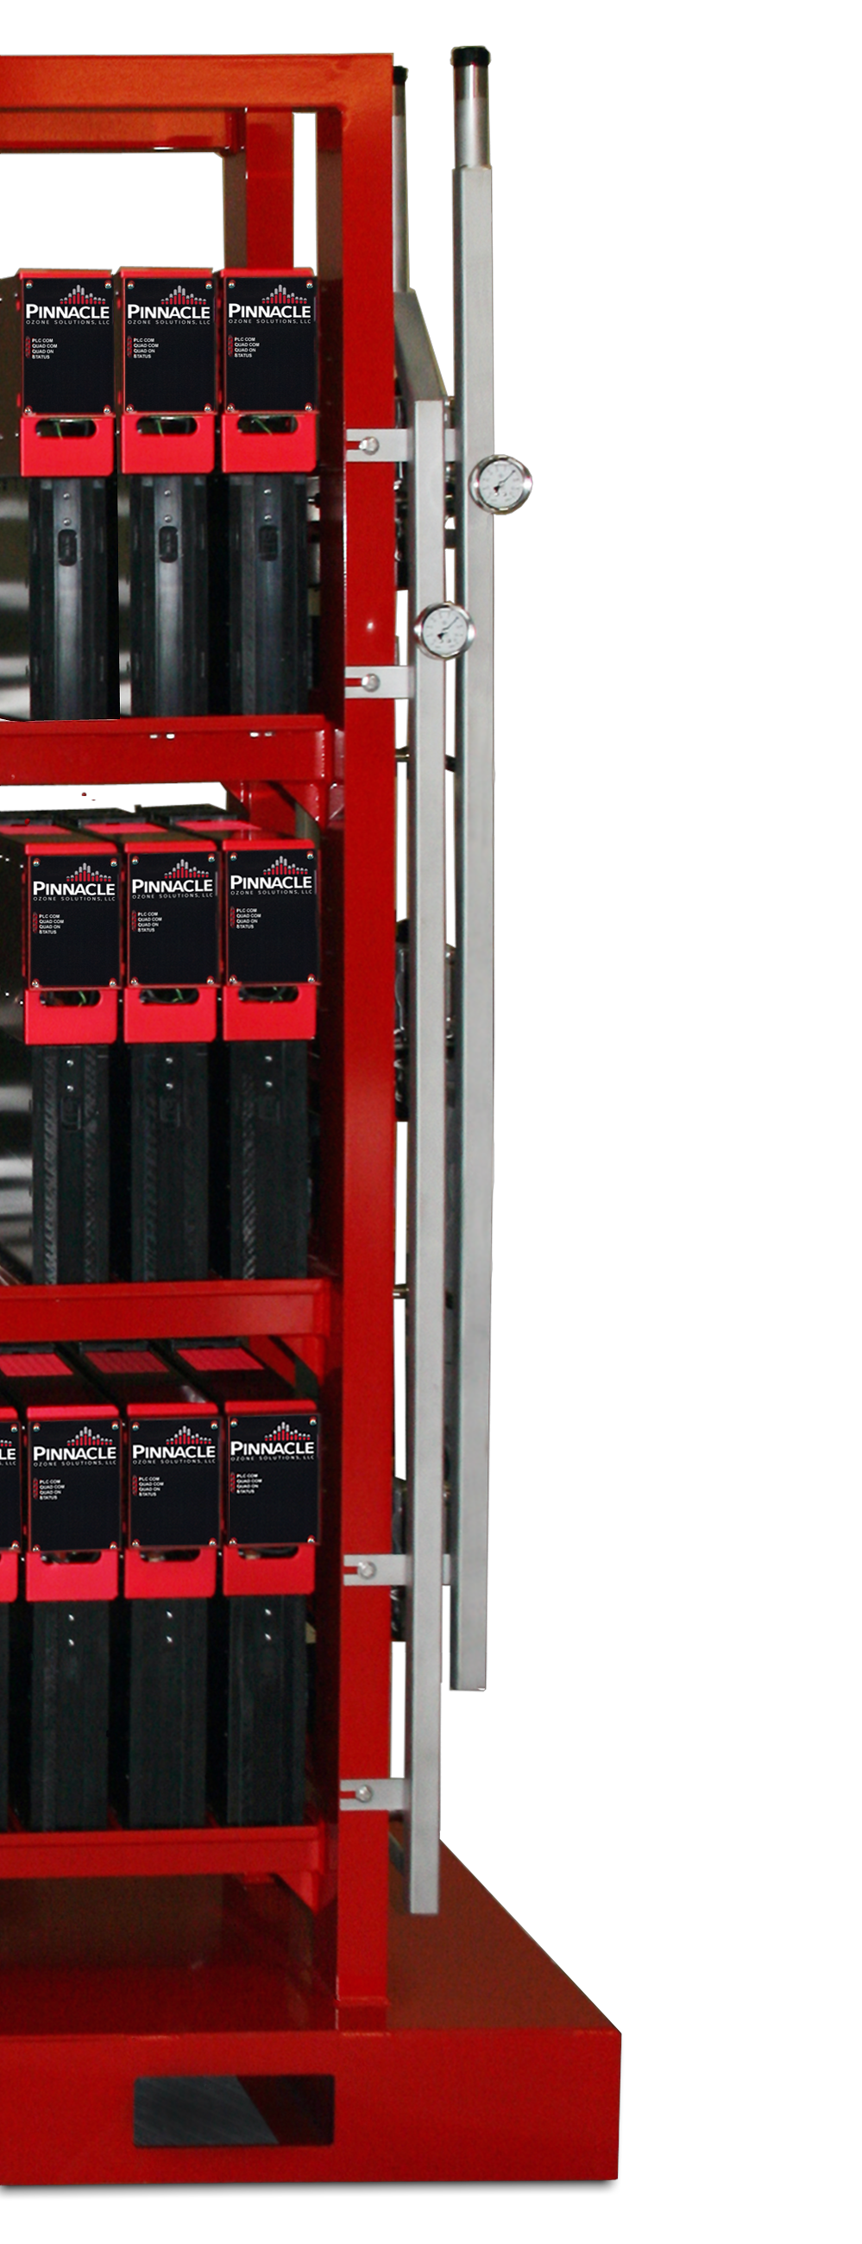
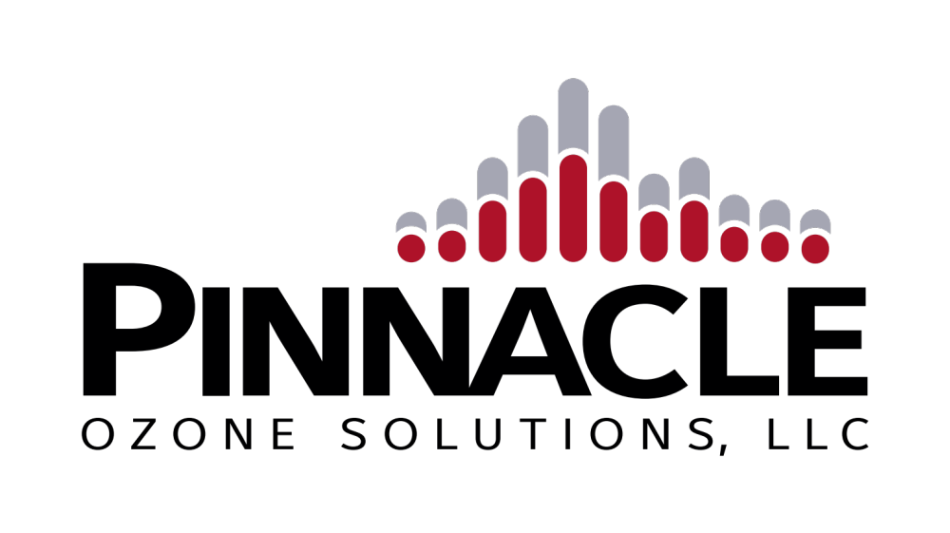
The World’s Most Advanced Ozone Technology
Philippe Taliana – Global Sales Manager

Slide 2
Typical Ozone System Process Diagram
System Components
  Oxygen Supply:
    Liquid Oxygen (LOX) or
    Onsite generation (PSA / VSA) or delivered oxygen for feed to ozone generator
    Min Quality: >93% O₂ @ Dewpoint = -65°F
  Ozone Generator:
    Converts O₂ to ~10% O₃ (typ) using electrified plasma field
    Pinnacle generators offer constant %BW output at any turn-down
    Market Leading Energy Efficiency (3.5 kWh/lb)
  Water Chiller:
    Closed-loop cooling for ozone generator
    Glycol based fluid preserves unit efficiency
  O₃ Injection
    Dissolves O₃ Gas Into Solution for Reaction
    Custom Design (based on dose, flow, etc)
    Typical Transfer Efficiency >93%
  O₃ Destruct
    Captures un-dissolved O₃ gas to prevent exposure
    Autocatalytic Reaction w/ Monitoring
    Assures no release / exposure to O₃
Typical Pinnacle Scope of Control
O₂ Supply
(PSA, VSA, or LOX)
Water Chiller
O₃ Generator
O₃ Destruct
Reactor / Holding / Contact Tank
Filtered Effluent
O₃ Injection

Slide 3
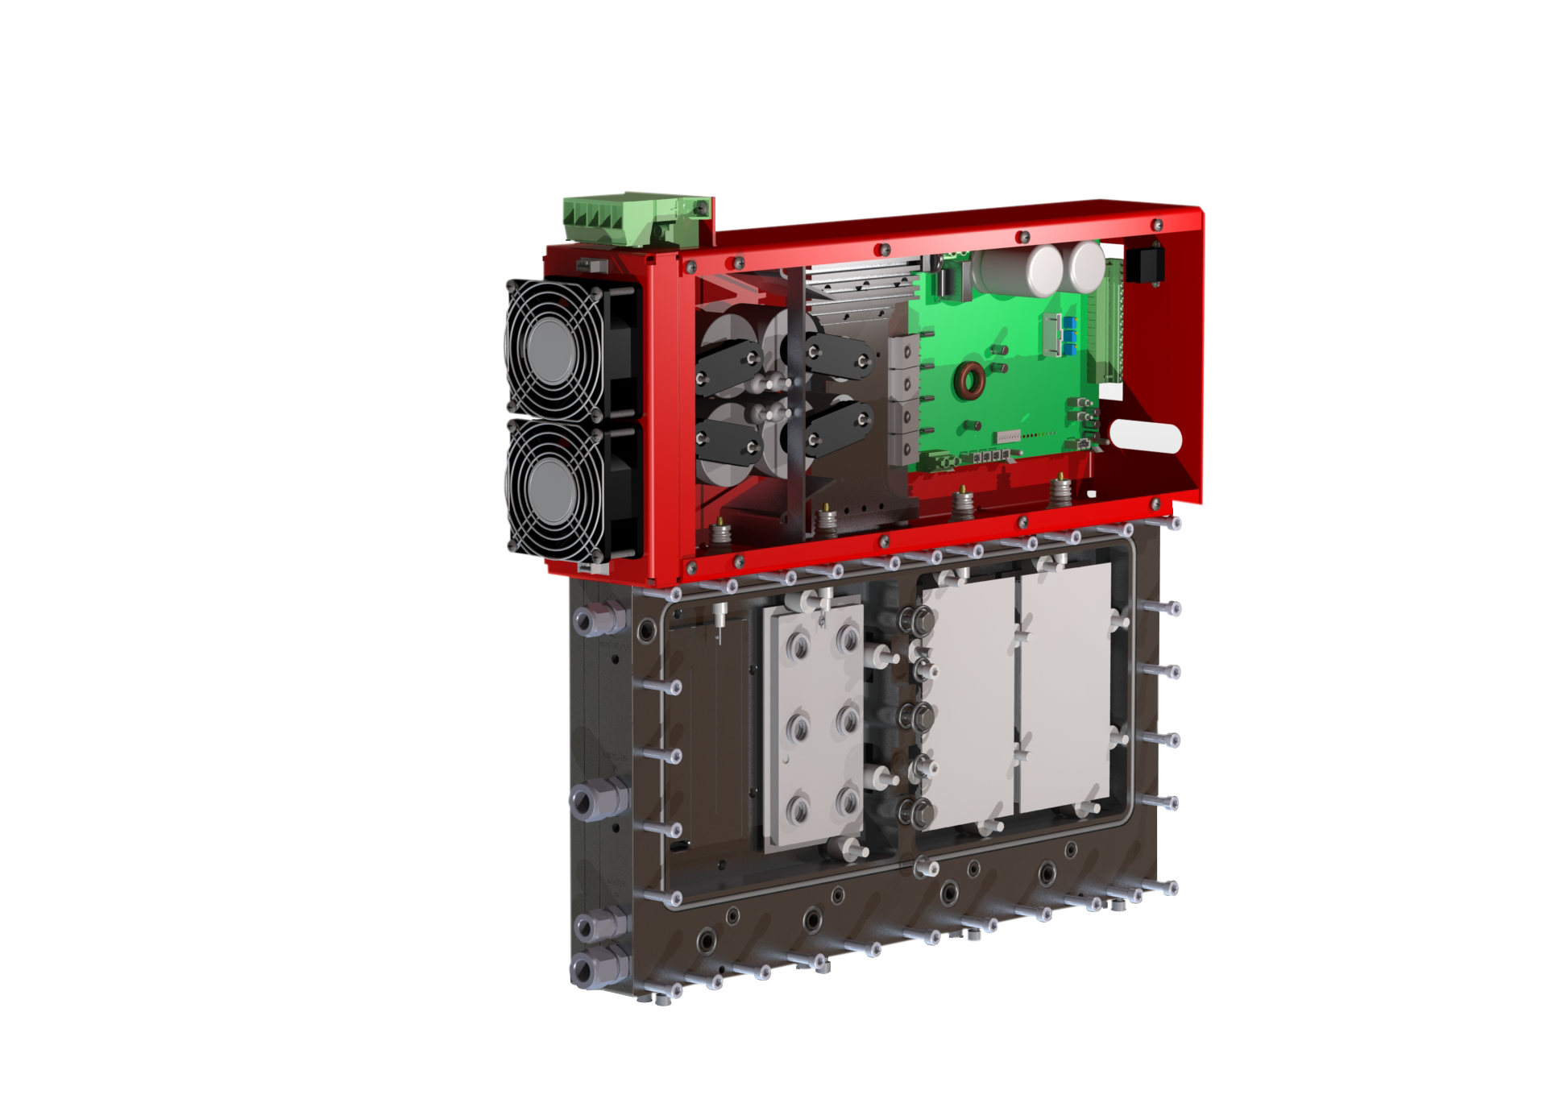
Modular Generator Cells
The World’s Most Advanced Ozone Generator Technology
  Developed as the world’s most energy efficient ozone technology
  Completely Integrated / Standalone Ozone Generator Cells
  Ruggedized Service-Free Cell Design
  Advanced Materials, Power Supply & Controls Technology
Integrated Controls — individual optimization & monitoring of each ozone cell
Ruggedized Construction — immune to vibration & shock
Advanced Materials — Ceramic Dielectrics and Maintenance-Free Operation
Built-In Hi-Frequency PSU — virtually silent 23 kHz operation
Dual Air / Water Cooling — reduces cooling by 40-60%
Constant %BW Output — 0-100% turn-down via variable gas-flow operation
Industry Leading Efficiency — 3.5 kWh/lb operation
5
1
4
6
7
3
2

Slide 4
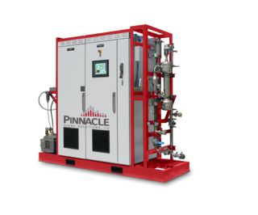
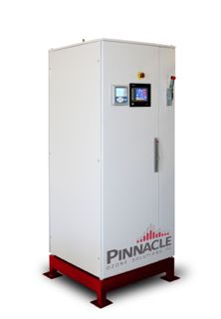
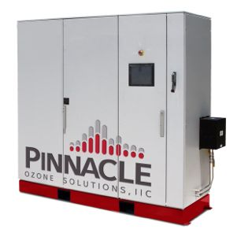
Pinnacle Ozone Technology
A Family of Ozone Generator Platforms
  Family of Flexible / Modular Ozone Process Integration Platforms
  Standard Complete Ozone Process Control & Integration
  Specifically Designed to Address 20-600 ppd Target Market
PEAK
SUMMIT
ZENITH

Slide 5
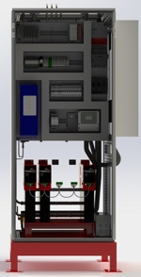
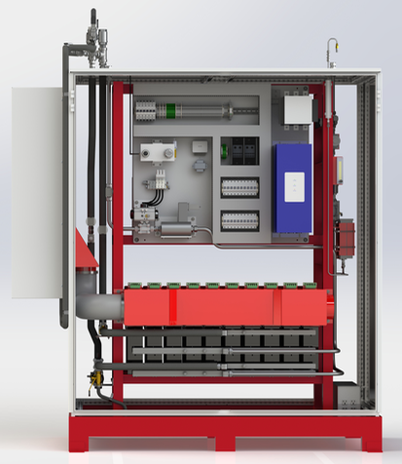
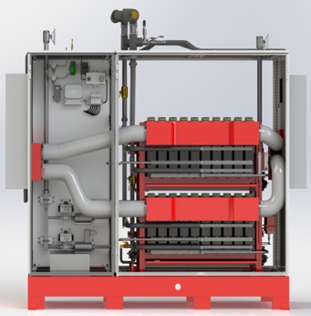
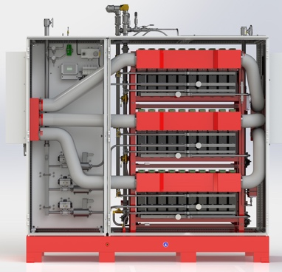
Scalability
Common QuadBlock / 10X -12X Rack Design Common to ALL Platforms
Modular Enclosure and Pedestal Allows Flexible Design
Only Dimensions & Connection Sizes Change
5x, 10x, 12x
Common PLC Package
Platform (Capacity) Specific Connections
Common / Custom I&C Package
Modular Enclosure System
2 x 10 (20x)
Common Inverter / Power System
Common 10x/12x Manifold Design
Modular Rack / Platform
Common 10x/12x Platform
3 x 10 (30x)
3 x 12 (36x)
Common Generator Design & Equipment for ANY Scale!

Slide 6
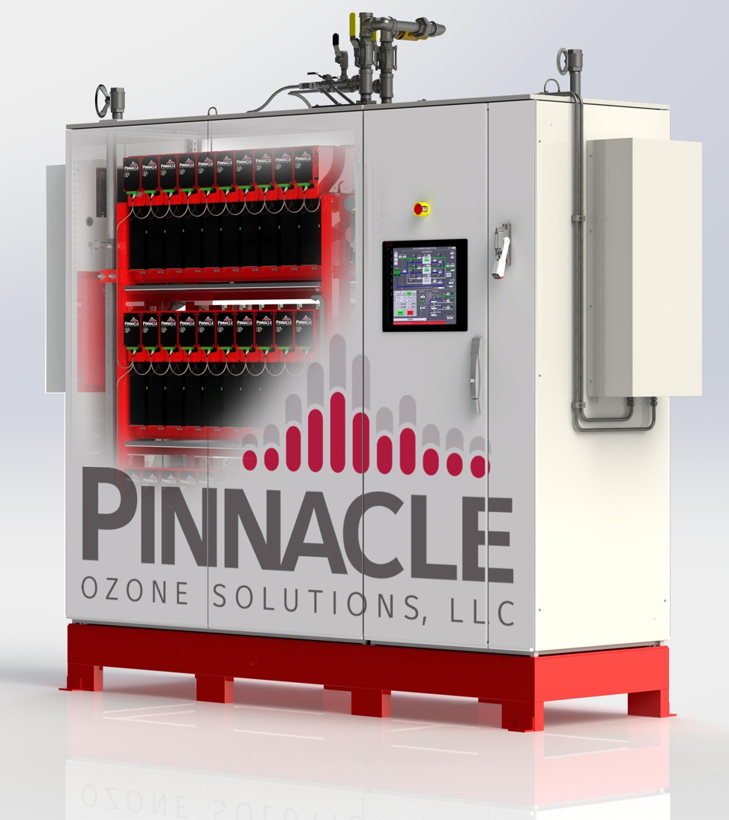
The World Most Advanced Ozone Technology
Customer Goal: “Like the Results. Love the Equipment”
Market Goal: Establish the New Standard for Ozone Technology
Modular
  Family of Modular Ozone Process Platforms
  Flexibly Adapts Capacity to Meet Project Needs
  Fully Integrated O3 Process Controls & Instrumentation
  Built-In Multi-Mode Process Control
  Self-Optimizing Process
Reliable
  Zero-Maintenance Ozone Cells
  +25yr QuadBlock Ozone Cell Life
  Built-In Redundancy
  Auto-Compensating Performance
  100% US Made & Supported
24-7 Remote & Online Support
  Onsite Service
Efficient
  Constant 6-18 %BW at Any Output
  True 0-100% Turn-Down
  Industry Leading Power Efficiency
  Less Cooling
  Smaller Footprint
  Ultra-Quiet Operation
  Built-In Cooling / Heating (no HVAC required)
  Appliance Like Installation (5 connections)
  10-40% Lower OPEX and 20yr NPV

Slide 7
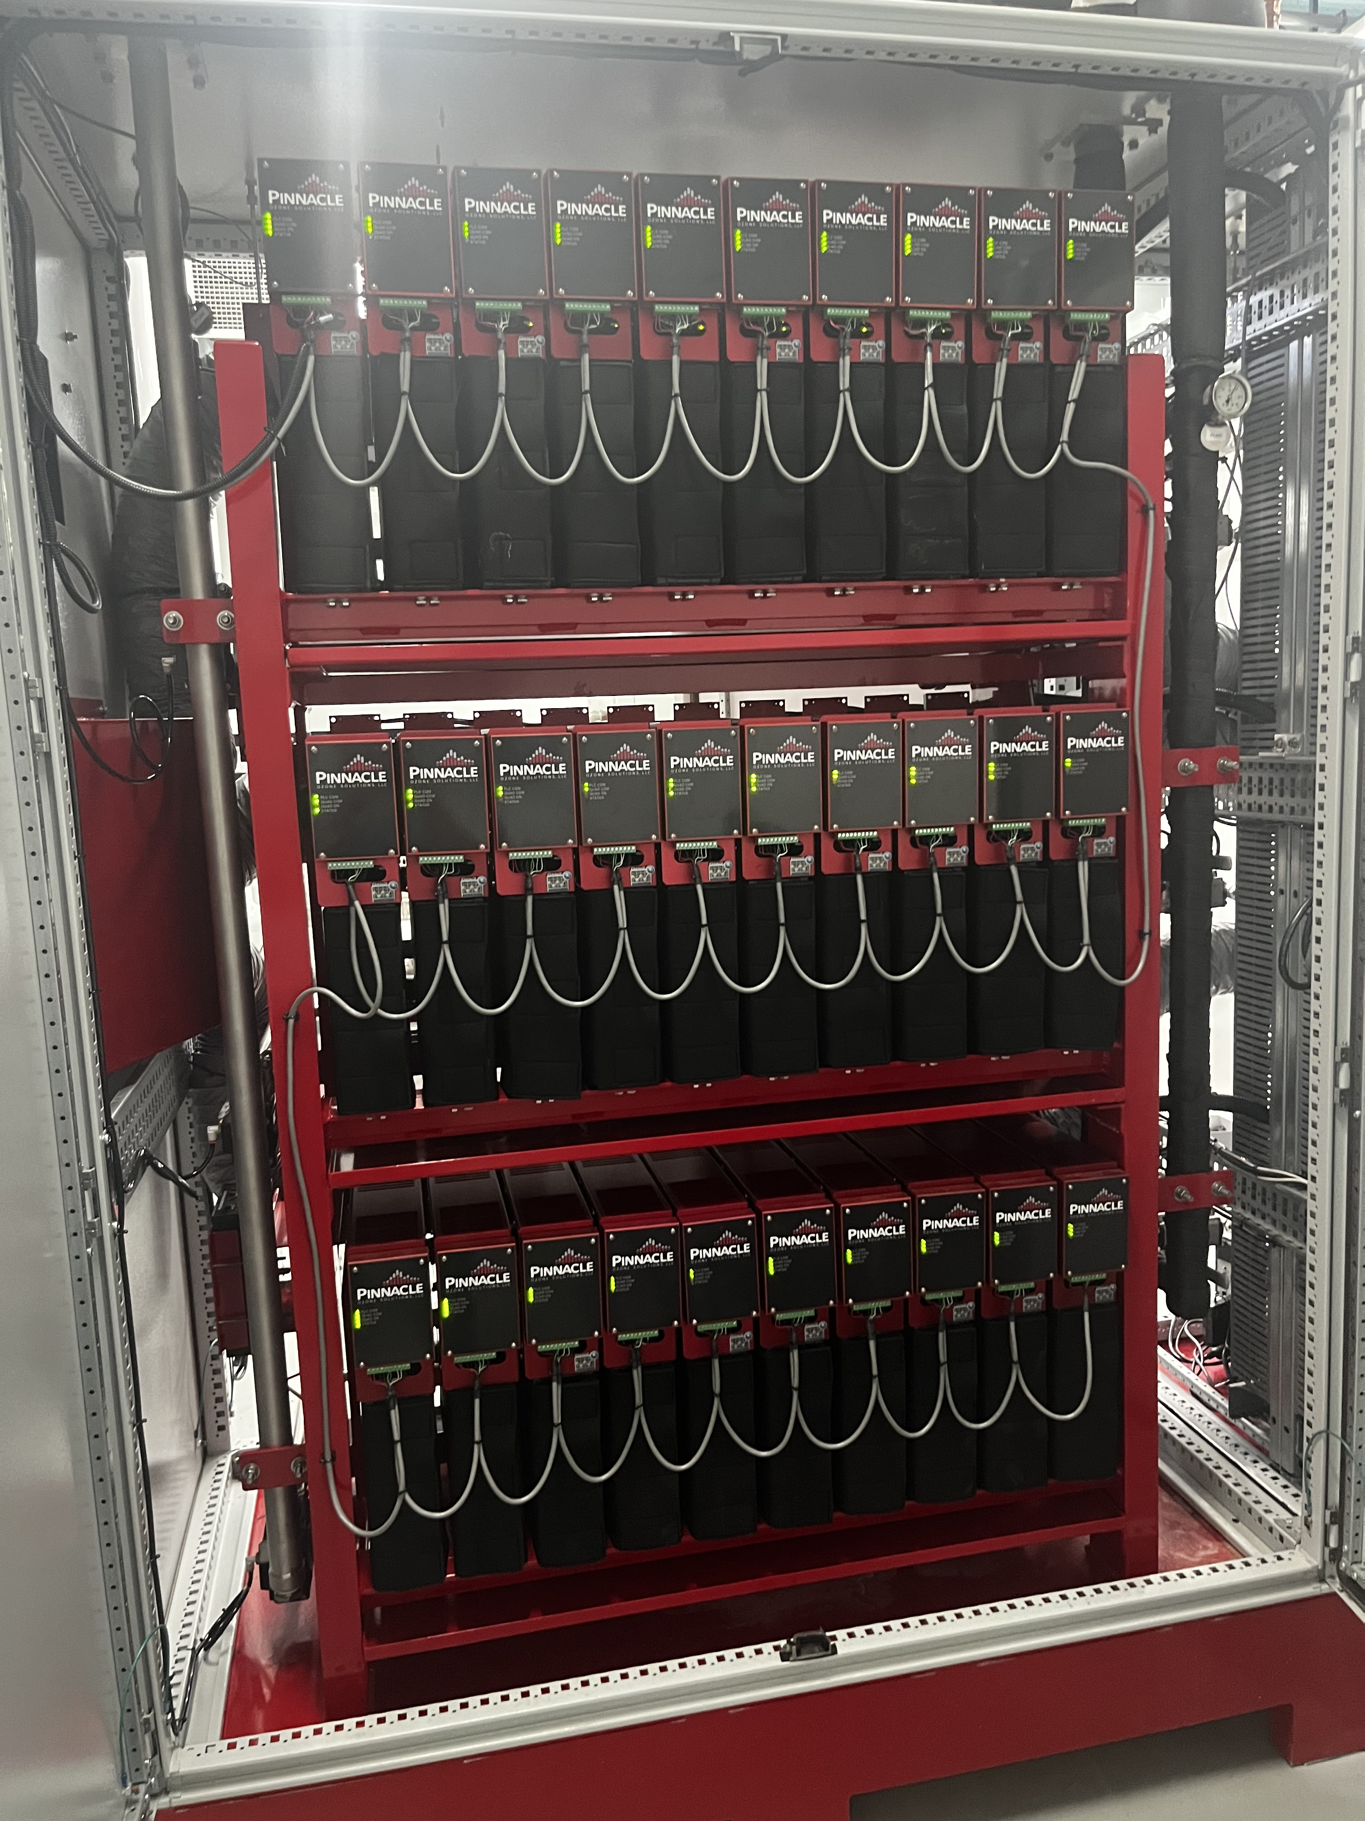
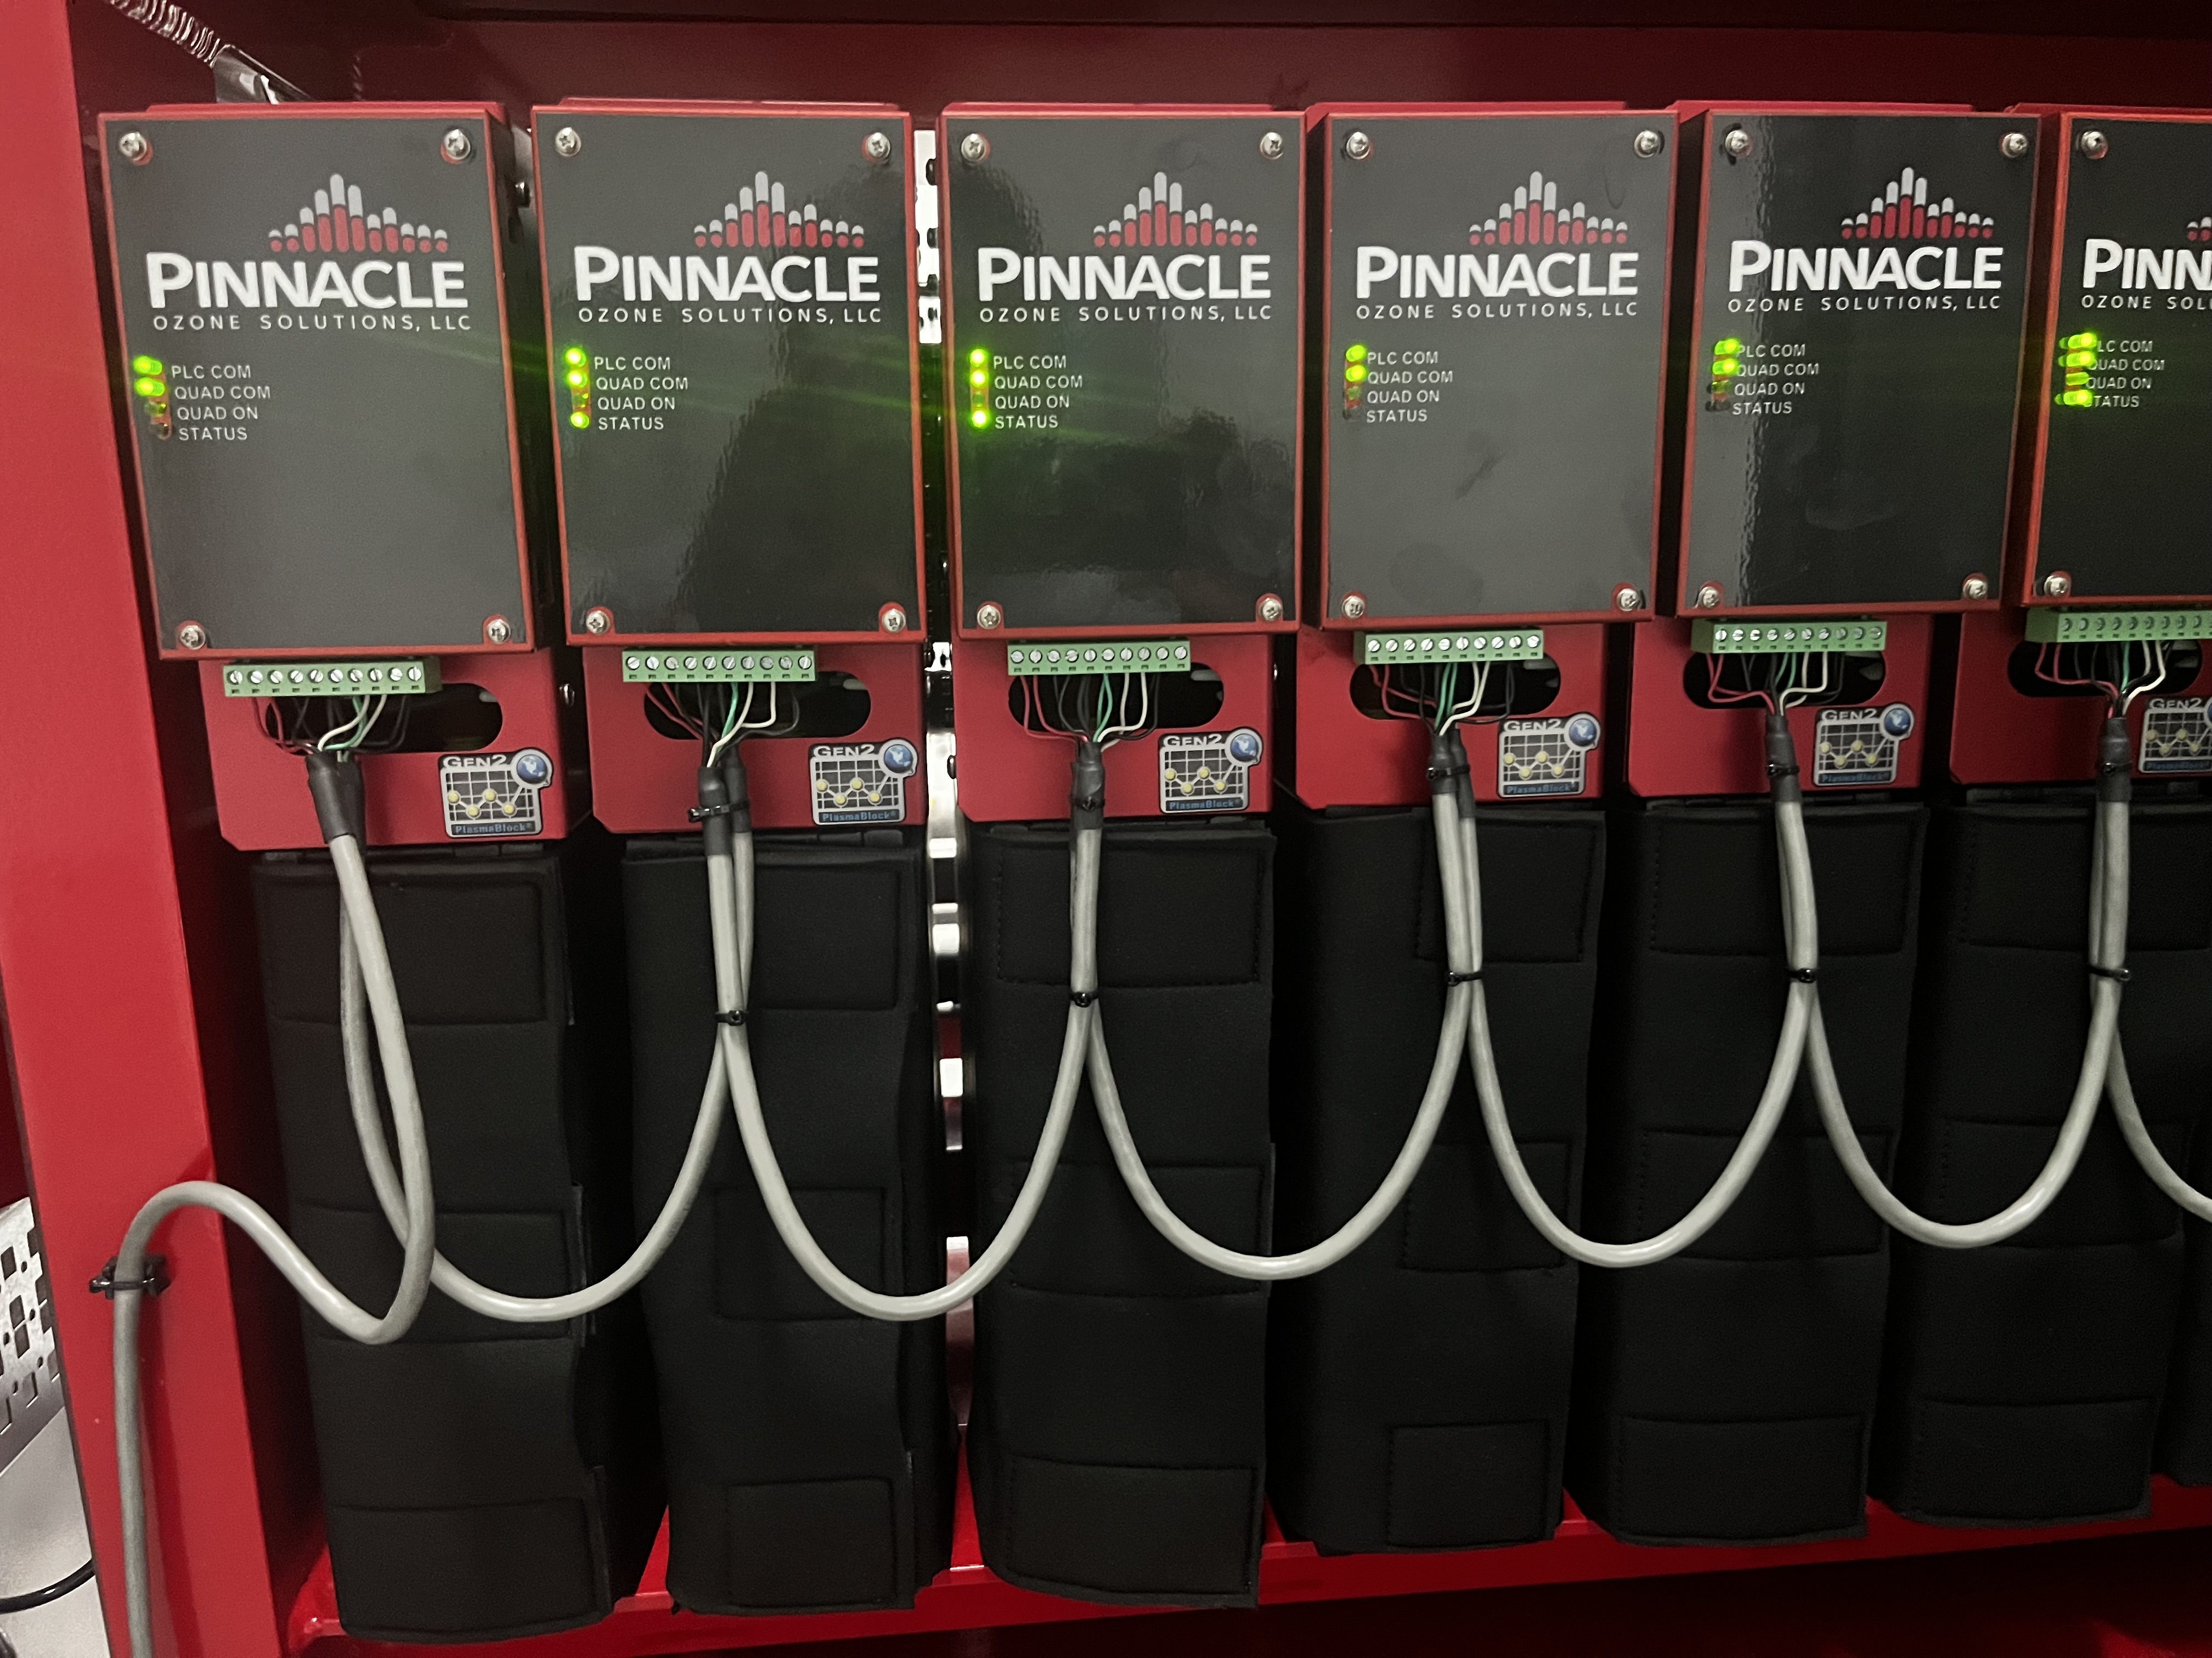
Quadblocks in a system

Slide 8
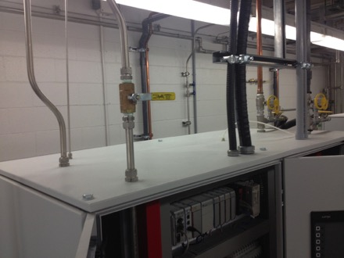
Easy to install
Enclosed cabinets
All equipment is on skids
6 connections:
  Gas in & out
  Water in & out
  Power
  Compressed air.

Slide 9
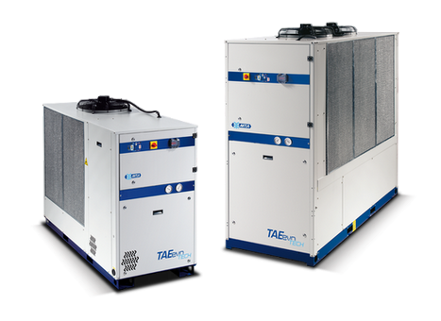
Ozone cooling
Different options:
  Air-to-water cooling
  Water-to-water cooling
  Heat Exchanger

Slide 10
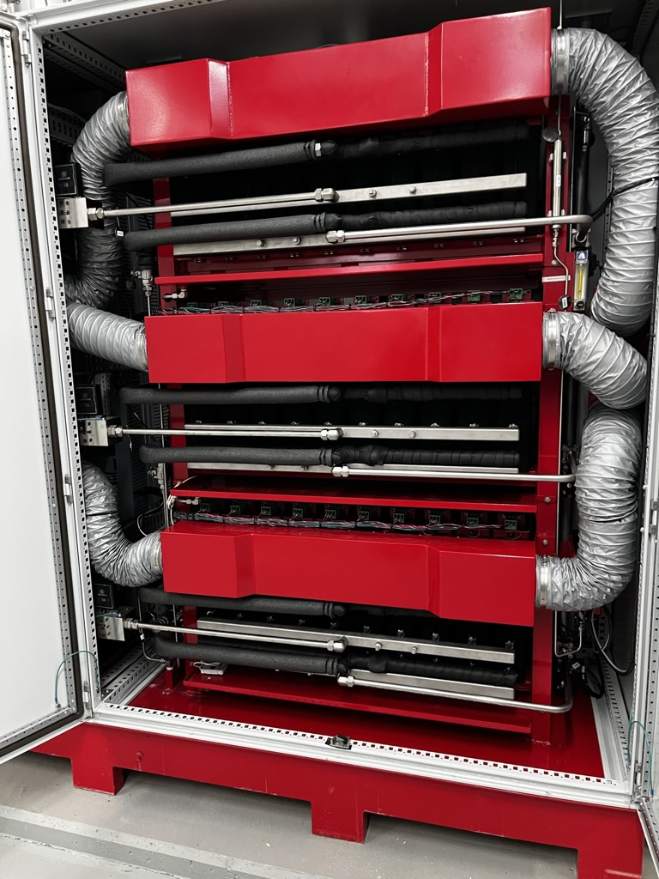
Ozone cooling
Air cooling for the electronics
Water cooling for the Dielectrics

Slide 11
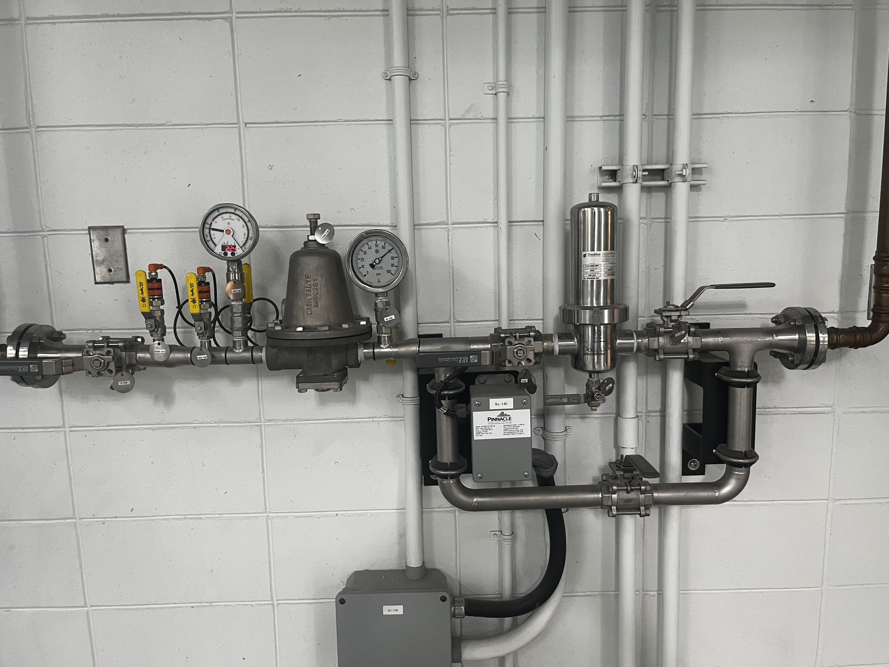
Oxygen treatment
Manifold
  Donaldson filter
  Demister
  pressure

Slide 12
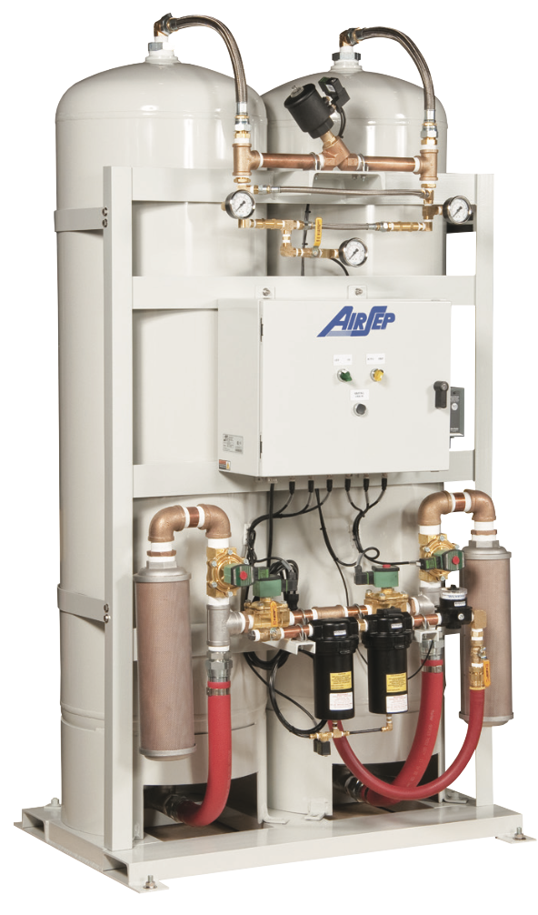
Oxygen supply
LOX
  High purity
VSA/PSA
  Min 93%
  Compressor/blower is the maintenance heavy equipment

Slide 13
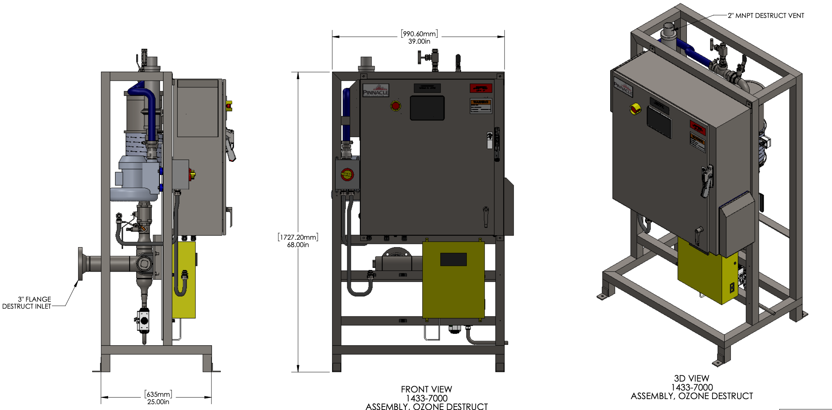
Ozone Off Gas Destruct
Ozone destruct sizing:
  Gas production
  Dimension of contact tank
  Level variation in the tank

Slide 14
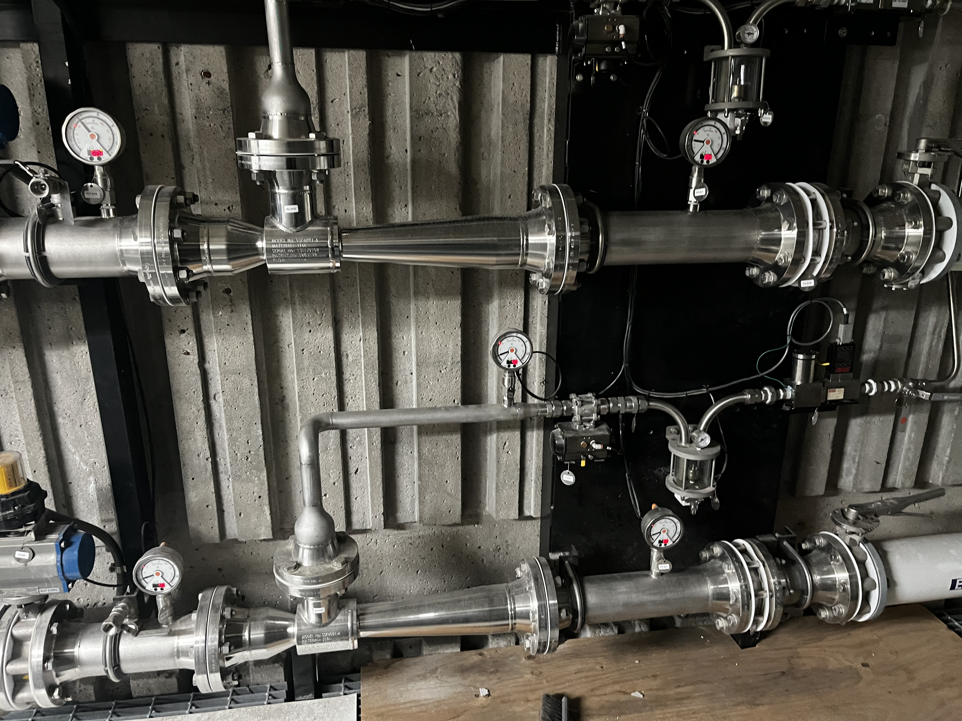
Injection
Side Stream injection
Venturi mixing
MTE warrantee (how to measurable?)
Dissolution
  Jet nozzle
  Pipe injection
  Ceramic diffusers

Slide 15
Instrumentation & controls
MOCP – Master Operator Control Panel
Ozone Generator
  Schneider PLC M251. Allen Bradley available upon request
  HMI Red Lion 15"
External instrumentation:
  Dissolved O3 residual analysers
  Ambient O2 and O3 analysers
  Demister
  Mass flow controler
  Dissolved ozone analyser or ORP

Slide 16
Project considerations
Equipment availability and lead-times Submittals: 6 weeks
                Delivery: up to 22 weeks after approval
Recommended useful Life/mechanical warrantee Injection can be longer
Performance warrantee
  Output (ppd) warrantee vs MTE

Slide 17
Local support
Local reps thruout North-America
Service capability out of Cocoa, FL
  Service contracts available
Remote access to the PLC, generators and ancillary components
  95% of the problems can be solved remotely
Your Rep Logo

Slide 18
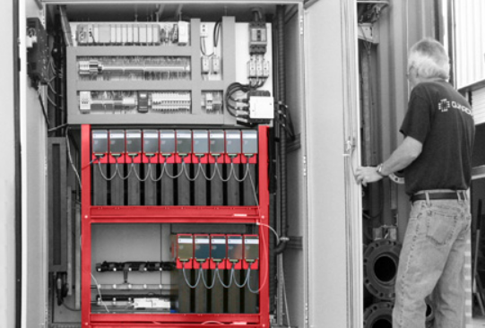
Maintenance & Operation
There is no spares to change periodically in the Pinnacle generator.
The dielectrics are built for life. Warrantee for 20 years
Items to maintain regularly:
Pumps on the injection system
Blower on the destruct system
Pumps on the chiller system
Compressor/Blower on O2 generation system

Slide 19
Applications - Municipal
Leachate
  Color removal
  Bacteria oxydation
Water Body remediation
Ozone & nanobubbles ??
Disinfection
  Multiple dosing points
Color Removal
Taste & Odor
1-4 Dioxane (AOP)
H2S removal

Slide 20
Applications-Industrial
Aquaculture
  Life support
  Disinfection
  Waste-Water
  Inlet (algea-blooms)
Textile
  Color removal
F&B
  Color Removal
  BOD removal

Slide 21

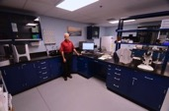
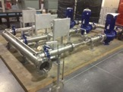
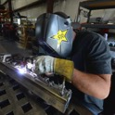

Pinnacle Capabilities
Uniquely Capable & Qualified for
Ozone Technology Projects
Ozone Application Engineering
Dedicated Ozone R&D Laboratory
Single-Source
Scope of Supply
In-House Manufacturing
World-Class Customer Support

Slide 22
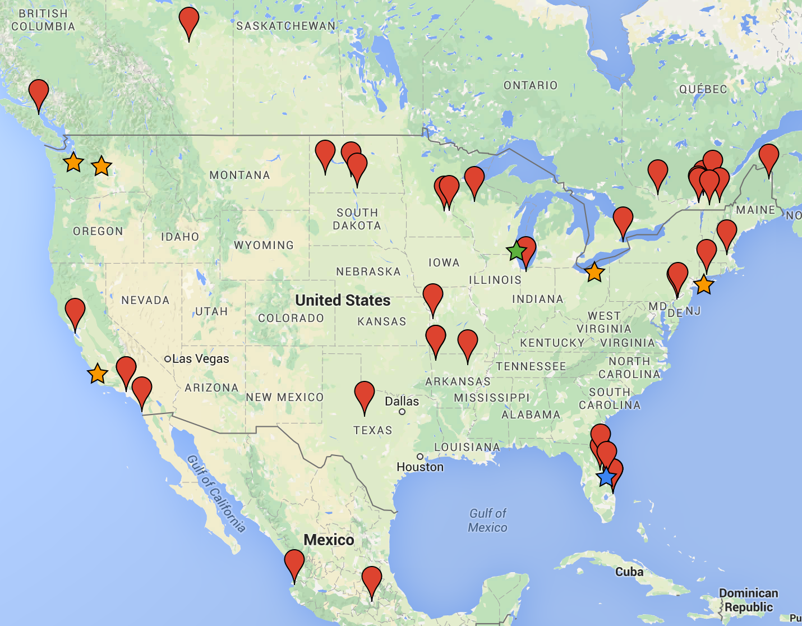









Installations
EXPERIENCE SUMMARY
  20+ Yrs Ozone Experience
  460+ Global Systems
  380+ US Ozone Projects
  50+ Installations
  Ranked #2 Global O3 Supplier by a Fortune 100 Customer
  Participation in All Key Market Segments

Slide 23
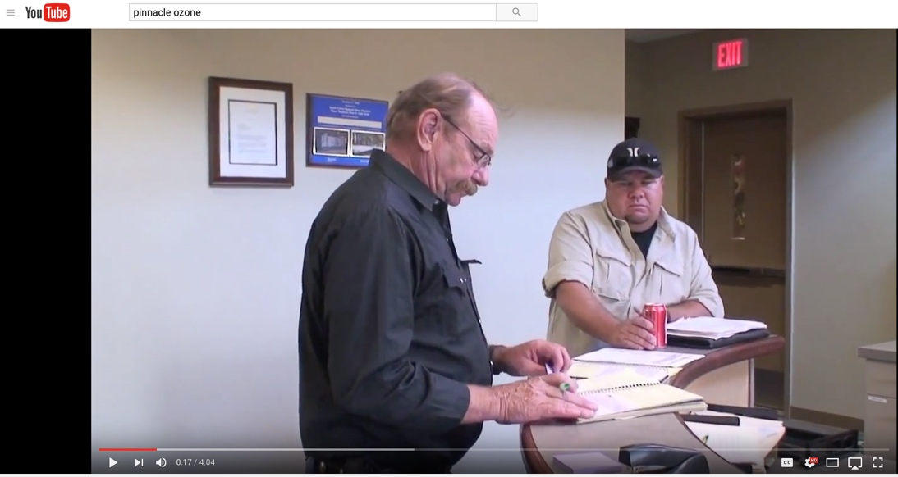
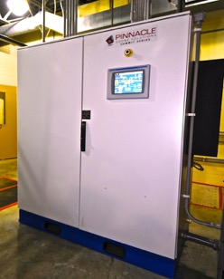
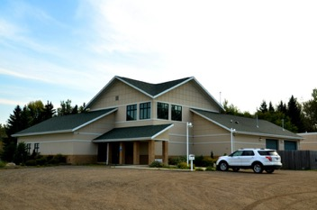
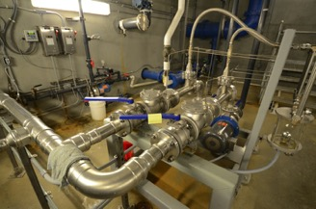
North Burleigh WTP, ND
2.5 MGD MF-RO WTP
  Raw Water Pre-Treatment
  Finished Water Disinfection
Complete Ozone Scope
  Peak 120 ppd System
  O2+Injection+Controls
Overall 20-40% OPEX Savings
>40,000+ Hrs Maintenance-Free beyond calibrations

Slide 24
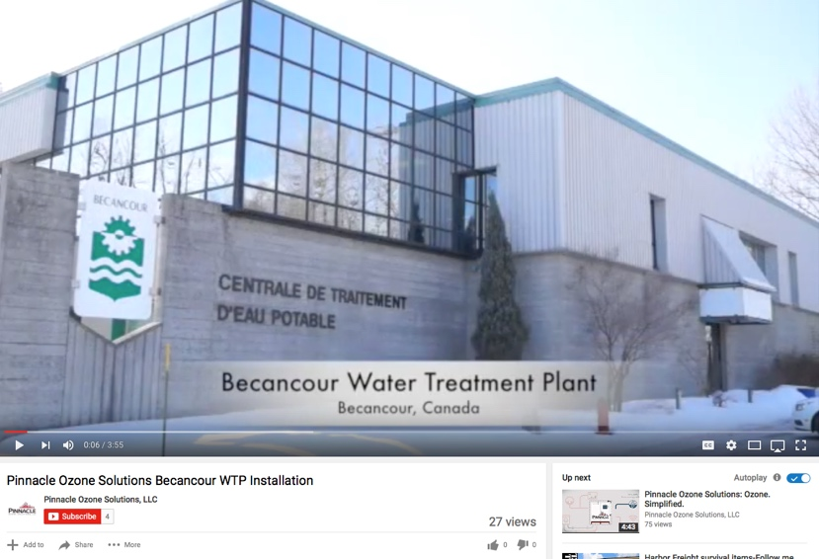
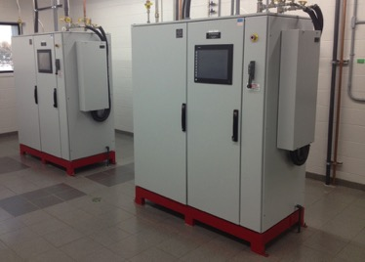
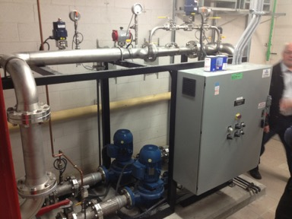
Ville de Becancour WTP, QC
2.5 MGD MF-RO WTP
  Raw Water Pre-Treatment
  Finished Water Disinfection
Complete Ozone Scope
  2x Peak 120 ppd System
  O2 + Injection + Destruct
  Complete Process Controls
April 2011 Startup

Slide 25

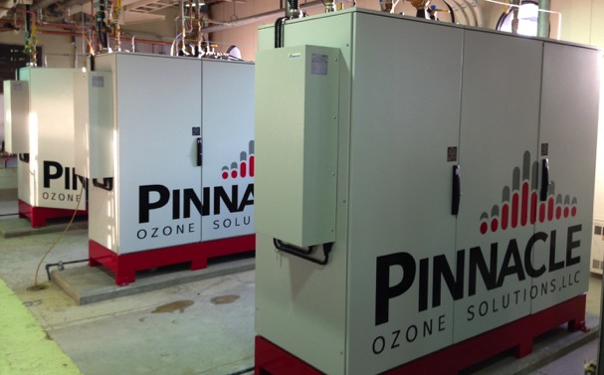
City of Sherbrooke, QC
3x Summit 220 ppd System.
Completely Auto Operation (flow & dose pacing / sequencing)
Primary Disinfection
Running since 4th day of Startup

Slide 26
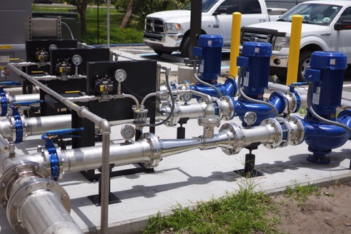
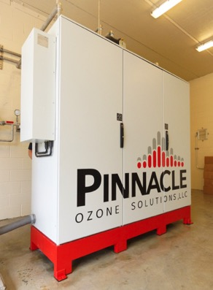
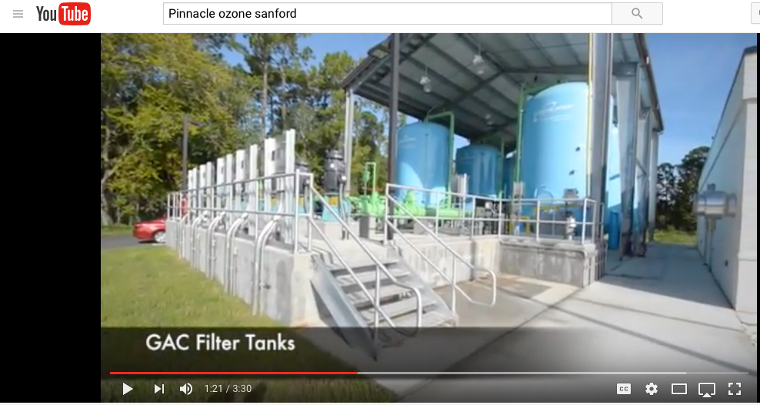
City of Sanford, FL
1 x 600 ppd
LOX, O₃, cooling, injection, controls
DBP Control

Slide 27
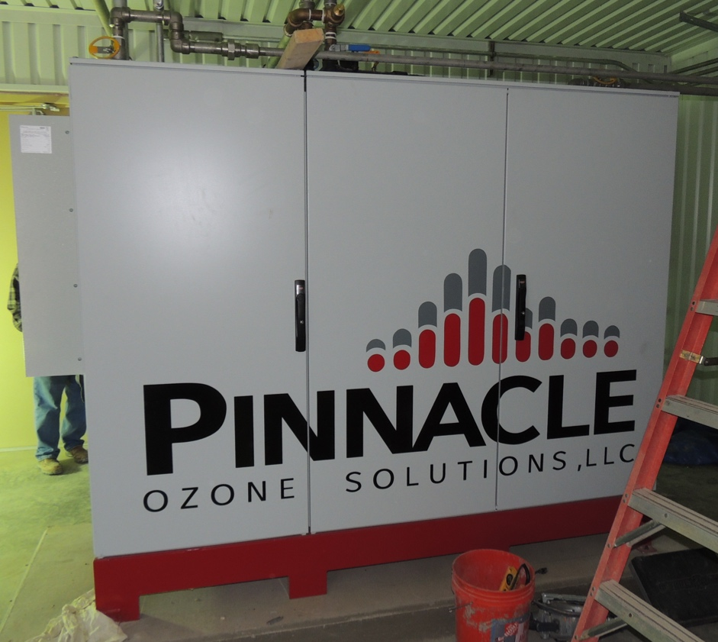
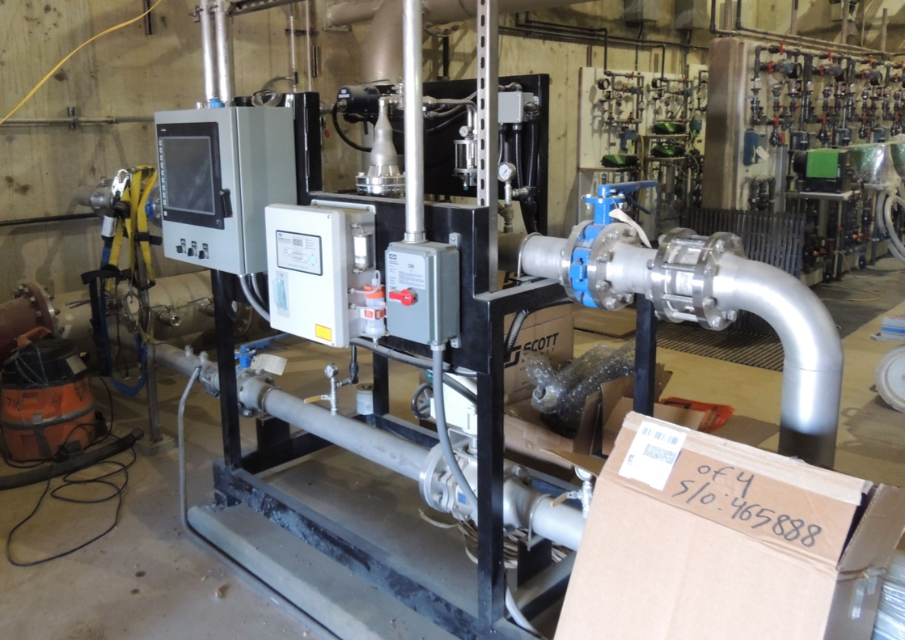
City of Abilene, TX
1 x 300 ppd System
O3 Injection + Destruct + Controls
6000 gal LOX System Supply
March 2015 Startup

Slide 28
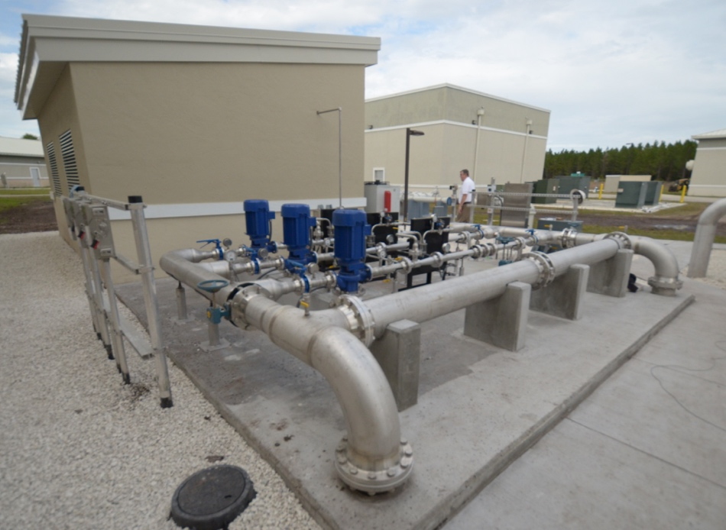
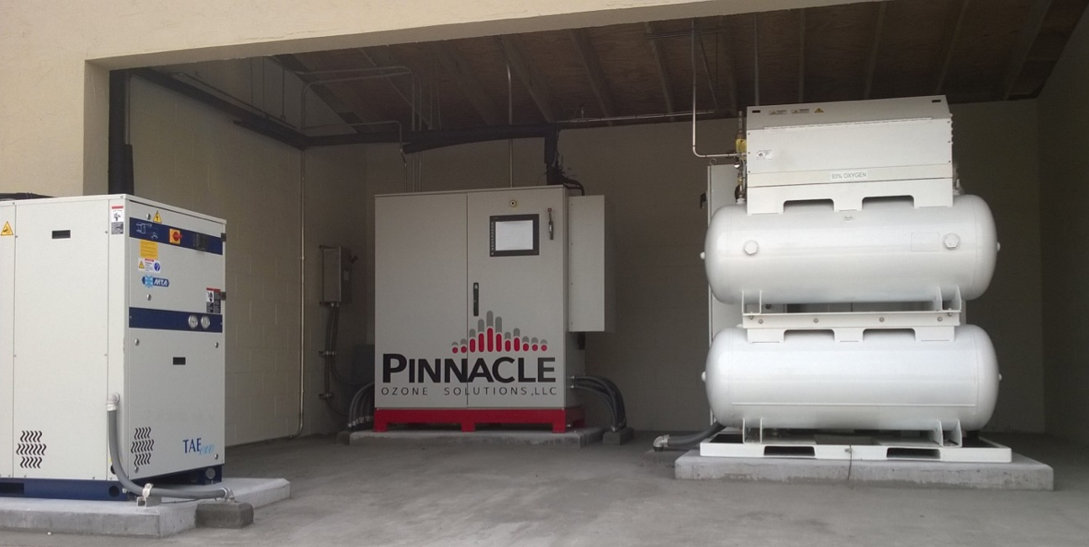
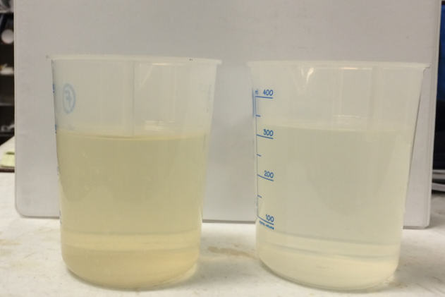
Palm Coast, FL
2 x 200 ppd Muni WTP
0-25 mg/l for UF/NF Concentrate Color / Fe Removal
VSA O2, O3, Cooling Water, Injection, DOZ + Color Control
February 2015 Startup

Slide 29
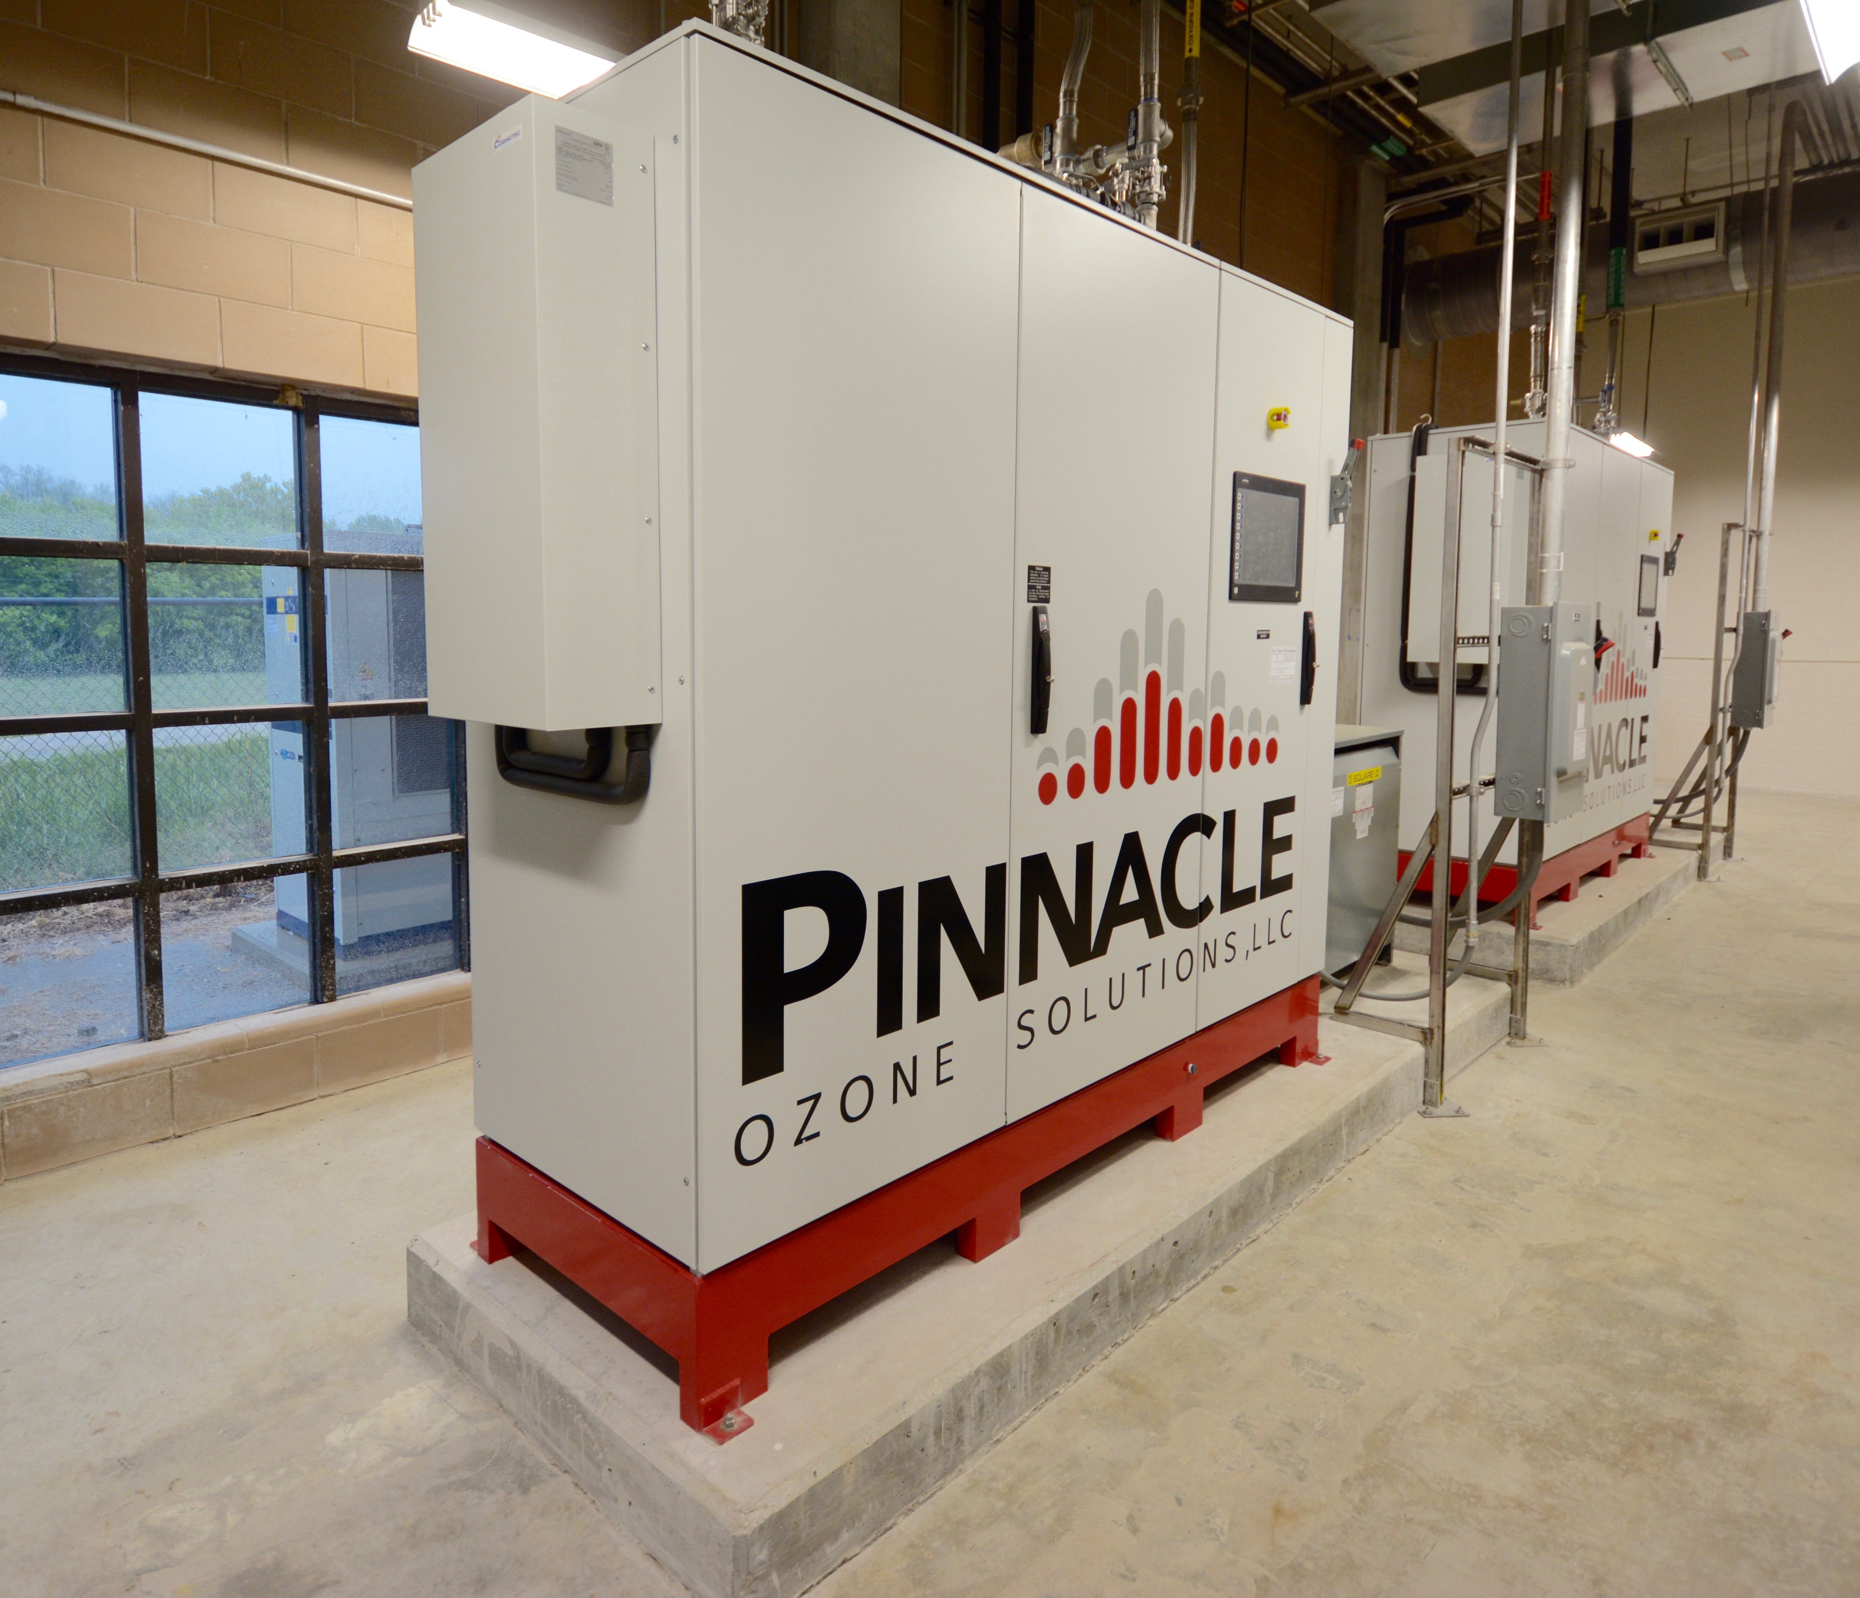
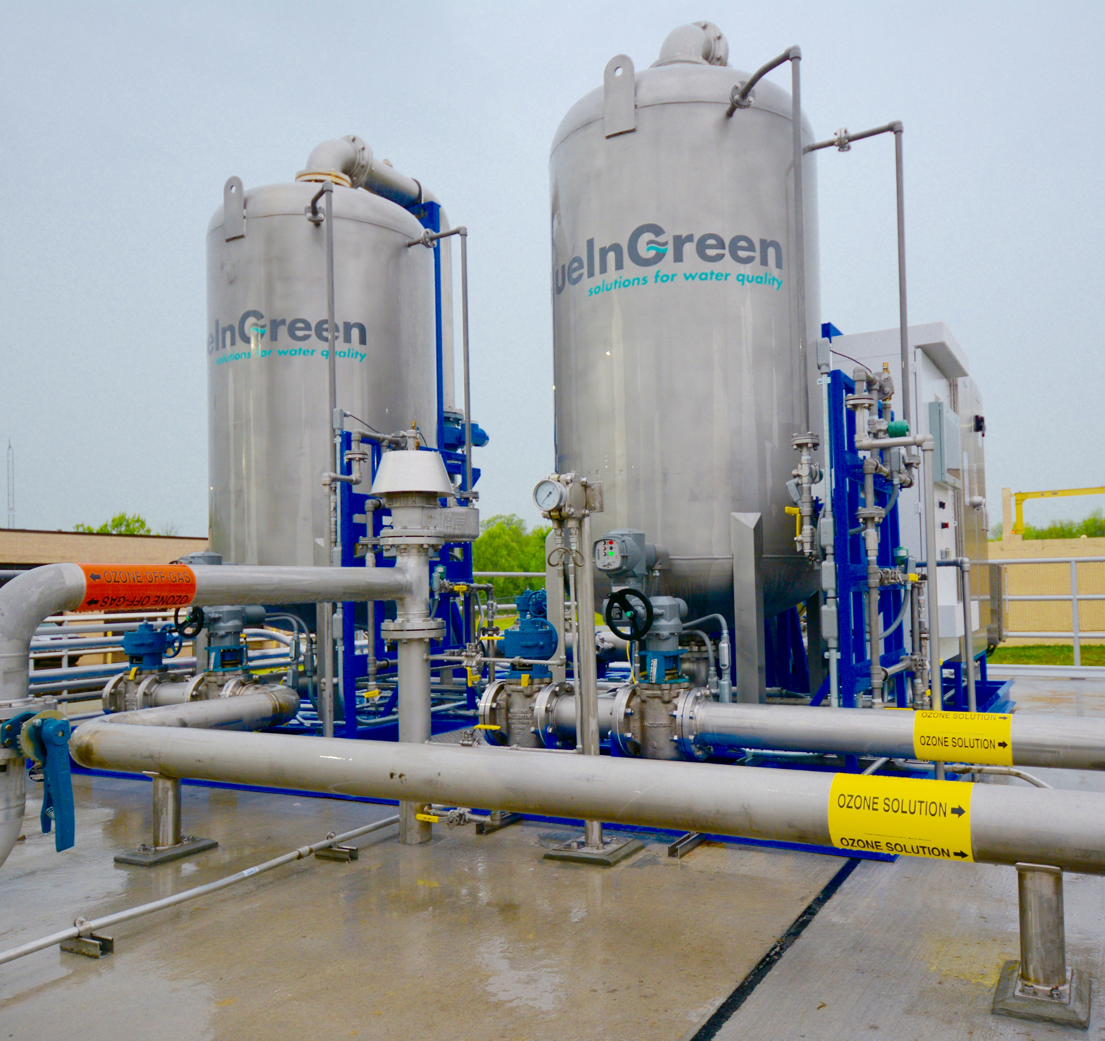
Fayetteville, AR
2 x 292 ppd Muni WWTP Disinfection
Partnered with BlueInGreen™ to provide turn-key ozone process solution

